Slide 1
Planning challenges for RE Deployment North African perspective
Addressing Variable Renewables in Long-Term Energy Planning (AVRIL) : 2-3 March 2015
Rim Boukhchina
Technical Senior Expert

Slide 2
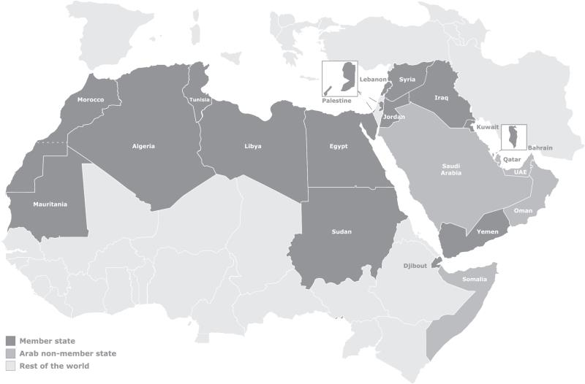
About RCREEE
RCREEE is an independent not-for-profit organization with 16 Arab member states
Mission : “To enable a sustainable growth in Arab states’ adoption of renewable energy and energy efficiency applications and initiatives through leading regional policy dialogues, learning, and research.”

Slide 3
Our Work Areas
Research and Analysis
Capacity Development
New technology orientation
Technical Assistance
Certification and credentialing
Workshops and trainings
Policies and regulations design
Implementation planning
Tender design and guidelines
Studies and publications
Monitoring and assessment
Indices and indicators
Regional benchmarking
Regional information and knowledge management systems
Labeling, standardization schemes and guidelines
Knowledge exchange
Professional internships
Institutional development
Compliance guidelines

Slide 4
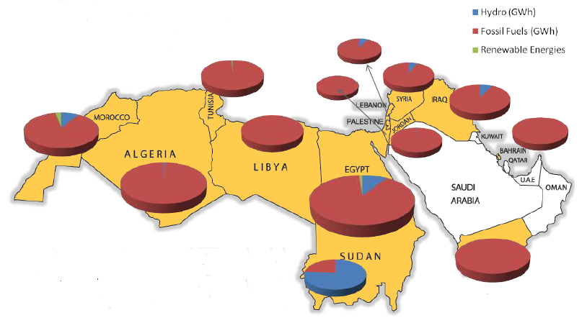
Electricity Context in Arab region

Slide 5
Electricity Mix in Arab region
Installed Capacity
RE share including Hydro : 9 %
RE share without Hydro : 1%
Electricity Generation
RE share including Hydro : 7.1 %
RE share without Hydro : 0.7 %

Slide 6
RE Share in the Arab Region
Installed Capacity
Electricity Generation
Low RE share in the Arab Region
Wind : 1% and 0.6% respectively in the installed capacity and electricity generation
Solar : 0.1 %

Slide 7
Electricity Mix in North African Countries
Installed Capacity
RE share including Hydro : 9.25 %
RE share without Hydro : 2 %
Electricity Generation
RE share including Hydro : 6.5 %
RE share without Hydro : 1.1 %

Slide 8
RE Share in North African Countries
Installed Capacity
Electricity Generation
More important contribution of wind Energy even if RE share still low
Wind : 2 % and 1 % respectively in the installed capacity and electricity generation
Solar : 0.2 %

Slide 9
RE Share in North African Countries

Slide 10
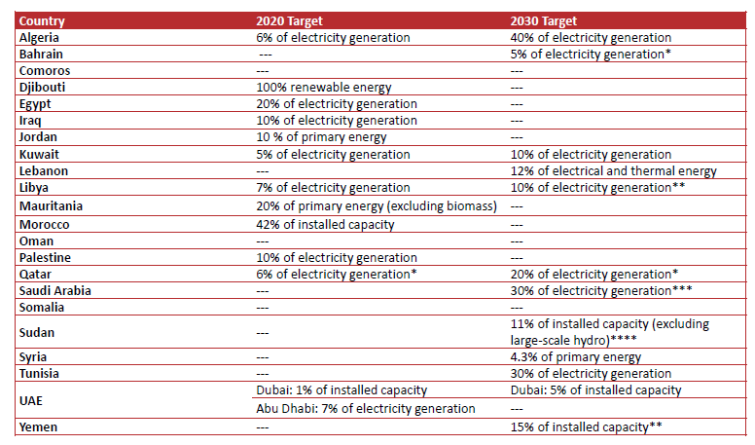
RE targets in Arab region

Slide 11
RE targets in North African Countries
Goals
NAC aims to reach 48.2 GW within 2020 and 2030
Algeria
Wind energy Objectives
474 MW Annually

Slide 12
RE Deployment Challenges
Algeria
Wind energy Objectives
474 MW Annually
1200 MW Annually
Egypt
Wind energy Objectives

Slide 13
RE Integration Challenges
Management of Electricity Generation
2
Grid Capacity & Infrastructure
Intermittence &
Variability
1
3
Connection
& Electricity Infrastructure Challenges
VRE Planning and Prevision Tools
5
4
Reserve Capacities

Slide 14
Existing Long-term Investment Planning Models
1
2
3
Cost effective
analyses
Based on National Load Curve
Do not consider RE Power Plant
Regional needs and request for long term planning tool based on national energy context and taking into consideration RE characteristics and specificity

Slide 15
Planning Challenges for RE Deployment
Subsidies on conventional fuels for electricity production
Extra cost and high investment of RE technologies
Lack of Storage System (Hydro Pump-Storage, others)
Interconnections between NA countries even if they exist are underexploited
Weakness of national grid infrastructure in the region
Political decision for RE objectives

Slide 16
Planning Challenges for RE Deployment
Long-term investment planning models do not take into consideration the variability and intermittence of RE
Lack of competiveness and national capabilities mainly in long term planning of RE and prevision of variable resources
Miscommunication between policy makers and stakeholders in the power sector
Lack of RE Grid Codes
Limited interconnection with European countries
Absence of regional market

Slide 17
Elements to be Considered in the Development of the Planning Model
National RE Potential
Load Curve and its future tendency
Impact of Grid interconnection
Extra cost of RE integration
Intermittence and Variability of wind and PV
Possibility of regional planning
Reserve solution , Capacity credit and reserve margin

Slide 18
Elements to be Considered in the Development of the Planning Model
National RE Potential
Load Curve and its future tendency
Impact of Grid interconnection
Extra cost of RE integration
Intermittence and Variability of wind and PV
Possibility of regional planning
Reserve solution , Capacity credit and reserve margin

Slide 19
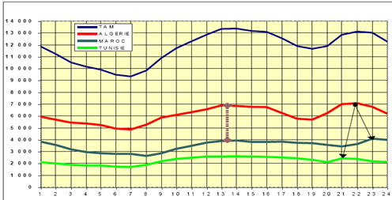
Load Curve and Future Tendency
The growing of Energy Demand 6-8% annually
The specificity of the load in the region of curve

Slide 20
Elements to be Considered in the Development of the Planning Model
National RE Potential
Load Curve and its future tendency
Impact of Grid interconnection
Extra cost of RE integration
Intermittence and Variability of wind and PV
Possibility of regional planning
Reserve solution , Capacity credit and reserve margin

Slide 21
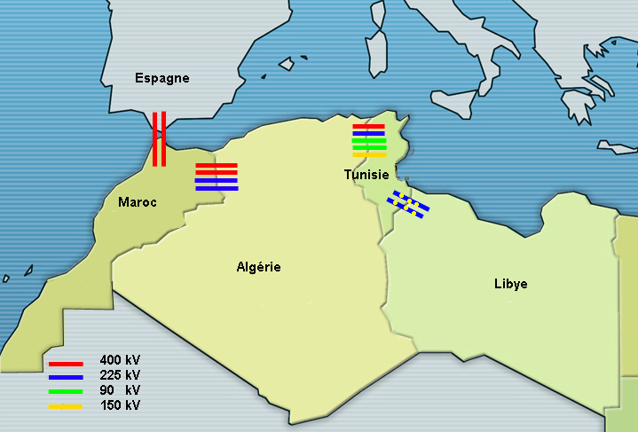
Interconnection in the region
NAC are interconnected and also connected to the European network through the interconnection between Morocco and Spain but electricity exchanges between countries remain underdeveloped and underused. Ambitious interconnection plans through submarine HVDC cables are forecasted between South and North Mediterranean Countries.

Slide 22
Elements to be Considered in the Development of the Planning Model
National RE Potential
Load Curve and its future tendency
Impact of Grid interconnection
Extra cost of RE integration
Intermittence and Variability of wind and PV
Possibility of regional planning
Reserve solution , Capacity credit and reserve margin

Slide 23
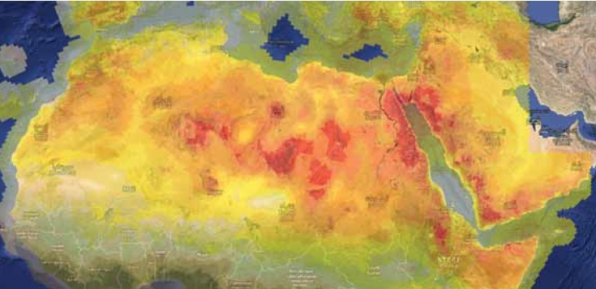
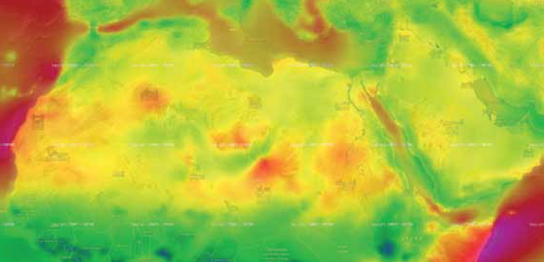
High RE potential in the region
Solar Potential
Wind Potential
The region is endowed with a high potential of RE that could be a real response to the growing demand for electricity and can contribute to the security of the energy sector in the long-term and to an economic growth

Slide 24
Elements to be Considered in the Development of the Planning Model
National RE Potential
Load Curve and its future tendency
Impact of Grid interconnection
Extra cost of RE integration
Intermittence and Variability of wind and PV
Possibility of regional planning
Reserve solution , Capacity credit and reserve margin

Slide 25
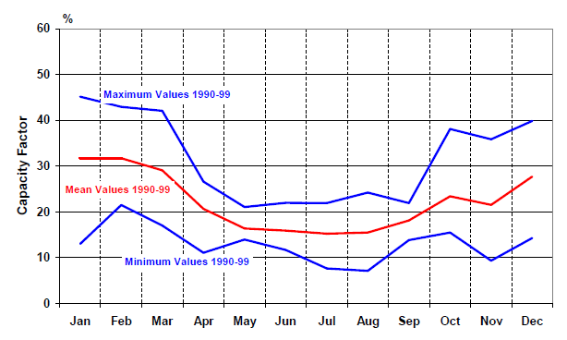
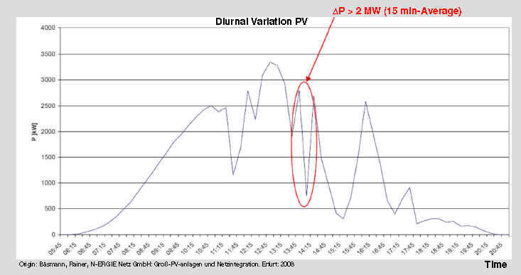
Variability of RE Generation
Seasonal Variability of Wind Energy
Sudden fluctuation of PV Generation

Slide 26
Elements to be Considered in the Development of the Planning Model
National RE Potential
Load Curve and its future tendency
Impact of Grid interconnection
Extra cost of RE integration
Intermittence and Variability of wind and PV
Possibility of regional planning
Reserve solution , Capacity credit and reserve margin
Adopt the Model to Energy Context of North African Countries highlight the impact of RE integration on RE energy sector
Ensure the Grid stability and security

Slide 27
To Summarize..
Importance of assessment of current existing modeling tools and analysis of their weakness.
Importance of adapting the planning models to specific context of the region.
Promote communication and awareness targeting policy makers and different stakeholders to highlight the importance of planning in RE deployment.
Importance of regional and integrated planning that could reduce margin reserve and therefore additional investments in power generation would be saved.
Strengthen national capacities and focusing capacity development activities on planning, building and operating power grids with a high share of renewable generation in the energy mix and management of peak and off-peak load .
Planning in North African countries presents local gaps and challenges, however the adoption of good planning methodology and tools will offer an optimal energy-mix and the reduction of high investment cost in the long term beside the security of electricity sector.

Slide 28
Plans are nothing; planning is everything (D.Eisenhower)…
Thank you for your attention
rim.boukhchina@rcreee.org

