Slide 1
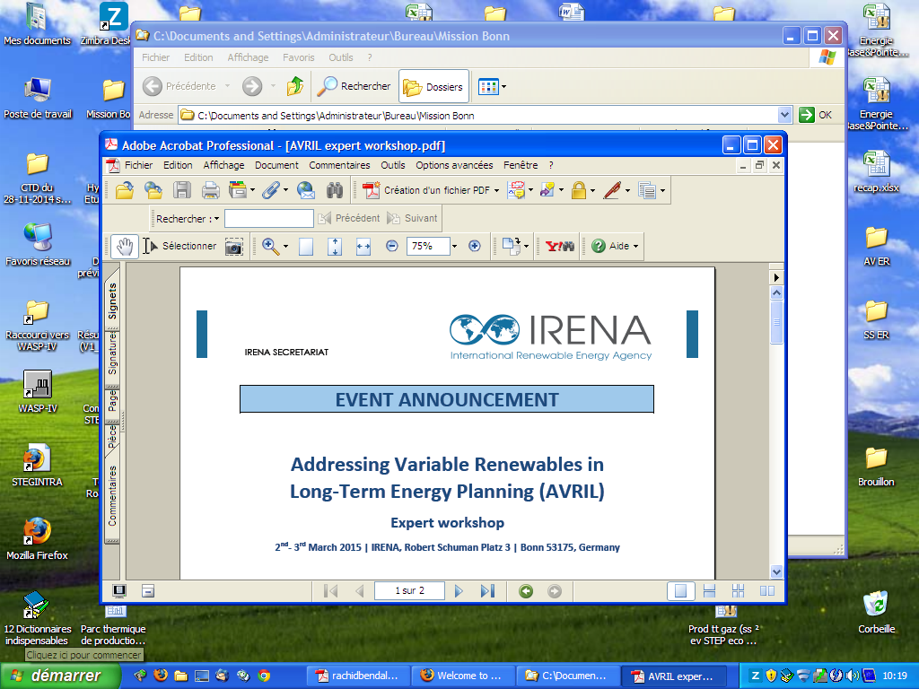
March 2-3, 2015, Bonn
Tunisian Company of Electricity and Gas
Expert workshop
Addressing Variable Renewables In Long‐Term Energy Planning (AVRIL)
Renewables Energy Integration In Long‐Term Energy Planning
Tunisian case : Current situation and challenges

Slide 2
Content
Tunisian current energy context
National energy strategy
Power generation planning process
Results of RES integration approach
Perspectives

Slide 3
1. Tunisian current energy context
Need for an Energy transition
75% of NG global demand for power generation
Continuous increase of the electricity demand (5%/y)
Reliance on NG for power generation (97%)
Limited electricity exchange through the neighboring countries
Increase of energy price subsidies
Structural deficit in energy balance
(41% in 2014)

Slide 4
2. National energy strategy
Aim : Energy supply security
Diversification of energy sources
Energy Efficiency
Development of Renewable Energy Sources (RES) is one of the axis of the new energy strategy
National target for 2030 : Increasing the share of RES in the Electrical Energy Mix up to 30%

Slide 5
2. National energy strategy
- Continuous updating of the Tunisian Solar Plan
- A project-law about power generation from RES is under study

Slide 6

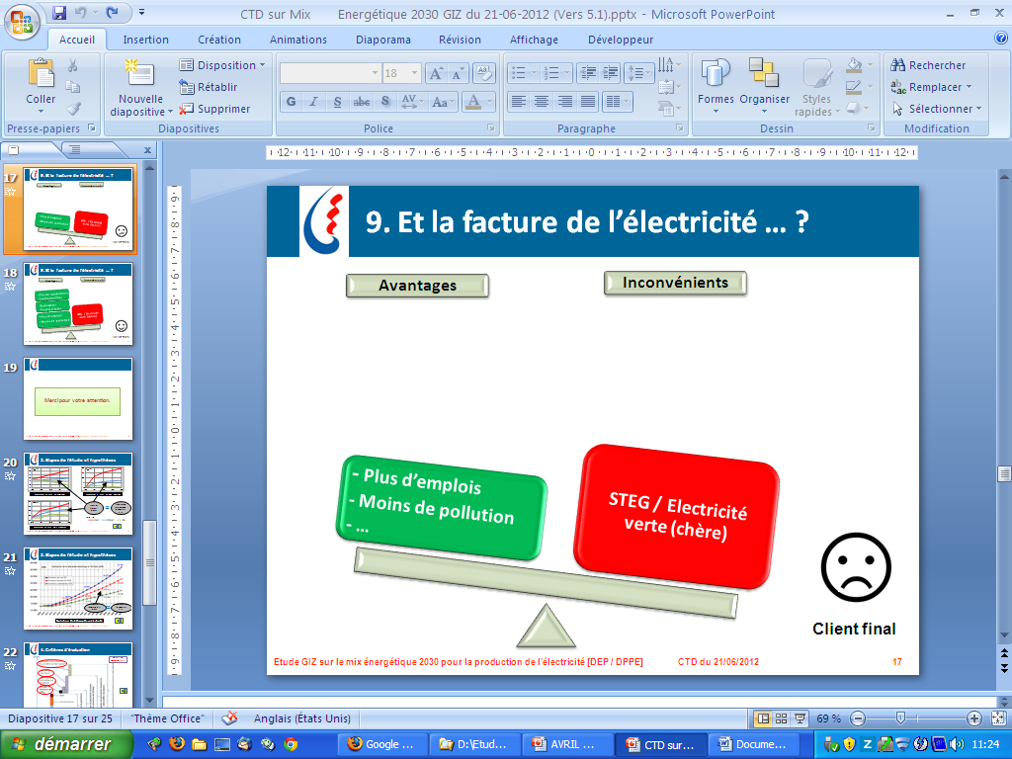
2. National energy strategy
To take into consideration
- Competitive
- Creating jobs
- Free CO₂ emissions
- Intermittent
- High investment costs
- Need for pumped storage stations
- Need for flexible generation units
- Need for back up capacities

Slide 7
3. Power generation planning process
Methodology
Load duration curve
Current power generation
Retirements
Candidates power plants
Projected fuel prices
Constraints :
Reserve Margin
LOLP
…
Developing power generation at least cost approach
(Investment+ Fuel + O&M + ENS) with adequate service quality
Long term power generation expansion
Power plant generation
Annual expenses (investment, fuel, O&M, ENS)
…
Used model : Wien Automatic System Planning Package WASP (developed by IAEA)

Slide 8
3. Power generation planning process
RES integration approach in generation planning
Given its intermittence, RES are modeled to operate in fuel saving :
 | RES Optimal Integration | Predefined target
Step 1 | Developing a long-term power generation plan without RES considering reliability constraints.
Step 2 | Modeling RES as (i) thermal power plants with no consumed fuel and with availability considered as load factor or (ii) hydro plant.
Step 3 | Integrating RES up to that investment commitments balance fuel saving costs. | Integrating RES up to predefined target.

Slide 9
4. Results of RES integration approach
Case Study
Case 1 : RES Optimal Integration
Energy generation by fuel type
RES Impact on reliability
Reference : What possible energy mix in Tunisia on 2030 ? (Study STEG-WB, 2013)

Slide 10
4. Results of RES integration approach
Case Study
Case 2 : 30% RES (Predefined target)
Energy generation by fuel type
RES Impact
Saving fuel Power generation overcapacity (off peak problem)
Reference : What possible energy mix in Tunisia on 2030 ? (Study STEG-WB, 2013)

Slide 11
4. Results of RES integration approach
WASP Limits
Due to use of LDC, WASP can not model properly PV plants (No difference between morning and evening peaks).
Despite the WASP ability of periodic modeling, using the RES hourly profile generation is necessary.

Slide 12
5. Perspectives
Use other RES integration approaches such as considering residual electricity demand (valid only for predefined projects). This approach consists in :
Defining hourly profiles of power generation from RES projects.
Deducing, from electricity demand curve, the energy generation from RES.
Optimizing power generation plan with the residual electricity demand.
Use other planning model which can properly model RES (by using load curve) such as MESSAGE model (§ IAEA Workshop / Tunisia, 2013).

Slide 13
Tunisian Company of Electricity and Gas
Expert workshop
Addressing Variable Renewables in Long‐Term Energy Planning (AVRIL)
Thank you for your attention
Emna BALI
Studies and Planning Management
ebali@steg.com.tn

