Slide 1
Office National de l’Electricité et de l’Eau Potable (ONEE) :
Moroccan Power System

Slide 2
Summary
Demand growth
Power production
National Programs for Renewable Energy development
The challenges and difficulties of integrating VRE

Slide 3
MOROCCO: A SIGNIFICANTLY GROWING ELECTRICITY DEMAND
Demand growth
(GWh)
Average Growth Rate: 6.5%

Slide 4
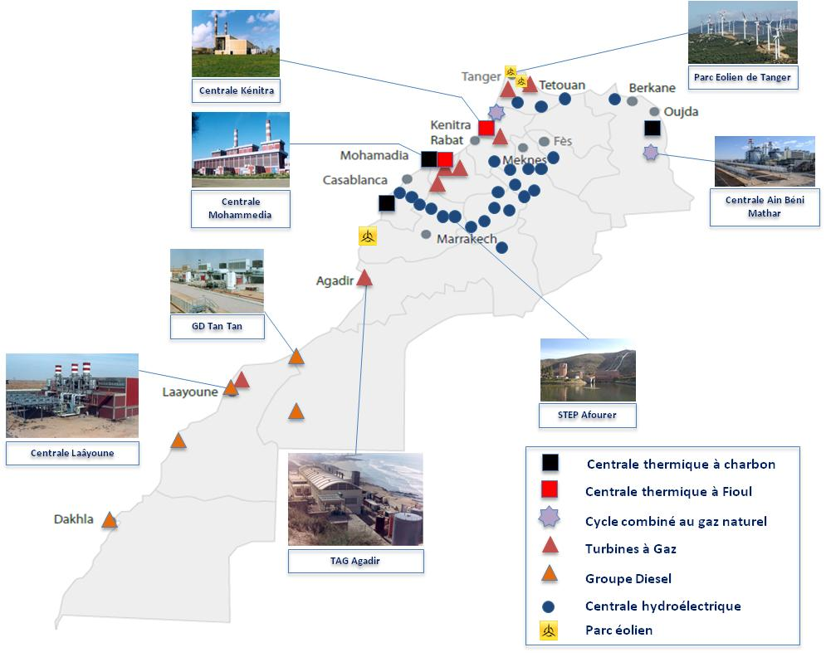
DIVERSIFIED POWER GENERATION CAPABILITIES
Energy consumption in 2014 : 33 529 GWh
Total Installed Capacity up until 2014 :
7 992 MW
Installed Capacity up until 2014 | MW | en %
Hydraulic | 1 306 | 16%
Pumped Storage Hydo | 464 | 6%
Total Hydraulic | 1 770 | 22%
Steam Turbine | 1 065 | 13%
Gaz Turbine (TAG) | 1 230 | 15%
Diesel Generators (GD) | 201 | 3%
Jorf Lasfar Power Plant | 2 080 | 26%
Combined Cycle of Tahaddart | 384 | 5%
Combined Cycle of Ain Béni Mathar | 452 | 6%
Total Thermal | 5 412 | 68%
ONEE Wind Farms | 200 | 3%
Private CED + Tarec | 350 | 4%
Private Wind Farms (law 13-09) | 203 | 3%
Private Wind Farms (Autoproduction) | 37 | 0%
Combined Cycle of Ain Béni Mathar (Solar Part) | 20 | 0%
Total Win and Solar | 810 | 10%
Total Installed Capacity | 7 992 | 100%

Slide 5
RENEWABLE ENERGY AT THE HEART OF AN ALL NEW NATIONAL STRATEGY FOR THE ELECTRICITY SECTOR
His Majesty launched successively in 2009 and 2010 Integrated Programs as a frame for the development of both Wind and Solar projects ;
Morocco has established a legal and regulatory framework allowing the Private Sector to carry out Renewable Energy Projects.
Renewable Energy Contribution Growth considered in the whole National Energy Mix

Slide 6
PLANNING IN THE ONEE- ELECTRICITY BRANCHE
The planning electrical system is an essentiel component of development planning.
It based on the guidelines of the national energy strategy:
A diversified and optimized energy mix around a choice of reliable and competitive technologies
Mobilization of national resources by increasing renewables part in the energy mix
aiming to achieve the target of 42% of the total installed capacity by 2020,
Energy efficiency as a national priority, in particular, the selection of technologies provided with the best proven capabilities and the encouragement of a rational and balanced use of electricity on the other,
Regional integration :The reinforcement of electrical interconnections with neighboring countries.
It aims to identify the least-cost development plan for generation, transmission and distribution in order to meet the demand.

Slide 7
Methodology and Tools
Optimization of capacity expansion: Minimization of an objective function defined as the update of discounted investment and operating costs, the residual value and the cost of unserved energy over a period of up to 30 years.
Optimization of the production dispatch: VALORAGUA model: Minimization of annual operating costs.
WASP-IV
Minimize of an objective function over a period of up to 30 years.
VALORAGUA
Allows optimization of the annual placement of hydrothermal production means
can increase the most economically installed capacity in the medium and long term.
Reliability and production costs of annual system configurations are evaluated by probabilistic methods.
Allows to find an optimal maintenance plan
step monthly and detailed modeling of hydraulics

Slide 8
Issues of integration of ENR
Contribution of VRE to peak power (during the peak) and need back-up
Contribution of VRE and low load factor of thermal plants
Variability of ENR and needs of flexible generation plants (ramping up and down)
Mismatch between low demand and overproduction (curtailing)

Slide 9
The difficulties of integration of ENR ...
solar and wind energy are "variable"
Variability at different time horizons (minutes, day, season) => the system must have the flexibility necessary to compensate for this variability.
Unsecured power: not always available when needed (ex: no photovoltaic solar in the evening peak) => need "backup".
Non-dispatchable => how to handle situations where there is too much energy knowing that levels of renewable energy curtailing shall not be significantly (Currently there is no technical and regulatory framework for curtailing VRE in MOROCCO)
the number of start on/off is limited

Slide 10
The flexibility of generation must be sufficient to balance the variability of VRE at different horizons (minutes, day, year)
The generation and expansion plan must take into account short term dynamics such as:
Duration and startup costs,
Minimum operating capacity,
Ramping up and down of plants.
Minimum duration to turn off and to start up.
Maximum number of starts per day per week per year
Spinning reserve (fixed to the size of the largest group)

Slide 11
Thank you for your attention
Mars 2015

Slide 12
Cadres législatif et institutionnel attractifs
Loi 13- 9
relative aux ENR: 4 innovations majeures
Ouverture de la production à la concurrence
ADEREE
Agence pour le développement des ENR et de l’Efficacité Energétique
Promotion des projets d’énergies renouvelables
Renforcement de l’efficacité énergétique
MASEN
Moroccan Agency For solar Energy
investisseur de référence pour la stratégie énergétique du Maroc
dédiée au financement des filières des énergies renouvelables
SIE
Société d’investissements énergétiques
Promotion placement, financement , et réalisation projets
Etude et conception des projets
Exportation d’électricité verte
Accès au réseau électrique
Construction de ligne directe pour l’export
Atlas éolien et solaire
Démonstrateurs pour Recherche appliquée
Contribution au dév. de l’expertise, la recherche et l’industrie solaire
Pilotage et suivi de la mise en œuvre du programme solaire
Renforcement de la capacité de production
Textes en cours d’adoption:
Décret d’application pour l’ouverture du marché des EnR à la moyenne tension
Mise en place d’une autorité de régulation des secteurs d’électricité et du gaz
Notes:
Aux niveaux législatif, réglementaire et institutionnel, les réformes nécessaires ont été entreprises pour accélérer le développement des énergies renouvelables et de l’efficacité énergétique. C’est ainsi qu’ont déjà été promulguées les lois relatives aux Energies renouvelables, à l’établissement de l’Agence de Développement des Energies Renouvelables et de l’Efficacité Energétique (ADEREE), à la création de l’Agence Marocaine pour l’Energie Solaire ‘Moroccan Agency For Solar Energy (MASEN) et de la Société d’Investissements Energétiques (SIE). Le texte sur l’Efficacité Energétique est en cours d’adoption

Slide 13
MODELES ECONOMIQUES VIABLES ET ATTRACTIFS
PROGRAMME EOLIEN INTEGRE
Contrat d’achat d’électricité à long terme (PPA)
PROGRAMME SOLAIRE MAROCAIN
Contrat d’achat d’électricité à long terme (PPA)
PROJETS ER DANS LE CADRE DE LA LOI 13-09
Vente directe aux clients;
Partenariat public privé
Partenariat public privé
Possibilité d’exportation
Accès au réseau- timbre de transport
ONEE fournisseur de dernier recours;
ONEE acheteur des excédents de production
Possibilité d’exportation
Lignes directes
Exigence d’intégration industrielle
Exigence d’intégration industrielle

Slide 14
