Slide 1
How do different tools support long-term energy planning?
Falko Ueckerdt, IRENA consultant
Expert Workshop, 2-3 March 2015, Bonn, IRENA IITC
Addressing Variable Renewables in Long-Term Planning (AVRIL)

Slide 2
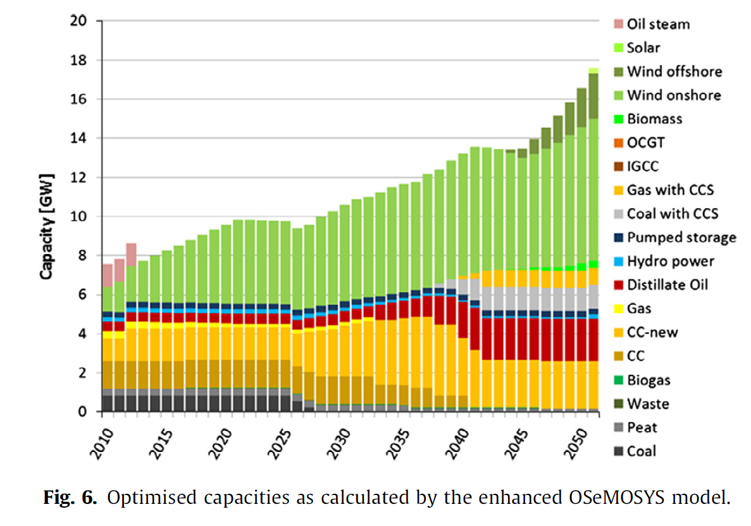
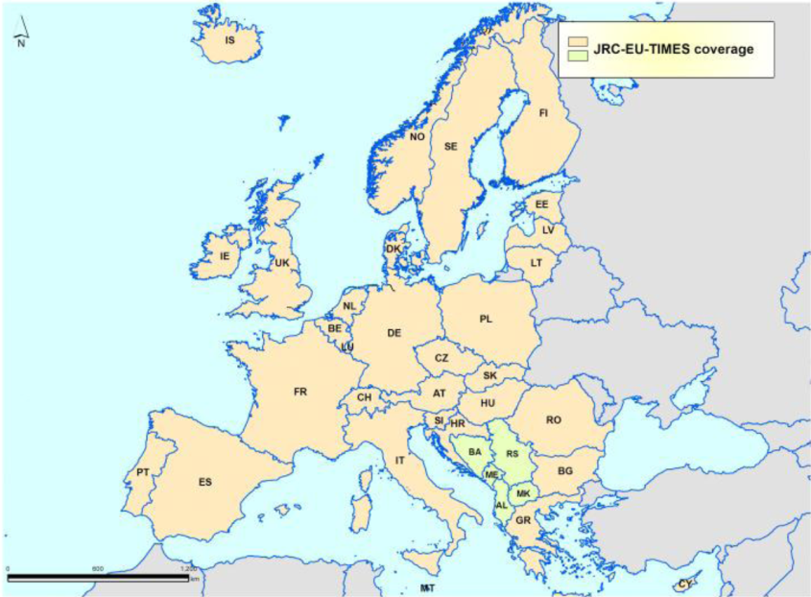
Long-term planning models are the focus of AVRIL
Capacity expansion OSeMOSYS Ireland
Typical models used in the focus countries are WASP, MESSAGE, TIMES, OSeMOSYS, BALMOREL
Linear capacity expansion models
with 1-36 regions,
temporal resolution of 1-5 years and 8-288 time slices (typically 12)
Intertemporal optimization for a time horizon of about 20-30 years
36 regions in the JRC-EU-TIMES

Slide 3
Different tools, different purposes, different time horizons. How do they need to support the long-term planning?
More detail
Stability analysis
(scope: sec.)
Steady state
?
Short term
Load flow analysis
(static – 8760h)
Dispatch
Mid term
Generation (transmission) capacities of a given year
Time horizon
Production cost models
(scope: days-years)
Transmission planning (~3-20y)
Deriving future grid structures based on geografical data. (input to a load flow analysis)
Generation expansion, Net transfer capacities
Long term
Long-term planning model (time horizon ~20-30y)
Long-term planning updated every few years
Less detail
2015
2020
2030
2040
Adapted from Manuel Welsch
Notes:
What is the optimal generation capacity expansion? → master plan, policy instruments, utility investments
Traditionally, subordinated to this: transmission planning. Shorter time horizon.
Calculate an hourly dispatch. Sufficient flexibility?
Steady state adequacy of the transmission grid. These analysis are used for current and future systems.
Can the system cope with disturbances and failures?
Traditionally, the more detailed tools were applied to a shorter time horizon. Generation capacity expansion with a long time horizon was somewhat independent from grid planning. With high VRE shares, this might change.
Sivael is a simulation tool used for load flow analysis (8760h), developed and used by the danish TSO.
What about short term grid planning?

Slide 4
Different tools, different purposes, different time horizons. How do they need to support the long-term planning?
More detail
Stability analysis
(scope: sec.)
All tools are needed. With high VRE shares the analyses need to be more concerted.
Better coordination of generation and transmission planning
Production cost models need to inform LT planning models
Are highly resolved analyses (production costs, grid studies) sensible for future years (>2025)?
Given uncertainty and technological progress
Simple approaches to assure system stability
Short term
Load flow analysis
(static – 8760h)
Mid term
Time horizon
Production cost models
(scope: days-years)
Transmission planning (~3-20y)
Deriving future grid structures based on geografical data. (input to a load flow analysis)
Long term
Long-term planning model (time horizon ~20-30y)
Long-term planning updated every few years
Less detail
2015
2020
2030
2040
Adapted from Manuel Welsch
Notes:
What is the optimal generation capacity expansion? → master plan, policy instruments, utility investments
Traditionally, subordinated to this: transmission planning. Shorter time horizon.
Calculate an hourly dispatch. Sufficient flexibility?
Steady state adequacy of the transmission grid. These analysis are used for current and future systems.
Can the system cope with disturbances and failures?
Traditionally, the more detailed tools were applied to a shorter time horizon. Generation capacity expansion with a long time horizon was somewhat independent from grid planning. With high VRE shares, this might change.
Sivael is a simulation tool used for load flow analysis (8760h), developed and used by the danish TSO.
What about short term grid planning?

