Slide 1
Financing renewable energy in small island developing states (SIDS) Early stage project development to access public funding
David Fay
Head, Project Administration Unit
Pacific Subregional Office, Suva
Asian Development Bank
Pacific Subregional Office
Notes:
Good morning Distinguished Ladies and Gentlemen,
Thanks to SPC for the invitation to speak this morning.
I must start by admitting that I was a late substitute for Anthony Maxwell – Principal Energy Specialist from HQ - the brains trust behind ADB’s “Proposed Pacific Renewable Energy Investment Facility”. The facility anticipates $750m of regional investments of which $300m is proposed to be GCF grant financed. Much effort has gone into making this GCF application, and my colleague Taniela will talk about this immediately after lunch today.
I’m a civil engineer (structures - with rail, ports & roads) background and have been resident in Fiji for only 4 months. I was asked to step in for Anthony as I am currently helping the Fiji government prepare a GCF proposal for the Nadi Flood Protection Project, and I am the project Officer for the Suva Water and Wastewater Project – which was the first project in the Pacific to receive a GCF grant – so I am quite familiar with the GCF application process. For what I lack in relative power sector expertise compared with Anthony – I will try to make up with relative youth and vigor.
I will be talking to you about renewable energy project preparation, and the considerations and steps to be taken when developing an application for GCF financing. Before doing this I will provide some context on ADB, our power projects in the Pacific, and some context behind the development and the performance of the Green Climate Fund.

Slide 2
Asian development bank
Multilateral development bank est. 1966
Owned by 67 members
Mandate: reduce poverty in the Asia-Pacific
Provider of financial and technical assistance for infrastructure development
Lends to sovereign and private sector
Bank-wide $27 billion approved in 2015
Bank-wide $2 billion clean energy 2015

Slide 3
ADB IN THE PACIFIC ENERGY SECTOR
Existing loan/grants in 8 Pacific countries
Existing portfolio of 20 projects of approx. $350 million
8 technical assistance grants - $16 million
Pipeline 14 projects in 9 countries proposed investment $305 million
Largest financier to energy sector in the Pacific

Slide 4
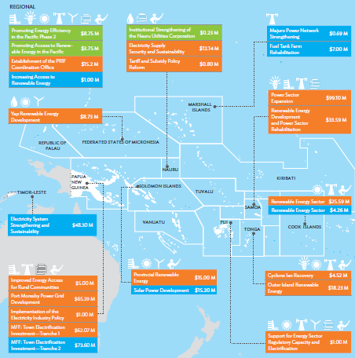
Notes:
14 member countries
10 countries <250,000 population
Throughout the region our investments involve mostly solar and network distribution investments

Slide 5
PACIFIC POWER SECTOR TRENDS / NEEDS ANALYSIS
Investment demand is expanding rapidly
Renewable energy is at the core of investment demand.
75% of our investments
Hydropower has the largest investment need (5 projects, $194 million)
Solar is the fastest growing technology by number of projects (7 projects)
Energy Access – major issue in Melanesia (primarily PNG)
Increased private sector involvement - Independent Power Providers (IPPs)
Appropriate regulations and legislation is being put in place to support reform
Notes:
We are observing that Private sector investments are growing exponentially (2010-2016 = capacity grew from 50 to 112MW …… 2016-2021 = 112 to 745MW) – a seven fold increase - requiring an estimated cumulative investment of US$2.7b
The remaining 25% of investments are involved in expanding/upgrading distribution networks
By number of power generation facilities solar is followed by biomass, hydro, wind and diesel – diesel in most cases doing the heavy lifting with the provision of base load.

Slide 6
GREEN CLIMATE FUND - TIMELINE
2009 The Green Climate Fund first proposed at Conference of the Parties to the Convention (COP 15) in Copenhagen, Denmark
2010 GCF established by the United Nations at COP 16 in Cancun, Mexico
2011 Governing Instrument adopted at COP 17 in Durban, South Africa
2012 Board meets for first time, with equally balanced country representation
2013 Permanent headquarters established in Songdo, Republic of Korea
2014 Initial resource mobilization raises over USD 10 billion equivalent
2015 First GCF funding decisions
Notes:
So how did we get to today where we are talking of the Green Climate Fund?
The science is irrefutable – the globe is warming
About GCF
4 degreES C. According to the IPCC, the current trajectory of GHG emissions rates will cause global temperatures to increase by 4°C by 2100 increasing the likelihood of severe, pervasive, and irreversible effects on every continent.
In addition, climate change has a disproportionately stronger impact on the lives and livelihoods of those societies which depend on the natural environment for their day-to-day needs – these are the people that are typically the most vulnerable.
The 2 DEGREES C TARGET. There is a global concensus that that we should try to limit temperature increases to 2C by 2100.
RESPONDING TO THIS CHALLENGE REQUIRES COLLECTIVE ACTION FROM ALL COUNTRIES –
The GCF IS A FINANCING TOOL TO DELIVER THIS ACTION

Slide 7
gREEN CLIMATE FUND - MANDATE
Established by 194 countries party to the UN Framework Convention on Climate Change in 2010.
Fund is designed as an operating entity of the Convention’s financial mechanism
It is governed by a 24 member Board, and receives guidance from the Conference of the Parties to the Convention (COP).
Mission : to expand collective action to respond to climate change.
Objective : support a paradigm shift in the global response to climate change by allocating resources at scale to low emission and climate resilient projects.
Focus : societies that are highly vulnerable to the effects of climate change, in particular Least Developed Countries (LDCs), Small Island Developing States (SIDS), and African States.

Slide 8
GCF tools
At end 2016 more than USD 10 billion and growing.
Aim for 50:50 balance between mitigation and adaptation investments.
At least 50% of adaptation funding goes to the most vulnerable countries, including LDCs, SIDS, and African States.
Direct private sector engagement in transformational climate-sensitive investments through the Private Sector Facility (PSF).
GCF offer investors a degree of risk-bearing capacity, to encourage innovation and leverage and crowd in additional financing.
Variety of financial instruments : grants, concessional loans, subordinated debt, equity, and guarantees, giving flexibility to match project needs and risk profiles.

Slide 9
GCF – Performance vs. MANDATE
In 2011 advanced economies formally agreed to :
to jointly mobilize USD 100 billion per year by 2020 to address pressing mitigation and adaptation needs of developing countries.
that a share of new multilateral funding should be channeled through the newly established Green Climate Fund.
In 2015 the first GCF funding decisions were made
At end 2016 GCF the project portfolio is characterized by:
27 projects of $3.6 billion in value – 9 are in the Asia Pacific
46% grants, 41% loans, 2% equity & 11% guarantees
48% public and 52% private
Notes:
So the performance hasn’t been as strong as first hoped
– not surprising when you consider the complexities behind establishing governance and operational systems
- project development lead times are also significant ……… so there will hopefully be a rush of new project approvals in the short term.

Slide 10
APPLICATION STRATEGY, STEPS AND PROCESS
Do you have a national power sector development strategy?
Approach to GCF – “direct” or “international”
Important considerations / questions:
what are the “results areas”?
project contribution to mitigation or adaptation goals?
fit with Investment Criteria
why is a GCF contribution critical for the project?
Concept Note submission and GCF response process
Consider a “readiness support” application to GCF to assist with your due diligence.
Due diligence
Notes:
Is the project supported by strategic national objectives and priorities?
“direct” – recipient countries can nominate competent subnational, national (7%) or regional (18%) implementing entities for accreditation to receive funding
“international” – recipient countries can access the Fund through accredited international (75%) entities -
“results areas” – also important as ……… now we get a feel for what results they want. So let me read them to you.
IPCC definitions:
“mitigation” – “actions to reduce emission of greenhouse gases”
“adaptation” – “adjustment in natural or human systems in response to actual or expected climatic stimuli or their effects, which moderates harm or exploits beneficial opportunities”
“results areas” – hints -
“GCF contribution critical” – GCF funding is not intended to displace traditional funding sources for financially / economically viable projects. Suva Urban Water and Waste Water Project – GCF $31m grant of a then anticipate $222m project – “

Slide 11
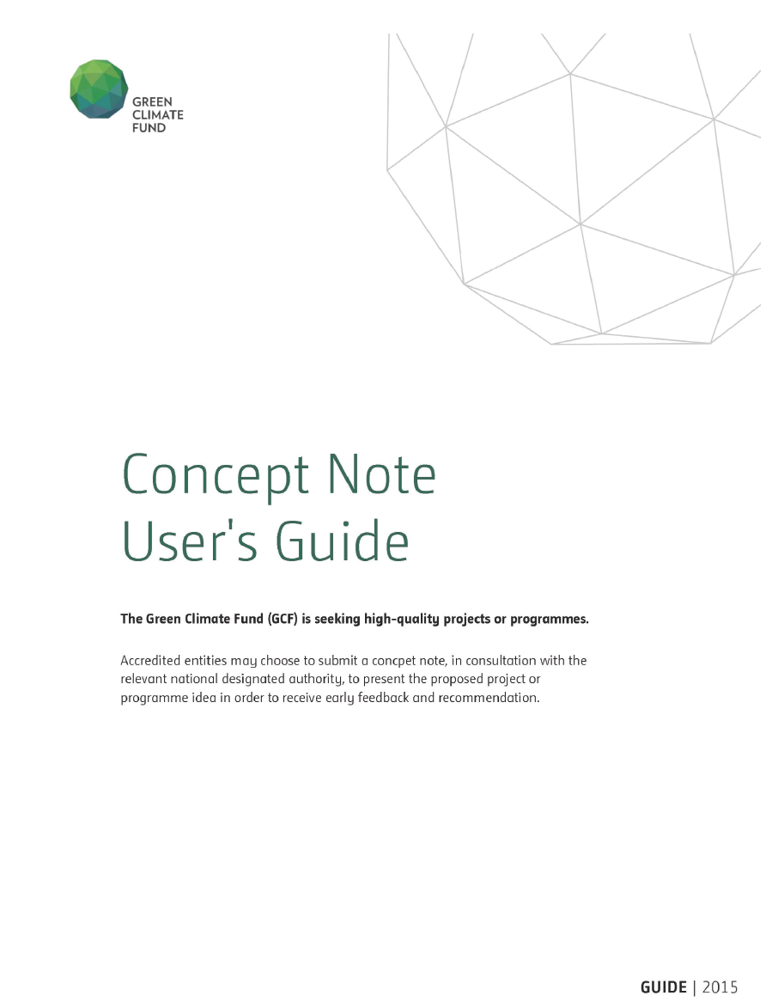
Investment CRITERIA
Notes:
Our GCF friends are good sports and they want you to be a success. You can submit them a concept note and seek their feedback on whether they think the project is suited to GCF financing – in some circumstances the GCF folk even make suggestions on how to strengthen the proposal.
This guide is important – it directs your thinking and initial project preparation activities.
In the introduction it says: ………..

Slide 12
Investment criterIA
Impact potential
Paradigm shift
Sustainable development potential
Needs of the recipient
Country ownership
Efficiency and effectiveness
Notes:
How are you going? ………. This is where it gets exciting.
The GCF Board have adopted six investment criteria …….. but what do these mean? – then read from the concept note.

Slide 13
DUE DILIGENCE REQUIREMENTS
Project due diligence. The following due diligence will be carried out for every project financed under the investment facility.
Technical.
Economic and financial
Governance
Poverty, social, and gender
Safeguards
Procurement
TIME : 12 to 24 months on ADB administered projects
Notes:
Technical - Alternatives and least cost options will be reviewed. Analysis will include technical design, grid development plans and grid integration studies. Technology will be adapted for Pacific conditions. Capacity constraints and climate risk will be assessed.
Economic and financial - Economic and financial viability of the projects will be carried out in accordance with the relevant ADB’s guidelines. Sustainability analysis will also be conducted.
Governance - Analysis will include financial management, procurement, and anticorruption. A Project Risk Assessment (PPRA) will be carried out for both executing and implementing agencies.
Poverty, social and gender - The social and poverty impacts of the projects will be assessed. Gender aspects will be assessed and mainstreamed in the individual project design as appropriate.
Environment and social safeguards - according to ADB Safeguard Policy Statement, June 2009.

Slide 14
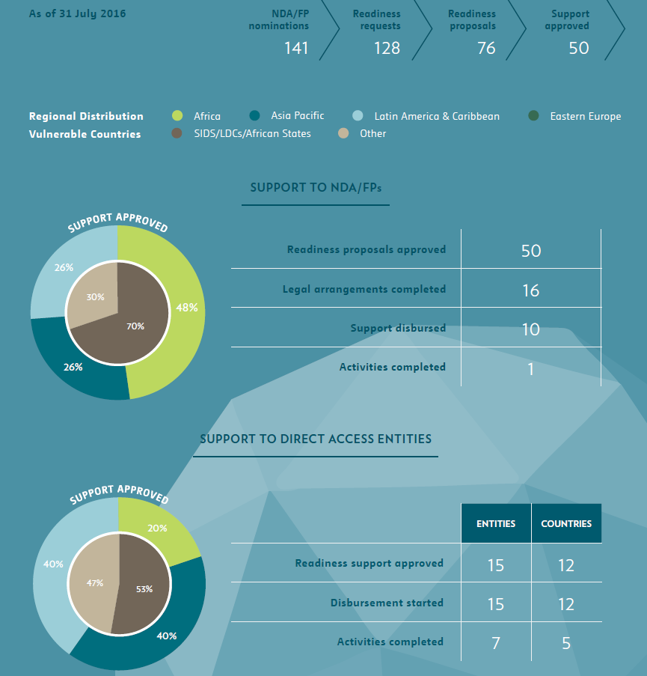
READINESS SUPPORT STATE OF PLAY
Notes:
It is crucial that developing countries are able to effectively access and deploy resources from the Green Climate Fund. That is why the Fund provides early support for readiness and preparatory activities to enhance country ownership and access. This "country readiness" funding is a dedicated and cross-cutting programme that maximizes the effectiveness of the Fund by empowering developing countries. Readiness and preparatory support activities are not one-off measures, but part of an ongoing process to strengthen a country’s engagement with the Fund. GCF focuses its readiness support on particularly vulnerable countries, including Least Developed Countries (LDCs), Small Island Developing States (SIDS), and African States – a minimum of 50% of country readiness funding is targeted at supporting these countries. The Fund has a total of USD 16 million available to immediately provide such support to countries, and may seek the release of further resources depending on the needs of countries. Support for these activities in individual developing countries is capped at USD 1 million per calendar year. This support may be delivered to countries directly through National Designated Authorities (NDAs) or Focal Points through a wide range of delivery partners with relevant expertise and experience. Alternatively, countries may select another institution that is well-versed in readiness activities as its delivery partner. These institutions can be international, regional, national, or sub-national, public or private. Led by the NDAs or Focal Points, the Fund may also deploy readiness and preparatory support to prospective regional, national, or sub-national entities seeking accreditation with the Fund to prepare them to apply for accreditation, as well as to Accredited Entities to develop project and programme pipelines. To see which governments have requested readiness grants from GCF, please refer to FINE PRINT in this section.

Slide 15
CHALLENGES
Lets start with the opportunities
international political will to act
technological advances - renewable energy investments are becoming increasingly viable
significant (more than can be absorbed) financing availability
significant project preparation assistance is available.
Challenges
fiscal
capacity – policy making and coordination of donors is managed by small units with limited ability to absorb donor support
Utilities find it difficult to retain staff
Utilities have “generalist” technical staff with little design and implementation experience

Slide 16
CONCLUSION
Objective of the presentation was to discuss steps, requirements and challenges in developing renewable energy projects
Conclusion : we have momentum on our side. The Next GCF meeting is in Samoa and the Pacific’s needs are going to receive great attention. Please continue to engage closely together with ADB and development partners so that we together can make a difference.
Contact : dfay@adb.org or phone: 331 8101 (+679) 999 6533
THANK YOU VERY MUCH FOR YOUR TIME

Slide 17
IMPORTANT RESOURCES
Green Climate Fund
https://www.greenclimate.fund/home
Please refer to menu tab to gain an appreciation of the resources that are available to assist in the GCF application process
Concept Note User’s Guide is available at : http://www.greenclimate.fund/documents/20182/239759/GCF_Concept_Note_User_s_Guide.pdf/64866eea-3437-4007-a0e4-01b60e6e463b
Pacific Power Association http://www.ppa.org.fj/
Pacific Private Sector Investors Prospectus
Pacific Region Infrastructure Facility http://www.theprif.org/
Power Benchmarking Report 2014
ADB
http://www.adb.org/documents/pacific-energy-update-2016
ADB Pacific Facebook page
https://www.facebook.com/adbpacificenergy/
Notes:
Wrap-up
Who ADB is and what we do
Potential

