Slide 1
GEF Support for Renewable Energy in SIDS and The Paris Agreement
Masako Ogawa
Global Environment Facility
December 2016

Slide 2
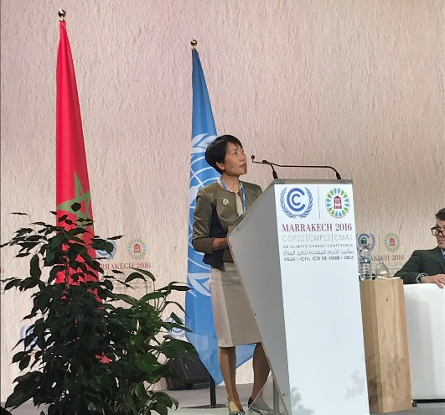
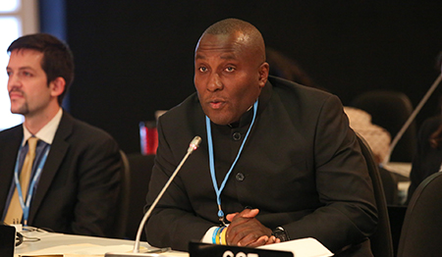
GEF Support for Renewable Energy in SIDS
GEF has invested RE projects in SIDS with US$210 million, leveraging US$ 1.3 billion in co-financing.
GEF continues its commitment to support SIDS, removing policy, regulatory and technical barriers, and developing innovative market-based mechanisms and financial instruments.

Slide 3
RE projects in Pacific SIDS (update)
Projects approved in Oct.2015 – Oct.2016
Country | Title | GEF financing (M$)* | Co-financing (M$) | Agency
Papua New Guinea | Facilitating Renewable Energy & Energy Efficiency Applications for Greenhouse Gas Emission Reduction (FREAGER) | 2.8 | 17.2 | UNDP
Samoa | Improving the Performance and Reliability of RE Power Systems in Samoa (IMPRESS) | 6.1 | 39.0 | UNDP
Tonga | Outer Island Renewable Energy Project | 2.6 | 13.2 | ADB
Tuvalu | Facilitation of the Achievement of Sustainable National Energy Targets of Tuvalu (FASNETT) | 2.6 | 15.9 | UNDP
Vanuatu | Barrier Removal for Achieving the National Energy Road Map Targets of Vanuatu (BRANTV) | 2.6 | 16.1 | UNDP
* ; excluding Agency fee and Project Preparation Grant

Slide 4
GEF Support for Renewable Energy in SIDS
Tonga “Outer Island Renewable Energy Project”
Construction and installation of solar PVs on up to 9 outer islands including storage
O&M trainings including a program manual for O&M of solar generation and distribution systems
Rehabilitation of the existing grid networks on Vava’u and 'Eua
Notes:
Tonga ratified the Paris Agreement on September 21, 2016.
INDC:
50% of electricity generation from renewable sources by 2020. In 2015 renewable energy accounts for approximately 9% of total electricity generation, with confirmed and funded investments taking this to 13% in 2016; and
70% of electricity generation from renewable sources by 2030.

Slide 5
GEF Support for Renewable Energy in SIDS
Samoa “Improving the Performance and Reliability of RE Power Systems in Samoa”
Improvement of regulation, standards and enforcement capacity
Boosting biomass energy resource use.
Application of power system performance and reliability enhancement technologies to address instability of existing grid.
Increase availability and access to the local financial resources.
Notes:
Samoa ratified the Paris Agreement on April 22, 2016, .
INDC:
100% of electricity generation from renewable sources by 2025;
Grid connected solar power generation projects, wind power rojects; and
Various bioenergy projects aimed at utilizing biomass, biogas or alternative bioenergy source for electricity generation.

Slide 6
GEF Support for Renewable Energy in SIDS
Vanuatu “Barrier Removal for Achieving the National Energy Road Map Targets of Vanuatu”
Design and implementation of suitable capacity development programs.
Improvement of policy and regulatory regime.
Development and operationalization of financing scheme for low carbon technology.
Demonstration of low-carbon technology. application in pilot on-grid and off-grid communities.

Slide 7
Support for Vanuatu’s INDC
Vanuatu signed the Paris Agreement on 22 April 2016.
The GEF project will facilitate the mitigation actions in its NDC:
The National Energy Road Map;
The Rural Electrification NAMA;
Off grid renewable energy projects under Scaling Up Renewable Energy in Low Income Countries Program; and,
Energy efficiency measures to contribute to the target 15% energy savings in the energy sector.

Slide 8
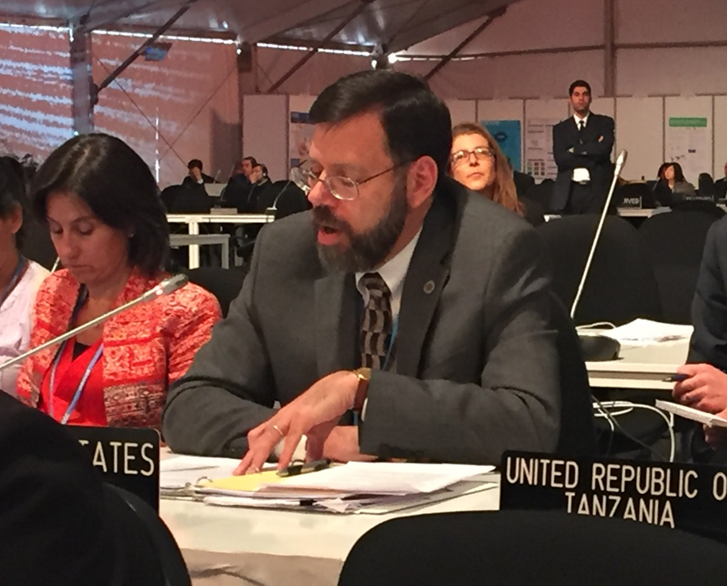
Capacity-building Initiative for Transparency
(CBIT)
Transparency is the foundation of the Paris Agreement’s “ambition mechanism”
A new trust fund hosted by the GEF to help developing countries’ efforts to enhance transparency
11 donors pledged totaling $55.3 million USD in Marrakesh (please visit https://www.thegef.org/news/new-gef-fund-gives-boost-paris-agreement-implementation).

Slide 9
CBIT Programing Priorities
Activities to build capacity to meet enhanced transparency requirements as defined in Article 13 of the Paris Agreement, such as:
to strengthen national institutions for transparency-related activities in line with national priorities;
to provide relevant tools, training, and assistance for meeting the provisions stipulated in Article 13;
to assist with improvement of transparency over time. (for more detail information; GEF/C.50/06)

Slide 10
CBIT projects
Projects approved in Nov.2016
Country | Title | GEF financing (M$)* | Co-financing (M$) | Agency
Costa Rica | Costa Rica's integrated reporting and transparency system | 1.0 | 3.2 | UNEP
Kenya | Strengthening National Institutions in Kenya to Meet the Transparency Requirements of the Paris Agreement and Sharing Best Practices in the East Africa Region | 1.0 | 1.0 | CI
South Africa | Capacity Building Programme to Implement South Africa's Climate National System | 1.1 | 2.2 | UNEP
Global | CBIT Global Coordination Platform | 1.0 | 0.4 | UNEP UNDP
* ; excluding Agency fee and Project Preparation Grant

Slide 11
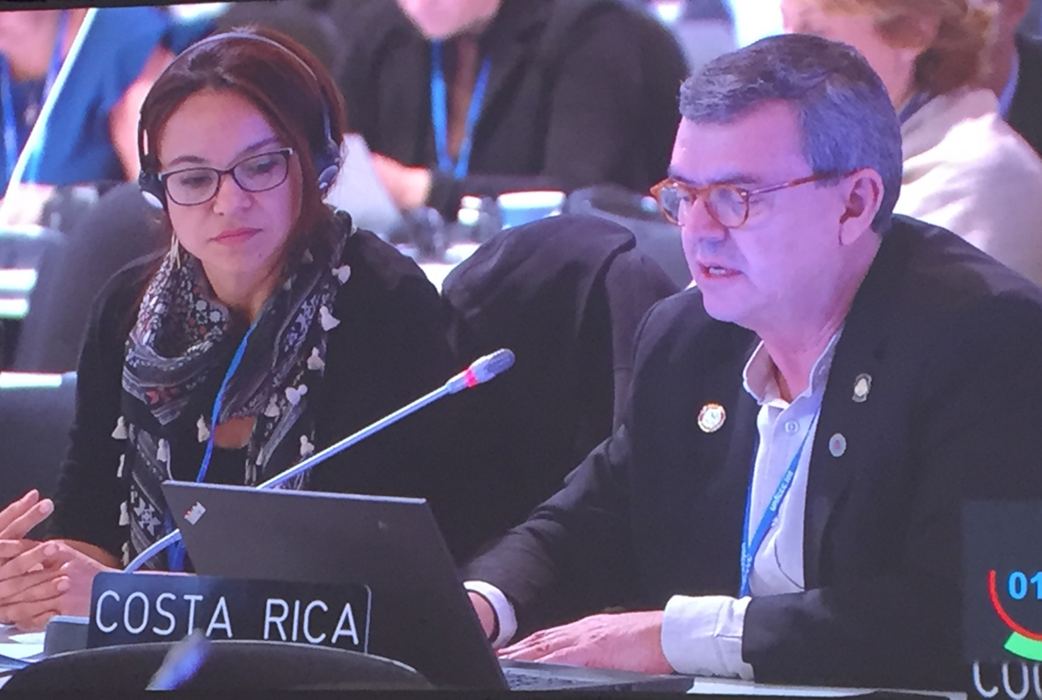
CBIT project in Costa Rica
“Costa Rica's integrated reporting and transparency system”
Development of a Strategic Climate Planning Unit
Implementation of a knowledge sharing platform for MRV-related transparency and data methodologies
Design of a quality control, assurance and continuous improvement
program for transparency
instruments

Slide 12
CBIT project in Kenya
“Strengthening National Institutions in Kenya to Meet the Transparency Requirements of the Paris Agreement and Sharing Best Practices in the East Africa Region”
Institutionalization of MRV system and development and adoption of data sharing protocols.
A fully functional MRV system for the AFOLU/Land based sector in Kenya.
Regional capacity building.

Slide 13
CBIT Global Platform
“CBIT Global Coordination Platform”
A web-based coordination platform with data, information, methodologies, guidance etc. on transparency initiatives.
Self-assessment tool to assess the state of the national transparency system.
Needs and gaps identified for enhancing national transparency system.
Regional workshops on transparency.

Slide 14
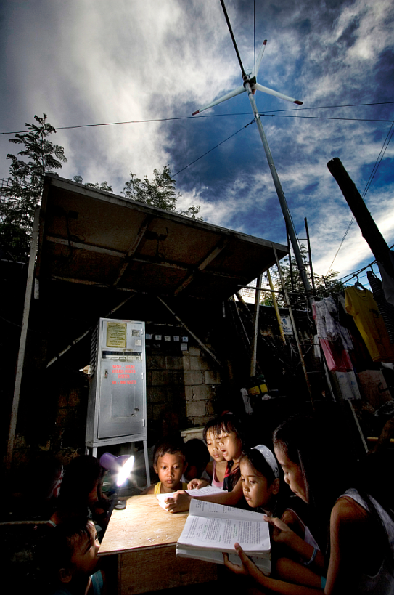
Thank You!
email: mogawa2@thegef.org
website: www.TheGEF.org

