Slide 1
ENERGY SECTOR PROGRAM AND PIPELINE - Sids
Kamleshwar Khelawan
December, 2016

Slide 2
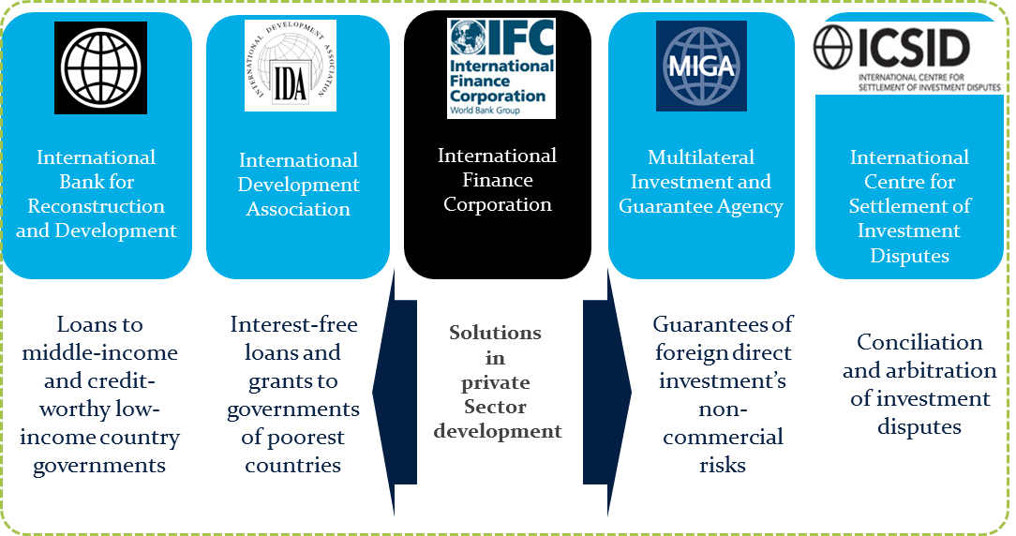
The World Bank Group

Slide 3
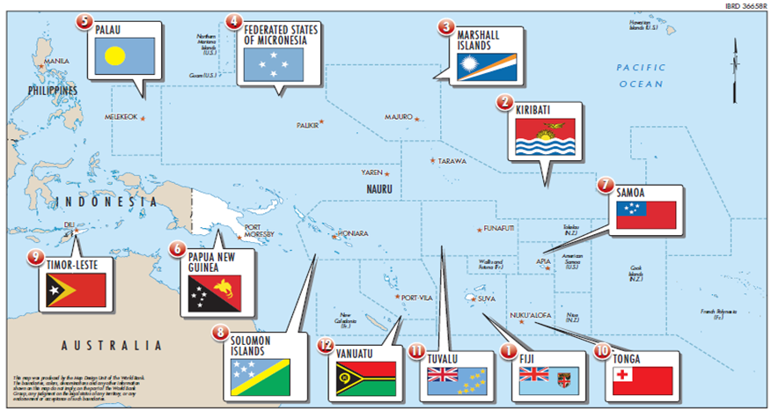
World Bank Pacific Energy
13 countries, a total population of about 10 million people, 2.2 million people if Papua New Guinea (PNG) and Timor-Leste (TL) are excluded.
9 PICs have populations well below 200,000 people
In terms of fossil energy sources, only PNG and TL have proven reserves of oil and natural gas (none are known to have domestic sources of coal)
RE resources:
  hydropower potential in Solomon Islands, Fiji, Samoa, & PNG
  geothermal potential in PNG, Vanuatu and Fiji
  solar remains as the main RE option in other PICs (wind second)

Slide 4
Characteristics
Demographics vary widely between countries, often feature small, isolated population centres.
Markets are very thin, difficult to serve, and without significant economies of scale. The total land (excl. PNG), is 1/3 the size of New Zealand spread over15 percent of the earth’s surface.
PICs are highly vulnerable to the impacts of natural disasters and climate change.
The Region is relatively aid abundant – coordination a priority.
Energy Access %

Slide 5
Pacific Energy Program
Strengthening energy planning, policy, institutional and regulatory frameworks, and capacity building.
Utilities’ reform: improved performance and sustainability
Facilitating least-cost power infrastructure, including through Public-Private Partnerships; and
Increasing access to affordable, reliable and sustainable electricity services.

Slide 6
Projects Under Implementation
Fiji
  Geothermal Power Development TA – (ESMAP)
FSM
  Energy Sector Development Project – (IDA)
Kiribati
  Grid Connected Solar PV – (GEF/PRIF)
  Utilities Reform Project – (Joint World Bank/ADB/PRIF)
PNG
  Energy Sector Development Project - (IDA/GEF)
  Linked: (i) RE Resource Mapping – (ESMAP/ASTAE), (ii) Energy Efficiency Strategic Plan (following the assistance on Third party access code/grid code) – (ASTAE)
  Solomon Islands
  Sustainable Energy Project – (IDA/GEF)
  Electricity Access Expansion Project – (GPOBA)
Tonga
  Tonga Energy Road Map Institutional and Regulatory Strengthening Project – (ASTAE/PRIF)
Tuvalu
  Energy Sector Development Project – (IDA/SIDS DOCK)
Vanuatu
  Energy Sector Development Project – (PRIF/ESMAP)
  Improved Electricity Access Project – (GPOBA)
  Vanuatu Rural Electrification Project Stage I – (PRIF-NZ)
Regional
  Sustainable Energy Finance Project – (GEF)
  Regional Sustainable Energy Industry Development Project – (SIDS DOCK/GFDR/SREP)
  Preparation of the Pacific Regional Data Repository for Sustainable Energy for All – (Implemented by SPC) (Bank-executed)

Slide 7
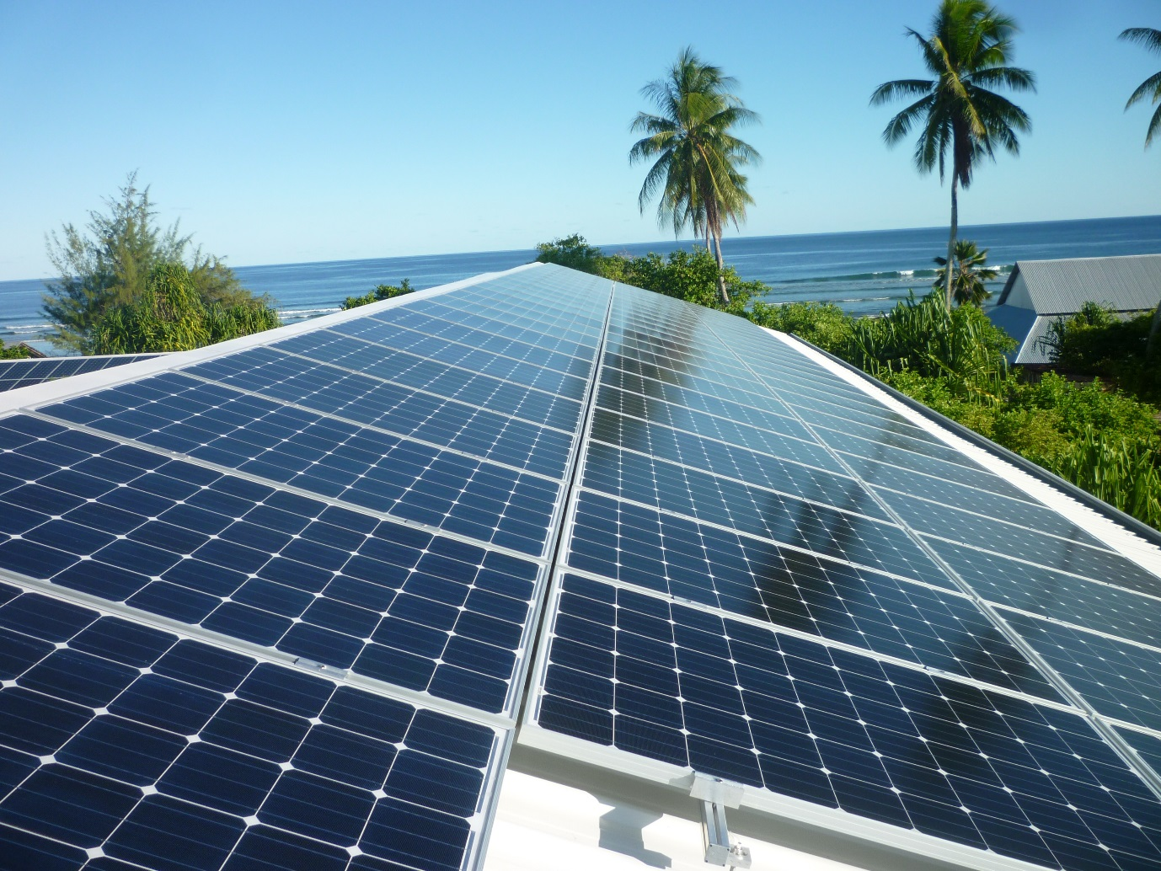
Kiribati Grid Connected Solar Project
Photos: Courtesy PUB, Kiribati

Slide 8
Projects Under Implementation
Fiji
  Geothermal Power Development TA – (ESMAP)
FSM
  Energy Sector Development Project – (IDA)
Kiribati
  Grid Connected Solar PV – (GEF/PRIF)
  Utilities Reform Project – (Joint World Bank/ADB/PRIF)
PNG
  Energy Sector Development Project - (IDA/GEF)
  Linked: (i) RE Resource Mapping – (ESMAP/ASTAE), (ii) Energy Efficiency Strategic Plan (following the assistance on Third party access code/grid code) – (ASTAE)
  Solomon Islands
  Sustainable Energy Project – (IDA/GEF)
  Electricity Access Expansion Project – (GPOBA)
Tonga
  Tonga Energy Road Map Institutional and Regulatory Strengthening Project – (ASTAE/PRIF)
Tuvalu
  Energy Sector Development Project – (IDA/SIDS DOCK)
Vanuatu
  Energy Sector Development Project – (PRIF/ESMAP)
  Improved Electricity Access Project – (GPOBA)
  Vanuatu Rural Electrification Project Stage I – (PRIF-NZ)
Regional
  Sustainable Energy Finance Project – (GEF)
  Regional Sustainable Energy Industry Development Project – (SIDS DOCK/GFDR/SREP)
  Preparation of the Pacific Regional Data Repository for Sustainable Energy for All – (Implemented by SPC) (Bank-executed)

Slide 9

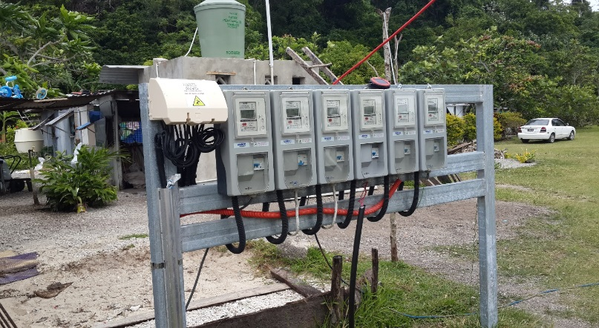
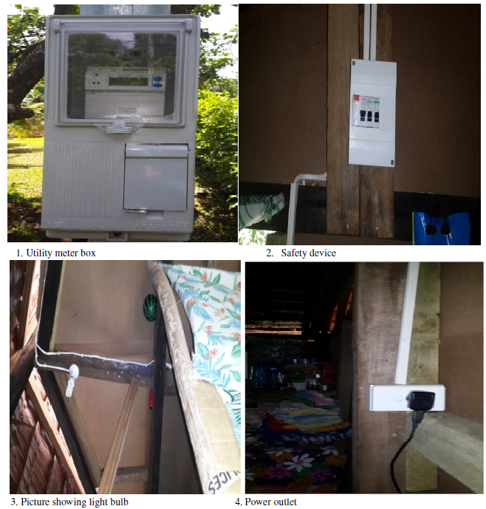
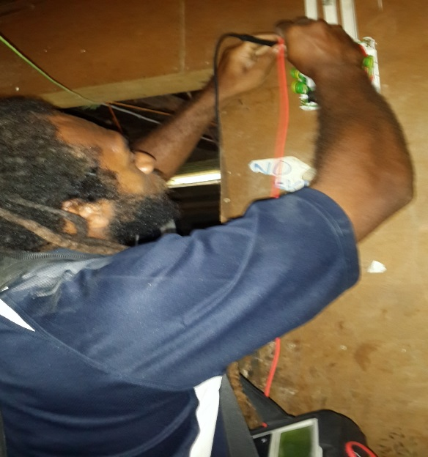
Vanuatu - Electricity Access Project
Source: Department of Energy
Photos: Courtesy DoE, Vanuatu

Slide 10
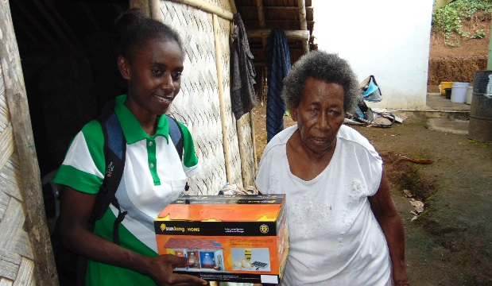
Vanuatu – Rural Electrification Project Stage I
Source: Department of Energy

Slide 11
Projects Under Implementation
Fiji
  Geothermal Power Development TA – (ESMAP)
FSM
  Energy Sector Development Project – (IDA)
Kiribati
  Grid Connected Solar PV – (GEF/PRIF)
  Utilities Reform Project – (Joint World Bank/ADB/PRIF)
PNG
  Energy Sector Development Project - (IDA/GEF)
  Linked: (i) RE Resource Mapping – (ESMAP/ASTAE), (ii) Energy Efficiency Strategic Plan (following the assistance on Third party access code/grid code) – (ASTAE)
  Solomon Islands
  Sustainable Energy Project – (IDA/GEF)
  Electricity Access Expansion Project – (GPOBA)
Tonga
  Tonga Energy Road Map Institutional and Regulatory Strengthening Project – (ASTAE/PRIF)
Tuvalu
  Energy Sector Development Project – (IDA/SIDS DOCK)
Vanuatu
  Energy Sector Development Project – (PRIF/ESMAP)
  Improved Electricity Access Project – (GPOBA)
  Vanuatu Rural Electrification Project Stage I – (PRIF-NZ)
Regional
  Sustainable Energy Finance Project – (GEF)
  Regional Sustainable Energy Industry Development Project – (SIDS DOCK/GFDR/SREP)
  Preparation of the Pacific Regional Data Repository for Sustainable Energy for All – (Implemented by SPC) (Bank-executed)

Slide 12
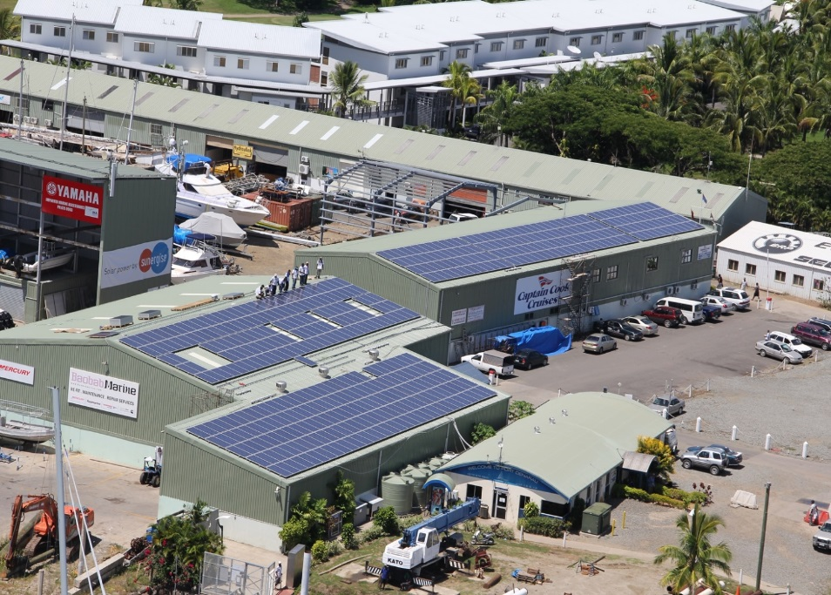
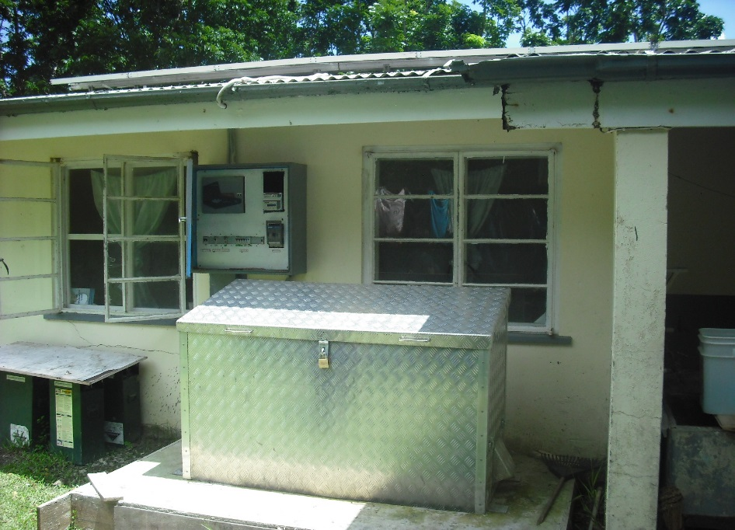
Sustainable Energy Finance Project – Risk Share Facility
Sustainable Energy Finance RSF (Fiji)
- leveraged US$40M for a cost around US$1.5M, NPL ratio 1.1%
Photos: Courtesy DoE, Fiji

Slide 13
Projects Under Implementation
Fiji
  Geothermal Power Development TA – (ESMAP)
FSM
  Energy Sector Development Project – (IDA)
Kiribati
  Grid Connected Solar PV – (GEF/PRIF)
  Utilities Reform Project – (Joint World Bank/ADB/PRIF)
PNG
  Energy Sector Development Project - (IDA/GEF)
  Linked: (i) RE Resource Mapping – (ESMAP/ASTAE), (ii) Energy Efficiency Strategic Plan (following the assistance on Third party access code/grid code) – (ASTAE)
  Solomon Islands
  Sustainable Energy Project – (IDA/GEF)
  Electricity Access Expansion Project – (GPOBA)
Tonga
  Tonga Energy Road Map Institutional and Regulatory Strengthening Project – (ASTAE/PRIF)
Tuvalu
  Energy Sector Development Project – (IDA/SIDS DOCK)
Vanuatu
  Energy Sector Development Project – (PRIF/ESMAP)
  Improved Electricity Access Project – (GPOBA)
  Vanuatu Rural Electrification Project Stage I – (PRIF-NZ)
Regional
  Sustainable Energy Finance Project – (GEF)
  Regional Sustainable Energy Industry Development Project – (SIDS DOCK/GFDR/SREP)
  Preparation of the Pacific Regional Data Repository for Sustainable Energy for All – (Implemented by SPC) (Bank-executed)

Slide 14
Projects Under Preparation/Pipeline
 | Increasing Access | Increasing Renewable Energy | Utilities Capacity/Increasing Efficiency | Energy Planning, Enabling Policy, institutional & regulatory support
Fiji
Kiribati |  |  | RE dispatch optimization
Papua New Guinea | Development of Transmission & Distribution Lines (Est. US$150, IBRD )
Solomon Islands |  | Tina River Hydropower (Approx. US$200m - IDA, K-Water, HEC, EDCF, GCF ) Renewable energy (SREP, IDA)
RMI |  | Renewable energy ( US$25m - IDA)
Vanuatu | Rural Electrification Stage II (US$20-25m – IDA, SREP, GoV, Users) | Geothermal Technical Assistance
Regional |  | Regional risk share facility

Slide 15
Thank you

