Slide 1
WORKSHOP ON FINANCING FOR RENEWABLE ENERGY IN SMALL ISLAND DEVELOPING STATES (SIDS), NADI, FIJI: 1-3 DECEMBER 2016
Session 12A: EE in Transport
Solomone FIFITA, Deputy Director (Energy), SPC

Slide 2
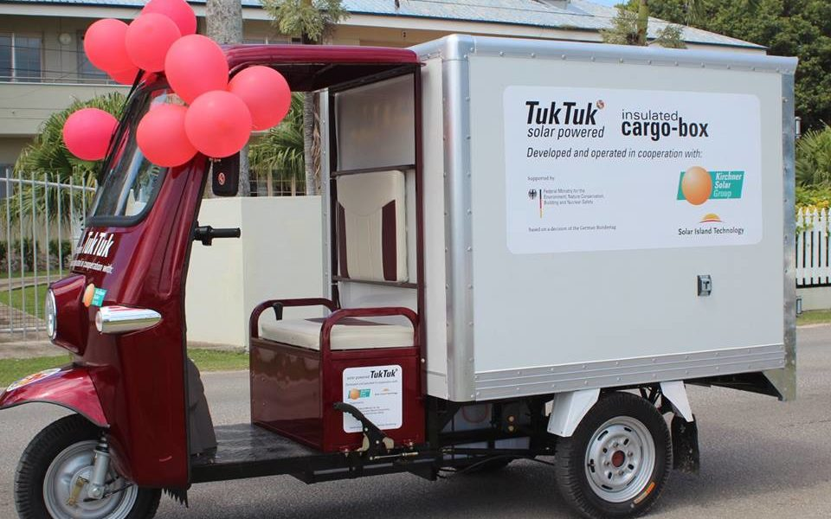
EE in transport
Acknowledged
Neglected
First Attempt

Slide 3
Energy sector plans vs. NDCs
 |  | % of current vehicles on fossil fuel | % of vehicles on fossil fuel after the programme | National EE in transport target % | Estimated Reductions in CO₂ emissions (tCO_{2e}/annum)
1. | RMI |  |  | Reducing emissions in transportation (including domestic shipping) by 16% in 2025 and 27% in 2030
2. | Palau |  |  | 22% energy sector emissions reductions below 2005 levels by 2025 45% Renewable Energy Target by 2025 35% Energy Efficiency Target by 2025 (in electricity generation, transport and waste)
3. | Tonga |  |  | Sector Emission Reduction Targets: Transport, Agriculture, Environment Friendly Waste Management and Reforestation

Slide 4
Energy sector plans vs. NDCs
 |  | National EE in transport target %
4. | Samoa | Efficient, Sustainable, Safe and Cost-Effective Energy Use in the Transport Sector 2.1 Regulate the importation and use of environmentally friendly and energy efficient vessels, motor vehicles and aircrafts; 2.2 Promote fuel efficiency in land and sea transport and ensure systems are reliable, efficient and affordable; 2.3 Promote the use of bio-fuel as a substitute for imported fossil fuels; 2.4 Ensure that energy related Acts and Regulations are enforced to govern supply, use, storage, distribution, disposal and refuelling of fossil fuel and its by-products (sea, land and air transport); 2.5 Enforce Waste and oil spillage strategies (Waste Management Plan) 2.6Encourage competition in the supply and distribution of fuel and ensure quality standards exceeded; 2.7Greenhouse gas abatement through energy efficiency and bio-fuel application in the transport sector

Slide 5
Building a good business case
Data
Current and planned investments in transport

Slide 6
Implementation modality
PEC Fund
ADB’s PIREIP

Slide 7
4 Pronged approach
Support climate-friendly transport policy development
Build investment pipelines to improve the flow and quality of Sustainable Transport
Unlock more private investment using Climate Finance instruments
Increase relevance of technical assistance and capacity building

Slide 8
Partnership Structure
UNDP
SPC and the PCREEE
LTAs and national authorities
Interested partners

Slide 9
Proposed Timeline
Nadi – Dec 2016
Port Vila – Dec 2016
Tonga – April 2017
GCF – June 2017

Slide 10
Questions to be discussed
Is there a need for an EE in transport project?
Pros and Cons of national vs. regional transport project
Comment and elaborate on the paradigm shift
Expand on the proposed 4 pronged approaches – list specific PIC needs
Please discuss the implementation modalities and the required partnerships – pros and cons
List the current and proposed investments in transport in the PICs
Comment on the proposed process and timeline
List any other issues the project design should be mindful of

