Slide 1
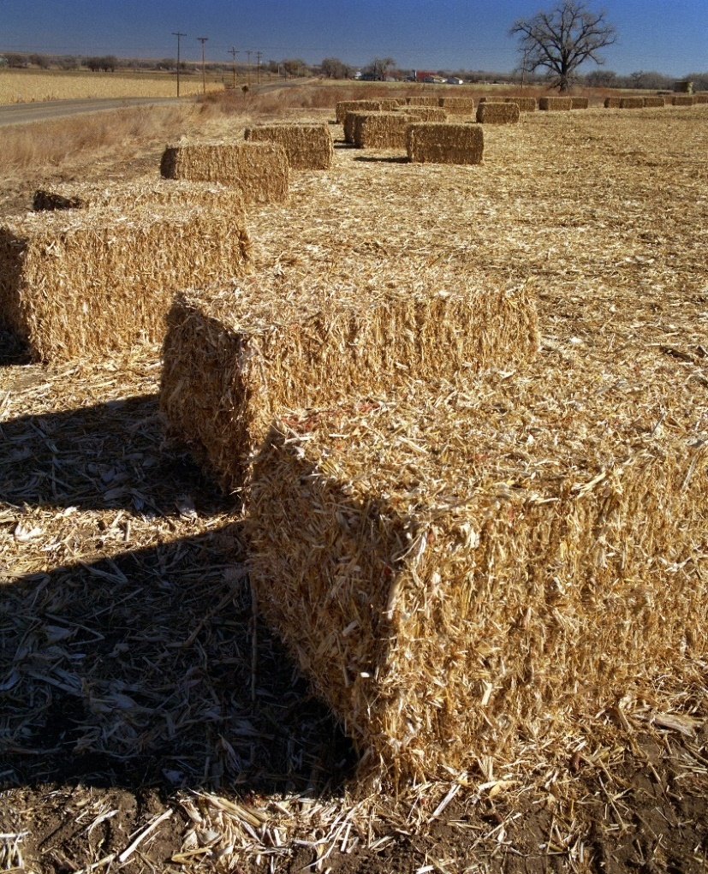
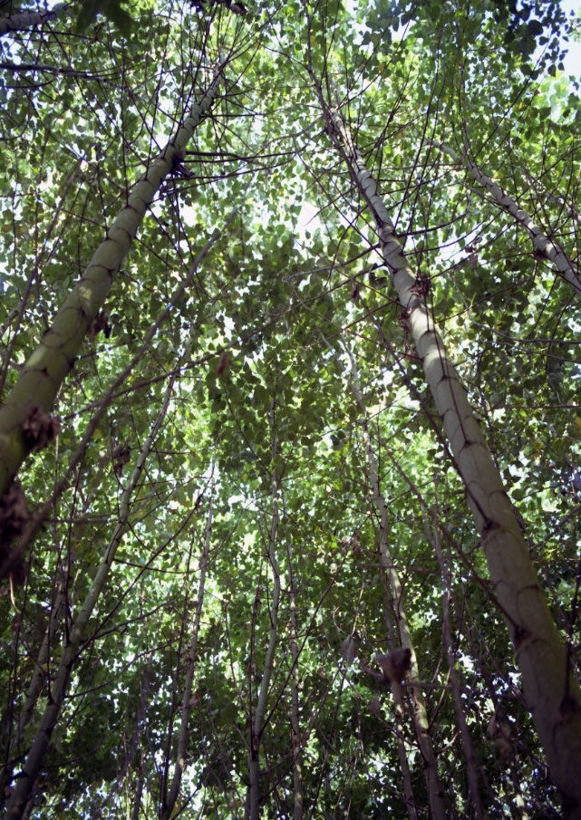
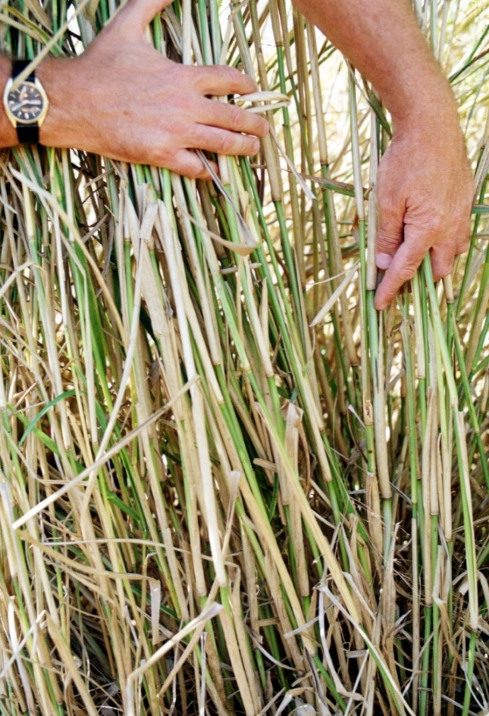
Bioenergy for Sustainable Development
International Workshop on Linkages between the
Sustainable Development Goals & GBEP Sustainability Indicators
German Development Institute
Bonn, 3 July 2017
Jeff Skeer
International Renewable Energy Agency (IRENA)
Notes:
The International Renewable Energy Agency (IRENA), the United Nations Food and Agriculture Organization (FAO), and the IEA Bioenergy agreement have jointly developed a brief on Bioenergy for Sustainable Development. I would like to walk you through the highlights, along with some analysis that underpin it. The complete text has been distributed for your reference. (Bring along a pile of copies to hand out.)

Slide 2
Bioenergy for Sustainable Development
Bioenergy represents a major type of renewable energy. As such, it is key to supporting the UN Sustainable Development Goals (SDGs) in the context of climate change and energy security. As summarized by the IPCC 5th Assessment Report, integrated assessment modelling indicates a high risk of failing to meet long-term climate targets without bioenergy. Global assessments by REN 21, IEA and IRENA find that bioenergy accounts for three-quarters of all renewable energy use today and half of the most cost-effective options for doubling renewable energy use by 2030. Bioenergy is part of a larger bioeconomy, including agriculture, forestry and manufacturing.
Notes:
The first point is that bioenergy is key to sustainable development, and it will be hard to meet climate goals without it. That’s because bioenergy makes up a large share of the cost-effective options for increasing renewable energy use.

Slide 3
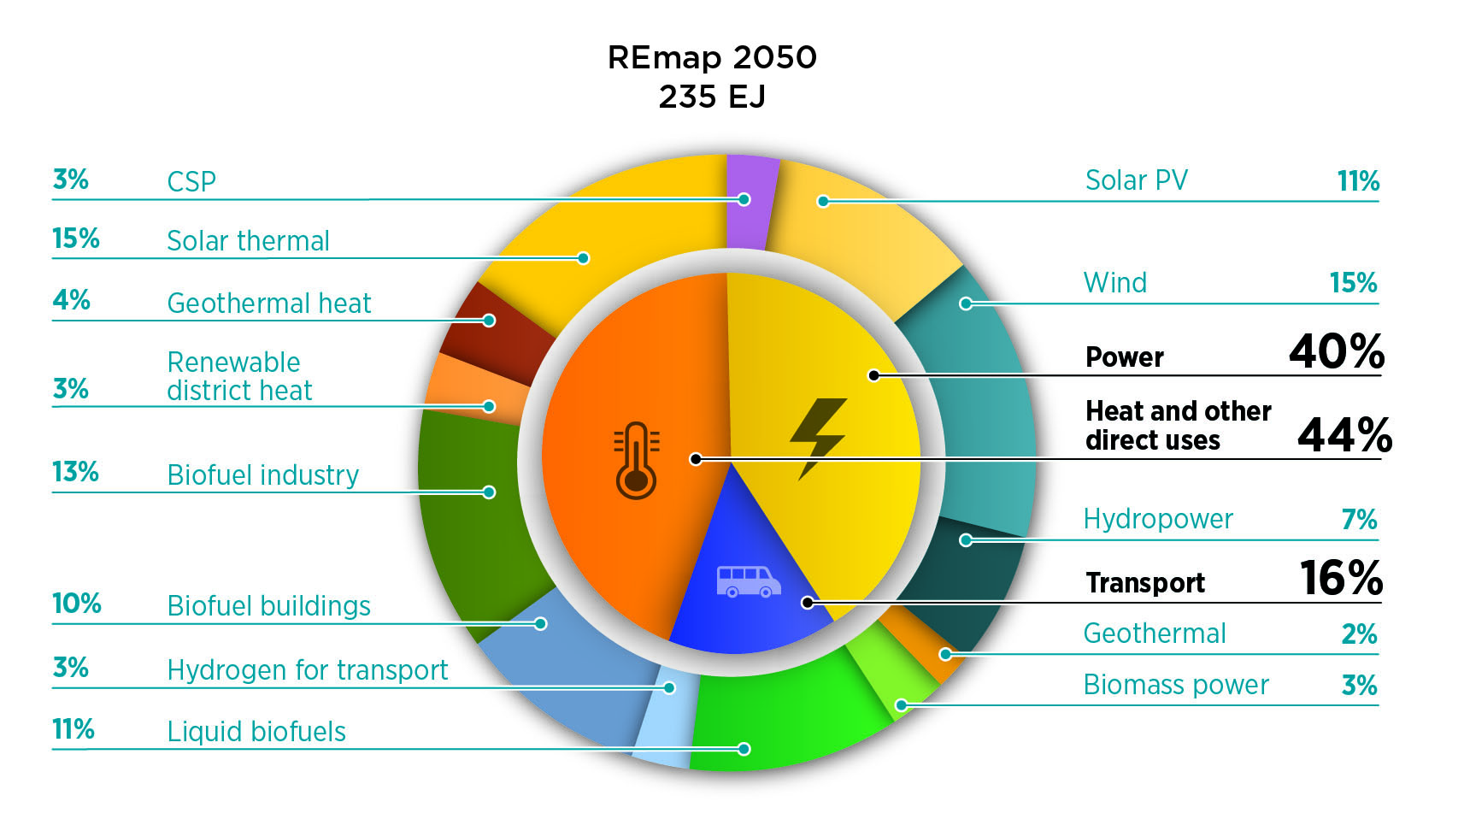
Major Modern Biomass Needs in 2050
Notes:
As we recently reported to the G20, IRENA’s REmap exercise envisions 235 EJ of renewable energy use in 2050, with 44% for heat and other direct uses, 40% for power, and 16% for transport.
Roughly three-eighths of the renewable energy supply (37%) would be some form of bioenergy: 10% would be for bioenergy in buildings, 13% for bioenergy to provide industrial process heat, 11% in the form of liquid biofuels for transport, and 3% for power.

Slide 4
Bioenergy Role in Every Energy Sector
In the power sector, bioenergy can provide flexibility to balance expansion of intermittent and seasonal wind and solar resources. For industry, biomass can efficiently supply high-temperature process heat, in conjunction with a wide variety of valuable biobased chemicals and materials. In the building sector, biomass provides the feedstock for highly efficient district heating systems, furnaces and cook stoves. In transport, liquid and gaseous biofuels can, together with electrification vehicle energy efficiency, achieve rapid and deep reduction in fossil fuel use. Biofuels are moreover the only current practical alternative to fossil fuels for aviation, marine shipping and heavy freight transport.
Notes:
The second main point in the brief is that bioenergy has a role to play in every energy sector – in the power sector for flexibility to balance wind and solar, in process heat and materials for industry, in heating systems and stoves for buildings, and fuels for transport. We emphasize that biofuels are the only current practical alternative to fossil fuels for aviation, marine shipping and heavy freight transport.

Slide 5
Bioenergy: Opportunities, Challenges
Bioenergy typically enhances regional energy access and reduces reliance on fossil fuels. It can vitalize the forestry and agriculture sectors and support increased use of renewable resources as feedstocks for a range of industrial processes. It can contribute to our global climate change mitigation goals as well as other important social and environmental objectives.
But bioenergy can also have negative impacts if not developed properly. Three key concerns are food security, risks that land use and land use change from bioenergy expansion may increase carbon emissions or reduce biodiversity, and challenges in achieving economic competitiveness and providing high quality and affordable energy services.
Notes:
A third point on the first page of the brief relates to opportunities and challenges. Bioenergy enhances energy access and reduces reliance on fossil fuels, thereby helping to mitigate climate change. But challenges arise with respect to food security, land use change that may increase carbon emissions or reduce biodiversity, and making bioenergy economically competitive.

Slide 6
Bioenergy Choices: Context-Specific
Bioenergy is multifaceted. Specific bioenergy options (such as biofuels produced from edible vs. non-edible feedstocks) are not good or bad per se; sustainability impacts are context specific and depend on the location and management of feedstock production systems. Fortunately, significant knowledge and competence are available to govern bioenergy expansion so as to harness opportunities and minimize risks of negative impacts.
Notes:
In meeting these challenges, it is important to recognize that whether bioenergy feedstocks are good or bad does NOT depend on whether they are useable as food, but rather on how well their production is managed to meet BOTH food and fuel needs in a sustainable fashion.

Slide 7
Sustainable Bioenergy Expansion: Multi-stakeholder Processes
Inclusive multi-stakeholder processes can identify areas best suited for bioenergy production (such as for agro-ecological zoning) as well as appropriate arrangements for promoting positive effects of production and development while avoiding or mitigating possible negative impacts. As an example, contract farming can provide an opportunity for small-scale farmers to diversify their land use and gain new incomes from selling part of their produce for bioenergy.
Notes:
Sustainable options for bioenergy expansion are highlighted in the second page of the brief. Inclusive processes with all key stakeholders can identify areas best suited for bioenergy production while avoiding or mitigating negative impacts on food production or the environment.

Slide 8
Sustainable Intensification of Land Use
Sustainable intensification and landscape planning – increasing output per unit of land while maintaining or improving ecosystems' health and productive capacity – can make land available for additional production while enhancing ecosystem services. So can restoring degraded land and reducing losses in the food chain. Biomass demand for energy can be met by integrating novel biomass production systems into agriculture and forestry landscapes. Such systems may use crop rotations, flexible crops (which can be used for multiple purposes), intercropping, and agroforestry approaches (such as use of nitrogen-fixing energy crops to boost yields of neighboring food crops). Integrated systems can produce food, feed, bioenergy feedstocks and other bio-based products from the same land area. They can also enhance biodiversity and mitigate land use impacts such as soil erosion, soil compaction, salinization, and eutrophication of surface waters related to excess fertilization
Notes:
Sustainable intensification and landscape planning – increasing output per unit of land while maintaining or improving ecosystems' health and productive capacity – can make land available for additional production while enhancing ecosystem services. So can restoring degraded land and reducing losses in the food chain.
Integrated systems can produce food, feed, bioenergy feedstocks and other bio-based products from the same land area. They can also enhance biodiversity and mitigate adverse land use impacts

Slide 9
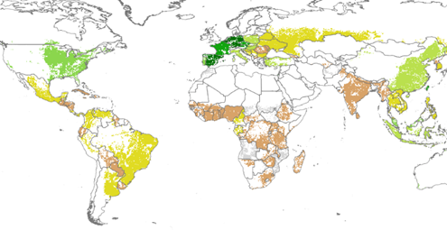
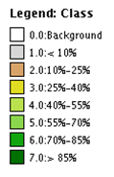
Yield Gap: Illustrated by Maize
Ratio of Actual to Potential Yield for Maize (Year 2000)
Source: Global Agro-Ecological Zones
Notes:
There is a lot of potential for sustainable intensification because there is a major gap between actual and potential yields. FAO, projects that global average yield for major food crops will rise from 4.2 t/ha in 2010 to 5.1 t/ha in 2050 But the potential yield is 10.4 t/ha. If the yield gap could be closed, less than half as much land would be needed for food.
For maize, a leading biofuel feedstock today, actual yield is less than 25% of potential yield in most of Africa and India, shown in brown. Similar disparities exist for other crops.

Slide 10
Pastureland Available Globally for Biofuel Crops
Pastureland
(3.4 billion ha)
Cropland
(1.5 billion ha)
100
100
1.5 billion ha
marginal & very
1.4 billion ha
prime & good
70 million ha more for food
by 2050 (FAO)
80
Could possibly grow some energy crops adapted to saline or desert conditions
Could be more suitable for energy crops than food crops
80
60
60
% Dietary protein
% Harvested Crops
40
40
20
20
0
0 0.5 1.0 1.5 2.0 2.5 3.0 3.5 4.0 4.5 5.0
Agricultural Land (Billion Hectares)
Notes:
There is also potential for sustainable intensification of pasture land, used to raise livestock. Beyond the 1.5 billion hectares of land that is used today to grow food crops, 1.4 billion hectares of prime and good pasture land is available. About 97% of the world’s food and feed is grown on the crop land, while less than 3% is grown on the pasture land. If this pasture land were used more intensively, food for the livestock could well be raised on a quarter of it, leaving three quarters for energy purposes and biodiversity enhancement.

Slide 11
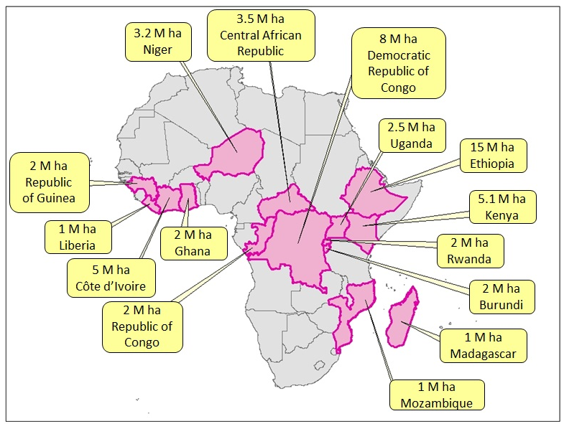
Degraded Landscape Restoration
Notes:
Additional energy crops might well be grown by restoring degraded lands. The Bonn Challenge and New York Declaration have committed countries to restore 350 M ha by 2030. The African Forest Landscape Restoration Initiative (AFR100), launched at COP21 in Paris, aims to restore 100 M of these hectares. It has already been joined by 15 countries.

Slide 12
Best Practice Losses by Food Chain Stage
Food Type | Agricultural Production | Postharvest Handling & Storage | Processing and Packaging | Distribution: Supermarket Retail | Consumption
Cereals | 2% | 2% | 3.5% | 2% | 1%
Roots & Tubers | 6% | 7% | 10% | 3% | 2%
Oilseeds & Pulses | 6% | 0% | 5% | 1% | 1%
Fruits & Vegetables | 10% | 4% | 2% | 8% | 5%
Meat | 2.9% | 0.2% | 5% | 4% | 2%
Milk | 3.5% | 0.5% | 0.1% | 0.5% | 0.1%
Notes:
The FAO has found that one-third of food produced for human consumption is lost or wasted, amounting to 1.3 billion tons per year. It is interesting to think how much less would be wasted, and how much land could be made available for bioenergy crops, if the best practice for each crop group at each stage of the food chain were adopted in every region. For example, at the consumption stage, the region with the lowest share of food waste is Sub-Saharan Africa. The lowest production losses are achieved in industrialised Asia. Post-harvest handling and storage losses are lowest in North America.

Slide 13
Potential Land for Solid Biomass
Closing the Yield Gap: 550 M ha
Better Use of Pasture Land: 950 M ha
Reduced Food Chain Losses: 270 M ha
Landscape Restoration: 350 M ha
TOTAL: OVER 2 BILLION HECTARES, 300 EJ
Notes:
Overall, a theoretical potential exists for over two billion hectares of land to become available for growing solid biomass. Assuming a yield of 10 tonnes per hectare and energy content of 15 gigajoules per tonne, this would equate to over 300 EJ of biomass, more than enough to displace all of the petroleum currently used for transport fuel.

Slide 14
Sustainable Bioenergy Expansion: Agricultural Residues
As food production expands to feed growing populations, this will induce more organic residues, both on the field and in processing. A portion of crop residues is typically required for soil management, depending on local circumstances such as climate, soil conditions, topography and crop type. Other crop residues are used for animal bedding or feed. The remainder (including residues currently burned in the field, with high air pollution and climate change impacts), along with nearly all processing residues, can be removed for bioenergy production.
Notes:
Getting back to the text of the brief, it is also noted that as food production expands to feed growing populations, there will also be more crop residues. While some of these are needed to keep the soil healthy and feed or bed animals, the rest can be used for bioenergy.

Slide 15
Sustainable Bioenergy Expansion: Forest Residues and Management
Similarly, as wood production in forests expands to meet growing demand for traditional forest products such as lumber and pulp and paper, there are significant opportunities to utilize process and manufacturing residues. Furthermore, significant volumes of forest wood that currently have no industrial use (such as wood of inferior quality and wood generated in natural disturbance events) can be used for bioenergy. Applying sustainable forest management principles will enhance the health and productivity of forests.
Notes:
Similarly, as wood production expands to meet growing demand for lumber which stores carbon in buildings and furniture, as well as for pulp and paper, there are growing amounts of other wood left over for bioenergy. Sustainable forest management can keep forests growing while more wood is extracted.

Slide 16
Sustainable Bioenergy Expansion: Post-Consumer Waste
Furthermore, population growth and urbanization results in larger quantities of post-consumer waste – not only food waste but also construction waste and discarded goods with substantial energy content. Converting waste to bioenergy or higher value materials reduces the need for landfills and can substantially reduce associated emissions of methane, which is a much more potent greenhouse gas than carbon dioxide.
Notes:
And growing cities mean additional food and construction waste – which can also be used for bioenergy – reducing the need for landfills and associated emissions of methane, a powerful greenhouse gas.

Slide 17
Sustainable Development Goals
Bioenergy can play an important and constructive role in achieving the agreed UN Sustainable Development Goals (SDGs) and implementing the Paris Agreement on Climate Change, thereby advancing climate goals, food security, better land use, and sustainable energy for all:
SDG-13: take urgent action to combat climate change and its impacts,
SDG-7: …affordable, reliable, sustainable and modern energy for all,
SDG-2: end hunger, achieve food security and improved nutrition and promote sustainable agriculture,
SDG-15: protect, restore and promote sustainable use of terrestrial ecosystems, sustainably manage forests, combat desertification, and halt and reverse land degradation and halt biodiversity loss.
The Paris Agreement reiterates the “need to promote universal access to sustainable energy” while calling for “action to conserve and enhance … sinks and reservoirs of greenhouse gases” and for “reducing emissions from deforestation and forest degradation.”
Notes:
Moving on to the third page of the brief, it is noted that bioenergy can play an important role in meeting specific UN sustainable development goals – climate change action, food security, sustainable land use, and access to affordable, reliable, modern sustainable energy for all.
(In this regard, the GBEP Sustainability Indicators are a key tool for measuring progress.)

Slide 18
Supporting SDG Implementation
Enabling bioenergy expansion that supports SDG implementation requires that policies and measures to promote best practices are put in place. These should consider the variation in conditions across continents, ensure biodiversity safeguards, and promote multiple ecosystem services in landscapes. This requires coordinated land management and involvement of individual farmers, landowners, policy-makers and other local and national stakeholders.
Trade-offs and synergies need to be discussed with relevant stakeholders who can also provide necessary information about the current land use and social, economic, and practical preconditions for on-going as well as suggested new land uses. Knowledge and management experience in use of biomass for energy should be shared across regions to promote best practices. This would facilitate the development of locally adopted management guidelines.
Notes:
To support the sustainable development goals, it is important to promote best practices which consider different conditions, safeguard biodiversity, and promote ecosystem services. Best practices can be promoted by sharing knowledge and experience across regions.

Slide 19
Expansion Measures: Higher Yields
Several measures can help boost yields and promote multi-functional land uses, providing sufficient food and animal feed for a growing population, as well as biomass for bioenergy and other valuable biobased products. Agricultural extension services can promote adoption of modern farming techniques and development of good management practices at a local level, including agroforestry strategies for growing a mix of high-yielding food and fuel crops in different soils and climates. Secure land tenure can give farmers financial incentives to manage their land for high yields while sustaining soil productivity. Logistical approaches for cost-effective harvesting and transport of agricultural and forest residues can be disseminated.
Notes:
To support sustainable bioenergy expansion, a key approach is to boost yields. Extension services can promote adoption of modern farming techniques. Secure land tenure can give farmers financial incentives to manage their land for high yields while keeping soil productive.

Slide 20
Residues, Waste, Degraded Land
Other steps can support better use of residues and waste from agriculture and forestry value chains. Examples include incentives for sustainable use of residues, supported by guidelines to ensure appropriate residue extraction rates in different conditions. Soft loans for machinery can further support the ramping up of bioenergy systems that use residues and waste as feedstock.
Use of degraded or marginal land is an option for biomass production that helps restore soil productivity and avoids or mitigates competition for higher quality land. Economic incentives to promote such land uses should be combined with dissemination of information on suitable production systems and experience from previous initiatives, while protecting vulnerable communities.
Notes:
A second important approach for sustainable bioenergy expansion is better use of residues and waste on farms and in forests. This can include guidelines for appropriate residue extraction rates, for example.
A third approach to sustainable bioenergy is restoration of degraded or marginal land which is not in productive use. Economic incentives and information on suitable production systems can promote this.

Slide 21
Reduced Food Chain Waste and Losses
Food chain losses could be reduced by promoting good harvesting techniques, investing in storage and refrigeration facilities, developing transportation infrastructure to safely deliver food to markets, discounting imperfect food items to encourage their sale, modifying labels so food is not discarded prematurely, and educating consumers to better match food purchases to their needs. Guidelines and support packages for governments and practitioners exist which demonstrate a number of practical approaches to sustainably meet food, feed and biofuel demand in the coming decades.
Notes:
A fourth approach to sustainable bioenergy is reduction of waste and losses in the food chain, for example by promoting good harvesting techniques, investing in storage and refrigeration facilities, developing transportation infrastructure, discounting imperfect food items to encourage their sale, modifying labels so good food is not discarded, and educating consumers to match food purchases to their needs.

Slide 22
Bioenergy in the Bioeconomy
Bioenergy is part of a larger bioeconomy, also including agriculture, forestry, fisheries and the manufacture of food, paper, wood and agricultural fiber products, bio-materials, bio-based chemicals and medicines. This broader bioeconomy accounts for about $2 trillion of annual trade and one-eighth of overall global trade volume. Policies to promote the bioeconomy may include intensified efforts to map global soils, systematic monitoring of contributions to SDGs, development of skills and knowledge for using bio-based materials in manufacturing and consumer products, biorefinery demonstration projects combining production of energy and higher value materials, and research on new food systems, sustainable aquaculture, and artificial photo-synthesis. They may also include specific renewable energy targets, mandates, loan guarantees and financial incentives.
Notes:
In conclusion, the brief notes that bioenergy is part of a larger bioeconomy which also includes agriculture, forestry, fisheries, manufacturing, materials, chemicals and medicines. Policies to promote the bioeconomy may include soil mapping, demonstration biorefinery projects that combine production of energy and high-value materials, research on new food systems, and the old standbys of renewable energy targets, mandates, loan guarantees and financial incentives.

Slide 23
Integrated Production Systems
The attitude towards biomass production for food, bioenergy and other purposes should evolve from single end-use orientation to integrated production systems that ensure high resource use efficiency and reward sustainable production and use. The output of such systems should be used with great care, striving to minimize waste and maximize efficiency while maintaining a healthy resource base for future generations.
Notes:
Finally the brief notes the importance of integrated production systems which ensure efficient use of resources and reward sustainable production and use – to minimize waste and maximize efficiency while maintaining a healthy resource base for future generations.

Slide 24
Contributing organizations:
IRENA – International Renewable Energy Agency
http://www.irena.org/
IEA Bioenergy – International Energy Agency Technology Collaboration Programme on Bioenergy
http://www.ieabioenergy.com/
FAO – Food and Agriculture Organization of the UN
http://www.fao.org/
Notes:
The brief was prepared by an international team of experts and officials from IRENA, IEA Bioenergy, and UN Food and Agriculture Organization.

