Slide 1
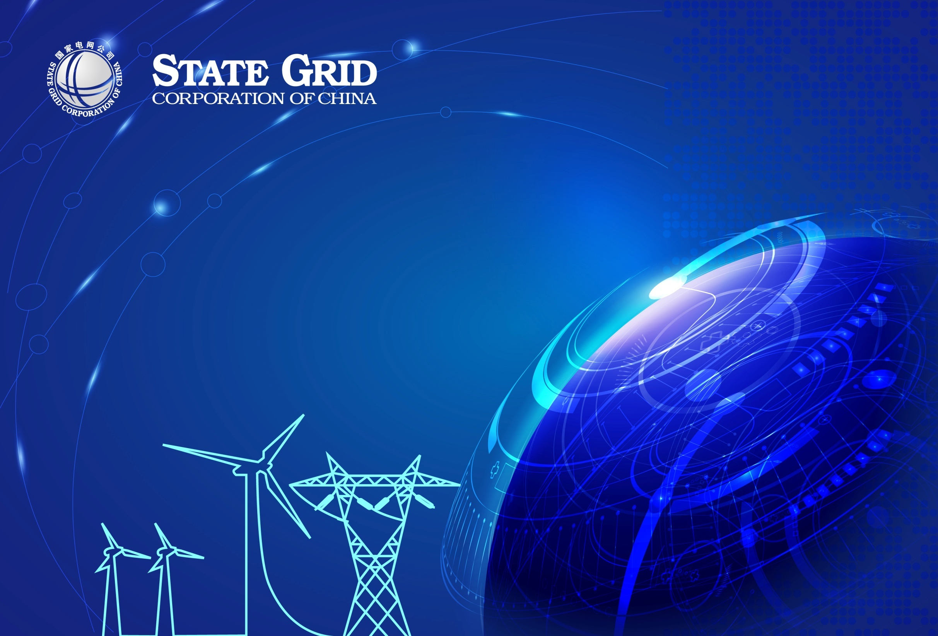
Deepen Cooperation , Tackle Challenges ,
Promote Sustainable Development of Renewable Energy
Shu Yinbiao
Chairman, State Grid Corporation of China
Vice President, IEC
12th November 2017

Slide 2

I. State Grid Corporation of China
II. Energy Transition in China
III. Practice of State Grid
IV. Suggestions

Slide 3
I. State Grid Corporation of China
II. Energy Transition in China
III. Practice of State Grid
IV. Suggestions

Slide 4

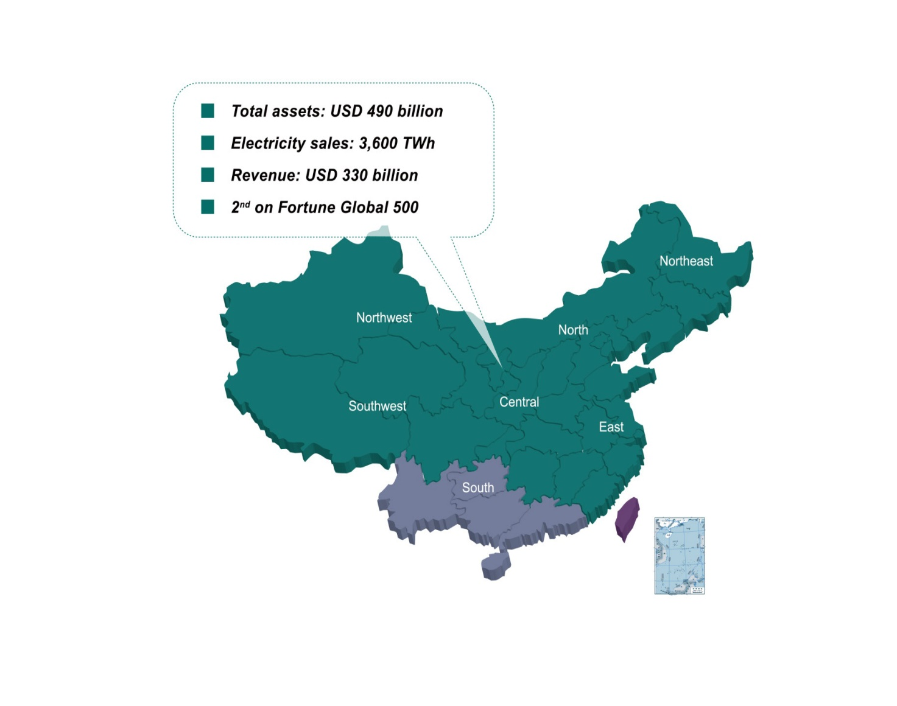
Investment, construction, and operation of power grid
Provide service for over 1.1 billion people
Largest utility in the world

Slide 5
I. State Grid Corporation of China
II. Energy Transition in China
III. Practice of State Grid
IV. Suggestions

Slide 6
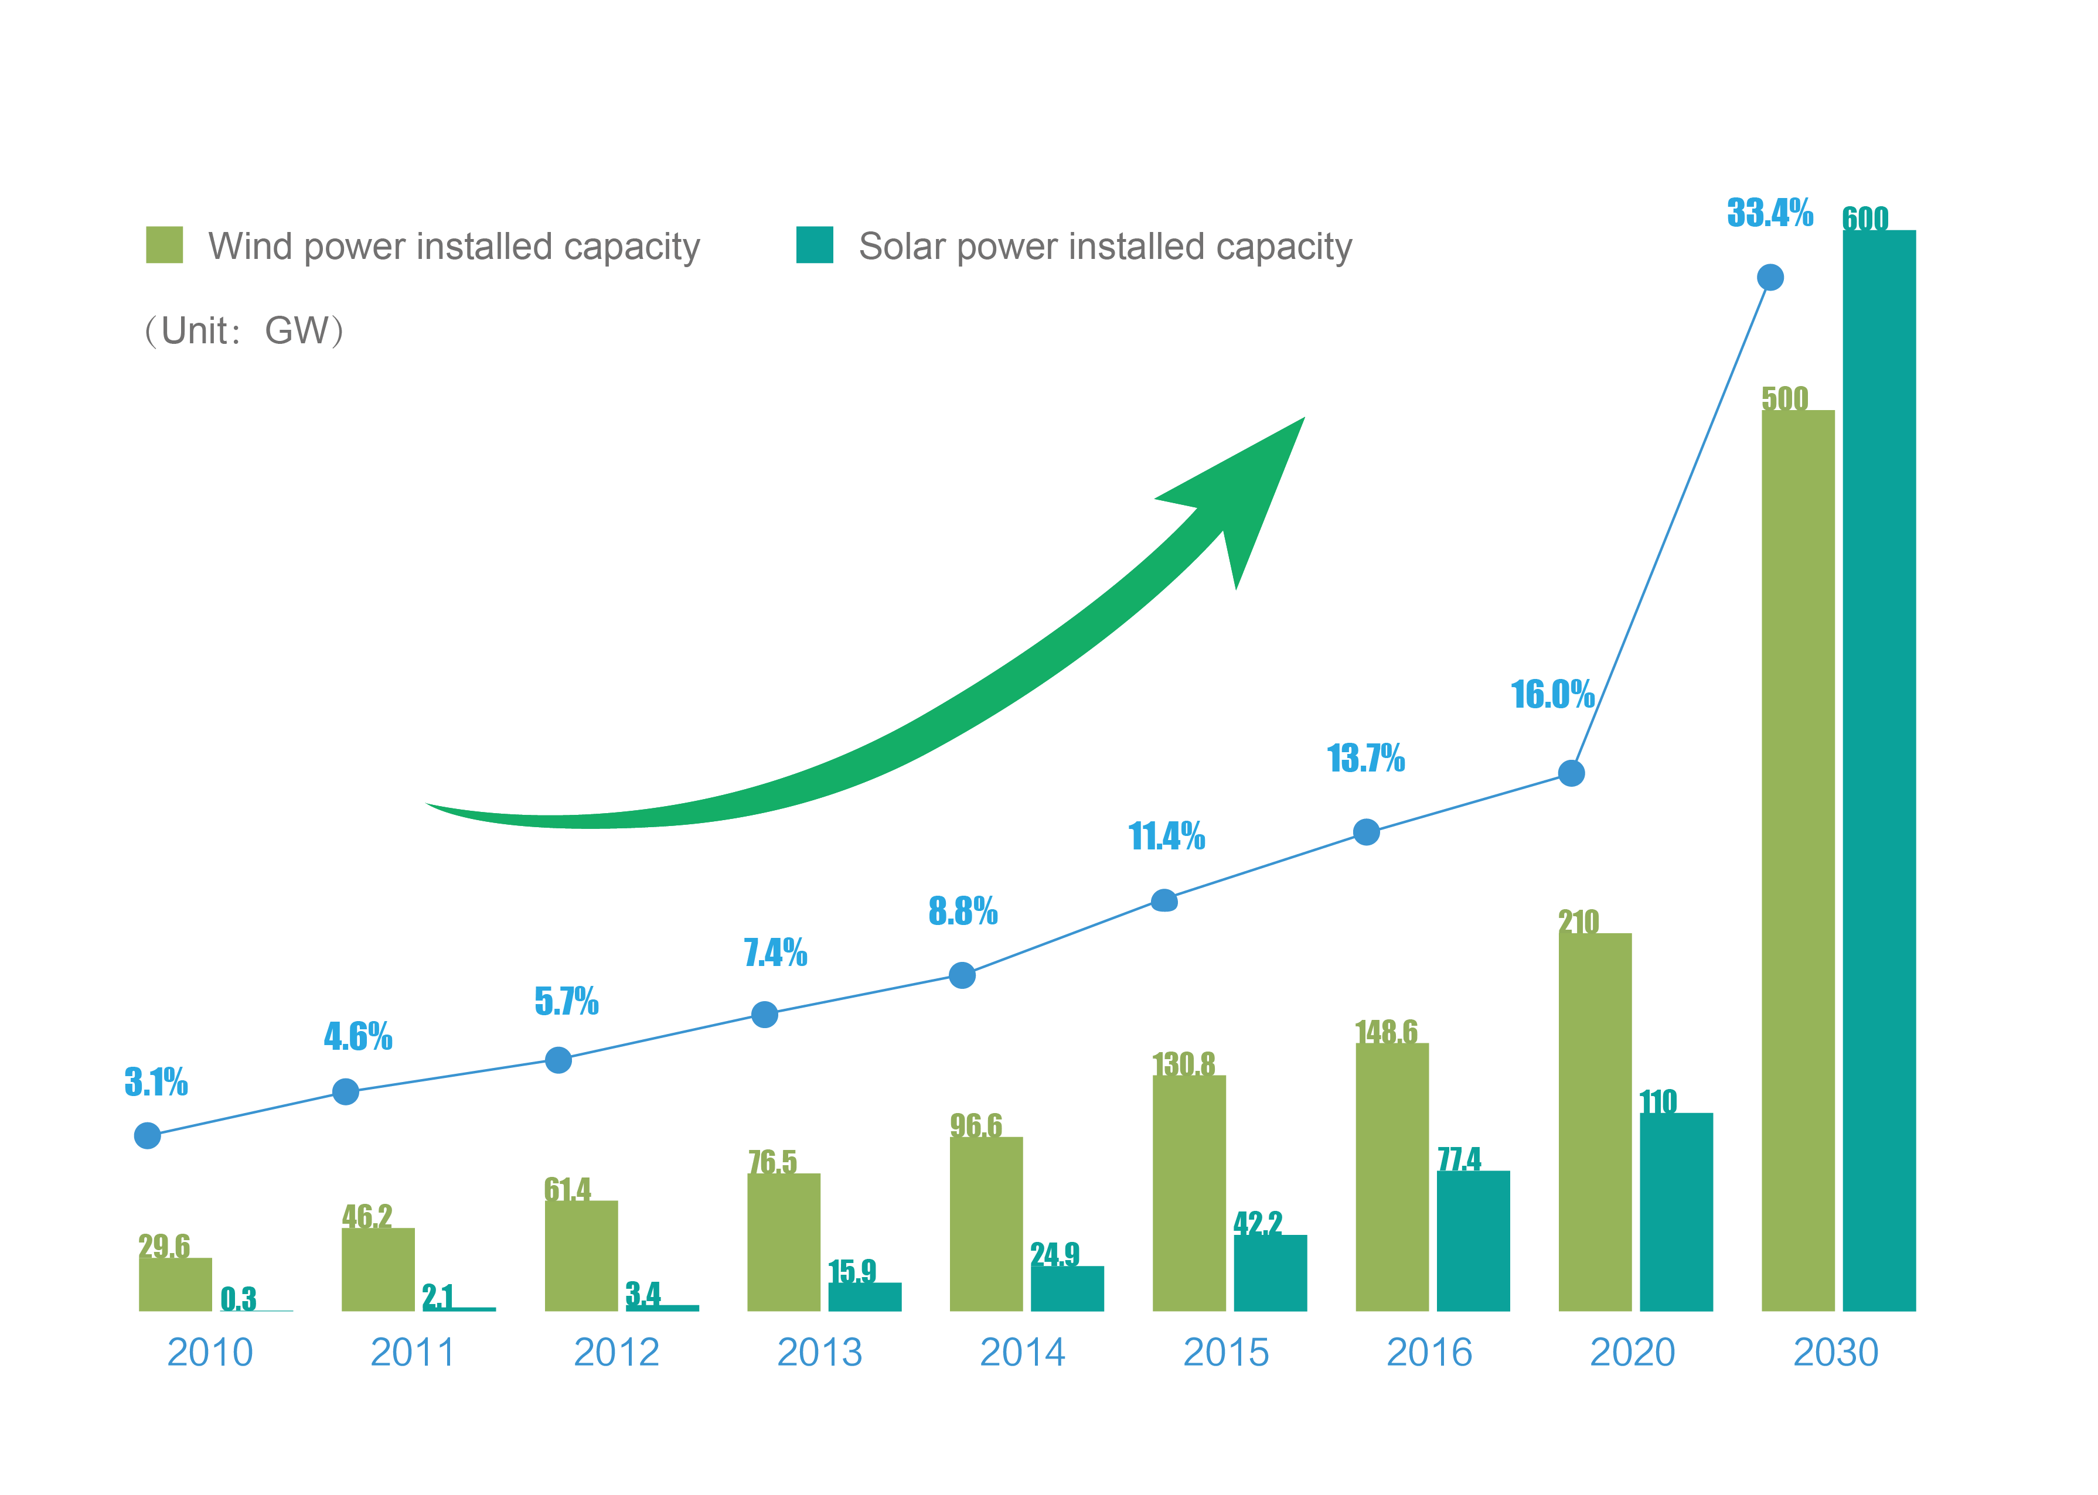
By the end of 2016, the installed capacity for
Wind power: About 150 GW / Annual growth rate: 46%
Solar power: About 80 GW/ Annual growth rate: 62%
Wind and solar installed capacity of total in China

Slide 7
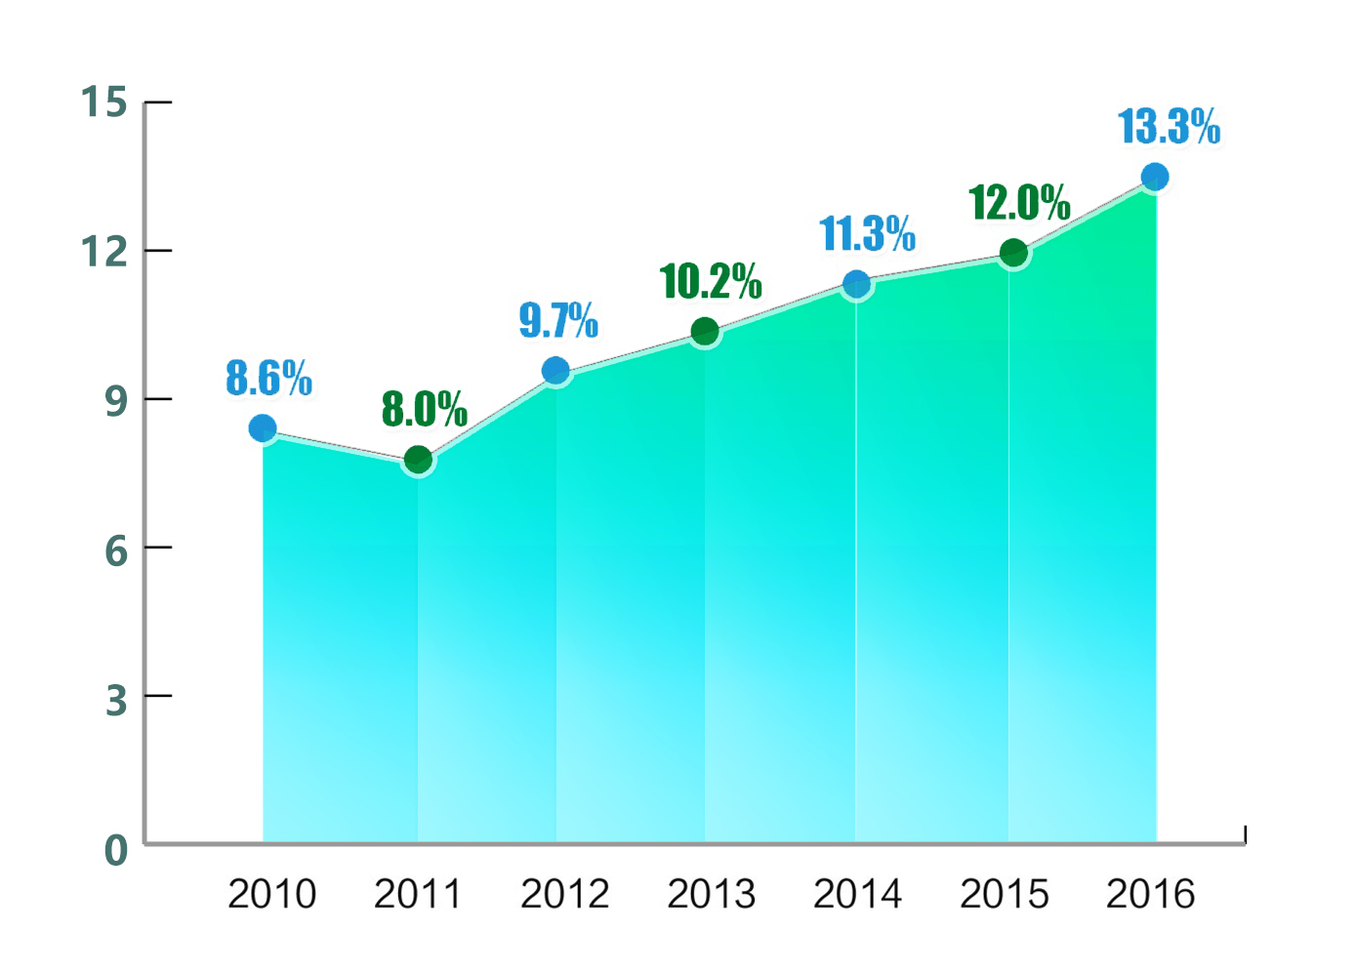


Proportion of non-fossil energy consumption in primary energy consumption

Slide 8
I. State Grid Corporation of China
II. Energy Transition in China
III. Practice of State Grid
IV. Suggestions

Slide 9
Development of UHV Transmission Grid
World largest scale of renewable energy integration by State Grid’s power grid
18 UHV projects in operation, 6 UHV projects under construction
By 2030, 2200 TWh electricity will deliver through UHV transmission lines
Enable large scale power transmission from renewable energy bases in West China to load centers in East China
Reduce local coal combustion by 660 million tons
Notes:
确立“建设大电网、形成大市场、支撑大开发”的发展思路，建成投运了具有国际先进水平的11项特高压交直流工程，累计送电6800亿千瓦时，成为连接中国西部北部新能源基地与东中部负荷中心的能源输送大通道。2010年以来，累计建成新能源并网及送出线路4.3万公里，接入风电和太阳能发电项目5459个，总装机容量超过1.7亿千瓦。

Slide 10
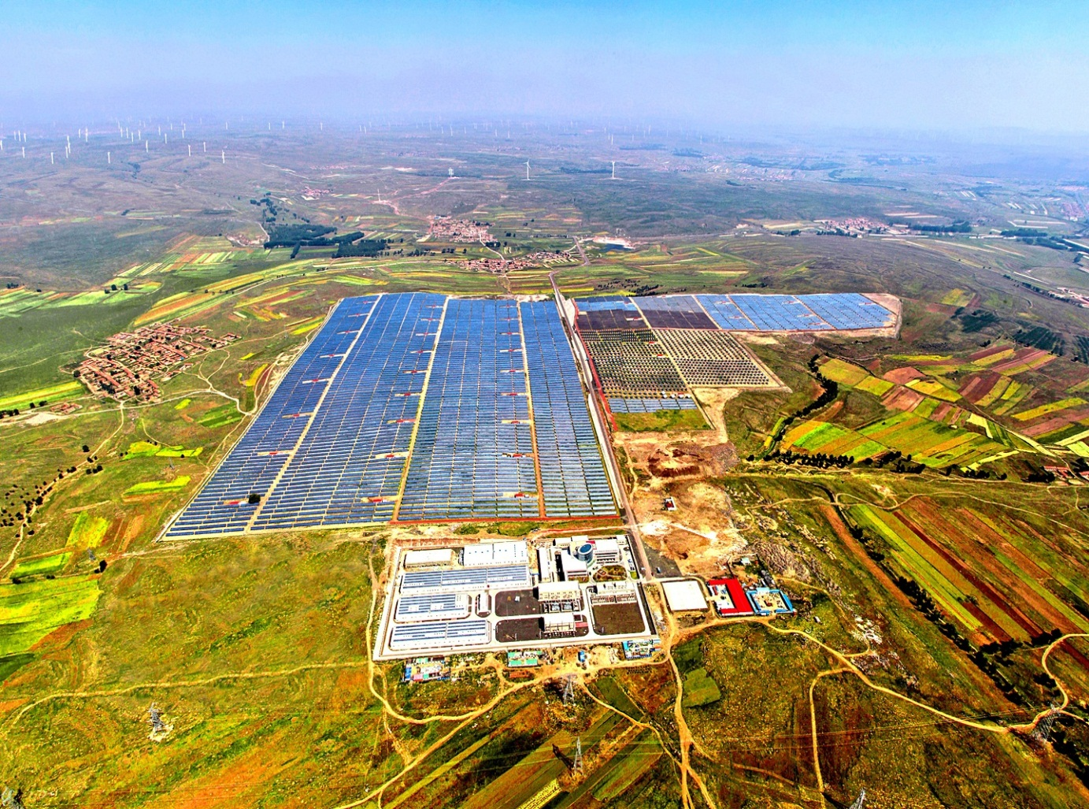
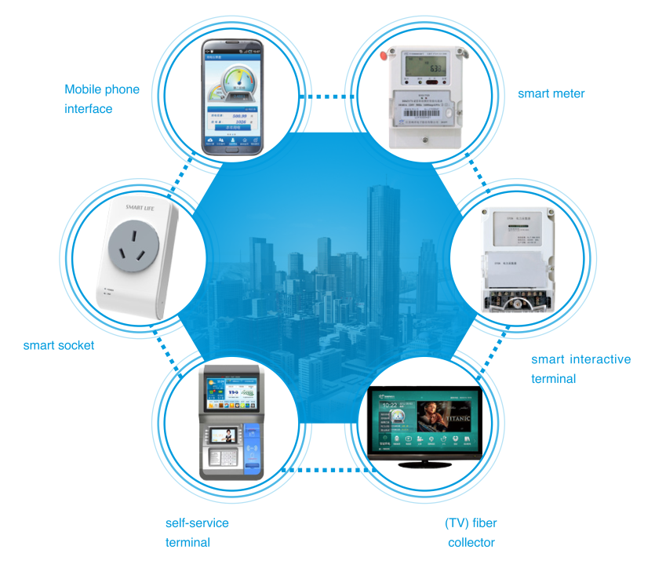
466.5 MW Wind Power
100 MW PV power
16 MW Energy Storage
Installed
430 Million
Smart Meters
Wind/PV/Storage and Transmission Demonstration Project
Smart Community/Building/Home

Slide 11
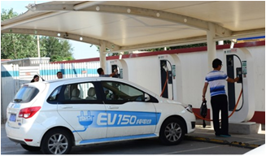
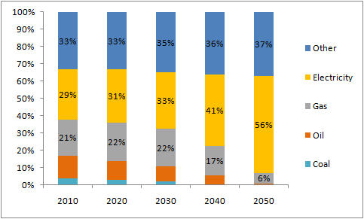
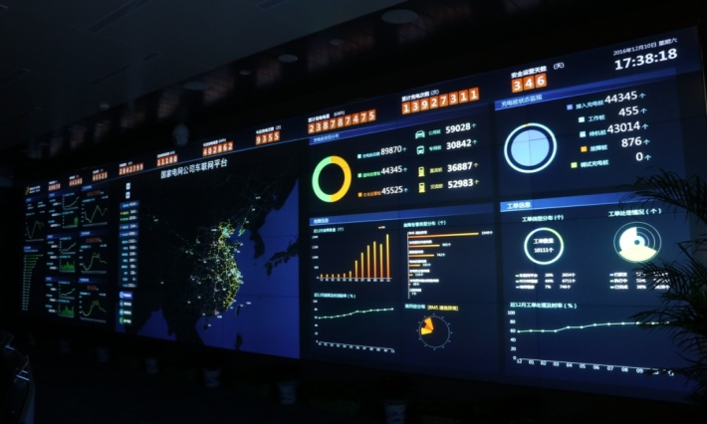
Implementing Electricity Replacement
Largest Internet of Vehicles
Integrating 165,000 charging poles
Serving over 1 million EVs
Proportion of Electricity in the Final Energy Consumption Around the World
Monitoring Center for Internet of Vehicles
Notes:
2016年以来，累计实施替代项目4万余个，替代电量1428亿千瓦时，超过北京市全年用电量。建成世界上最大的高速公路快充网络，建设充电站2000余座、充电桩4.4万个，覆盖16个省、121个城市。建成了全球最大的智慧车联网平台，累计接入充电桩15.1万个，服务100万辆电动汽车出行。

Slide 12
I. State Grid Corporation of China
II. Energy Transition in China
III. Practice of State Grid
IV. Suggestions

Slide 13
1.Facilitate infrastructure connectivity by UHV technology
2.International cooperation under “Belt and Road” Initiative
3. All sectors involvement

Slide 14

Thank You!
Notes:
14

