Slide 1


Transforming the Energy System
A Roadmap to 2050
Francesco La Camera
IRENA Director-General
11th IEA IEF OPEC Symposium on Energy Outlooks • 17 February 2021

Slide 2
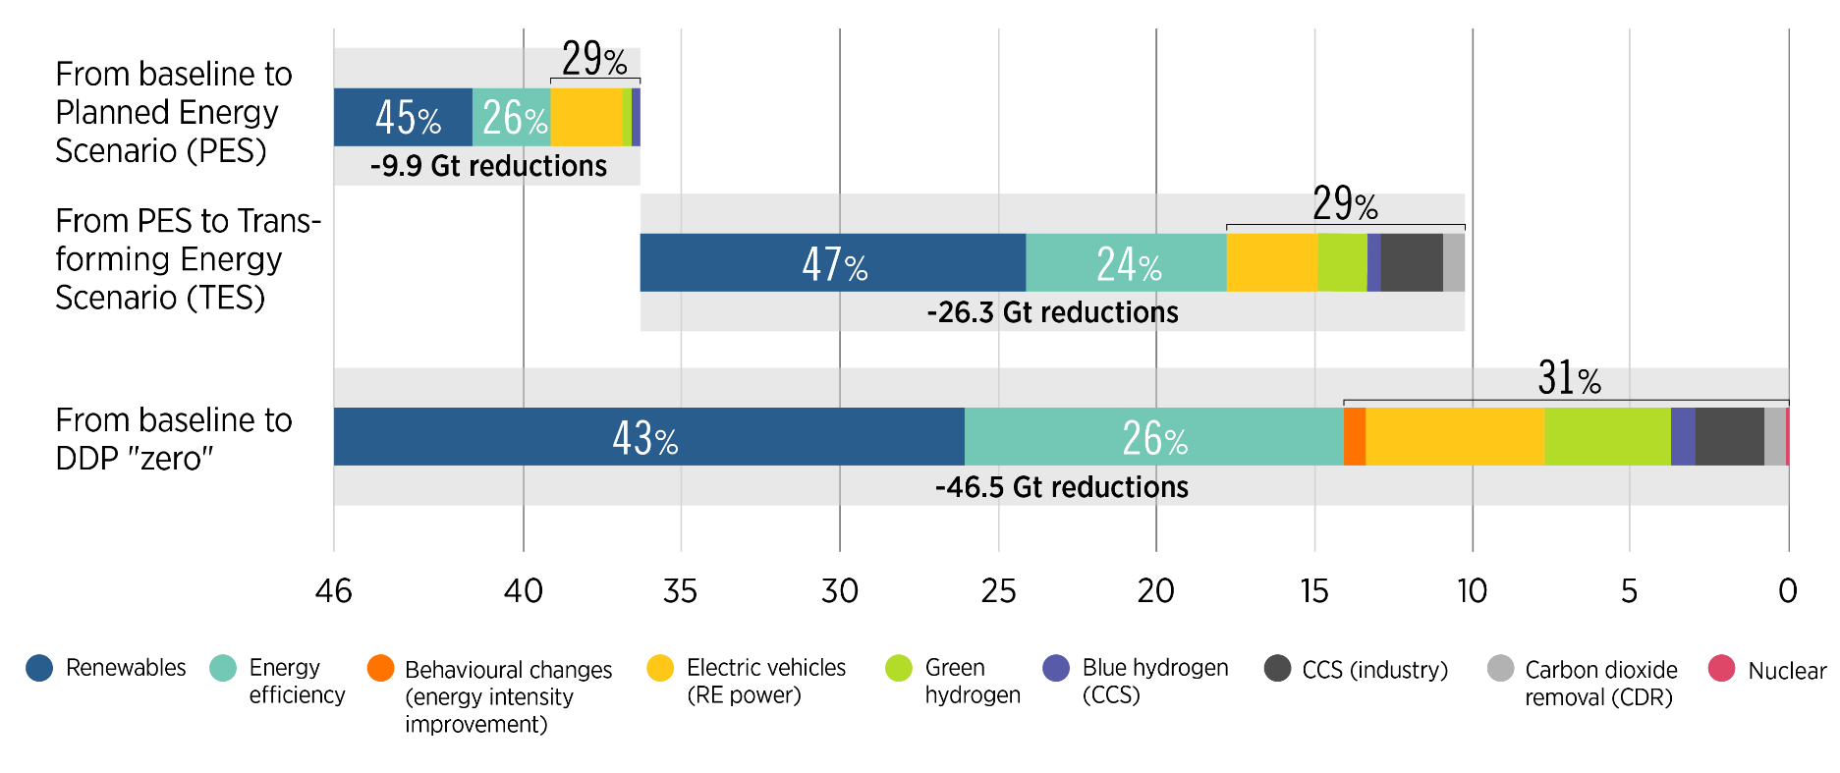
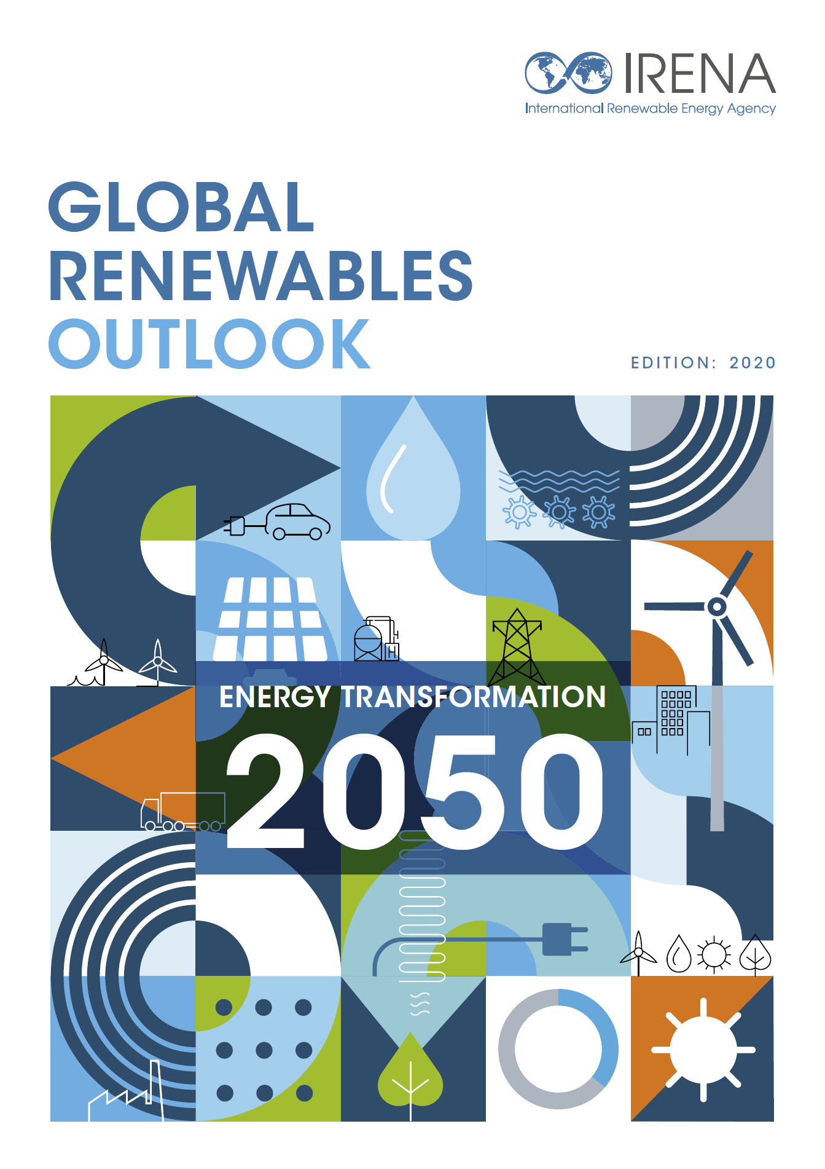
IRENA energy transition pathways provide options to cut energy-related CO₂ emissions to 2050
Energy and industrial process-related CO2 emission reductions (Gt CO₂/y by 2050)
2 degrees
1.5 degrees
H₂
Source: IRENA
Energy efficiency, renewables, end-use electrification, green hydrogen and synthetic fuels will play a crucial role in global decarbonisation.
2

Slide 3
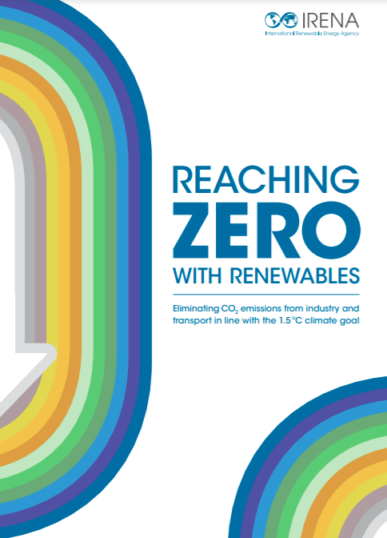
Emission reductions from baseline emissions in 2050 to ZERO
Total emissions
Use of carbon dioxide removal measures
Green hydrogen and synthetic fuels
Reduced demand and improved energy efficiency
Direct use of renewable heat and biomass
46.5 Gt
Direct use of clean, predominantly renewable, electricity
3

Slide 4
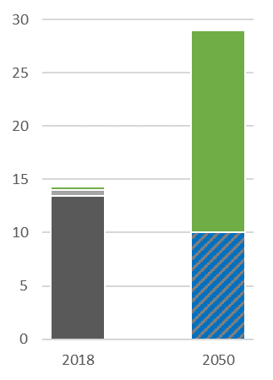
Green Hydrogen as game changer developing green H₂ economies
EJ
In 2050:
Two-thirds of hydrogen produced could come from green hydrogen
Green hydrogen: Electrolysis
with RE power
Today
About 14 EJ hydrogen produced mainly from fossil source - green and blue hydrogen production is negligible (1% green)
Electrolysis
Fossil without CCS
Non-RE sourced
Blue hydrogen: fossil with CCS
Electrolysis with non-RE power
2018
2050 TES

Slide 5
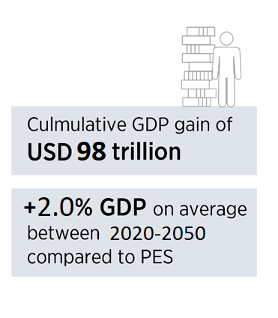
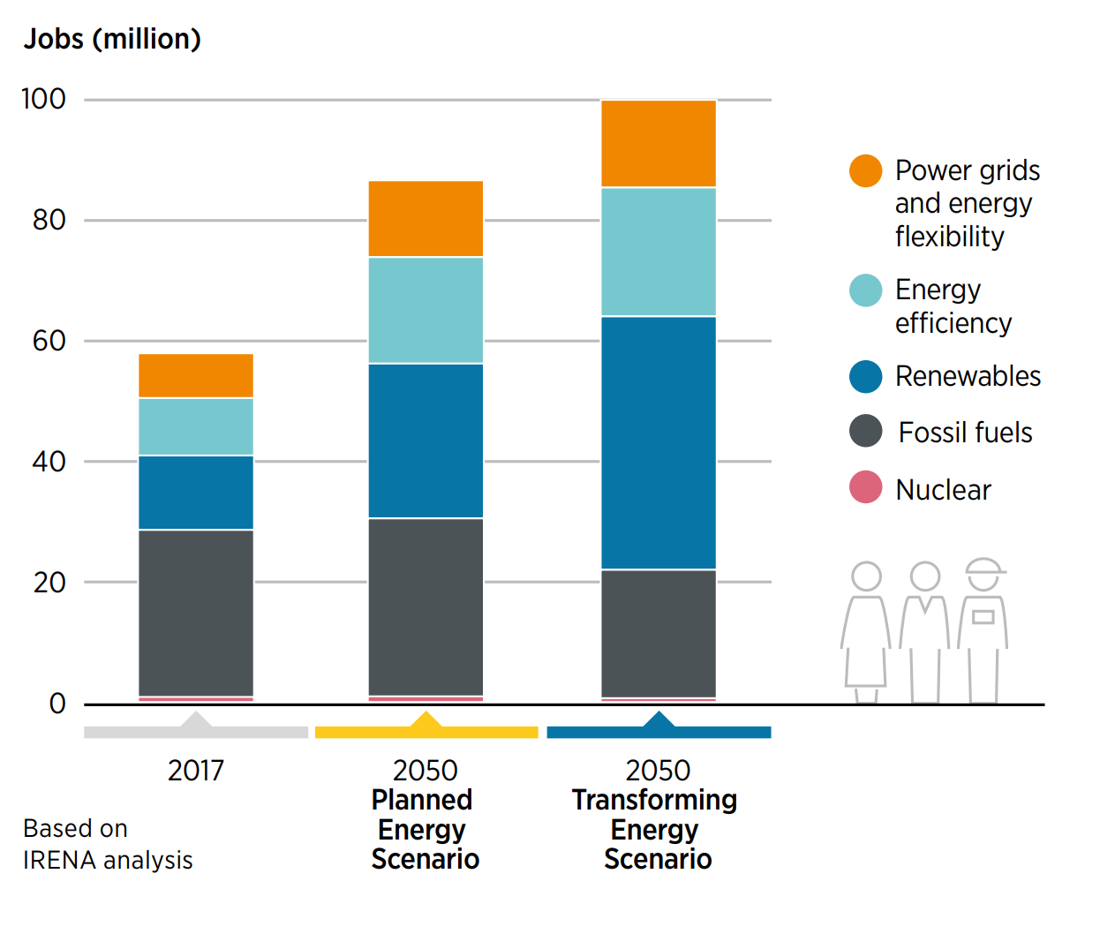


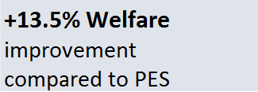
IRENA pathways generate employment, welfare and growth benefits to 2050
+ 13.3
Million jobs
5

Slide 6
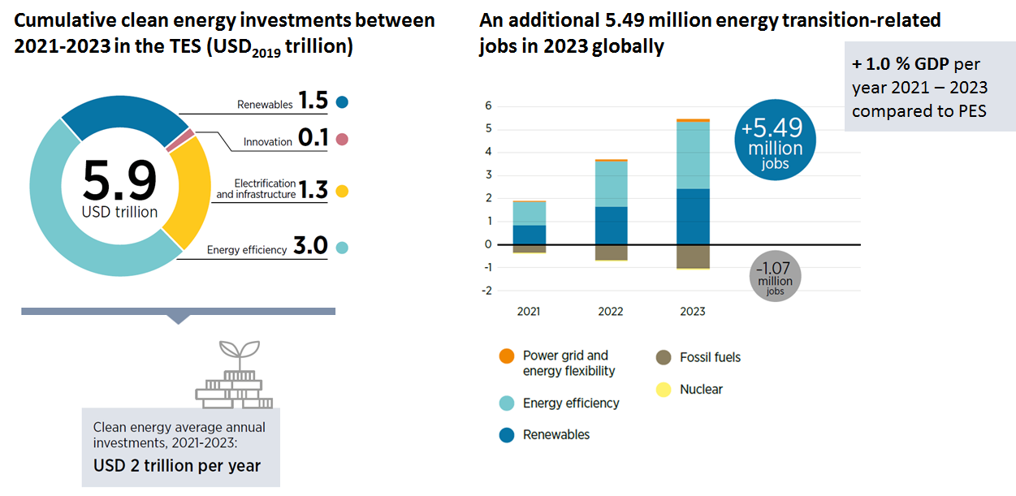


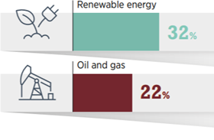
Short-term benefits from investing in the energy transition

Slide 7


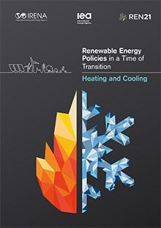
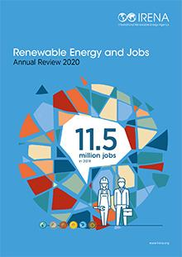
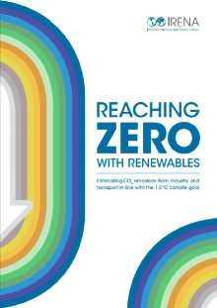

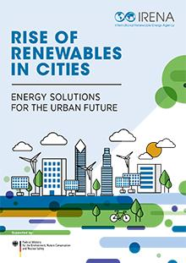
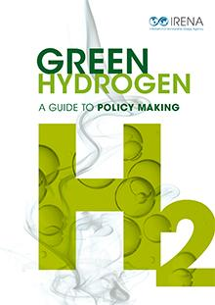
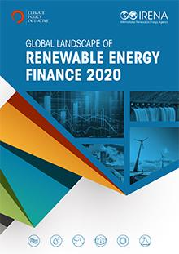
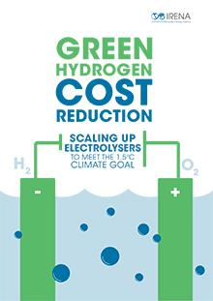
Thank you for your attention!
www.irena.org

