Slide 1










Enabling low-temperature renewable district energy in cities
Brian Vad Mathiesen
bvm@plan.aau.dk / @brianvad
Sustainable Energy Planning Research Group, Aalborg University
Integrating low-temperature renewable energy sources in District Energy Systems
IRENA - The International Renewable Energy Agency
www.heatroadmap.eu / www.4dh.eu / www.sEEnergies.eu / www.reinvestproject.eu
@HeatRoadmapEU / @4DHresearch / @sEEnergiesEU / @REInvestEU

Slide 2
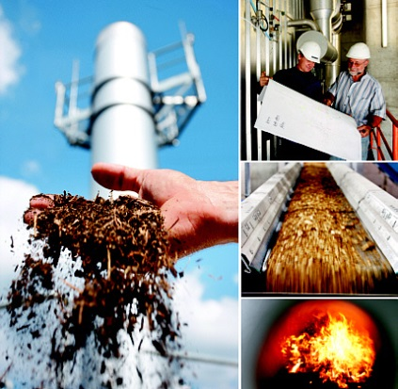

What does the future bring for you?
More or less district heating?
Net zero emission buildings?
Passive houses?
Gas-electricity hybrid heat pumps?
What types of district heating are fit for the future?
Should district heating decrease or increase?
Who should own and profit from heating and district heating system?

Slide 3

New rapport “Integrating low-temperature renewables in district energy systems: Guidelines for policy makers”
Understand the challenges
  Identify challenges, barriers and general renewable energy context
  Help understand key renewable energy sources and technologies
Guidelines for policy makers
  Strategic plans, stakeholder involvement, understand technical challenges, mapping demands and resources
  Creating an enabling regulatory framework
Illustrated short cases

Slide 4
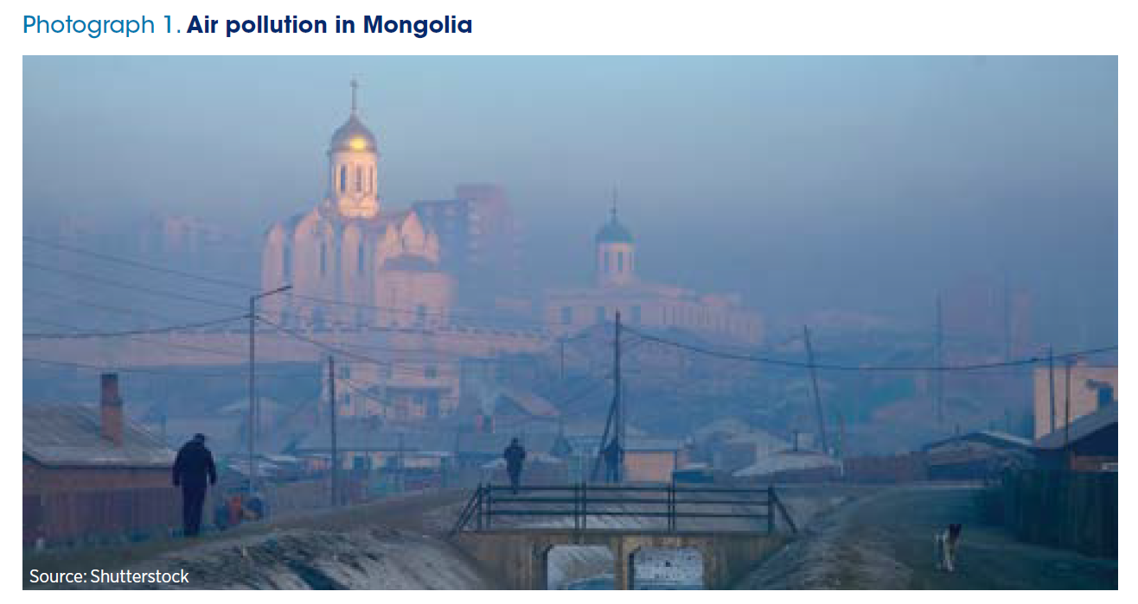

Slide 5

District energy systems using renewable energy sources contribute to the Sustainable Development Goals

Slide 6

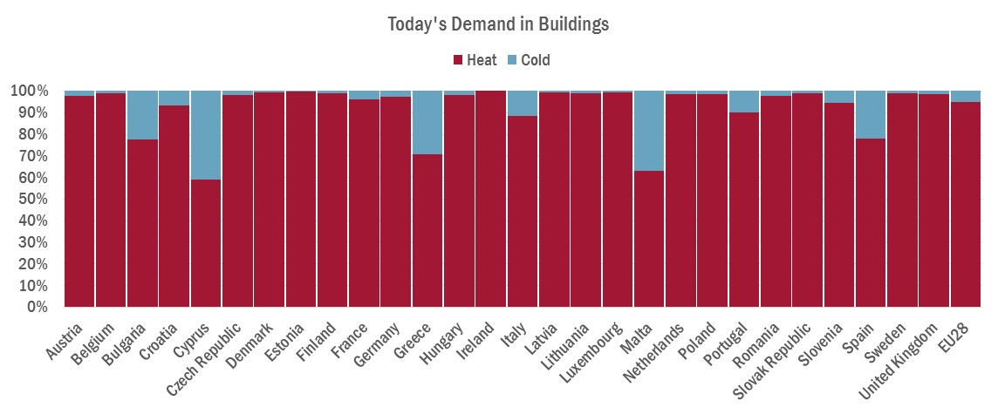
Heating vs. other sectors
Heating and cooling demand in 2015 in the EU28 by end-use compared to total final energy demand
- Large share for All Member States (not just the ‘cold’ North)
- Overall cooling share in general is 10-15%
Heating and cooling demand in 2015 in the EU28 by end-use compared to total final energy demand
Notes:
Major black box is heating.
https://ec.europa.eu/energy/en/topics/imports-and-secure-supplies
The EU imports 54% of all the energy it consumes, at a cost of more than €1 billion per day. Energy also makes up more than 20% of total EU imports. Specifically, the EU imports:
90% of its crude oil
69% of its natural gas
42% of its coal and other solid fuels
40% of its uranium and other nuclear fuels.

Slide 7
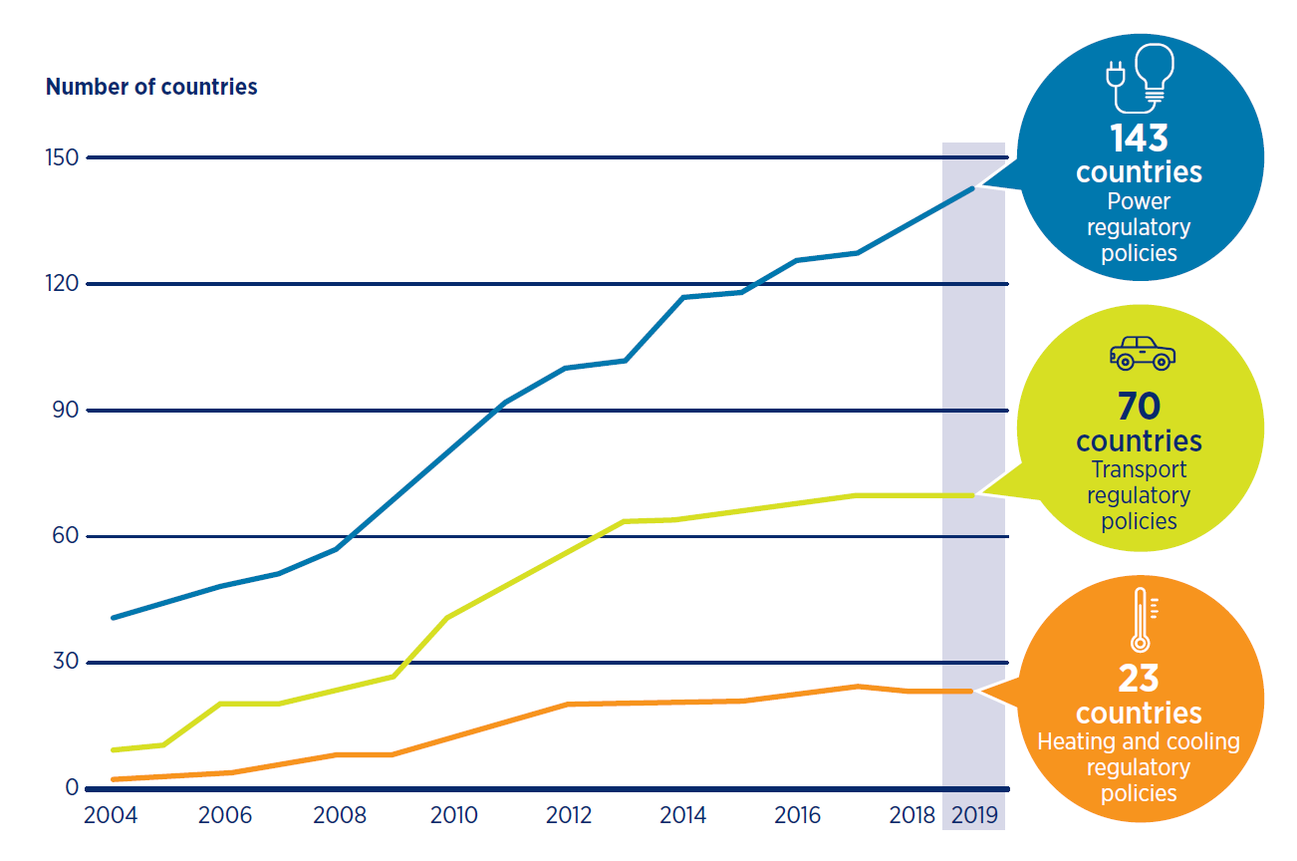
Number of renewable energy regulatory incentives and mandates, by type, 2014-19
The problem for decision makers:
Lack of focus + high complexity

Slide 8
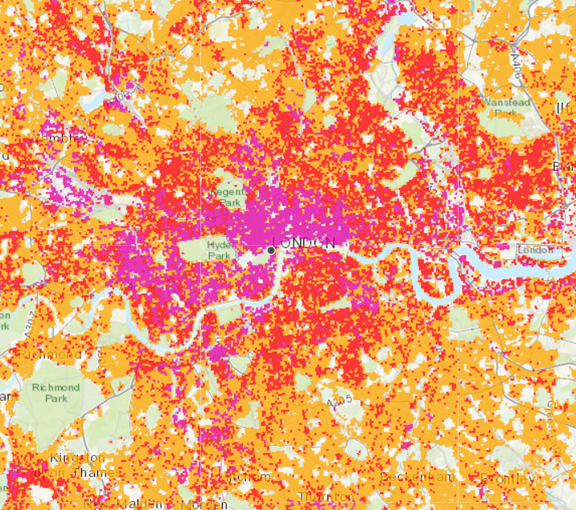
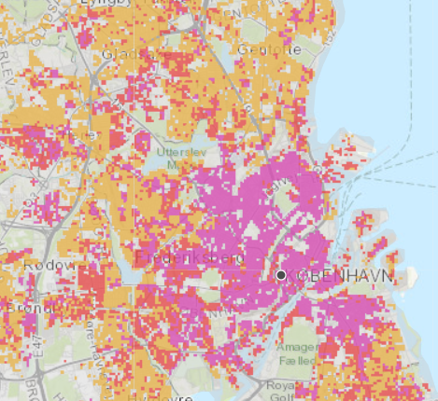
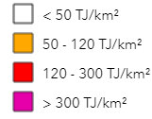
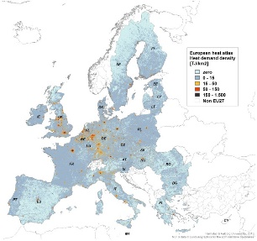
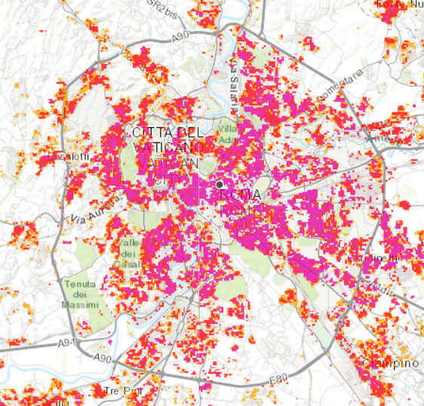
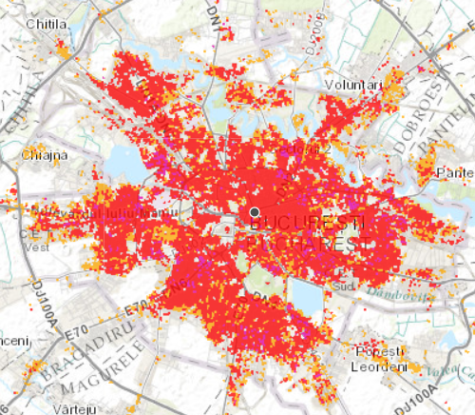
Today’s Heat Demand from Peta 4.2 (www.heatroadmap.eu)
London
←<5% DH
Copenhagen
>90% DH →
Roma
←<5% DH
Bucharest
~75% DH →
Heat Demand
Densities 2015
Notes:
Prague: From Jiri Vecka - Teplarenske sdruzeni CR <vecka@tscr.cz>
Hello David,
I made quick consultation with major DH company in Prague - Prague district heating company.
This company alone covers around 40% of the heat demand. But there are several other smaller DH companies, these companies deliver according to expert estimates around 5% in addition.
So in total around 45% heat demand in Prague is covered by DH.
But we have other cities (like Ostrava city - analysed in STRATEGO project) where the DH share is much higher.
Kind regards
Jiri
ADH CR
Jiří Vecka
Association for District Heating of the Czech Republic
Partyzánská 1/7
170 00 Prague 7
Czech Republic
TEL: +420 266 751 206
GSM: +420 607 825 270
WEB: www.tscr.cz
-----------------------------------------------------------------------------------------------
Zagreb: From Tomislav Novosel <tomislav.novosel@fsb.hr>
From: Tomislav Novosel [mailto:pumpica@gmail.com] On Behalf Of Tomislav Novosel
Sent: 23 February 2016 20:35
To: David Connolly <david@plan.aau.dk>; goran.krajacic@fsb.hr; neven.duic@fsb.hr
Subject: Re: Zagreb DH Share
Hi David,
the director confirmed that the 33% should be correct.
Best regards,
Tomislav
------------
Dear David,
according to the cities SEAP, 33% of the heating energy in the residential sector is being covered by DH. The numbers vary for other sectors with the biggest exceptions being healthcare with almost 50 and culture with almost none, but since the residential sector is the biggest consumer by far I would say that an estimate of 30-40%, depending on the year, is reasonable. This might change a bit if the individual metering scheme proves successful but the data for that won't be available for some time.
I will also contact the DH plant director to confirm these values.
Best regards,
Tomislav
-----------------------------------------------------------------------------------------------
Bucharest: From bogdan.anton@tractebel.engie.com
Hello David,
In Bucharest, according to official data, the supply with heat and hot water by using district heating system, was 76% last year.
My best regards,
Bogdan
Bogdan ANTON
Director - Energy Efficiency
bogdan.anton@tractebel.engie.com
T +40 31 2248 160
F +40 31 2248 201
M +40 745 207 429
tractebel-engie.com

Slide 9
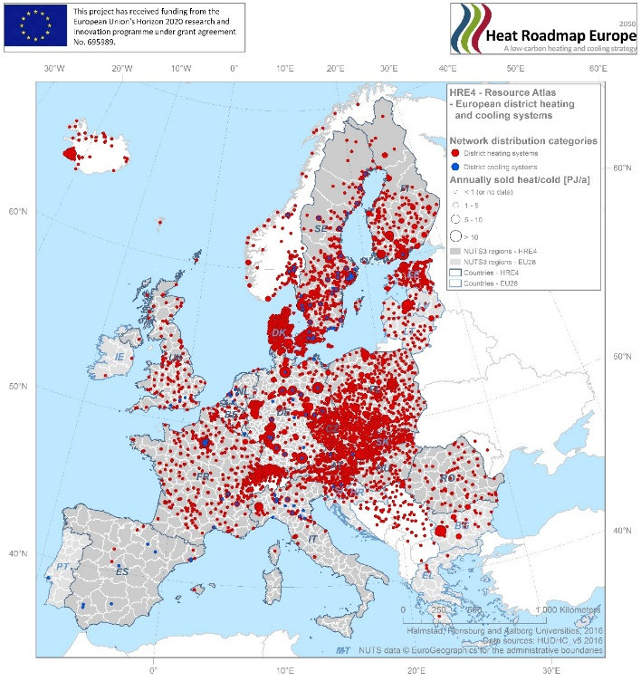
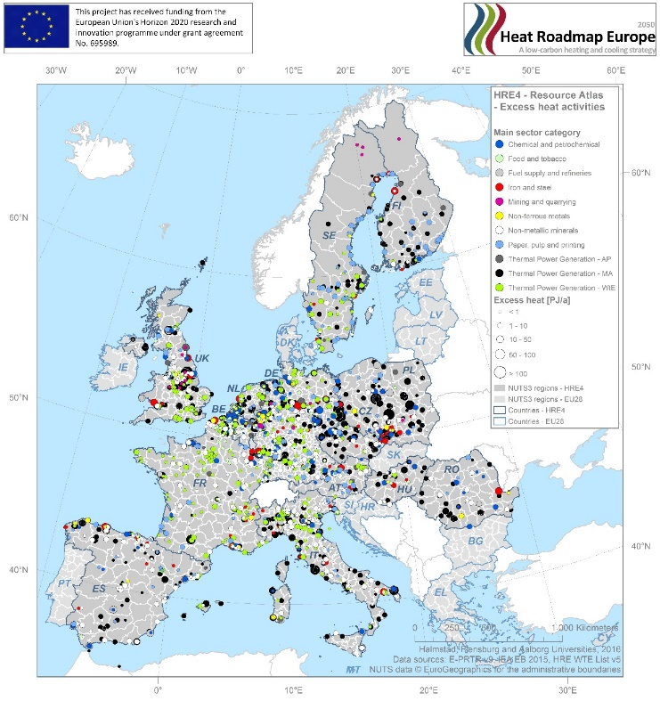
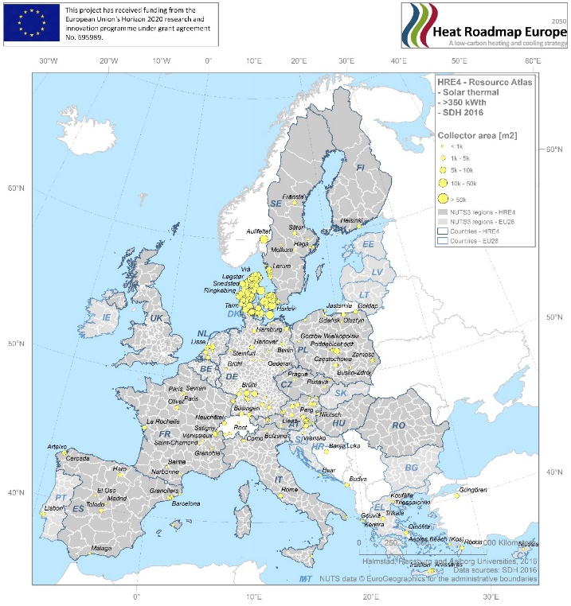
We have 27+10 regulator experiments in Europe to learn from!

Slide 10

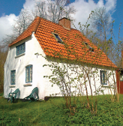
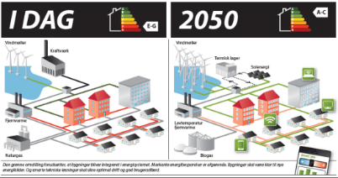

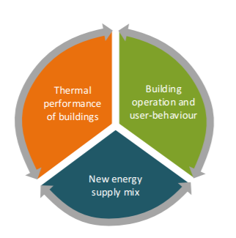

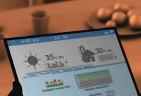

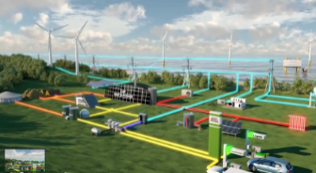
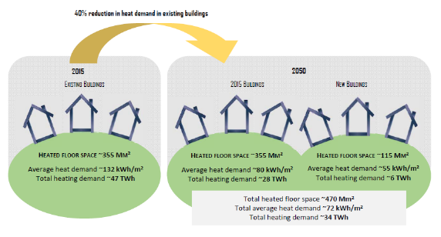

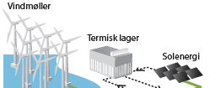
Three focus areas for buildings
Stop before passive house standards

Slide 11
Renewable Energy vs. District Heating

Slide 12
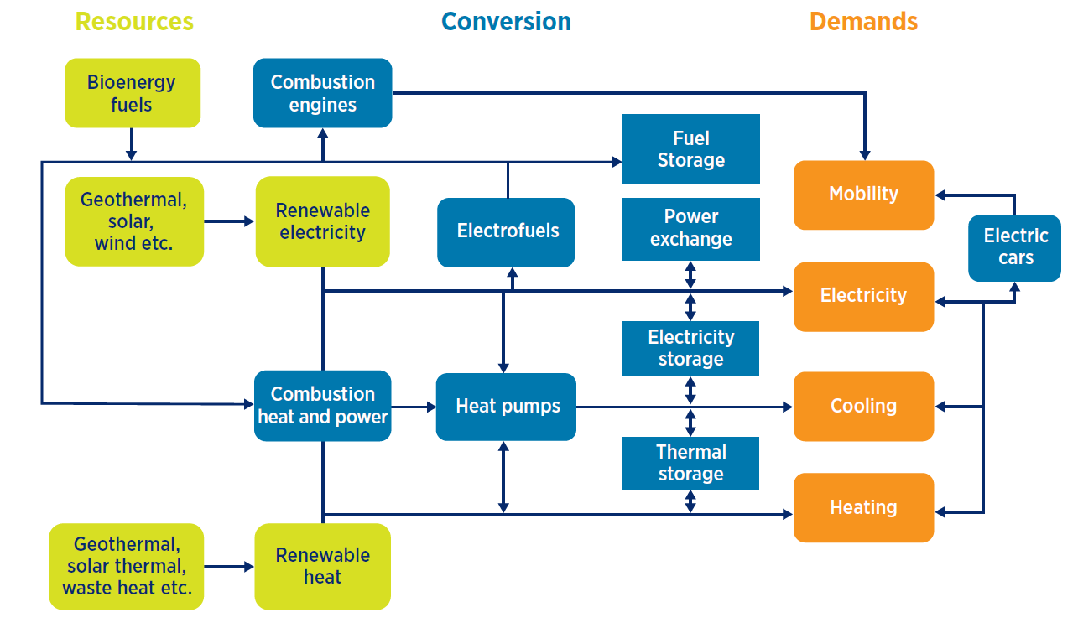
Smart Energy Systems

Slide 13
Strategic heating and cooling plans
Clear political drivers and identify the main stakeholders.
  Lead by local authorities, but it requires key support from national governments to provide ambitious targets and an enabling framework
At the national level governance and regulatory frameworks,
  Set direction for the implementation of the entire energy system and the role of district energy in decarbonisation and sustainable development.
Upgrade the required skills of the workforce, including those involved in individual renewable energy technologies and, in some markets, the modernisation of district energy infrastructure.
Develop local strategic heating and cooling plans and determine which stakeholders will be involved and on what grounds, and how to engage them in the process.
Facilitate the public acceptance of the transition to renewable-based district energy projects.
  Achieved by including citizens, practicing transparency and raising awareness about the merits of district energy systems and renewable technologies.

Slide 14
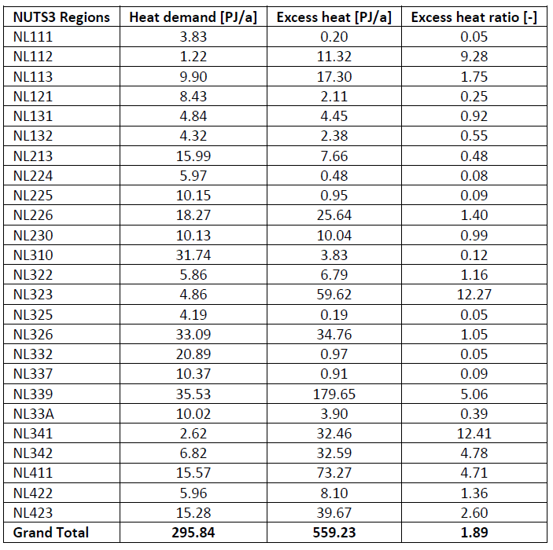
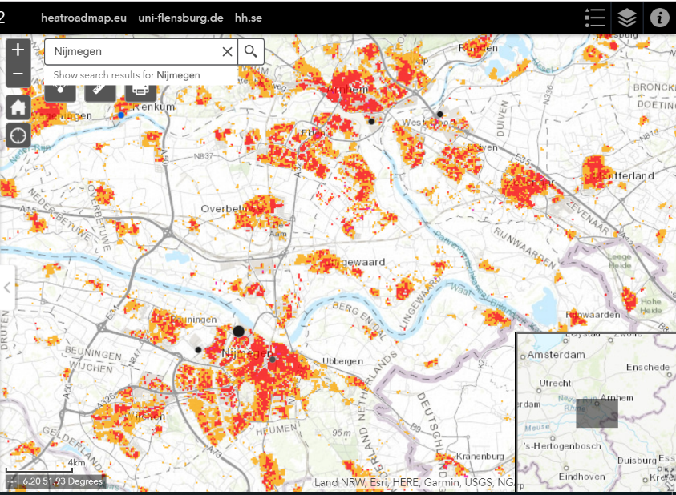
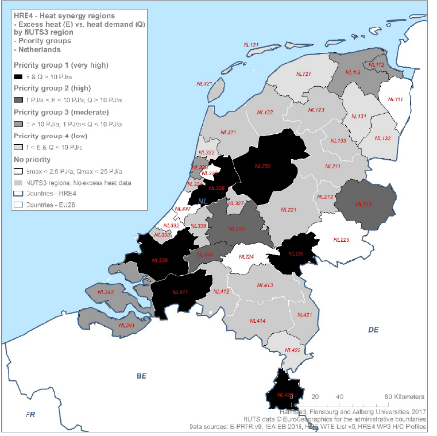
Heat synergies map in PETA4 - Netherlands
Heat demands: 296 PJ/y
Excess heat: 560 PJ/y
District heating share: 6%
Renewable energy in heating: 3%
Not a Technical barrier to improve energy efficiency?

Slide 15
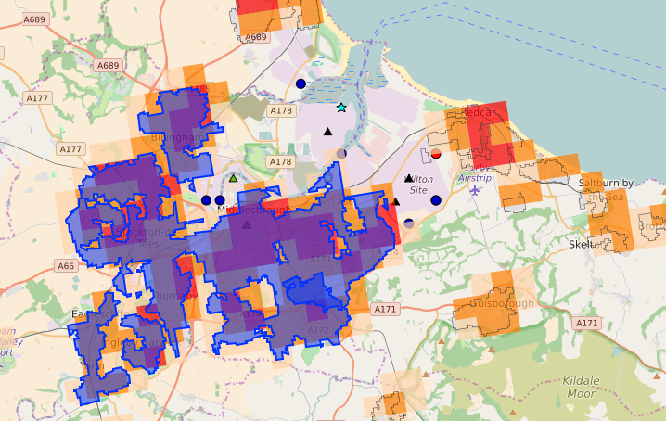


Case Study: Middlesbrough, UK (350,000 People)
WP2: Pan-European Thermal Atlas: www.heatroadmap.eu
Excess Heat
35 PJ/Year
Heat Demand Suitable for DH
10 PJ/Year
10 km
Notes:
Going to a more local scale – Peta can be used.
Areas for district heating based on heat density.

Slide 16
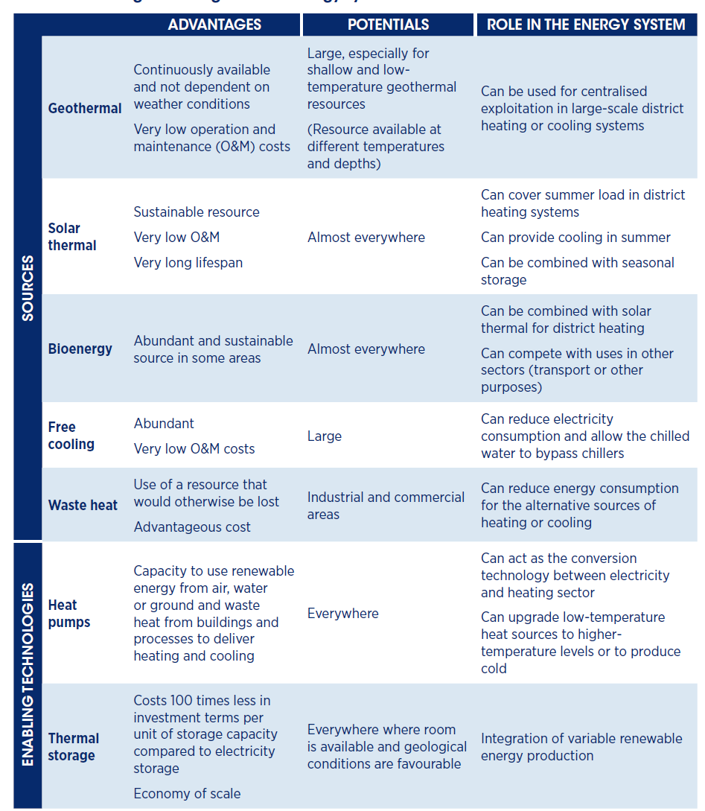
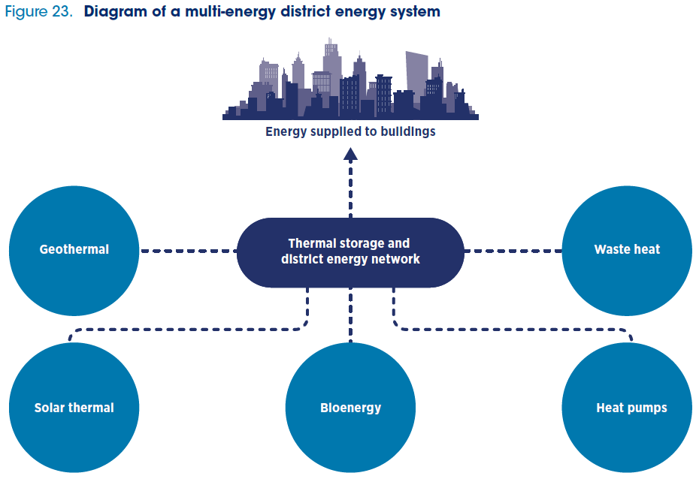
District heating sources and technologies

Slide 17
Elaborate technical scenarios based on the demand for heating and cooling and mapping of resources
Improve the collection of data on heating and cooling demand by making actual measurements at the building level or using existing tools to make demand estimates through top-down or bottom-up modelling.
Assess the available heat resources for utilization in the heating and cooling of buildings by using existing tools such as geographical information systems or by developing heat atlases. The information generated by the use of these tools could be used to support planning and investment in district energy systems.
Ensure that the scenarios advanced for heating and cooling development are in line with long-term targets.

Slide 18
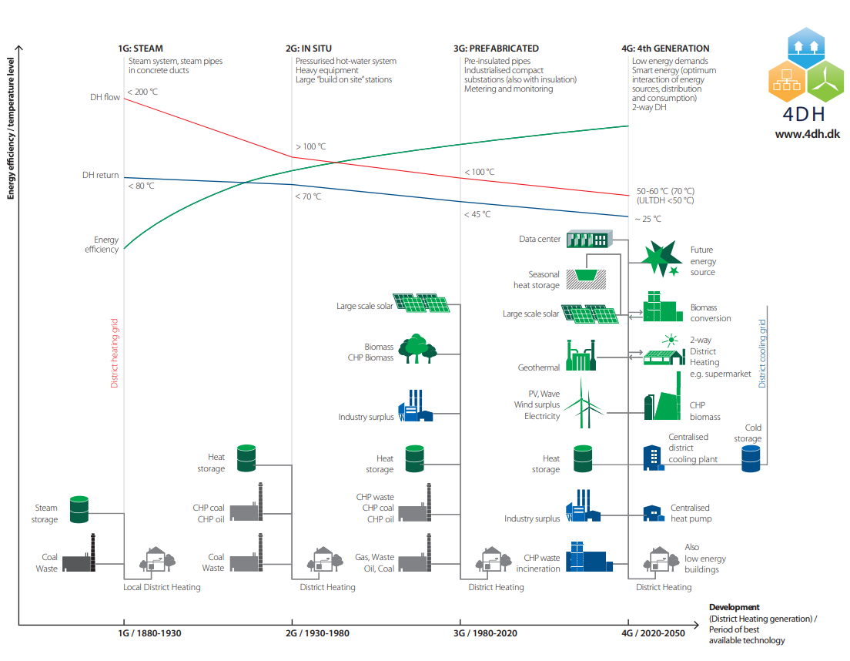
The developments of District Heating

Slide 19
Energy efficiency is required on both the demand and supply side of the heat sector

Slide 20
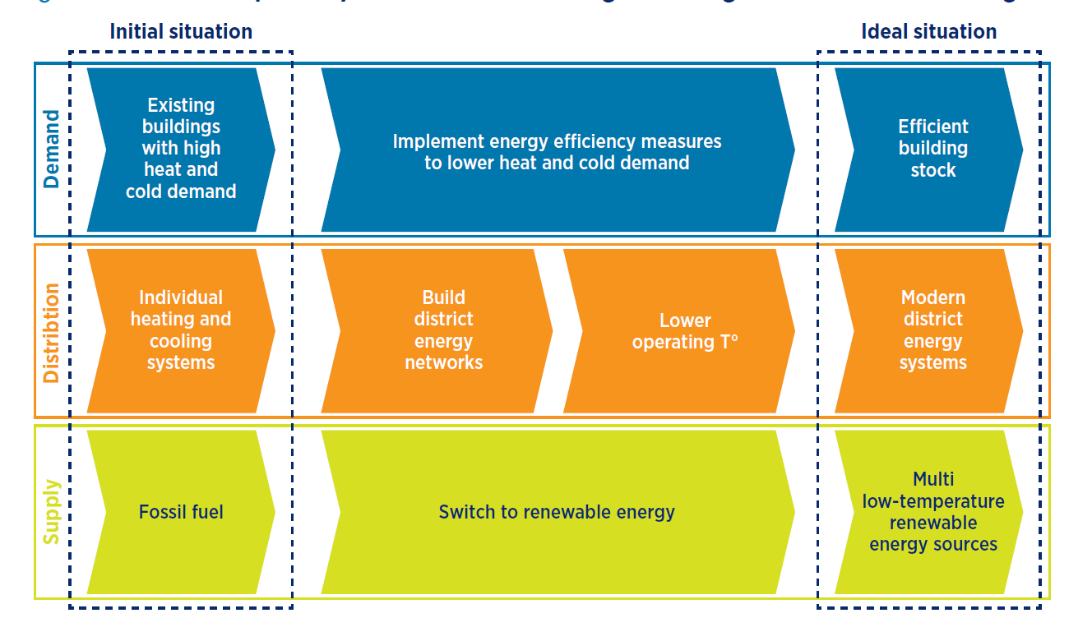

Slide 21
Integrated district heating strategies and plans.
Integrate changes of supply, modernisation of the network and building renovation plans to achieve an optimum performance level (both technical and socio economic) and avoid lock-in effects and disconnections
Align the development of district energy and energy efficiency in buildings and create synergies between them. For example, design neighbourhood schemes in which energy efficiency measures are implemented at the demand and supply sides simultaneously. Encourage more energy-efficient practices by moving to consumption-based billing for all consumers.
Implement measures to decrease the operating temperatures both for systems already in operation and new district heating networks in existing neighbourhoods. This can be done
  at the building level by introducing control systems, redesigning heating equipment, retrofitting with energy efficient building envelopes, redesigning domestic hot water preparation systems and substations, etc.; and
  at the network level by insulating pipes, incorporating temperatureboosting technologies, instituting measures to lower return temperatures, and avoiding higher flow rates that could damage the network, etc.

Slide 22
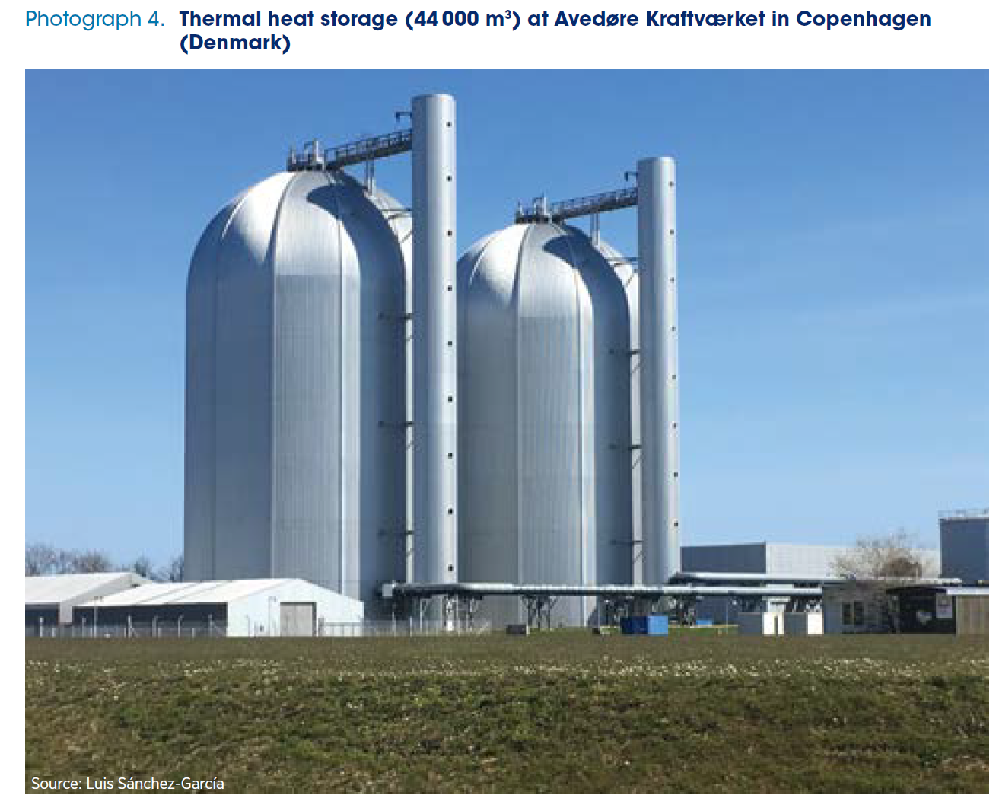
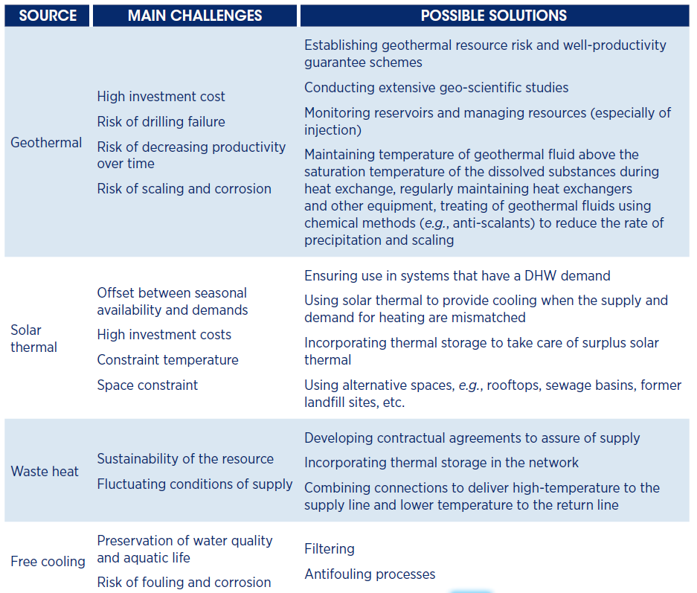

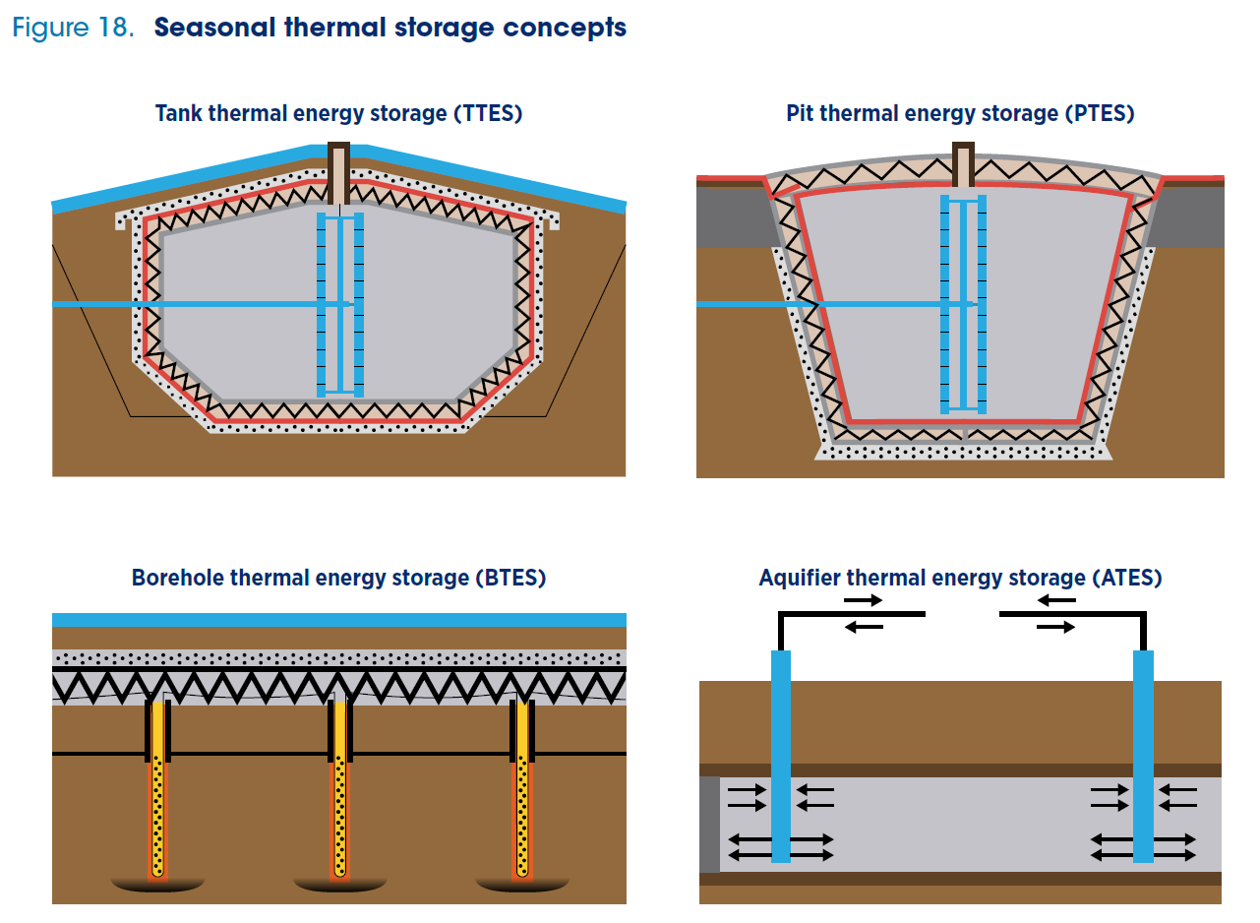

Slide 23
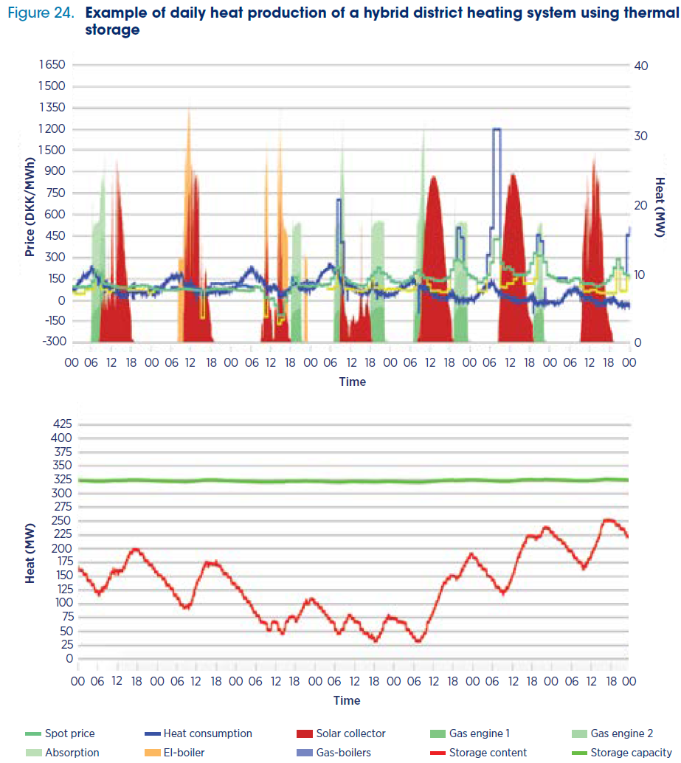
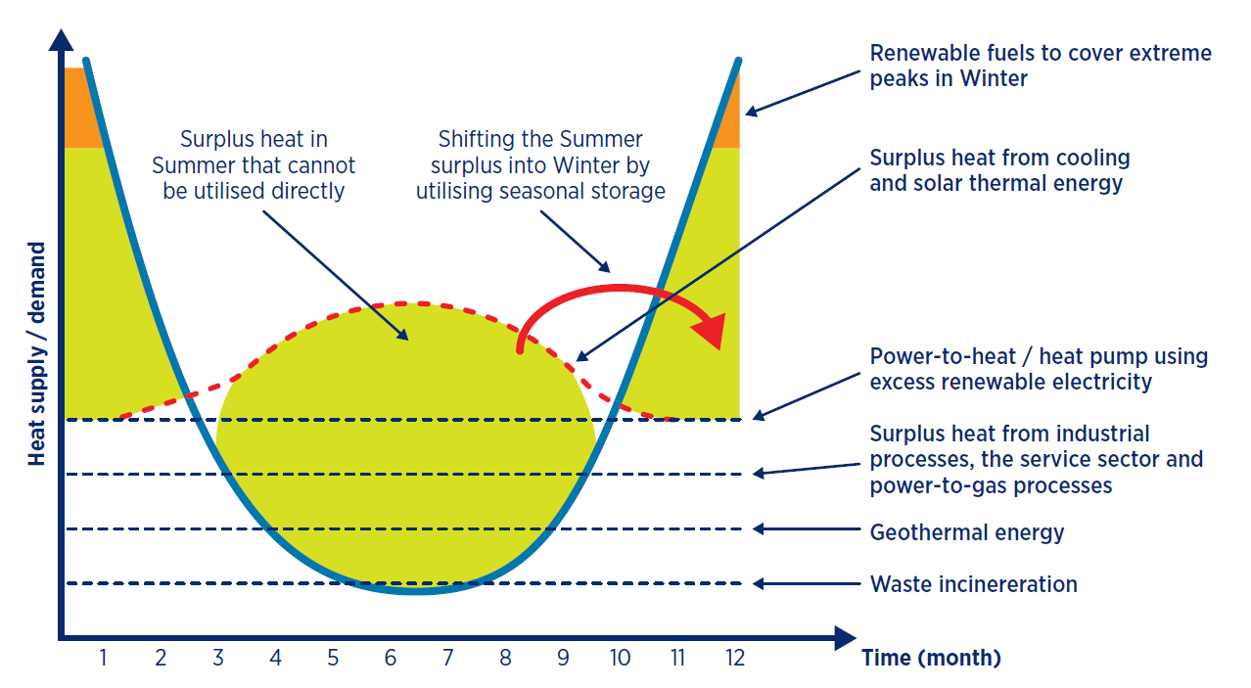
Complex supply – cheaper heat
Principle production structure
Concrete case

Slide 24
Promote the utilisation of locally available renewable energy sources for heating and cooling by addressing intrinsic challenges.
Build capacity to develop sound renewable energy projects and address technical challenges for integrating and operating low-temperature sources in new or existing district energy systems.
Ensure adherence to best practices for the operation of local renewable energy sources. These best practices result in the most cost-efficient and sustainable utilisation of resources, e.g., reinjection for geothermal energy or seasonal thermal storage for solar thermal.

Slide 25

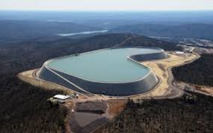
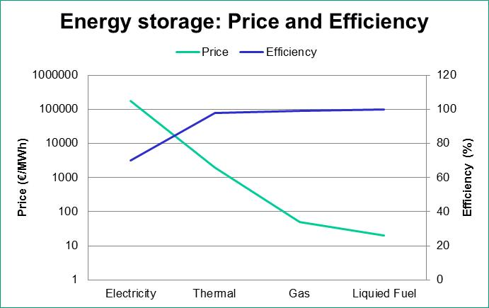
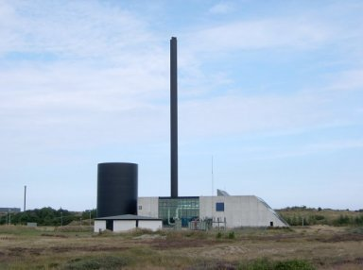
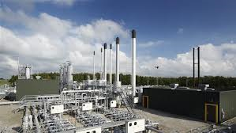
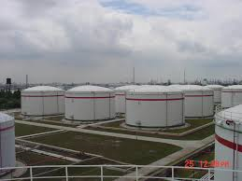

Energy Storage
Pump Hydro Storage
175 €/kWh
(Source: Electricity Energy Storage Technology Options: A White Paper Primer on Applications, Costs, and Benefits. Electric Power Research Institute, 2010)
Thermal Storage
1-4 €/kWh
(Source: Danish Technology Catalogue, 2012)
Oil Tank
0.02 €/kWh
(Source: Dahl KH, Oil tanking Copenhagen A/S, 2013: Oil Storage Tank. 2013)
Natural Gas Underground Storage
0.05 €/kWh
(Source: Current State Of and Issues Concerning Underground Natural Gas Storage. Federal Energy Regulatory Commission, 2004)

Slide 26
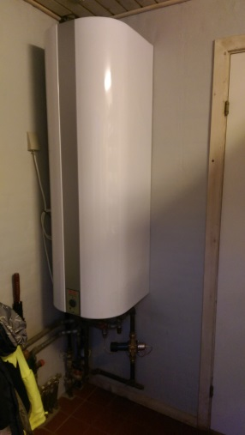
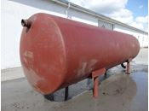
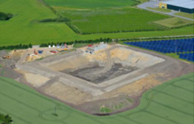
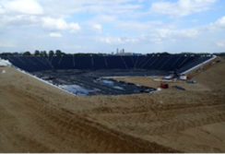
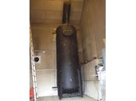
Thermal Storage
0.16 m3 Thermal Storage
300.000 €/MWh
(Private house: 160 liter
for 15000 DKK)
6200 m3 Thermal Storage
2500 €/MWh
(Skagen: 6200 m3
for 5.4 mio. DKK)
4 m3 Thermal Storage
40,000 €/MWh
(Private outdoor: 4000 m3
for 50,000 DKK)
200,000 m3 Thermal Storage
500 €/MWh
(Vojens: 200,000 m3
for 30 mio. DKK)

Slide 27
Recommended development of thermal demands
Current policy: 25% reduction in space heating
HRE: 30% reduction in space heating
Current policy: annual refurbishment rate between 0,7% and 1,0%
HRE: annual refurbishment rate at 1,5% to 2%, AND deeper renovations when they occur

Slide 28
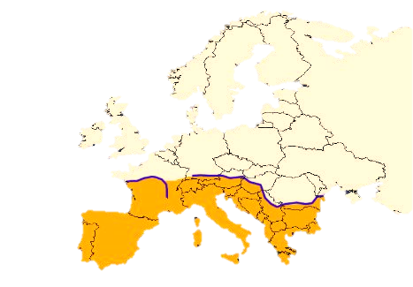

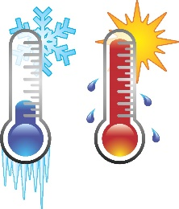
50% of the heat demand in Europe can be supplied with district heating

Slide 29


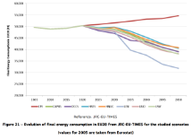


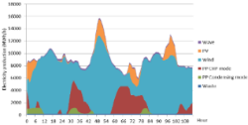

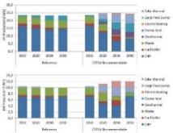
Heat Roadmap Europe Methodology
Data profiling and mapping
Energy System analyses
BAU (References)
Heat Roadmap Europe Alternatives
Results (PES, CO2, Costs)
Building Demand Savings Potential
Costs of Making Savings
District Heating Potential
District Heating Resources
Energy System Potential
Energy System Resources
Notes:
So, how do we do this?
Using the data on the demands in the built environment and industry, we develop an understanding of what the heat and cold demands are to understand to what extent, and at what cost, it is possible to reduce these in the future. For this we mainly use the outputs developed in the FORECAST model.
Using the geographical mapping of the demands and resources available to us, we can investigate the potentials of heating and cooling infrastructures; particularly district heating. This comes from Peta, which Bernd will discuss today. Based on this, we can consider the impact of the urban and rural fabrics, and the cost of collective technologies for heating and cooling.
These are related in an overall perspective of what the energy system, including industry, power, and transport need, and what overall resources are available for this.
By combining all these, we can make an overall assessment of what the best mix is between saving energy, and supplying it sustainably, and individual supply technologies like heat pumps and biomass boilers vis a vis district heating.
The scenarios that we develop through this, we can compare with baseline evolutions. We can look at the hourly operation of these Heat Roadmap scenarios, and compare their primary energy supply, cost, decarbonisation, and the level at which they allow for the use of renewables. By developing these scenarios, we can start to look at the barriers that exist today, have market dialogues, and start developing business models to implement them.
By combining all these elements, we aim to create the integrated strategies that are necessary to empower the transition to decarbonised heating and cooling systems – and, in extension, low-carbon and renewable energy systems in Europe in the future.

Slide 30
There is more excess heat in Europe than all of the heat demand in buildings

Slide 31
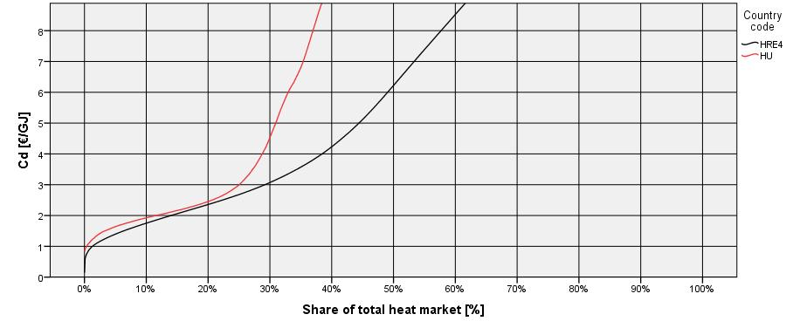

Minimum Recommended DH levels of the total heat market pr. country

Slide 32
Why isn’t it happening?
Heating is complex
Heating and cooling is local
Heating is long term
Heat savings and district heating have large investment costs
Heating and cooling is cultural, has ownership challenges and profit margins

Slide 33


Slide 34

Strategic heating and cooling plans

Slide 35

Ensure enabling regulatory conditions, supportive financing options and business models are put in place.
Consider district energy grids as public infrastructure and ensure a level playing field through fiscal levers, legislation and price regulation, but also consider externalities such as greenhouse gas emissions or air pollutants
Overcome uncertainty associated with demand for heating and cooling to attract investment by first connecting high-demand consumers – while making sure the full potential can be exploited.
In addition to public finance, including grants, explore the involvement of the private sector and innovative practices such as partnerships with energy service companies (ESCOs) or crowdfunding.

Slide 36


Ensure enabling regulatory conditions, supportive financing options and business models are put in place.
Develop schemes to de-risk renewable-based applications. For example, promote support schemes for geothermal energy which are tailored to the market maturity and that reduce investors’ risk of drilling unproductive wells and/or declining well productivity.
Set up a comprehensive and transparent governance scheme through ownership, regulation and pricing that promotes district heating and cooling systems. The systems should be based on renewables and waste heat sources and align with societal goals.

Slide 37


Thank you for your attention
www.brianvad.eu
www.energyplan.eu/buildings
www.sEEnergies.eu
www.EnergyPLAN.eu
www.energyplan.eu/smartenergysystems/
www.heatroadmap.eu
www.energyplan.eu/SmartEnergyEurope
www.4DH.eu
www.energyplan.eu/solar
Follow me on twitter and LinkedIN

