Slide 1
Francesco La Camera
Director-General
BEDT22 • March 2022

Slide 2
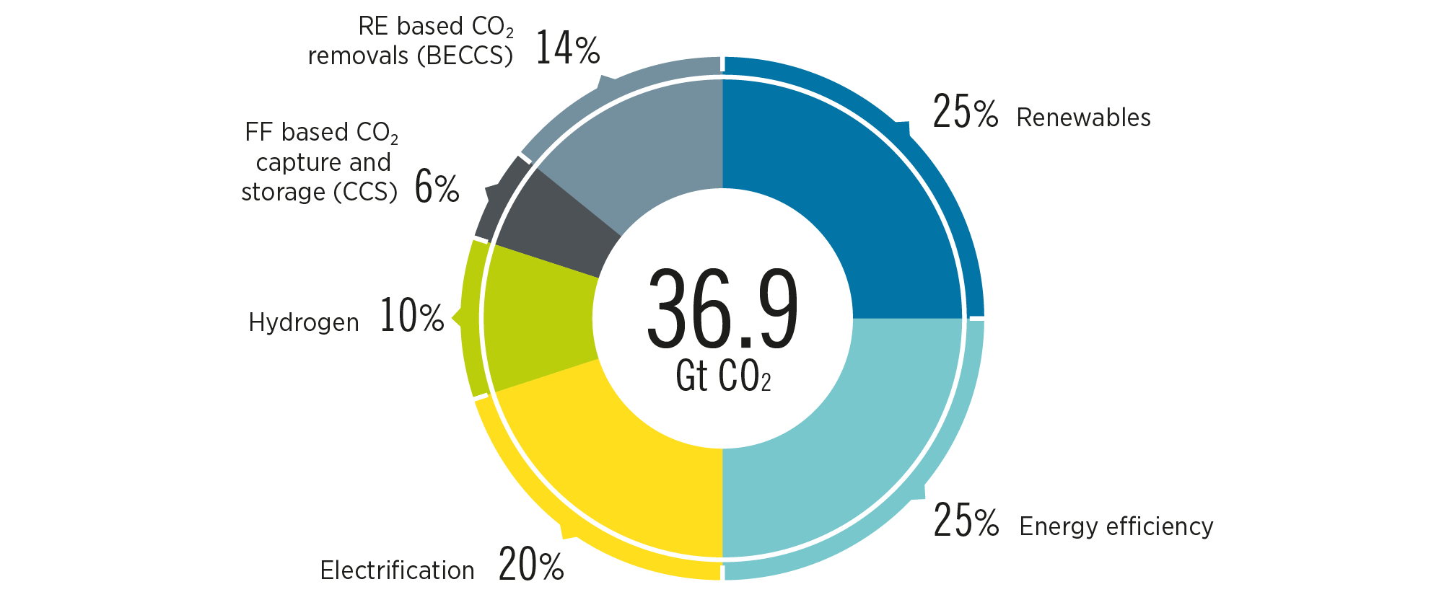
Renewables, efficiency and electrification dominate energy transition
Reducing emissions by 2050 through six technological avenues
90% of all decarbonisation in 2050 will involve renewable energy through direct supply of low-cost power, efficiency, electrification, bioenergy with CCS and green hydrogen.

Slide 3
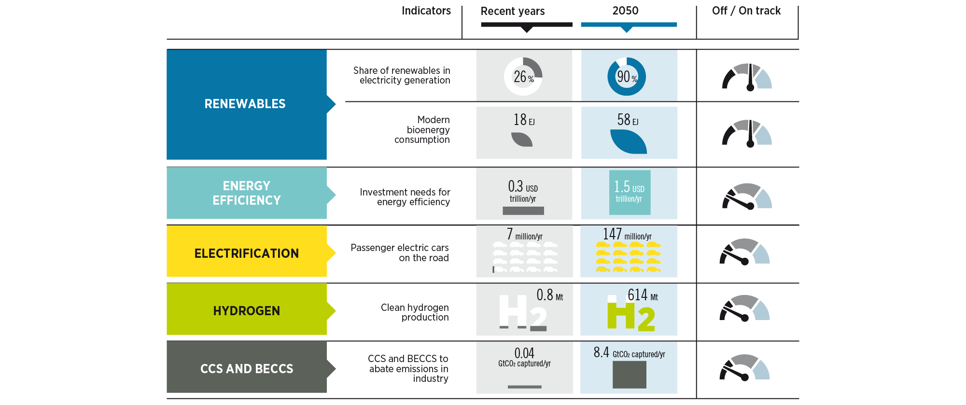
Despite some progress, the energy transition is far from being on track to 1.5°C
Tracking progress of key energy system components
Achieving the 2050 target depends on sufficient action by 2030. Radical action is needed to change the current trajectory. This will require political will and well-targeted policy packages.

Slide 4
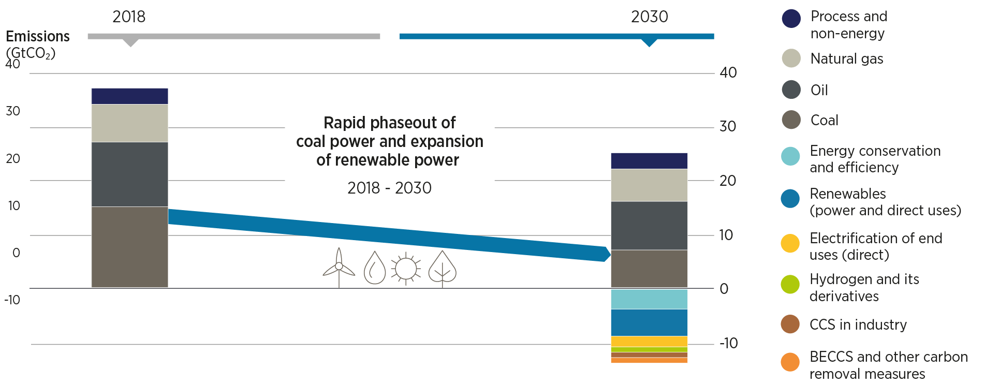
Key milestones and actions for rapid emission reductions
Ramping up renewables, together with an aggressive energy efficiency strategy, is the most realistic path toward halving of emissions by 2030.
The decarbonisation of end-uses needs to make much faster progress, with many solutions provided through electrification, green hydrogen and the direct use of renewables.
A comprehensive set of policies is needed to achieve the necessary levels of deployment by 2030 and maximise benefits.

Slide 5
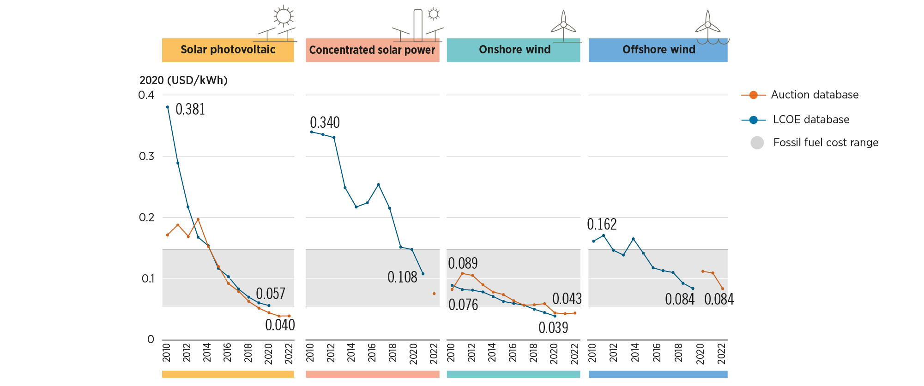
Renewables-based electricity is already the cheapest power option in most regions
The global weighted average levelised cost of electricity from utility-scale solar photovoltaic (PV) projects fell by 85% between 2010 and 2020, concentrating solar power (CSP) by 68%; on-shore wind by 56%, and off-shore wind by 48%.

Slide 6
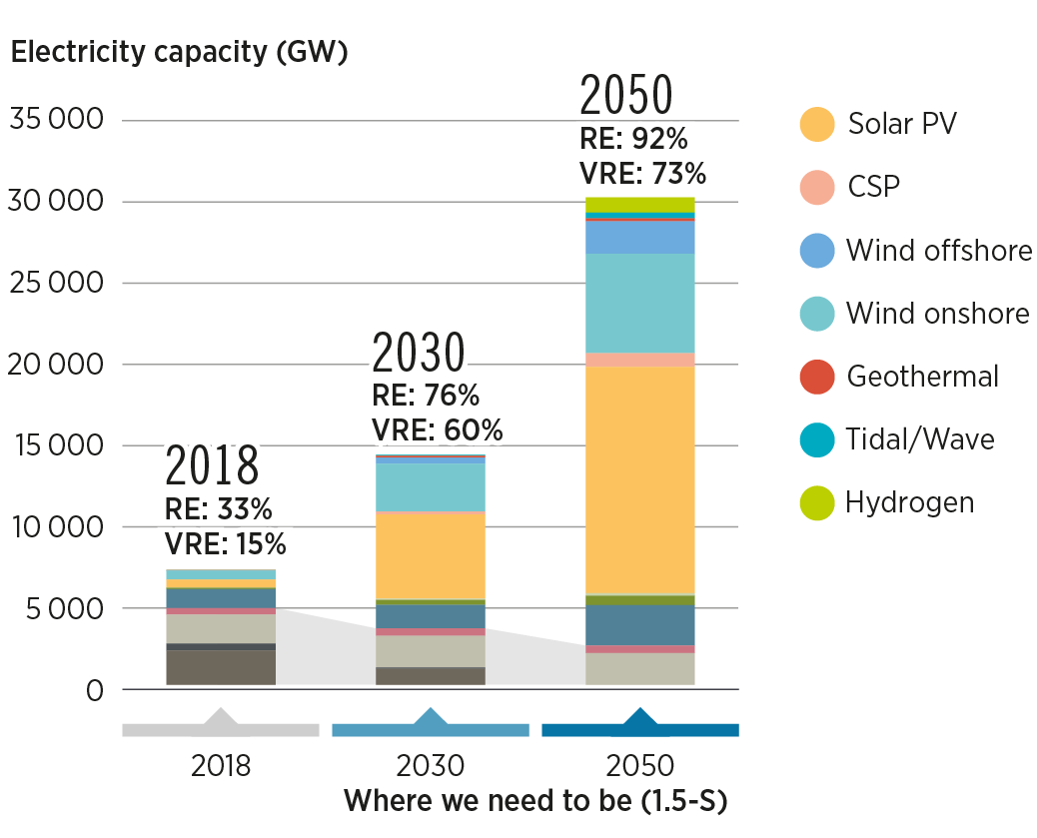
Renewables could decarbonize 90% of the power sector by 2050
Renewables will provide 65% of the total electricity supply by 2030 respectively from over 25% in 2018
Specific policies and measures such as RE targets, tax incentives, pricing mechanisms, among others are needed to increase the deployment of renewables
Renewables will necessitate an annual investment of more than USD 1 trillion till 2030.

Slide 7
Electricity becomes the main energy carrier in future energy systems
Global electricity demand in end-use sectors will rise 1.3 times the 2019 levels to reach Ca.31 000 TWh by 2030.
The share of electrification in end-use sectors like industry, buildings, transport to reach 28%, 56%, and 9% in 2030, respectively.
Policymakers should identify priorities for electrification with a focus on hard-to-abate sectors and devise strategies for its deployment.

Slide 8
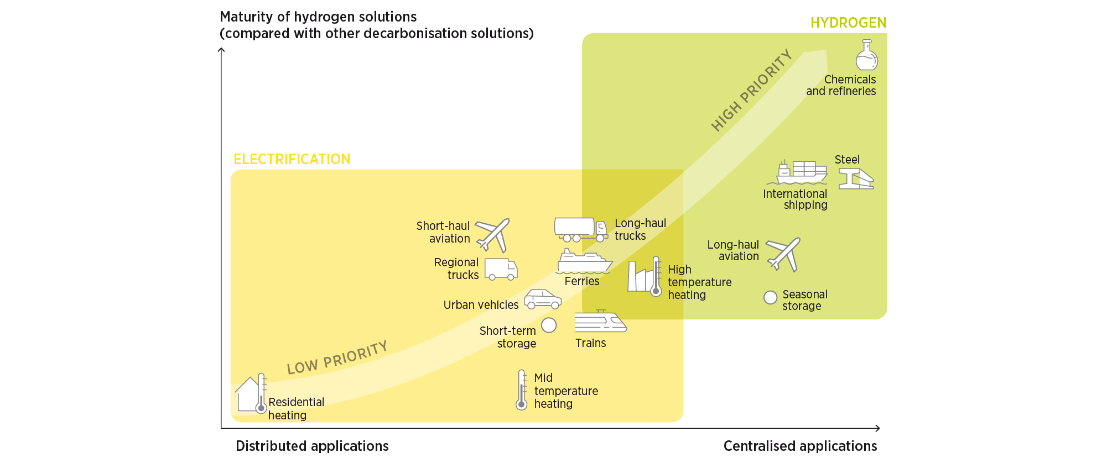
Green hydrogen needs to move from niche to mainstream by 2030
Policymakers should identify priorities for indirect electrification using green hydrogen with a focus on hard-to-abate sectors and devise strategies for its deployment.

Slide 9
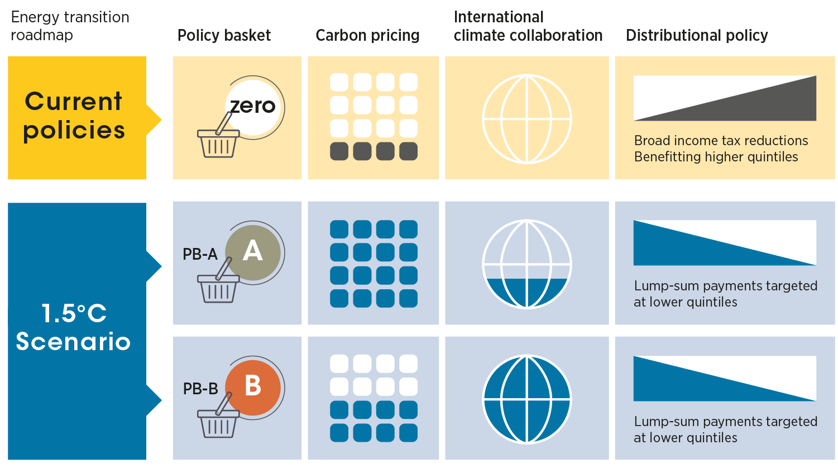
Policy as a cornerstone of a sustainable energy transition
An ambitious, sustainable and resilient energy transition depends on triggering a global collaborative effort and deep social engagement
Policies such as international collaboration, carbon pricing and distributional policies have an important impact on the socio-economic footprint of the energy transition and hence on its social acceptability.
IRENA’s sensitivity analysis shows that progressive policy baskets improve the distribution of transition benefits while maintaining the global positive socio-economic footprint, hence enabling sustainable and resilient transitions.

Slide 10
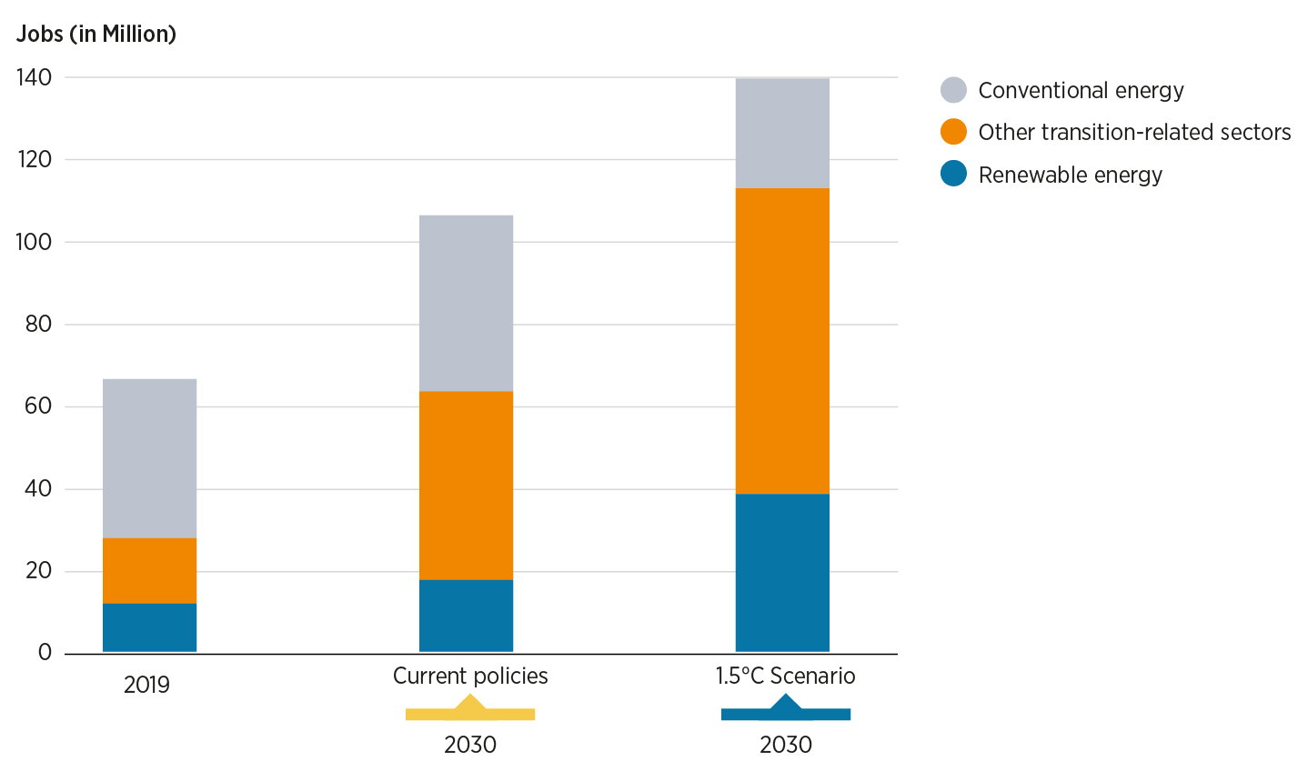
An additional 85 million energy-transition related jobs could be created by 2030
Meeting the human resource capacity necessary to fill these newly created jobs requires a scaling up of education and training programmes as well as measures aimed at building an inclusive and gender-balanced transition workforce.

Slide 11
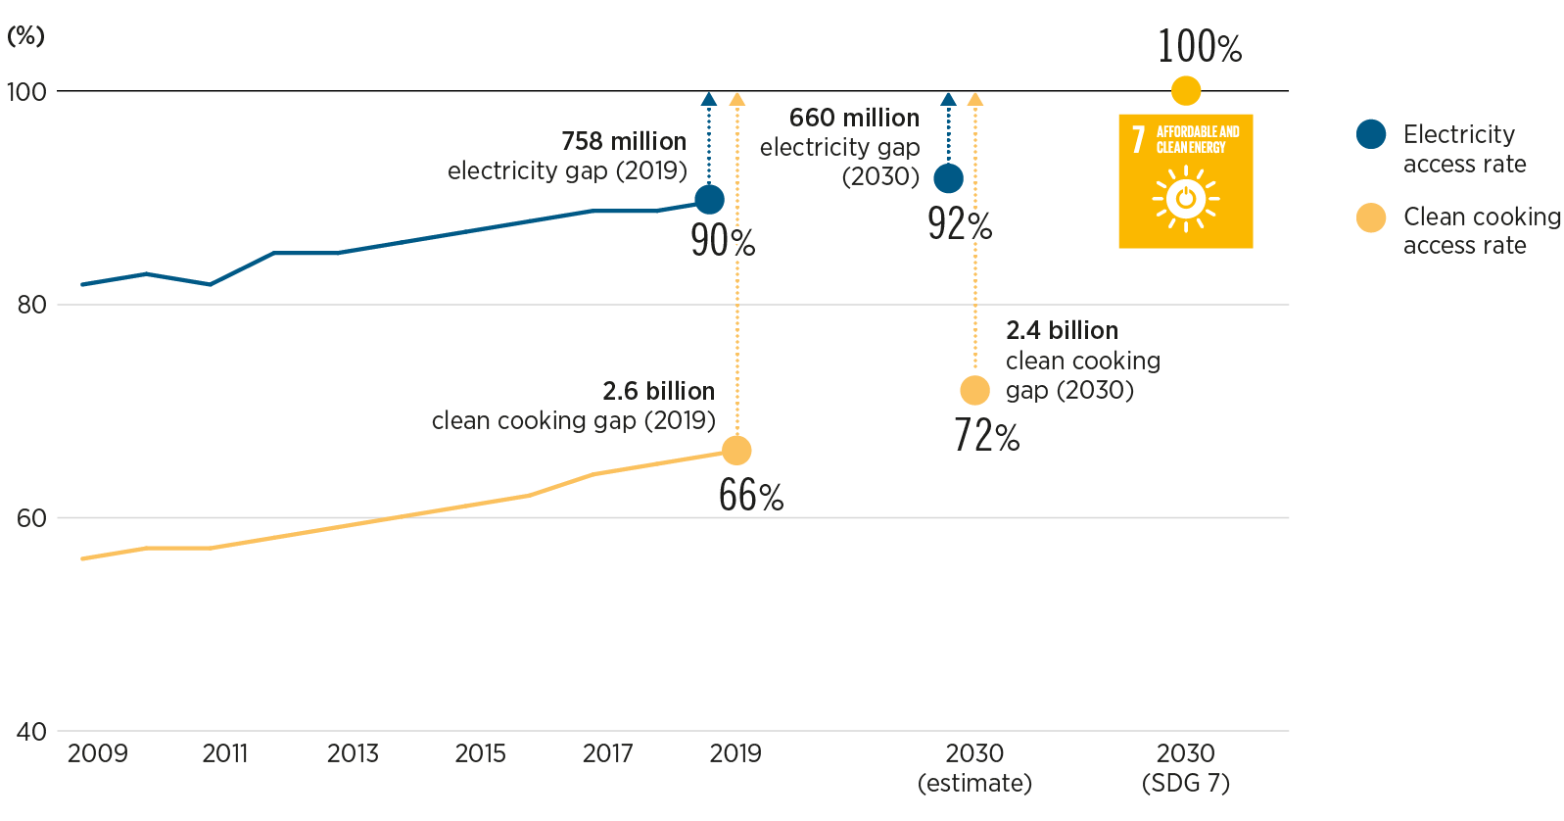
The world is set to miss the target of universal energy access by 2030 by a wide margin
An estimated 758 million people were living without electricity globally in 2019; 2.6 billion had no access to clean cooking fuels and technologies. Achieving universal access is a vital pillar of a just and inclusive energy transition.

Slide 12
Thank you!

