Slide 1
Long-Term Energy Scenarios and Low-Emission Development Strategies: Stocktaking and Alignment
Asami Miketa
Senior Programme Officer, Power Sector Investment and Transition Planning

Slide 2
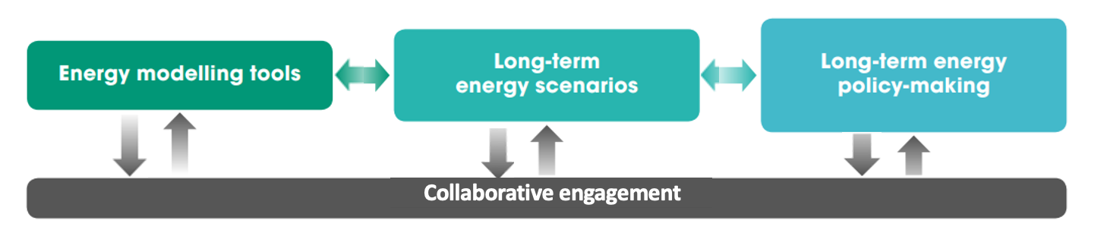
Scenario-based long-term planning
A transparent and open LTES development process is essential for the clean energy transition
Source: IRENA 2020, Scenarios for the Energy Transition
Notes:
Here at IRENA, we look at this mental model, where the long-term energy policy making process is fed by long-term energy scenarios, which are often produced by modelling tools. Etc
-> so why do we use scenarios? for policy advice, signals for investment and technology development, raising ambitions on the national and international levels, building consensus between stakeholders, and ensuring resilient infrastructure especially with climate change
-> and although scenarios have been used for ever, the energy transition is posing challenges such as VRE, hydrogen infrastructure, fossil fuel phaseout, increasing need for demand side flexibility, hydrogen T&D, and many other relatively new challenges
-> so why is it important to talk about this now? net-zero targets have become almost default now, and that changes how scenarios need to be developed, with a lot more complexity, and it requires a whole society approach and not just for example one institution or ministry planning the energy system
Transition to following slide on why this led us to initiating the LTES Network

Slide 3
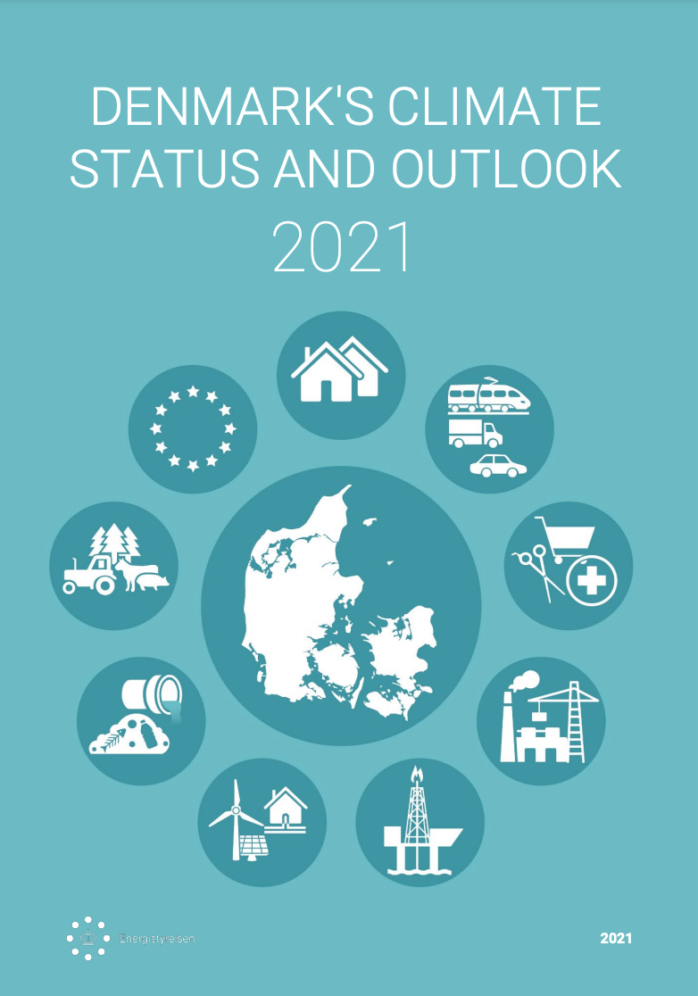

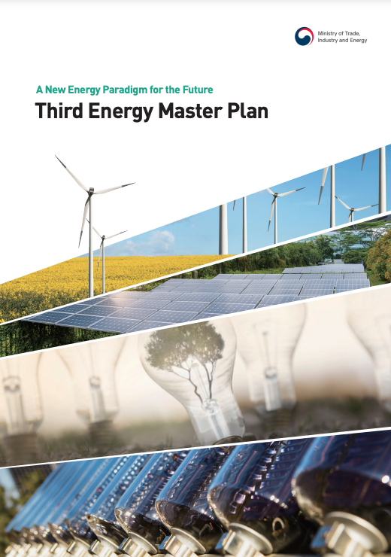


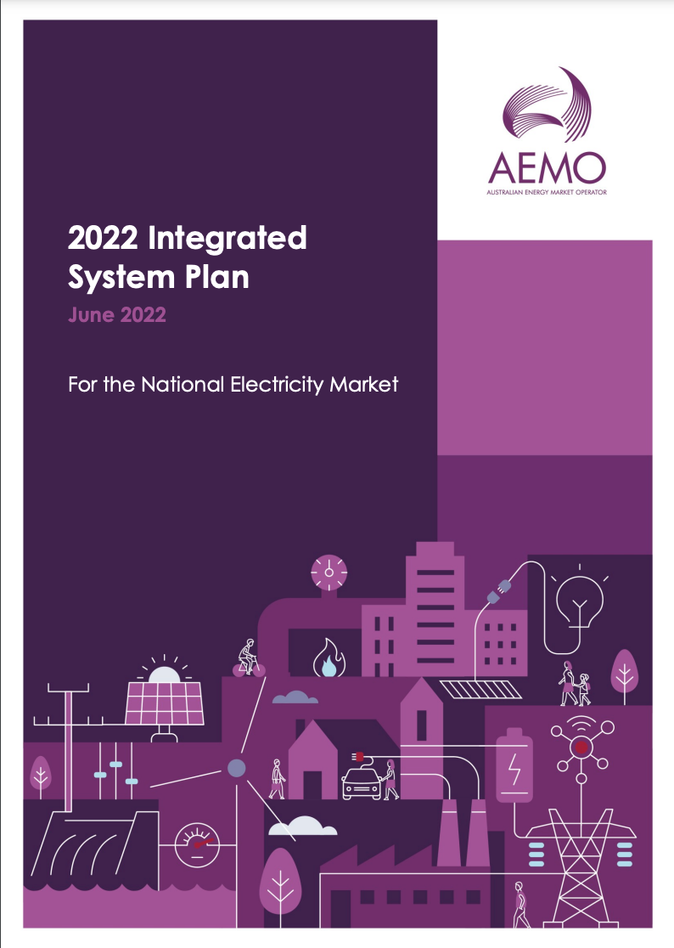
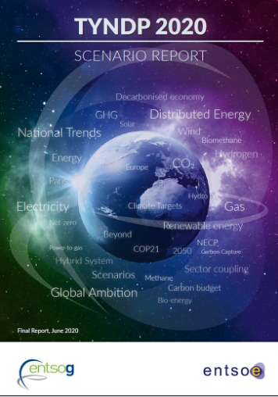
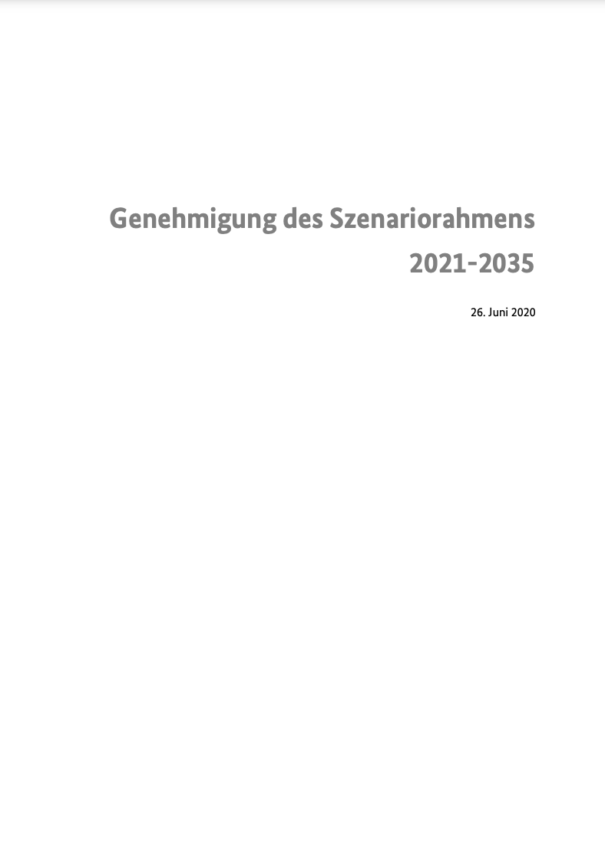
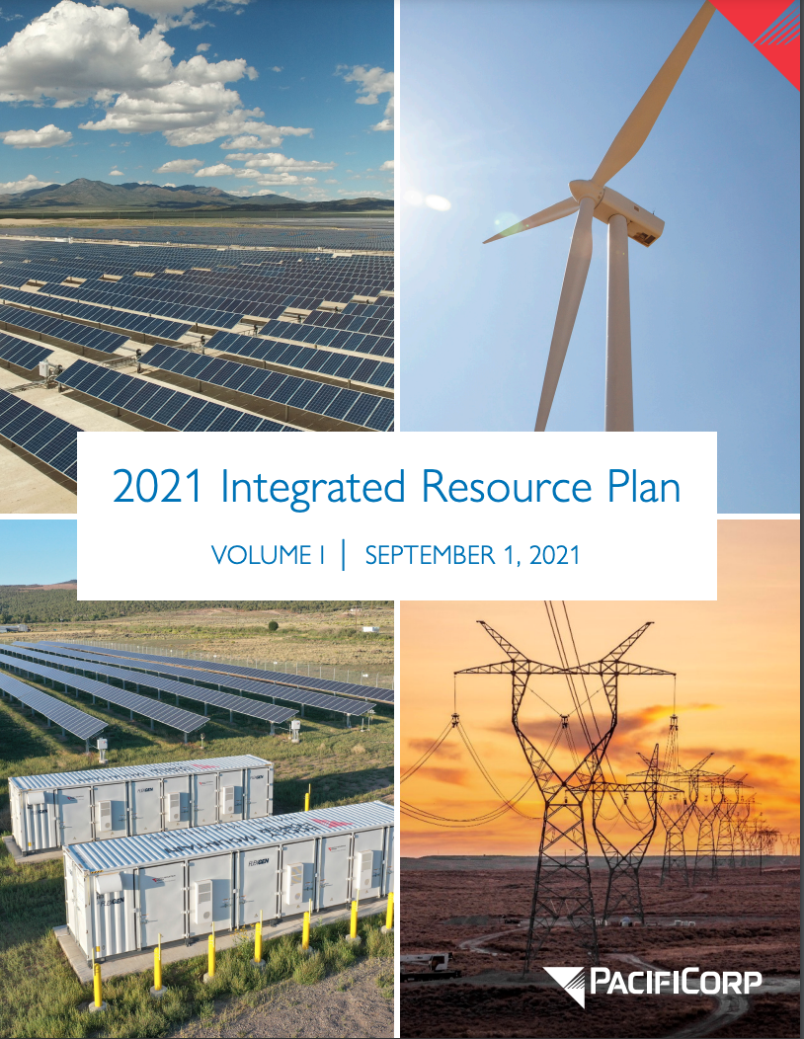
Planning the energy transition
Notes:
Many governments develop/use long-term energy scenarios (LTES) for policymaking
LTES network led by Denmark and Germany to promote the effective use of LTES
80% of the LT-LEDS are based on LTES

Slide 4
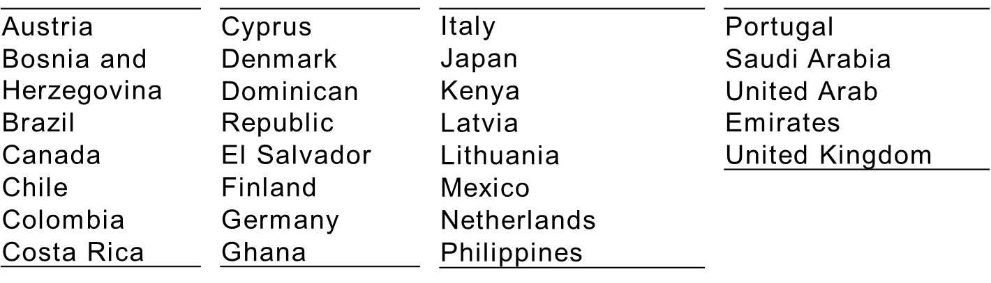
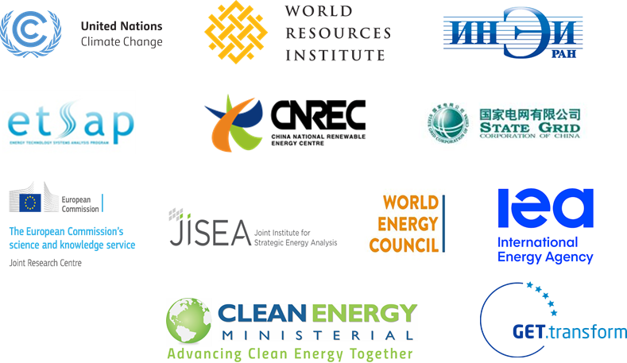
Five years of Long-Term Energy Scenario (LTES) Network
Overview
Provides a global platform to exchange national LTES practices among scenario practitioners.
Promotes wider and more effective use of LTES for the clean energy transition in governments.
+50 countries examples over 60 international and regional events and webinars organized.
Members:
      26 country members (+3 in process)
      12 technical partners institutions

Slide 5
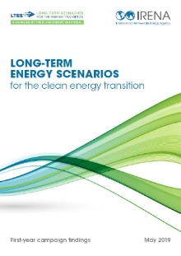
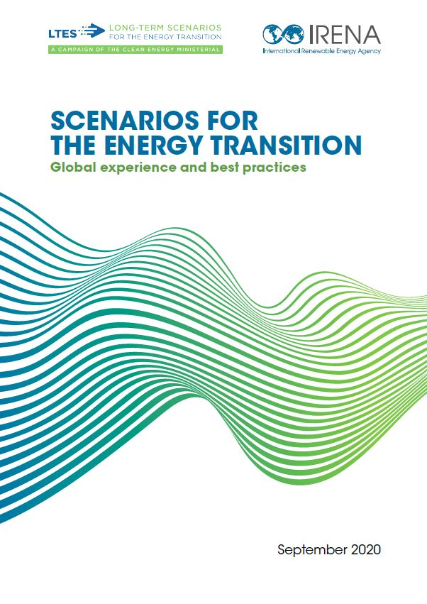
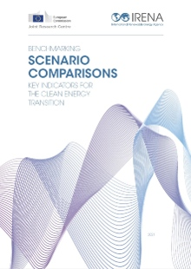
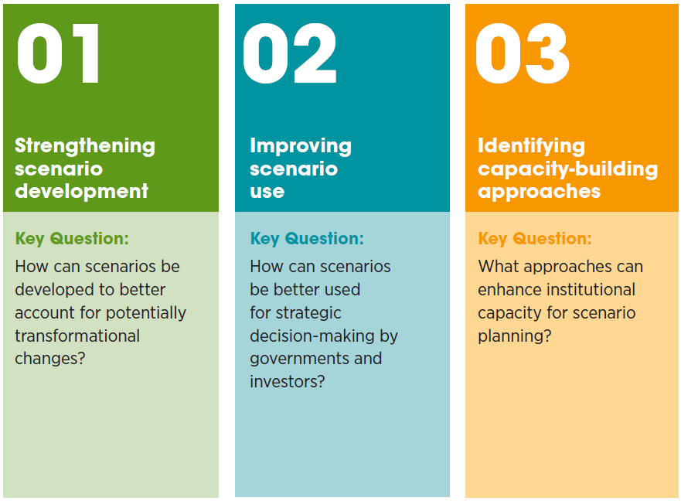
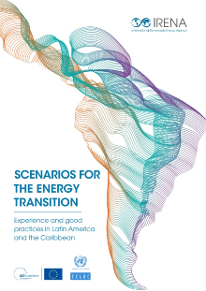
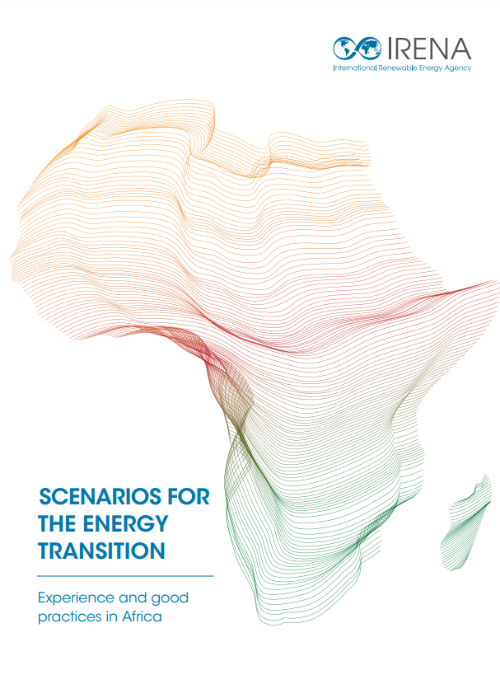
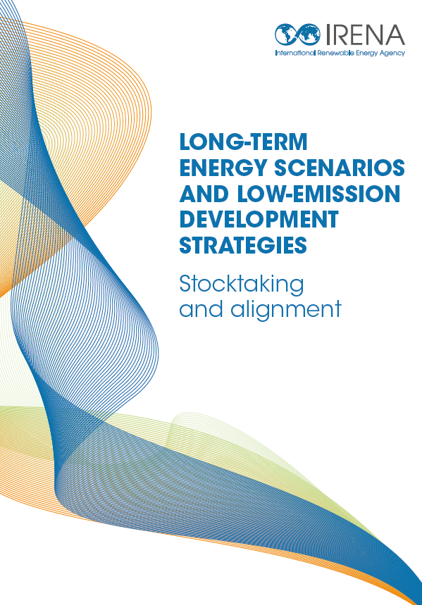
LTES Network
Aspects explored
Knowledge collected

Slide 6
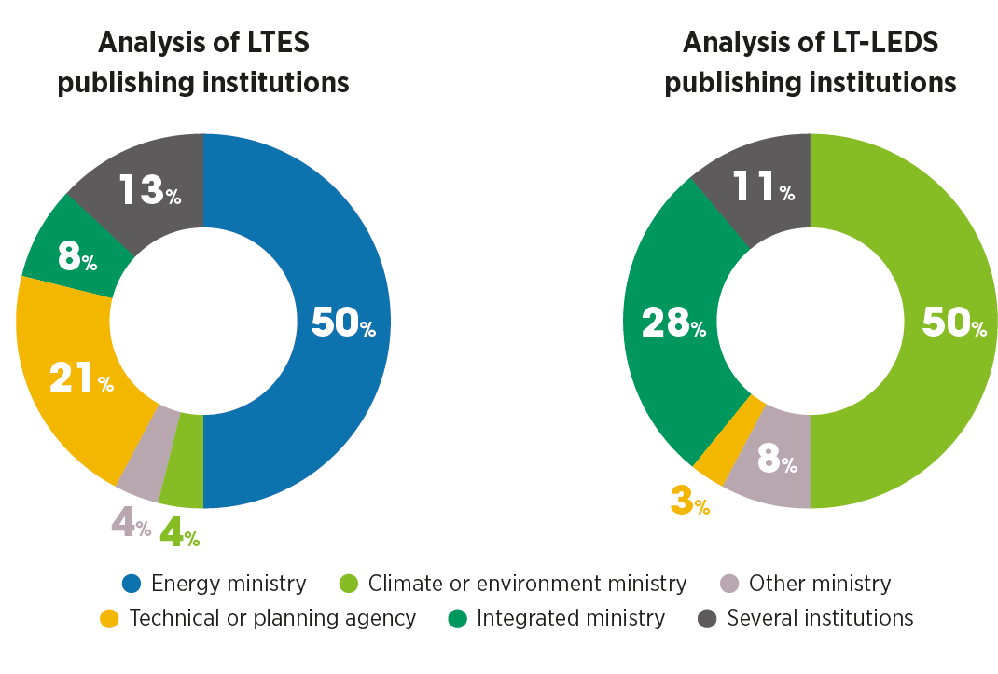
LTES and LT-LEDS: Stocktaking and Alignment
36 out of 53 LT-LEDS are scenario based
24 out of 70 LTES were developed within the last 5 years and have a planning time horizon of over 15 years
Notes:
Objective:
Perform a comparative analysis of institutional processes and technical coverage of scenario-based LTES and LT-LEDS, complementing the UNFCCC’s LT-LEDS synthesis report.
Scope
Cover scenario-based LT-LEDS and LTES from countries with official submissions to the UNFCCC, or from IRENA LTES Network country members.
LTES documents developed within last 5 years.
LTES documents with planning horizon > 15 years.
Focus on governance and institutional processes and coverage of 62 elements of the energy transition.
In total 60 scenario-based documents analyzed (36 LT-LEDS and 24 LTES) over 45 countries.
Publishing institutions: LTES rely more on specialised energy planning institutions or are published as joint publications by two ministries while LT-LEDS are relatively often published by environment ministries or integrated ministries (i.e., ministry with an interdisciplinary portfolio). These integrated ministries, with their broader portfolios typically adopt a big-picture approaches to climate goals.

Slide 7

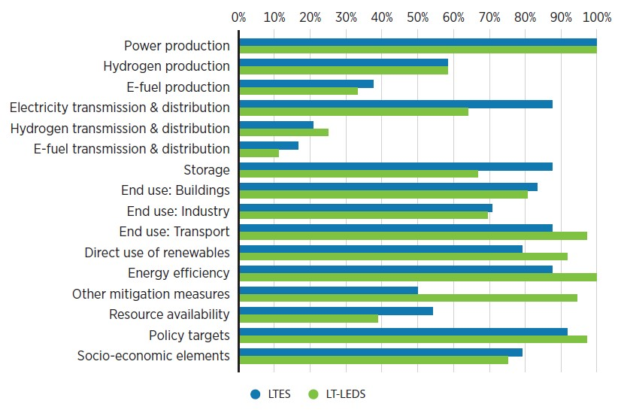




Key Takeaways – Institutional and technical aspects
Institutional aspects
Technical aspects
Stakeholder consultation
LT-LEDS: 98%, with broad engagement
Net-zero targets
LT-LEDS: 27/36
LTES: 67%, with focus on expert consultation
LTES: 7/24
Scope
Average # of scenarios
General alignment between LTES and LT-LEDS on scenario scope
LT-LEDS: 4
LTES: 5
Notes:
Stakeholder consultations: The resulting planning documents and scenario-based LT-LEDS can thus reflect the viewpoints of different stakeholders, including convergences and potential disagreements.
Net-zero targets: All LT-LEDS have a planning horizon until 2050 or longer, while 10 out of 24 LTES have a planning horizon shorter than 2050. This helps explain the discrepancy
Scope:
Demand assessment: 100% LTES, 97% LT-LEDS
Whole energy system: 88% LTES, 97% LT-LEDS
Power capacity expansion: 92% for both LTES & LT-LEDS
Open economy: 75% LTES, 78% LT-LEDS
Average number of scenarios: the number of scenarios ranged from 1 to 26 for LT-LEDS, and 1 to 40 for LTES
Technical aspects: graph shows general overview of what elements are included, and we have more detailed breakdowns for each section
General: LTES and LT-LEDS scenarios are well-aligned in terms of general coverage, with a similar coverage of the elements
Elements that are covered well: Both types of scenarios do very well in covering energy supply, although LTES cover power-related infrastructure (T&D, storage) much more comprehensively
Elements where coverage can be improved: both resource availability (especially critical minerals) and social aspects could use more attention, as well as hydrogen T&D

Slide 8
Key findings
Good level of alignment between LTES and LT-LEDS scenarios.
Energy policy planning needs to expand its scope to consider broader changes.
Climate policy also needs to consider alignment with energy policy objectives.
LT-LEDS present opportunities for energy and climate policymaking to come closer.
Wider adoption of scenario-based planning leads to further stakeholder engagement and data-based dialogue, which can result in greater buy-in from sectors beyond energy and climate.
Aligned processes and scenarios can send an important signal to policymakers, investors, and technology developers and open opportunities for cooperation.
Notes:
The analysis in this report shows a generally good level of alignment between LTES and LT-LEDS scenarios.
Energy policy planning needs to expand its scope to consider broader changes surrounding the energy sector and the implications for wider sectors of the economy.
Climate policy also needs to consider alignment with energy policy objectives to ensure that energy stakeholders are on board with the implementation of climate goals.
LT-LEDS present opportunities for energy and climate policymaking to come closer. Institutional co‑ordination in LTES and LT-LEDS development allows climate policy to incorporate the energy sectors’ objectives into the LT-LEDS.
Wider adoption of scenario-based planning approaches for LT-LEDS can lead to robust strategies, as it leads to further stakeholder engagement and data-based dialogue, that can result in greater buy-in from sectors beyond energy and climate.
Aligned processes (through dedicated institutions, ministries, steering committees, etc.) can allow for aligned trustworthy scenarios that can send an important signal to policymakers, investors, technology developer and open opportunities for cooperation.

Slide 9
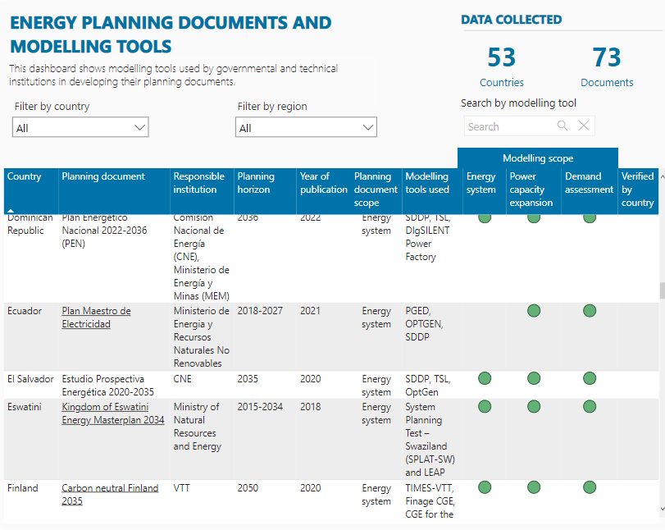
Energy transition planning dashboard

Slide 10



Use of LTES by the financial sector
LTES as a signal for investment decisions
Tool for financial sector to assess risk
What’s the next step for governments?

Slide 11
شكرا لكم
谢谢
Thank you
Merci
Спасибо
Gracias

Slide 12
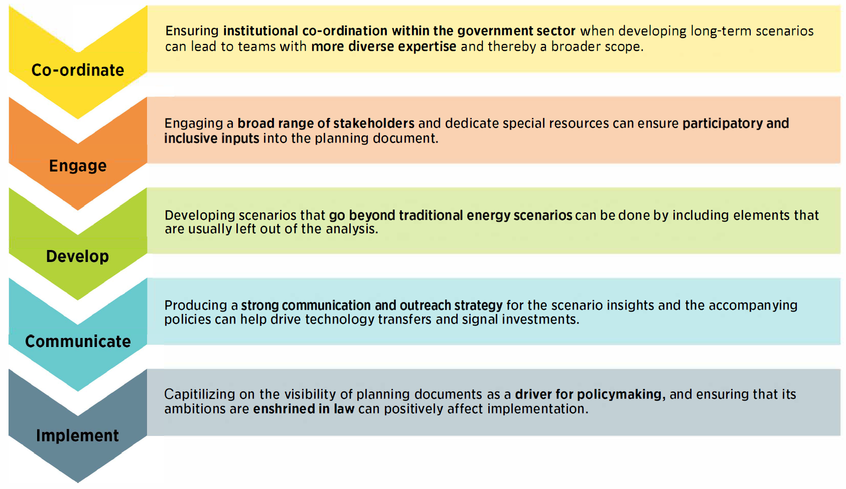
Recommendations for LT-LEDS development

Slide 13
Key Takeaways – Institutional and modelling aspects
  Publishing institutions: LTES rely more on specialised energy planning institutions or are published as joint publications by two ministries while LT-LEDS are relatively often published by environment ministries or integrated ministries (i.e., ministry with an interdisciplinary portfolio).
  Stakeholder consultations: although at different levels, both LTES and LT-LEDS documents consider public consultations as a key aspect for their development
  Modelling: on average, LTES documents use five scenarios and LT-LEDS documents use four; several countries integrate their main model with models focused on sub-sectors through collaborations with external experts; LEAP is most popular among LTES, TIMES and its variations are most popular among LT-LEDS.
Notes:
Publishing institutions: LTES rely more on specialised energy planning institutions or are published as joint publications by two ministries while LT-LEDS are relatively often published by environment ministries or integrated ministries (i.e., ministry with an interdisciplinary portfolio). These integrated ministries, with their broader portfolios typically adopt a big-picture approaches to climate goals.
Stakeholder consultations: The resulting planning documents and scenario-based LT-LEDS can thus reflect the viewpoints of different stakeholders, including convergences and potential disagreements.

Slide 14
Key findings
The analysis in this report shows a generally good level of alignment between LTES and LT-LEDS scenarios.
Energy policy planning needs to expand its scope to consider broader changes surrounding the energy sector and the implications for wider sectors of the economy. Climate policy also needs to consider alignment with energy policy objectives to ensure that energy stakeholders are on board with the implementation of climate goals.
LT-LEDS present opportunities for energy and climate policymaking to come closer. Institutional co‑ordination in LTES and LT-LEDS development allows climate policy to incorporate the energy sectors’ objectives into the LT-LEDS.
Wider adoption of scenario-based planning approaches for LT-LEDS can lead to robust strategies, as it leads to further stakeholder engagement and data-based dialogue, that can result in greater buy-in from sectors beyond energy and climate.
Aligned processes (through dedicated institutions, ministries, steering committees, etc.) can allow for aligned trustworthy scenarios that can send an important signal to policymakers, investors, technology developer and open opportunities for cooperation.
Notes:
The analysis in this report shows a generally good level of alignment between LTES and LT-LEDS scenarios.
Energy policy planning needs to expand its scope to consider broader changes surrounding the energy sector and the implications for wider sectors of the economy. Climate policy also needs to consider alignment with energy policy objectives to ensure that energy stakeholders are on board with the implementation of climate goals.
LT-LEDS present opportunities for energy and climate policymaking to come closer. Institutional co‑ordination in LTES and LT-LEDS development allows climate policy to incorporate the energy sectors’ objectives into the LT-LEDS.
Wider adoption of scenario-based planning approaches for LT-LEDS can lead to robust strategies, as it leads to further stakeholder engagement and data-based dialogue, that can result in greater buy-in from sectors beyond energy and climate.
Aligned processes (through dedicated institutions, ministries, steering committees, etc.) can allow for aligned trustworthy scenarios that can send an important signal to policymakers, investors, technology developer and open opportunities for cooperation.

Slide 15

Key Takeaways – Coverage of energy transition elements
  LTES tend to represent power sector-related elements, such as power production, electricity T&D and storage more comprehensively than scenario-based LT-LEDS.
  Scenario-based LT-LEDS address in more detail aspects such as electrification of buildings, electrification of industry, transport sector, direct use of renewables, energy efficiency, and other mitigation options (such as CCUS, CDR, LULUCF).
  In both LTES and scenario-based LT-LEDS the inclusion of e-fuels production and T&D and hydrogen T&D is predominantly done in a qualitative manner.
  Both LTES and scenario-based LT-LEDS address the socio-economic elements (job impacts, behavioural change, and health impacts) in a more qualitative manner.
  Scenario-based LT-LEDS address storage and resource constraints in a more qualitative manner.

Slide 16
LTES and LT-LEDS: Stocktaking and Alignment
Objective:
  Perform a comparative analysis of institutional processes and technical coverage of scenario-based LTES and LT-LEDS, complementing the UNFCCC’s LT-LEDS synthesis report.
Scope
  Cover scenario-based LT-LEDS and LTES from countries with official submissions to the UNFCCC, or from IRENA LTES Network country members.
  LTES documents developed within last 5 years.
  LTES documents with planning horizon > 15 years.
  Focus on governance and institutional processes and coverage of 62 elements of the energy transition.
  In total 60 scenario-based documents analyzed (36 LT-LEDS and 24 LTES) over 45 countries.

Slide 17
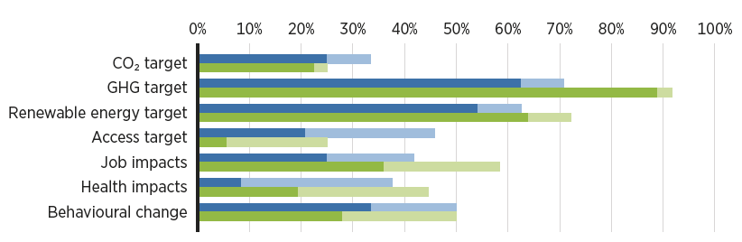
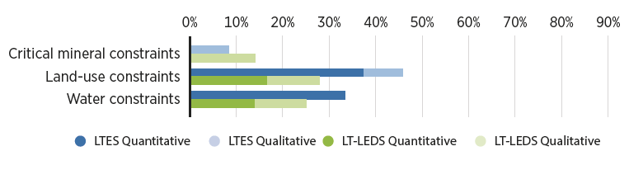
Key Takeaways – Coverage of energy transition elements
  Contextual elements
  Both LTES and scenario-based LT-LEDS address the socio-economic elements (job impacts, behavioural change, and health impacts) in a more qualitative manner.
  Scenario-based LT-LEDS address storage and resource constraints in a more qualitative manner.
  Resource constraints

Slide 18
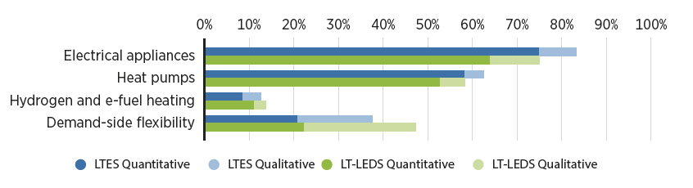
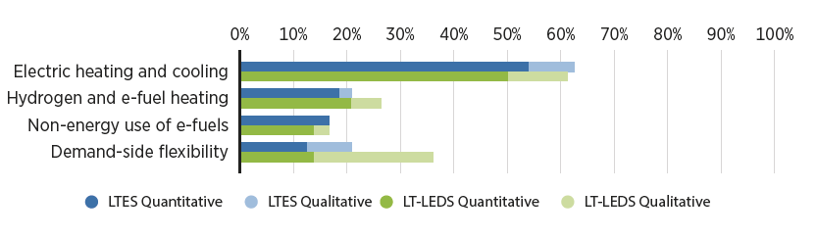
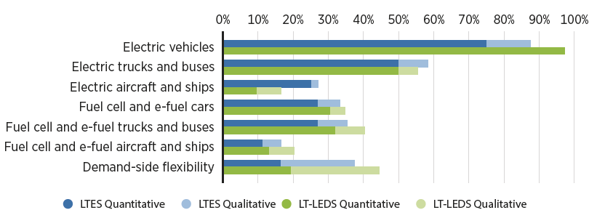
Key Takeaways – Coverage of energy transition elements
  End-use applications in building sector
  End-use applications in industry sector
  End-use applications in transport sector
  Scenario-based LT-LEDS address in more detail aspects such as electrification of buildings, electrification of industry, transport sector, direct use of renewables, energy efficiency, and other mitigation options (such as CCUS, CDR, LULUCF).

Slide 19
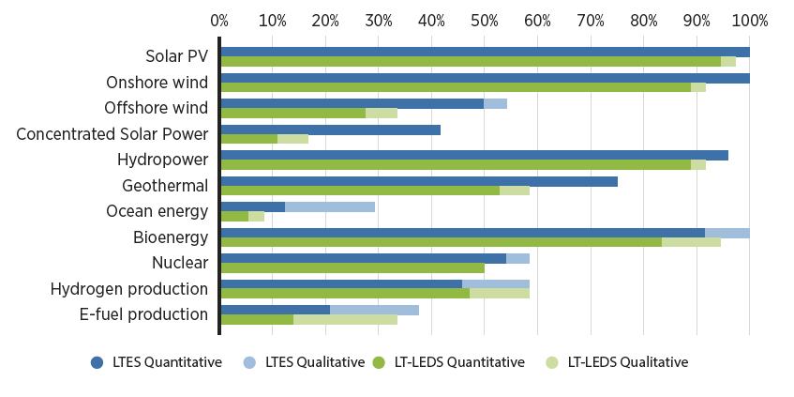
Key Takeaways – Coverage of energy transition elements
  LTES tend to represent power sector-related elements, such as power production, electricity T&D and storage more comprehensively than scenario-based LT-LEDS.
  In both LTES and scenario-based LT-LEDS the inclusion of e-fuels production and T&D and hydrogen T&D is predominantly done in a qualitative manner.

Slide 20
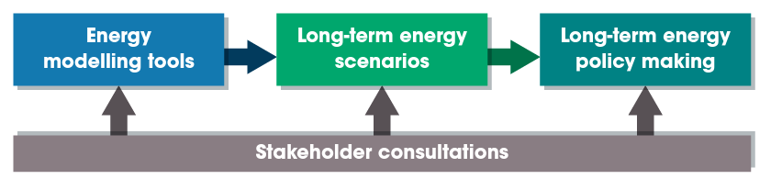
Why LTES?
BENEFITS
Policy advice
Signals for investment
Ambition raising
Consensus building
Infrastructure resiliency
CHALLENGES
Increasing VRE
Fossil fuel phaseout
Demand-side flexibility
Hydrogen infrastructure
And many more…
WHY LTES NOW?
Net-zero targets are changing the landscape of LTES
Energy transition planning requires society-wide effort
Notes:
Here at IRENA, we look at this mental model, where the long-term energy policy making process is fed by long-term energy scenarios, which are often produced by modelling tools. Etc
-> so why do we use scenarios? for policy advice, signals for investment and technology development, raising ambitions on the national and international levels, building consensus between stakeholders, and ensuring resilient infrastructure especially with climate change
-> and although scenarios have been used for ever, the energy transition is posing challenges such as VRE, hydrogen infrastructure, fossil fuel phaseout, increasing need for demand side flexibility, hydrogen T&D, and many other relatively new challenges
-> so why is it important to talk about this now? net-zero targets have become almost default now, and that changes how scenarios need to be developed, with a lot more complexity, and it requires a whole society approach and not just for example one institution or ministry planning the energy system
Transition to following slide on why this led us to initiating the LTES Network

Slide 21
LTES and LT-LEDS: Stocktaking and Alignment
Objective:
  Perform a comparative analysis of institutional processes and technical coverage of scenario-based LTES and LT-LEDS, complementing the UNFCCC’s LT-LEDS synthesis report.
Scope
  Cover scenario-based LT-LEDS and LTES from countries with official submissions to the UNFCCC, or from IRENA LTES Network country members.
  LTES documents developed within last 5 years.
  LTES documents with planning horizon > 15 years.
  Focus on governance and institutional processes and coverage of 62 elements of the energy transition.
  In total 60 scenario-based documents analyzed (36 LT-LEDS and 24 LTES) over 45 countries.

Slide 22
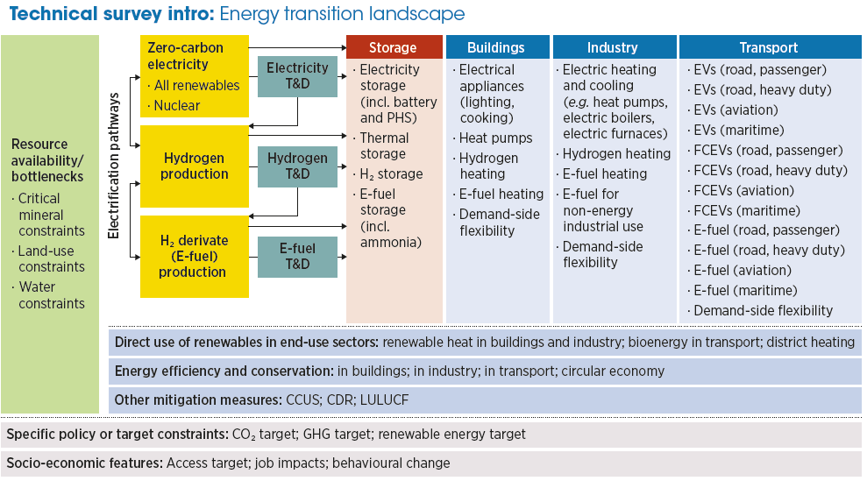
Key Takeaways – Coverage of energy transition elements (CAN BE SKIPPED)

