Slide 1
International trade and green hydrogen
Supporting the global transition to a low-carbon economy
Presenters:
Svetlana Chobanova, WTO| Luis Janeiro, IRENA
TUESDAY, 20 FEBRURARY 2024 • 14:00 – 14:30 CET

Slide 2


SPEAKERS
Svetlana Chobanova
WTO
Luis Janeiro
IRENA

Slide 3
Please make sure to mute yourself during the session to avoid background noise
If you have Questions to the speaker, please use the Q&A/chat feature
The slides and a recording at https://irena.org/events/2020/Jun/IRENA-Insights

Slide 4
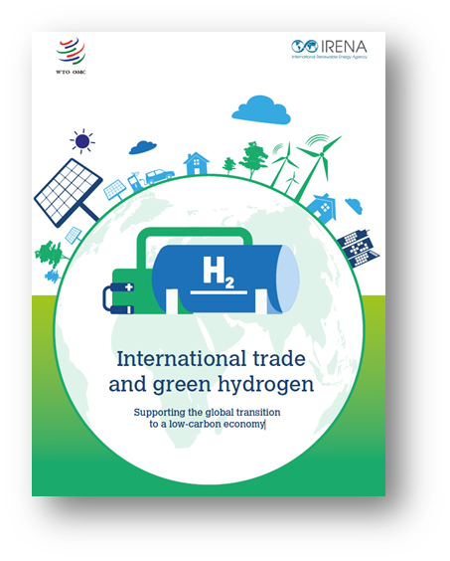


International trade and green hydrogen
Supporting the global transition to a low-carbon economy

Slide 5
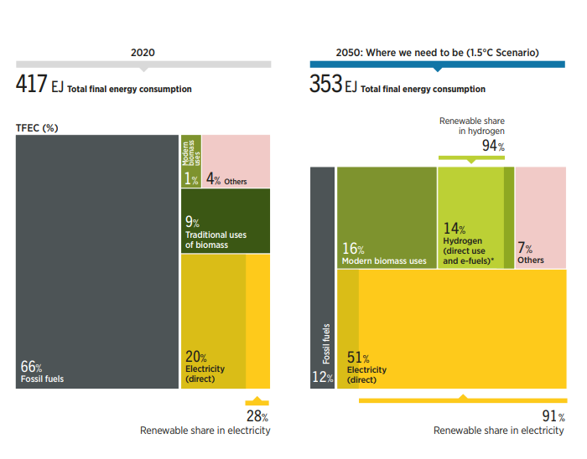
Role of hydrogen in IRENA’s 1.5°C Scenario
Breakdown of total final energy consumption by energy carrier in 2020 and 2050 under IRENA’s 1.5°C Scenario:
By 2050, electricity becomes the main energy carrier, accounting for more than half of the global final energy consumption.
Hydrogen and hydrogen derivatives represent up 14% of total final energy consumption by 2050.
94% of hydrogen production should come from renewables.

Slide 6
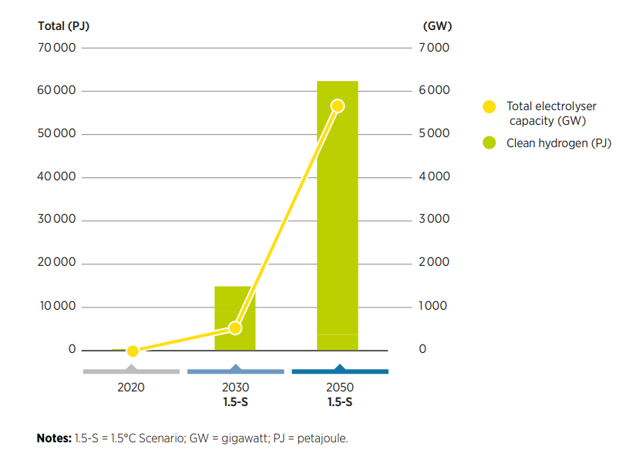
Scaling hydrogen production will be a major challenge
Global clean hydrogen supply in 2020, 2030 and 2050 in IRENA’s 1.5°C Scenario.
Bulk of today’s hydrogen production is fossil-based (mostly natural gas, but also coal)
Most of global hydrogen production in 2050 should come from renewables
The electricity requirement for green hydrogen in 2050 is comparable to today’s global electricity consumption.
From ~ 1 GW to >5700 GW electrolyser capacity by 2050.
Source: IRENA, 2023. World Energy Transitions Outlook 2023: 1.5°C Pathway, Volume 1

Slide 7
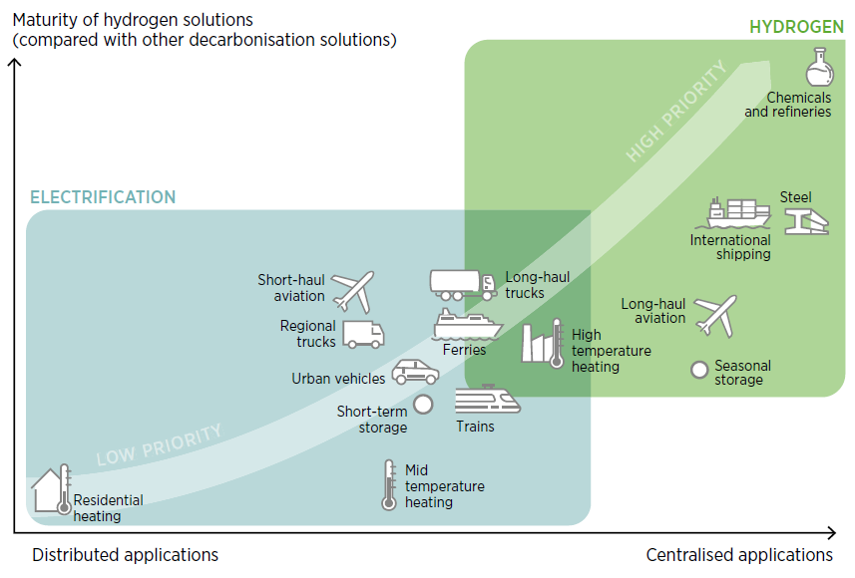
Priority uses for hydrogen across the energy system

Slide 8
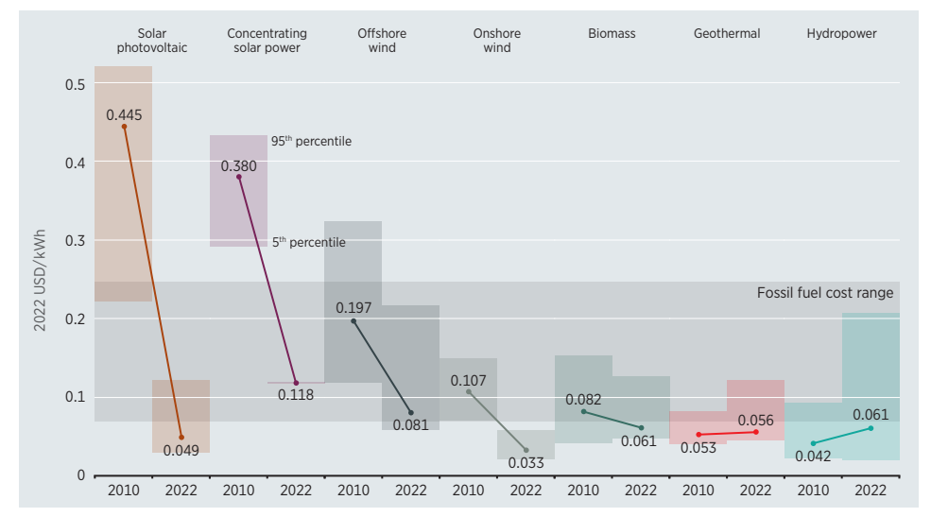
We are transitioning to a world of abundant, cheap renewables
Source: IRENA, 2023. Renewable Power Generation Costs in 2022. Available from: https://www.irena.org/Publications/2023/Aug/Renewable-power-generation-costs-in-2022

Slide 9
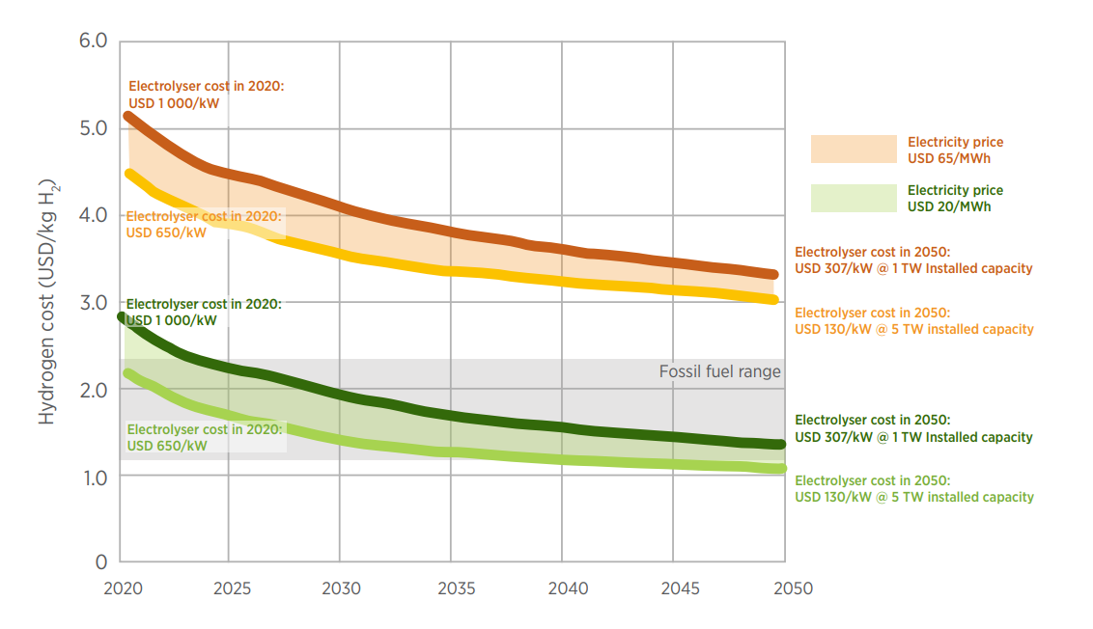
Green hydrogen costs depend on electrolyser cost electricity cost
Source: IRENA, 2022. Global hydrogen trade to meet the 1.5C goal. Part I: Trade outlook for 2050 and way forward.

Slide 10
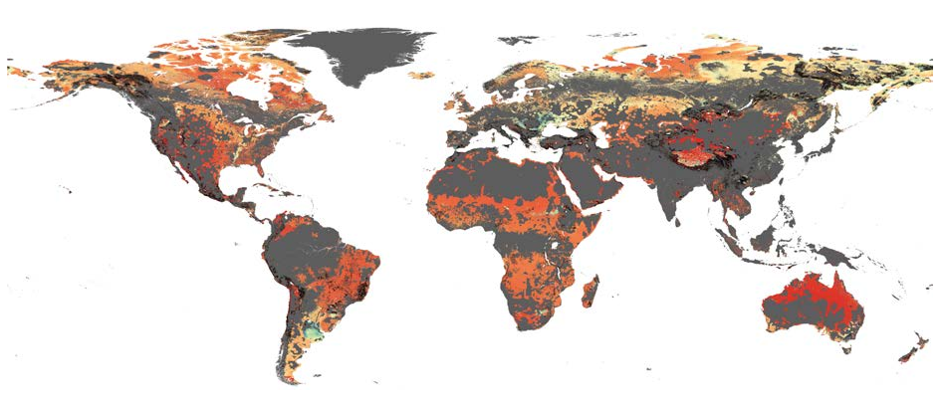
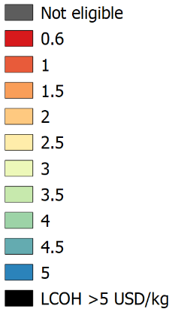
Global levelised cost of hydrogen in 2050
Note: Assumptions for capital expenditure are as follows: solar photovoltaic (PV): USD 270-690/kW in 2030 and USD 225-455/kW in 2050; onshore wind: USD 790-1435/kW in 2030 and USD 700-1 070/kW in 2050; offshore wind: USD 1 730-2 700/kW in 2030 and USD 1 275-1 745/kW in 2050; electrolyser: USD 380/kW in 2030 and USD 130/kW in 2050. Weighted average cost of capital: Per 2020 values without technology risks across regions. Land availability considers several exclusion zones (protected areas, forests, permanent wetlands, croplands, urban areas, slope of 5% [PV] and 20% [onshore wind], population density, and water availability). Source: IRENA, 2022. Global hydrogen trade to meet the 1.5C goal. Part I: Trade outlook for 2050 and way forward

Slide 11
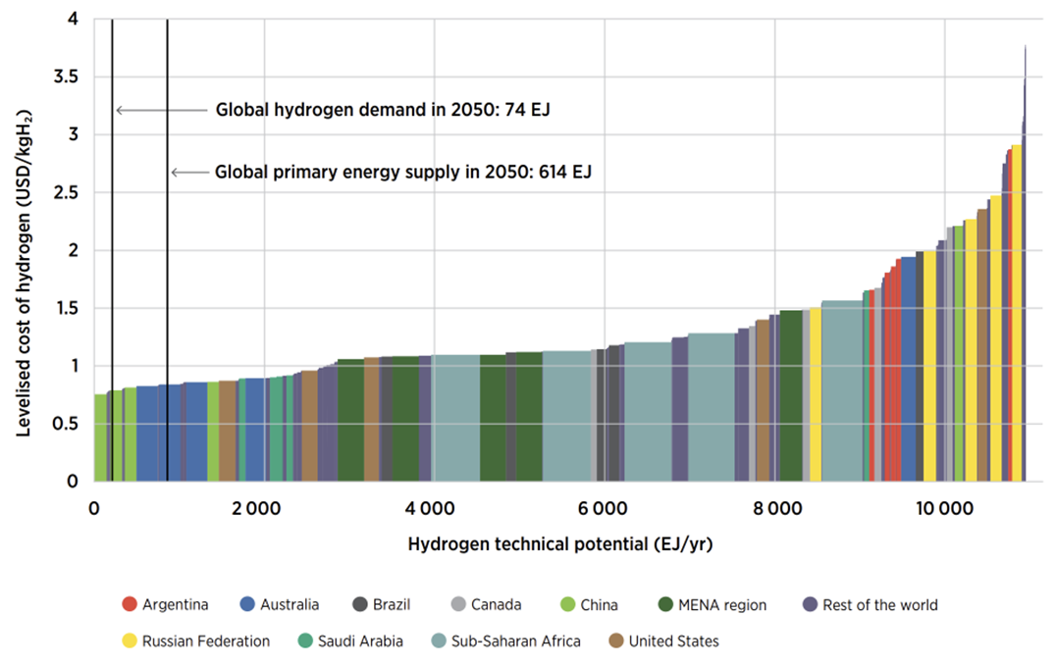
Green hydrogen technical potential, almost 20 times the global primary energy supply in 2050
Source: IRENA, 2022. Global hydrogen trade to meet the 1.5C goal. Part I: Trade outlook for 2050 and way forward.

Slide 12
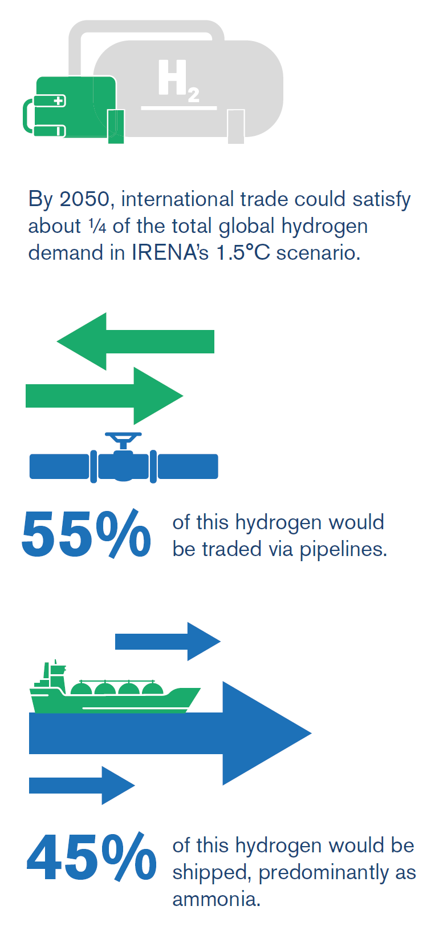
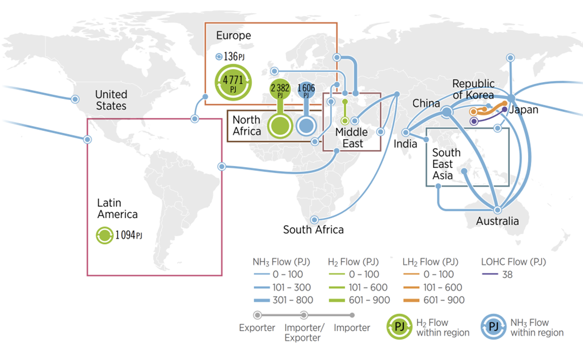
About a quarter of the global hydrogen demand could be internationally traded
Source: IRENA, 2022. Global hydrogen trade to meet the 1.5C goal. Part I: Trade outlook for 2050 and way forward.

Slide 13
Global imports in hydrogen and derivatives (ammonia and methanol)
Trade of hydrogen and derivatives is increasing since 2020
Current trade of hydrogen is rather small compared to ammonia and methanol – almost two orders of magnitude
Hydrogen in the order of 300 USD millions, while Ammonia and Methanol in the order of 18 and 14 USD billions respectively in 2022
Source: WTO and IRENA (2023) International trade and green hydrogen: Supporting the global transition to a low-carbon economy

Slide 14
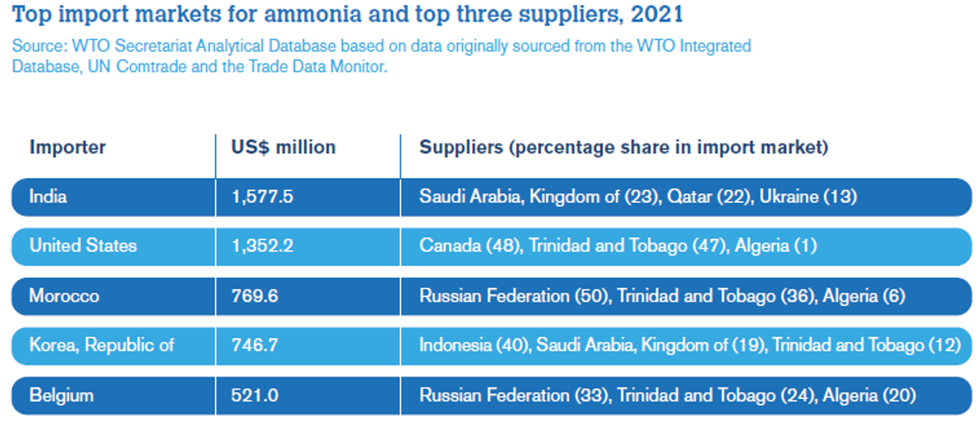
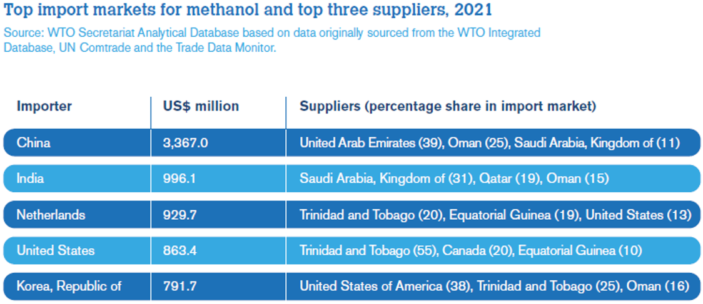
Top import markets for ammonia and methanol in 2021
Source: WTO and IRENA (2023) International trade and green hydrogen: Supporting the global transition to a low-carbon economy

Slide 15
Trade in goods and services across the whole green hydrogen value chain
Renewable energy production
Hydrogen & hydrogen derivatives production
Transport, storage and reconversion
Use
EQUIPMENT
Renewable energy generation equipment, e.g., solar panels, wind turbines, etc.
Electric equipment.
Electrolysers
Compressors, valves, flow control, metering and related equipment
Ammonia, methanol, direct reduced iron production plants.
Piping and storage systems.
Compressors, valves, flow control, metering and related equipment.
Hydrogen, ammonia, methanol, hot briquetted iron transport vessels.
Ammonia, methanol, production plants.
Direct reduction furnaces for iron production.
Fuel cell systems.
Hydrogen-ready (industrial) boilers
Hydrogen-ready gas turbines for power generation.
Fuel cell electric vehicles.
Ammonia, methanol and hydrogen storage equipment.
SERVICES
      Design
      Engineering
Related construction
Operation and management
Transportation and storage services
Related construction (e.g., port terminals)
Wholesale and retail (e.g., hydrogen stations)
Marketing
R&D, technical testing and analysis, consulting and training, various professional and business services
Source: WTO and IRENA (2023) International trade and green hydrogen: Supporting the global transition to a low-carbon economy

Slide 16






Summary - Five Key Actions to Foster Green Hydrogen Trade
5. Increasing international cooperation through cross-borders dialogue and increased in joint capacity building programmes.
1. Addressing trade by reducing tariffs and non-tariff barriers on green hydrogen, electrolysers, derivatives and other products along the supply chain.
2. Developing sound quality infrastructure by adopting national measures based on international standards and engaging in international standardization.
4. Using sustainable government procurement by purchasing low-carbon goods and services and stimulating innovative solutions.
3. Implementing support policies via targeted and non-discriminatory environmental subsidies to help sustain growth in electrolyser capacity.
Source: WTO and IRENA (2023) International trade and green hydrogen: Supporting the global transition to a low-carbon economy

Slide 17
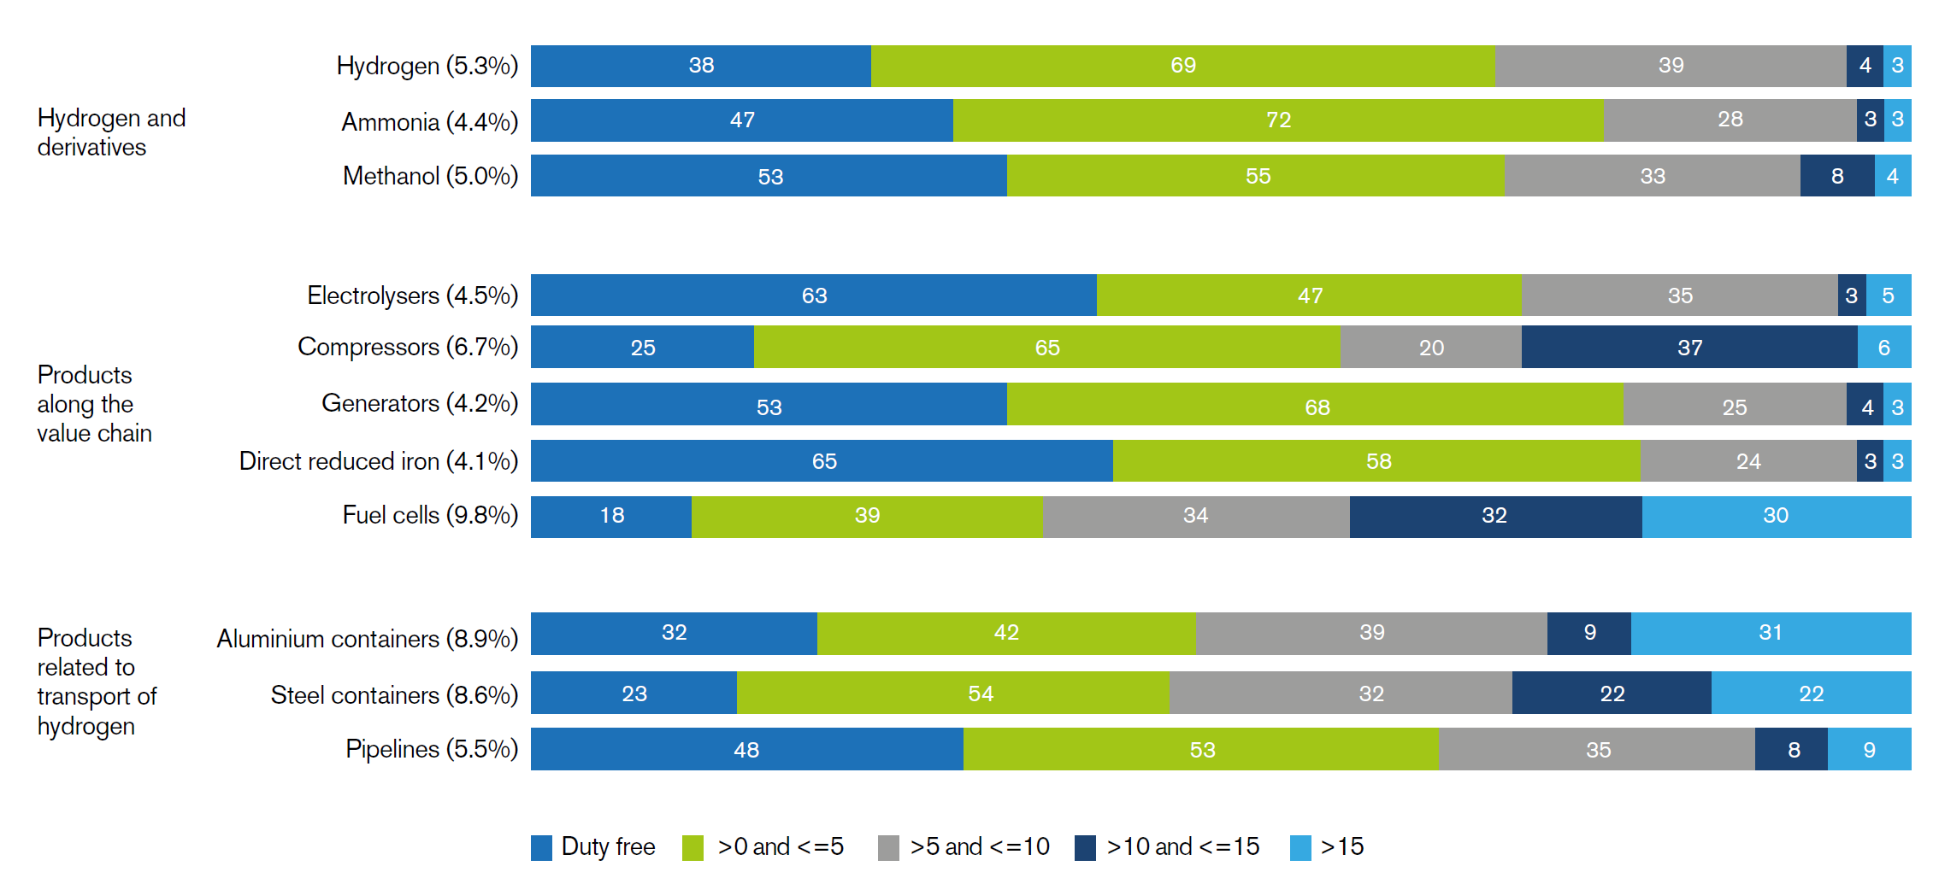
Open trade along the supply chain can foster access to technology, lower costs and promote green hydrogen production
Average applied MFN tariffs (in parentheses) and number of members by tariff range (bars)
Source: WTO and IRENA (2023) International trade and green hydrogen: Supporting the global transition to a low-carbon economy

Slide 18
Quality infrastructure can ensure sustainability, safety and performance of green hydrogen production
International standards can promote sustainable and safe green hydrogen trade
Under the TBTA*, technical regulations in accordance with international standards are considered not to create unnecessary obstacles to international trade
Harmonized verification procedures can minimize differences in verifiers’ competences and approaches
WTO disciplines promote harmonization on verification procedures based on recommendations of int. standardizing bodies as a means of avoiding unnecessary obstacles to trade
The TBTA encourages members to accept, whenever possible, the results of conformity assessment procedures performed by other members
Trust building can facilitate mutual recognition of conformity assessment
Clear and credible labelling can facilitate trade in green hydrogen and its derivatives
Labelling measures should be based on international guidance, should not be discriminatory and should not create unnecessary barriers to trade.
Sharing experiences in multilateral settings can help build trust and eventually enable convergence through the development of international guidance
Dialogue and cooperation can avoid unnecessary negative trade impacts
*The WTO Agreement on Technical Barriers to Trade
Source: WTO and IRENA (2023) International trade and green hydrogen: Supporting the global transition to a low-carbon economy

Slide 19
Environmental subsidies can scale up new technologies and make climate-friendly products more affordable
Implement targeted and non-discriminatory environmental subsidies
Governmental support policies can help to sustain growth in electrolyser capacity and green hydrogen production, promoting cost efficiencies and narrowing the cost differential between the production costs of green and of fossil-based hydrogen.
Close the economic gap between fossil fuels and green hydrogen
Phasing out and redirecting fossil fuel subsidies would make it possible to incorporate costs of environmental externalities not reflected under subsidized prices rendering green hydrogen more competitive.
Subsidy reforms must be mindful of the various economic and social forces at work, as well as the imperative for a just and equitable transition.
Policies should be targeted to boost innovation in cleantech startups and should not place imported products at a competitive disadvantage vis-à-vis domestic ones unjustifiably.
Source: WTO and IRENA (2023) International trade and green hydrogen: Supporting the global transition to a low-carbon economy

Slide 20
Sustainable procurement can create a large and stable demand, lowering costs and reducing uptake uncertainty
Sustainable government procurement policies
Actions could include introducing minimum requirements for green products/materials in procurement processes, ensuring the presence of a verification and labelling system to guarantee the sustainability of green products, setting up centralized auction schemes.
International collaboration
Coordinated demand-creating policies can send a strong signal to mobilize investment, while collaboration can support the establishment of more secure and diversified demand over time.
Governments can leverage sustainable procurement policies to create a large and stable demand for green hydrogen and derivatives.
The plurilateral WTO Agreement on Government Procurement, together with other WTO rules, can play an important role in ensuring that open government procurement markets are leveraged to support green hydrogen markets.
Source: WTO and IRENA (2023) International trade and green hydrogen: Supporting the global transition to a low-carbon economy

Slide 21
Cross-border coordination and collaboration can help to address trade tensions and avoid rising costs and red tape
Encourage technology development and innovation through dialogue
Engage in cooperation for a on green hydrogen
IRENA’s Collaborative Framework on Green Hydrogen is a vehicle for cooperation and coordinated action to accelerate development and deployment of green hydrogen and its derivatives.
Increase technical assistance and capacity-building
Support the needs of developing economies through Aid for Trade
Regulatory cooperation between WTO members and stakeholders could help build trust between regulators and serve as an incubator for discussions on emerging regulations.
Advanced economies could provide TA and capacity-building to developing economies with comparative advantages in renewable energy production, to help them create an enabling environment for green hydrogen production at scale.
The Aid for Trade initiative can facilitate technology transfer partnerships that can help to expand domestic manufacturing capacity, as well as help enhance market access and create adequate regulatory conditions for a cross-border hydrogen trade.
Source: WTO and IRENA (2023) International trade and green hydrogen: Supporting the global transition to a low-carbon economy

Slide 22
Q & A
5 min

Slide 23
THANK YOU FOR JOINING US!
SEE YOU IN OUR NEXT WEBINARS
www.irena.org/events/2020/Jun/IRENA-Insights

