Slide 1
SACREEE FOR MARKET-BASED ADOPTION OF RENEWABLE ENERGY AND ENERGY EFFICIENCY Presentation to the SADC Renewable Energy Entrepreneurship Support Facility Workshop 27 April 2017 Maseru, Lesotho
Notes:
This template can be used as a starter file to give updates for project milestones.

Slide 2
ENERGY CONTEXT IN THE SADC REGION
Current steady economic growth is already outpacing the development of energy services, and the lack of supply of cost-effective energy is holding back the socio-economic development prospects of the region.
In the majority of the countries
Over 60% of the population lives in rural areas
Access to grid-based electricity is less than 50% and traditional biomass is the main source energy for cooking, with detrimental effects to health and the environment

Slide 3
ENERGY ACCESS IN SELECTED COUNTRIES IN SADC REGION
SADC Electricity Access is at around 42% and lower than 10% in rural areas
The trend is an increase of access in all countries
However significant differences remain within the region
REEESAP, 2016

Slide 4
BARRIERS FOR THE DEVELOPMENT OF SUSTAINABLE ENERGY MARKETS IN THE SADC REGION
POLICY AND REGULATION
Lack of enabling policies and regulations that stimulate markets for RE and EE
TECHNICAL
Weak and limited electricity grid infrastructure that limits possible grid connection of RE generated electricity
CAPACITY
MARKETS
Limited support available for bankable project preparation
Standards and labeling of equipment are not harmonized across the region to allow an integrated market
Need to integrate into the post- 2015 Inclusive and Sustainable Industrial Development (ISID) agenda highlighting the importance of energy
Knowledge and experience not shared across borders
Limited capacity and awareness of the technical and economic possibilities of RE/EE technologies and their applications
Low R&D capacity and funding and little regional cooperation between R&D institutions
Technical capacity for installation, and operation and management of RE systems is limited
Limited capacity to initiate, implement and manage Public- Private Partnership (PPP) projects effectively
Limited capacities to identify, develop, and implement innovative RE/EE projects
FINANCING
Limited information on availability of RE resources on which to base decision to invest
Potential EE improvement technologies not widely known in the Region
Limited information on the social and environmental impacts and acceptability of the technology
Markets for RE/EE technologies and energy services fragmented along national boundaries
Lack of knowledge at vocational and university level
Limited exposure of local Financial Institutions to RE/EE investment projects
Limited experience on special purpose soft loans for RE/EE projects for SMEs and low income sections of the population.
Perceived risky nature of the RE/EE projects
Low local content of technology leading to high RE equipment maintenance costs
Energy policy developed in isolation with regional and international trends leading to disharmony

Slide 5
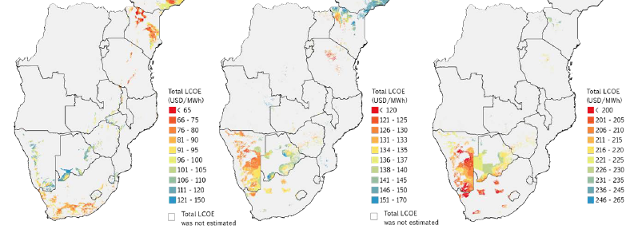
POTENTIALS FOR RE: SOLAR AND WIND RESOURCES IN CONTINENTAL COUNTRIES
Huge wind, solar PV & solar CSP potential of 370,570 MW at 300 W/m2 resource quality; 605,840 MW at 270 W/m2 and 1,257,770 MW at 300 W/m2, (IRENA, 2015).

Slide 6
POTENTIAL FOR ENERGY EFFICIENCY
Levels of Primary Energy Intensity of SADC Member States
Source: REEESAP, 2016; citing Source: SE4ALL, Global Tracking Framework, Full Report, 2015

Slide 7
DSM & ENERGY EFFICIENCY OPTIONS IN SADC
Awareness Raising – including implementation of energy efficiency labels and Minimum Energy Performance Standards (MEPS).
More Efficient Technologies – including lighting, industrial equipment, efficient cooking, etc
Fuel Switching – e.g. use of LPG, SWH.
Load Management - including ripple control and time-of-use-tariffs
Electricity grid losses mitigation - e.g. with pre-paid & smart metering
Building codes

Slide 8
SACREEE – THE SADC CENTRE FOR RENEWABLE ENERGY AND ENERGY EFFICIENCY

Slide 9
SACREEE – THE SADC CENTRE FOR RENEWABLE ENERGY AND ENERGY EFFICIENCY
SACREEE was established in 2016 by the SADC Energy Ministers and endorsed by 35th SADC Council of Ministers Meeting -Decision 61 with a mandate to promote
increased access to modern energy services
improved energy security across the SADC Region
SACREEE s mandate is to implement the Regional Renewable Energy and Energy Efficiency Strategy and Action Plan (REEESAP) through the promotion of market based adoption of renewable energy and energy efficient technologies and energy services
SACREEE is established on a sustainable basis through the following sources of support:
Member States contributions
Donor funding
Cost recovery from services offered to projects.
SACREEE Secretariat is based in Windhoek, Namibia
Partnerships are key! The SACREEE core supporters

Slide 10
SACREEE GOVERNANCE STRUCTURE
SACREEE Executive Board
SACREEE Secretariat
Executive Director
Technical and Admin Staff
Seconded International Staff
SACREEE Technical Committee
15 National Focal Institutions
One from each SADC Member State

Slide 11
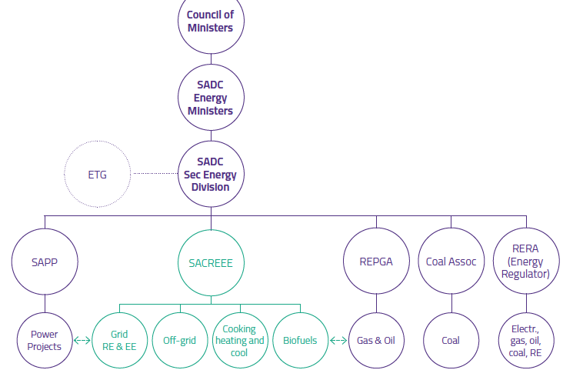
SACREEE FOR RE/EE INTEGRATION IN SADC
SACREEE is a subsidiary organisation of SADC
Notes:
SAPP, SACREEE & RERA are the only SADC specialised agencies that are operational

Slide 12
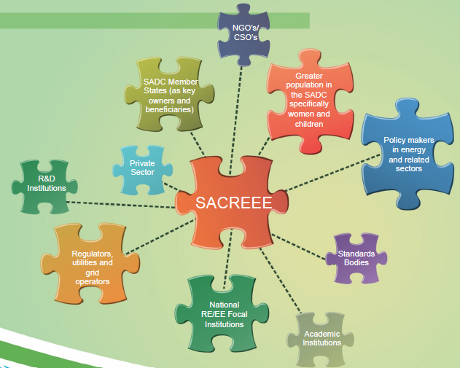
KEY STAKEHOLDERS FOR SACREEE

Slide 13
PROVIDING REGIONAL SUPPORT TO NATIONAL ACTIONS - SACREEE ACTIVITIES
SACREEE develops and executes regional programs and projects in order to support SADC Member States
To increase access to sustainable energy services;
To develop sustainable energy markets;
To improve the legal and regulatory framework and ensure policy coherence and alignment of RE & EE activities with national/regional and international policies;
To align the national actions with international commitments and climate change actions (e.g. NDCs)
To support donor harmonization, coordination and to create synergies with other ongoing initiatives;
To strengthen local capacities through capacity building activities
To foster networks between research and training institutions (Network of Energy Excellence for Development (NEED), SOLTRAIN, etc) as well as organize train-the-trainers workshops;
To improve the availability of quality energy data and information for sound decision making on policy and investment

Slide 14
SACREEE – THE KNOWLEDGE HUB FOR SUSTAINABLE ENERGY
Think tank, lobbying agent and advisory platform for RE & EE in SADC
Facilitator for north-south and south-south cooperation for knowledge and technology transfer
Partner of the UNIDO South-South Cooperation Network with the other Centres in West and Eastern Africa
Focal point for the implementation of SE4ALL Initiative & Nationally Determined Contributions (NDCs) in SADC
Co-organizer of conferences and exhibitions, forums and workshops
SACREEE Acts as a...

Slide 15
SHORT-TO-MEDIUM TERM SACREEE FOCUS AREAS
Policy
Energy Data and Knowledge Platform
Energy Efficiency
Energy Access including Clean Cooking
Small Hydro Power Development
Resource Assessment and Grid Integration
Energy and Gender Mainstreaming
Entrepreneurship Support
Early Stage Project Development
Capacity Building
Knowledge Management
Financing

Slide 16
SADC Renewable Energy Entrepreneurship Support Facility
Address barriers and challenges experienced by the private sector
enhance and strengthen the capacity of small to medium entrepreneurs in assessing the business potentials of sustainable energy,
develop viable business plans and loan requests, and managing and maintaining their businesses successfully
increase the confidence of financial institutions in sustainable energy systems and
create linkages between the entrepreneurs and financial institutions.
Jointly implemented by SACREEE and IRENA
Kick off meeting taking place on 27 April 2017 in Maseru, Lesotho

Slide 17
Renewable Energy Resource Assessment and Zoning study for the Africa Clean Energy Corridor (ACEC)
Study carried out in 2015, identified, valued and prioritized high-quality and cost-effective large-scale wind, solar PV, and concentrated solar power (CSP) zones for grid integration.
21 countries of the Eastern Africa Power Pool (EAPP) and the Southern African Power Pool (SAPP).
ACEC aims to accelerate the expansion of renewable electricity production, taking advantage of the continent’s enormous untapped potential and helping to sustain future growth through renewable power development zoning, planning processes, enabling mechanisms, capacity building and public information.

Slide 18
ACEC -Phase 2: Review of zoning work and financial assessment
Zoning work is being reviewed, updated and deepened at national levels
Based on the zoning outcomes – assessment of financial feasibility and suitability of specific sites in order to guide RE investments. It will enable project developers to have a clearer understanding of the economic feasibility and investment needed for the development of the sites.
Workshop taking place in Windhoek on 24 – 25 April 2017
Ministries of Energy
national utilities
regulatory bodies
research institutions.
Notes:
and used in IRENA planning models to allow a more accurate assessment of renewable energy deployment potential within each country. Working with key stakeholders, IRENA is translating results of this work into projects to be considered in the regional and continental planning processes and possible development.

Slide 19
SADC Program on Gender and Sustainable Energy
The program contributes towards increased access to modern, affordable, and reliable energy services, energy security and environmental sustainability by tailoring national and regional policies, projects and programs to the energy needs of men and women.
Specific objectives:
1. Steer and support the development of gender-sensitive policies.
2. Improve knowledge management, awareness creation and advocacy on gender and energy issues
3. Build and strengthen capacities in gender mainstreaming in energy policies and projects
4. Implement gender-responsive investment and business promotion in sustainable energy development in the SADC region
Regional assesment and developing of regional Gender and Sustainable Energy Strategy – currently carried out jointly by SACREEE and NREL

Slide 20
Objectives of the SACREEE Energy Efficiency Program
Lighting
Standards and Labelling
Cooking
Buildings
Industry

Slide 21
SADC Industrial Energy Efficiency Programme (SIEEP)
SIEEP contributes to the competitiveness of the industrial sectors of SADC Member States by building their capacity to adopt, invest and utilise energy efficient technologies and practices.
Target group are medium and large scale industries.
SIEEP is in line with the SADC Industrialization Strategy and Roadmap, 2015-2063.
Current Activities (in cooperation with the European Union)
Assessment of EE potential in Industries
potential on electricity energy saving opportunities,
potential for renewable energy heating and cooling applications in industry,
capacity to implement energy and efficiency measures
capacity of industries on implementing ISO 50001
Development of a regional program for Industrial Energy Efficiency to be endorsed by the Member States

Slide 22
SADC regional EE lighting initiative
Work with the SADC Member States in order to promote a rapid uptake of efficient, high quality lighting products with the objective to permanently remove any inefficient lamps from the market in the SADC region
Create a Regional Concerted Action expert group on energy efficient lighting which will act as a know how exchange platform and as an advisory group of experts towards decision makers in order to facilitate sound decision making process on the political level
Collaborate with existing testing institutions and laboratories and support the establishment of new ones in order to put in place mechanisms for high quality testing facilities
Implement measures that increase national and regional demand for high-efficiency, high quality on-grid and off-grid lighting products

Slide 23
SACREEE is partner in the Global Network of Regional Sustainable Energy Centers
Share of lessons learned and capacity building through collaboration among the regional centres.

Slide 24
THANK YOU FOR YOUR ATTENTION
SADC Centre for Renewable Energy and Energy Efficiency - SACREEE
Ausspann Plaza No. 1
No. 11 Dr. Agostinho Neto Street
Ausspannplatz
Windhoek, NAMIBIA
www.sacreee.org
Mr. Kudakwashe (Kuda) Ndhlukula
EXECUTIVE DIRECTOR
Email: kuda.ndhlukula@sacreee.org
Tel: +264 818407702

