Slide 1
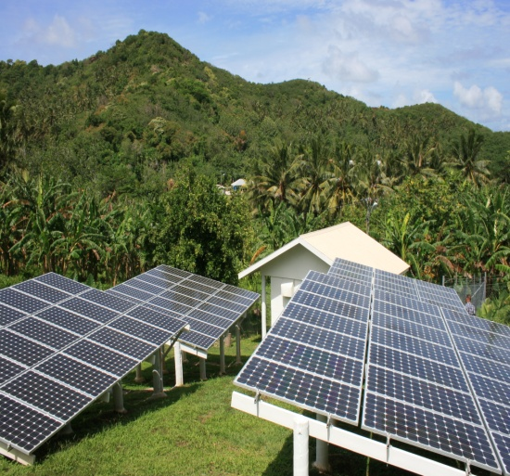
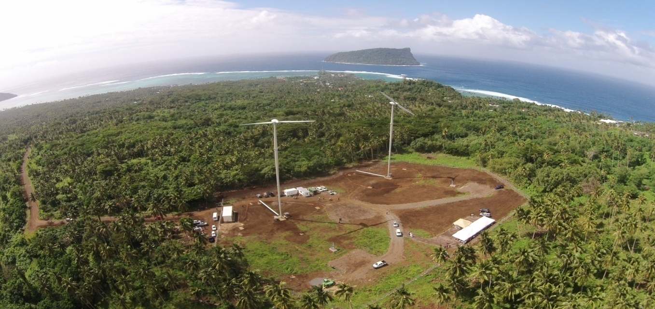
SAMOA

Slide 2
Policies/Regulations to Support Energy Transition
Strategy for the Development of Samoa 2016/17 – 2019/20
Quality Energy Supply “Sustainable Energy Supply towards energy self sufficiency”
Samoa Energy Sector Plan 2012-2016 (new plan is in draft 2017-2020)
Reduce the growth rate in the volume of Imported fossil
fuel by 10% by 2016;
To be 100% renewable energy (electricity) supply by 2017
INDCs Implementation Strategy 2016: “100% renewable energy target for electricity generation in 2017 through the year 2025”
Energy Efficiency Bill 2015.

Slide 3
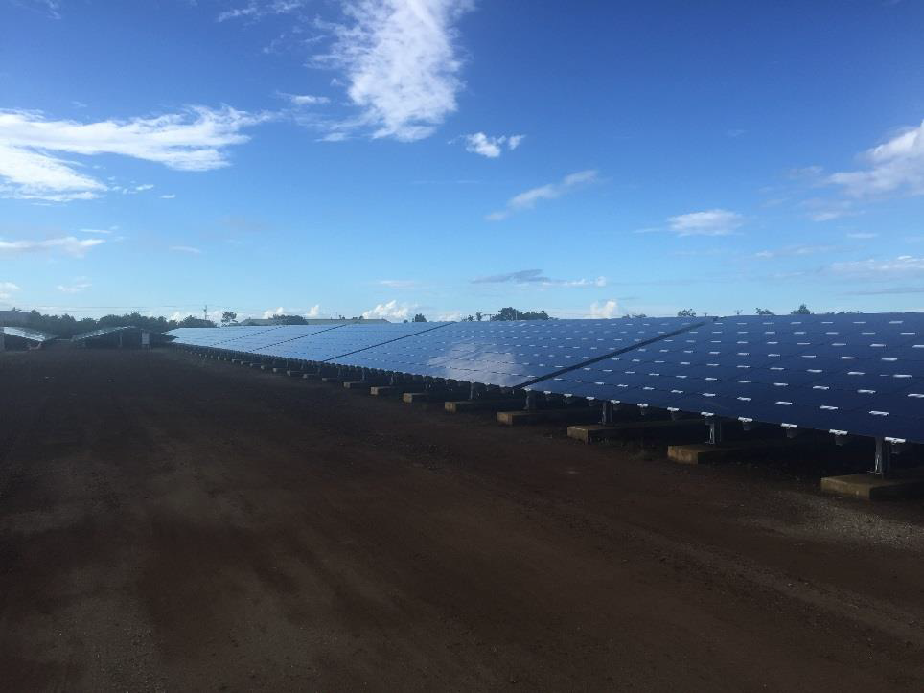
Renewable Energy Project
Solar Project
Company – Solar for Samoa Ltd (Independent Power Producer)
Technology – Solar System dc Photovoltaic
System size – 3.1MW
Ownership model –
Percentage of capacity – Powered by 47,360 thin film PV modules with each capacity of 110Wp

Slide 4
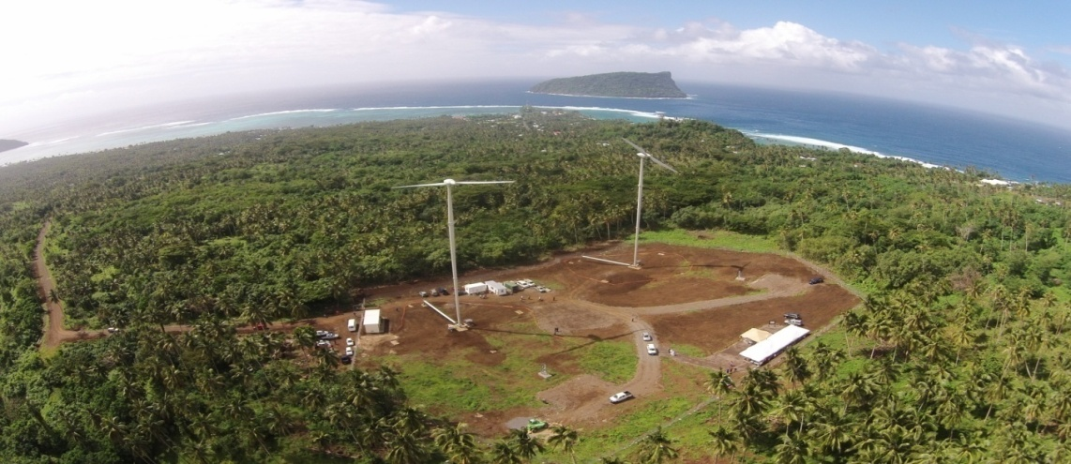
Renewable Energy Projects
2. Vailoa Aleipata Wind Farm
Donor Partner – United Arab Emirates Government (Masdar)
Technology – Wind energy
System size – 550kW, two 55m high wind turbines, each producing 275kW, total output of 1.5 millions units pa

Slide 5
Notable Successes and/or Challenges
Challenges
Lack of Legal energy framework to guide energy developments
Lack capacity of staff in understanding various Renewable Energy technologies
Natural resources for RE are under ownership of the people (villages)
Purchasing Power Agreement (agreeing on the selling price)

Slide 6
Workshop Expectations/Outcomes
Identify and understand methods of successfully deploying renewable energy technologies.
The transitioning process from fossil fuel to Renewable Energy
Current Renewable Energy Policies which guide the transitioning of the energy systems.

Slide 7
SAMOA
Notable Successes and/or Challenges
Lack of Legal energy framework to guide energy developments
Lack capacity of staff in understanding various Renewable Energy technologies
Natural resources for RE are under ownership of the people (villages)
Purchasing Power Agreement (agreeing on the selling price)
Workshop Expectations/Outcomes
Identify and understand methods of successfully deploying renewable energy technologies.
The transitioning process from fossil fuel to Renewable Energy
Current Renewable Energy Policies which guide the transitioning of the energy systems.
Policies/Regulations to Support Energy Transition
Strategy for the Development of Samoa 2016/17 – 2019/20
Samoa Energy Sector Plan 2012-2016 (2017-2020 in draft)
Intended Nationally Determined Contribution Implementation Strategy
Energy Efficiency Bill 2015
Renewable Energy Projects: Constructed or In Process
Solar Project
Wind Project

Slide 8
Thank you

