Slide 1
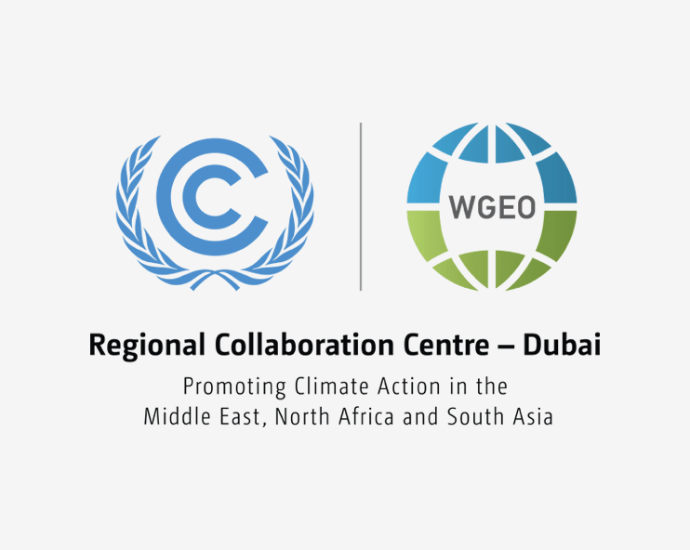


COP 26 Climate-Energy Dialogue in the Middle East and North Africa
27 April 2021
11:30 – 13:30 (GMT + 4)

Slide 2
Please make sure to mute yourself during the session to avoid background noise
A recording of the webinar will be available on the IRENA website
If you encounter any technical issues, please write your issue in the chat box

Slide 3
Opening Remarks
Scene - Setting Presentation: IRENA’s NDC Support in the Middle East and North Africa
Panel Discussion 1: Achieving and advancing the NDC targets through energy sector transformation
Scene - Setting Presentation: Promoting Green Recovery in the MENA
Panel Discussion 2: Promoting Green Recovery in MENA linked with NDCs and long-term strategies
Closing Remarks
AGENDA

Slide 4
Francesco La Camera, Director General, IRENA
James Grabert, Director, Mitigation Division, Acting Director, Communication and Engagement Division, UNFCCC Secretariat
Janet Rogan, UK COP26 Ambassador for Middle East and North Africa, Eastern Europe and Central Asia
Opening Remarks

Slide 5

Scene-setting presentation
IRENA’s NDC Support in the Middle East and North Africa
Gurbuz Gonul, Director, Country Engagement and Partnerships (CEP)

Slide 6
IRENA’s NDC Support in the Middle East and North Africa
27 April 2021
11:30 – 13:30 (GMT + 4)

Slide 7
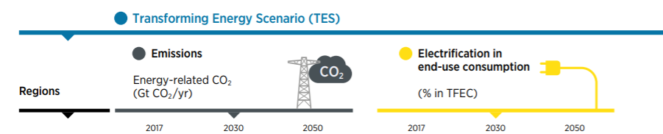
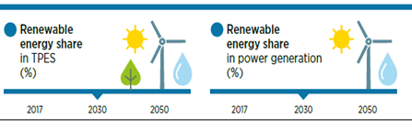

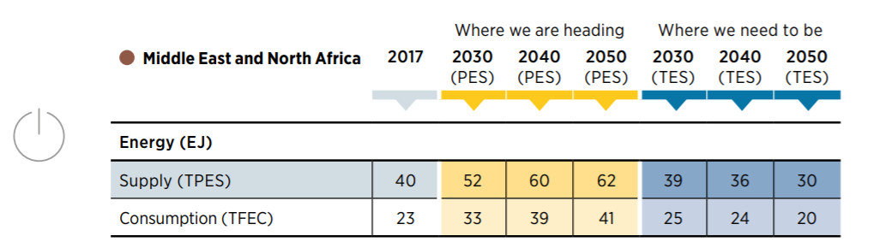
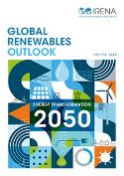
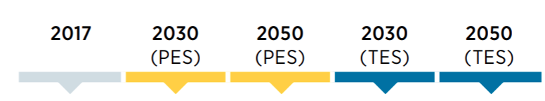



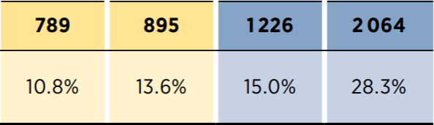
Energy Transition in the Middle East and North Africa
Improved energy efficiency leading to lower energy supply and consumption
Renewable energy jobs in energy-sector employment (%)
Renewable energy jobs (thousands)

Slide 8
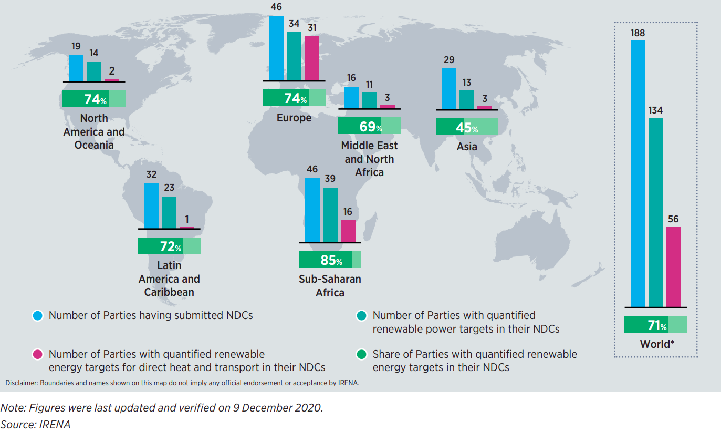
Renewable Energy Components in Nationally Determined Contributions
188 NDCs submitted
134 mention quantifiable targets for renewables.
26 include Long-Term low emission development strategy

Slide 9
IRENA’s NDC Engagement
3 bn
tonnes
CO₂ – eq. annually
Europe
Albania
Belarus
Bosnia and Herzegovina
Georgia
N.Macedonia
Turkey
Asia
Azerbaijan
Bhutan
Cambodia
Indonesia
Kazakstan
Kyrgyzstan
Lao PDR
Mongolia
Myanmar
Nepal
Pakistan
Thailand
Uzbekistan
SIDS
Antigua & Barbuda
Bahamas
Barbados
Belize
Dominica
Dominican Republic
Fiji
Grenada
Guyana
Mauritius
Nauru
Palau
Papua New Guinea
Saint Kitts & Nevis
Saint Lucia
St Vincent & Grenadines
Sao Tome & Principe
Seychelles
Tonga
Vanuatu
4 MENA countries
MENA
Egypt
Jordan
Lebanon
Sudan
Latin America
Colombia
Cuba
Ecuador
El Salvador
Nicaragua
Panama
Paraguay
Uruguay
Benin
Botswana
Burkina Faso
Cameroon
Eswatini
Gabon
Gambia
Liberia
Mali
Mozambique
Niger
Nigeria
Rwanda
South Africa
Uganda
Zambia
Zimbabwe
Sub-Saharan Africa
NDC Support Finalised (8)
Implementation of Support (32)
Work plan development (09)
Scoping / Initial discussions (19)
Disclaimer: Boundaries and names shown on this map do not imply any official endorsement of acceptance by IRENA.

Slide 10
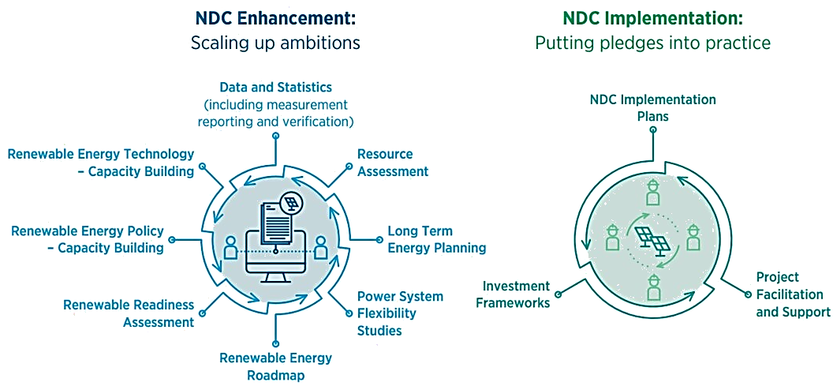
How IRENA Helps Countries Strengthen their Climate Pledges

Slide 11
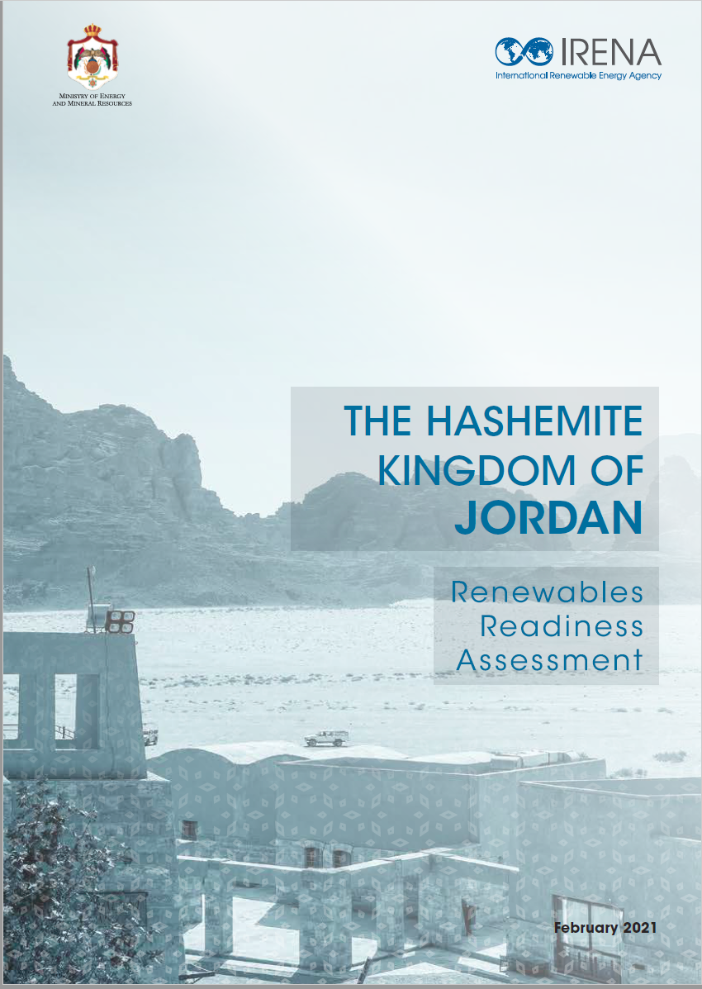
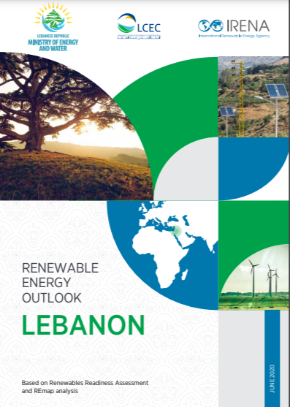
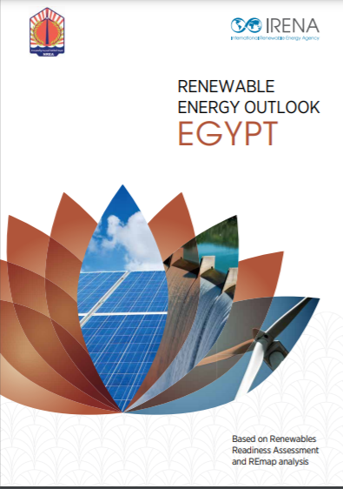
Nationally Determined Contributions (NDCs)
IRENA’s Engagement in the Region
Areas of Support
Activities under support
Capacity Building on policy and finance
Resource Assessment support
Renewable energy investments and project facilitation
Type of Support
Human capacity and skills building
Renewables Readiness Assessment
Enhancement
Enhancement & Implementation
Implementation
1
2
1

Slide 12
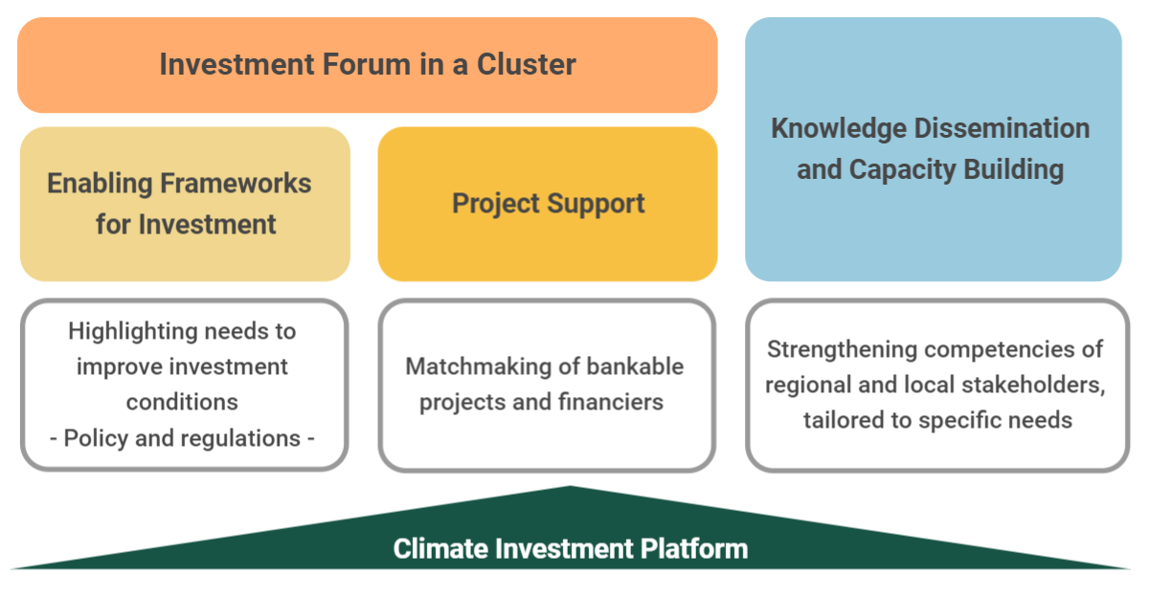


Climate Investment Platform: Investment Forums

Slide 13
IRENA’s NDC CONTACT POINTS
Mr. Gurbuz Gonul Director, Country Engagement and Partnership (CEP) GGonul@irena.org IRENA Headquarters, Masdar City P.O. Box 236, Abu Dhabi United Arab Emirates
Mr. Binu Parthan Head, Regions BParthan@irena.org | Mr. Zoheir Hamedi Regional Programme Officer, zhamedi@irena.org | Ms. Reem Korban Associate Programme Officer rkorban@irena.org

Slide 14
Moderator: Conor Barry, Team Lead for Intergovernmental Negotiations Unit and NDC/LT-LEDs / Sectorial Support Unit, UNFCCC secretariat
Panelists:
Mary Awad, Ministry of Environment, Lebanon, Project Officer, Climate Change Projects
Mohamed Ouhmed, Ministry of Energy, Mines & Environment, Morocco, Director for Renewable Energy and Energy Efficiency
Nagmeldin Mahmoud, Higher Council for Environment and Natural Resources, Sudan (HCENR), Director of the General Directorate of Climate Change
Thibaud Voita, NDC Partnership, Head of Knowledge Products
Radia Sedaoui, UNESCWA, Chief Energy Section
Panel Discussion 1
Achieving and advancing the NDC targets through energy sector transformation

Slide 15
Scene-setting presentation
Promoting Green Recovery in MENA linked with NDCs and long-term strategies
Roula Majdalani, Cluster Leader
Climate Change and Natural Resource Sustainability Cluster

Slide 16
COP 26 Climate-Energy Dialogue in the Middle East & North Africa Region
Webinar, 27 April 2021
Promoting Green Recovery in MENA linked with NDCs and long-term strategies
Roula Majdalani
Cluster Leader
Climate Change and Natural Resource Sustainability Cluster

Slide 17
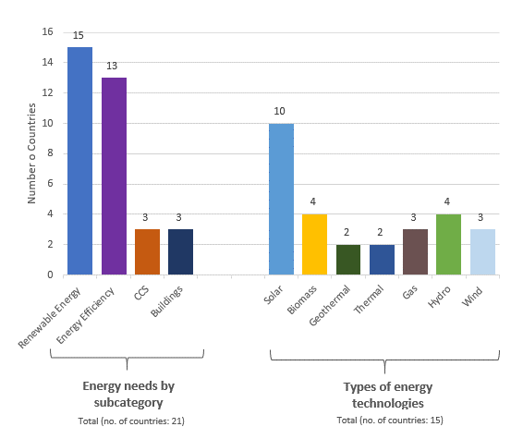
21 Arab States identify energy sector targets in their NDC and other UNFCCC official submissions
Key energy needs identified include:
  Network upgrade to allow it to integrate renewable energy (smart metering or smart grid systems, regional interconnection and storage capacity);
  Increasing the accessibility to electricity in rural and peri-urban areas by financing hybrid solutions with renewable energy for rural mini networks;
  Reducing energy import dependence via RE;
  Diversifying energy sources by increasing reliance on renewable sources and energy efficiency measures; and
  Increase access to modern energy for lighting and heating to the poorer communities and internally displaced populations IDPs to replace charcoal.
      Source: League of Arab States, UNFCCC, and ESCWA, Forthcoming.

Slide 18
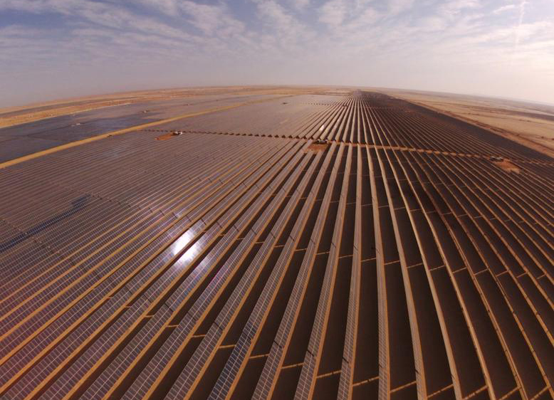
The Arab region is making progress towards its targets
Nearly all Arab countries have committed to increasing the share of renewable energy in the national energy mix:
  Morocco committed to 50% by 2030;
  Egypt to 40% by 2035;
  Oil producing states such as UAE, Algeria, and Qatar committing to 20-30% within the next twenty years.
The region is also making progress …
  The UAE continues to set the pace in reducing the cost of producing solar energy leading to a tariff reaching AED 4.97 fils/kWh (USD 1.35 cents/kWh) in 2020.
  The Middle East’s largest wind power plant will be constructed in 2022 in Saudi Arabia.
  Jordan is seeing rapid growth in renewable energy deployment.

Slide 19
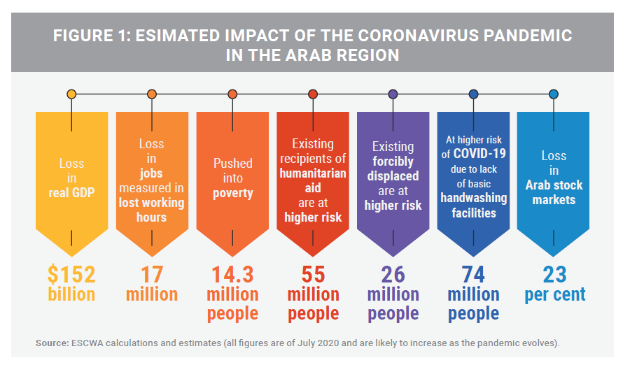
Arab Governments are Juggling Competing Priorities and Facing Fiscal Strain
Estimated Impact of the Coronavirus Pandemic in the Arab Region

Slide 20
Just 11 of 21 Arab NDCs include estimated finance needs for NDC implementation. Most do not provide granular estimates.
Egypt, Iraq, & Morocco account for 80% of climate finance needs estimated in Arab NDCs
Source: Developed by ESCWA
Source: Developed by ESCWA

Slide 21
The supply of climate finance is well below the estimated need. This is a quantity problem. The purpose of support is not matched to the Arab priority of adaptation, and loans outnumber grants by 10 to 1. These are quality problems.
Note: Figures developed by ESCWA based on the OECD Climate Finance Database. The figure presented includes commitments with a “principal” climate Rio marker as well as “climate components” reported by multilateral development banks. Commitments with a “significant” climate Rio marker are not included.
Source: Adapted from ESCWA and IsDB, Forthcoming. Mainstreaming Climate into National Development Planning in the Water, Energy, and Transport Sectors.

Slide 22
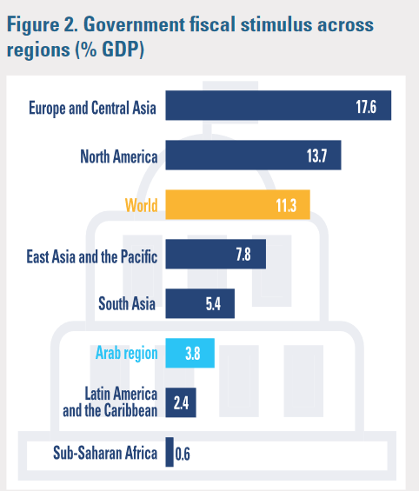
Green Recovery in the Arab Region
At global level, stimulus plan account for 22% of global GDP while in the Arab region, it accounts for less than 4% of the regional GDP.
1. Investment in recovery can fund green growth if well targeted:
  As countries revise/prepare new NDCs for COP 26, estimates of financial needs should be well quantified
  The region needs more public international finance support
  Arab States can also expand the application of innovative instruments such as green bonds to mobilize resources
  Continued strengthening of policy and regulatory environments that are conducive to RE and EE will also be critical to the capacity of Arab states to achieve increased ambition
2. Green investments can have co-benefits for climate action and building back better, including:
  Putting economic diversification on the right track
  Achieving job creation in Green growth sector
  Achieving Energy Security
Government fiscal stimulus across regions (%GDP)

Slide 23
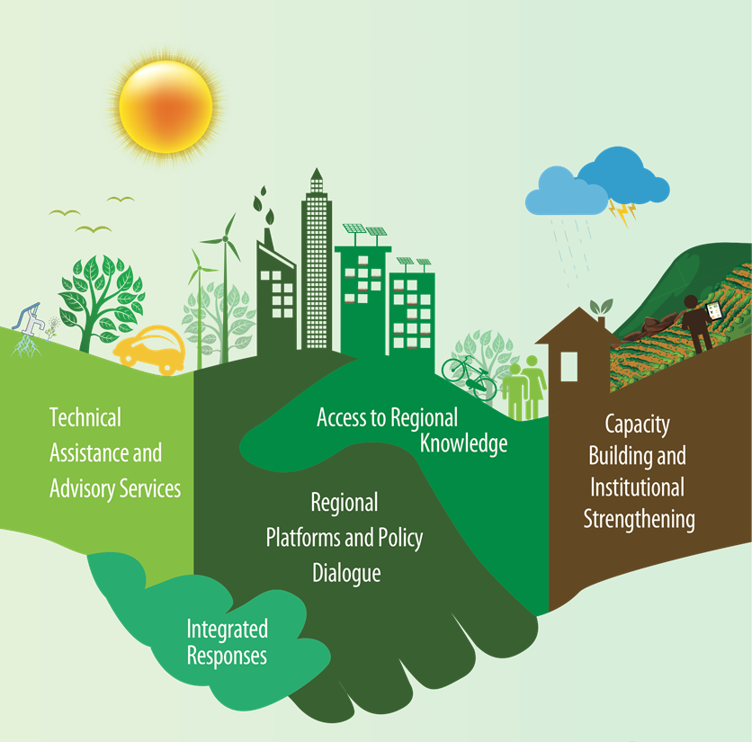
Arab Centre for Climate Change Policies
(ACCCP)
Arab Centre for Climate Change Policies was established pursuant to resolution 329 (XXX) adopted at the 30th ESCWA Ministerial Session (Beirut, 28 June 2018).
ACCCP aims to strengthen the capacity of Arab States to better understand and address the implications of climate change for sustainable development in key thematic areas.

Slide 24
Thank you !
For additional information, please visit ESCWA’s website on: www.unescwa.org

Slide 25
Moderator: Dolf Gielen, Director, IRENA Innovation and Technology Centre, IRENA
Panelists:
Ayman Tharwat, Minister plenipotentiary, Deputy Director of Environment and Sustainable Development, Ministry of Foreign Affairs, Egypt
Dr Rehab Almageed, Higher Council for Environment and Natural Resources, Sudan (HCENR), NDC Focal Point
Yacoub Marar, Ministry of Energy and Mineral Resources, Jordan, Director Renewable Energy and Energy Efficiency
Dr Maged Mahmoud, Regional Center for Renewable Energy and Energy Efficiency (RCREEE), Acting Executive Director
Mohamed Ossama, Project Director for TAQA Solar, TAQA Arabia, Egypt
Panel Discussion 2
Promoting Green Recovery in MENA linked with NDCs and long-term strategies

Slide 26
Closing Remarks
Binu Parthan, Head of Regions, Country Engagement and Partnerships

Slide 27
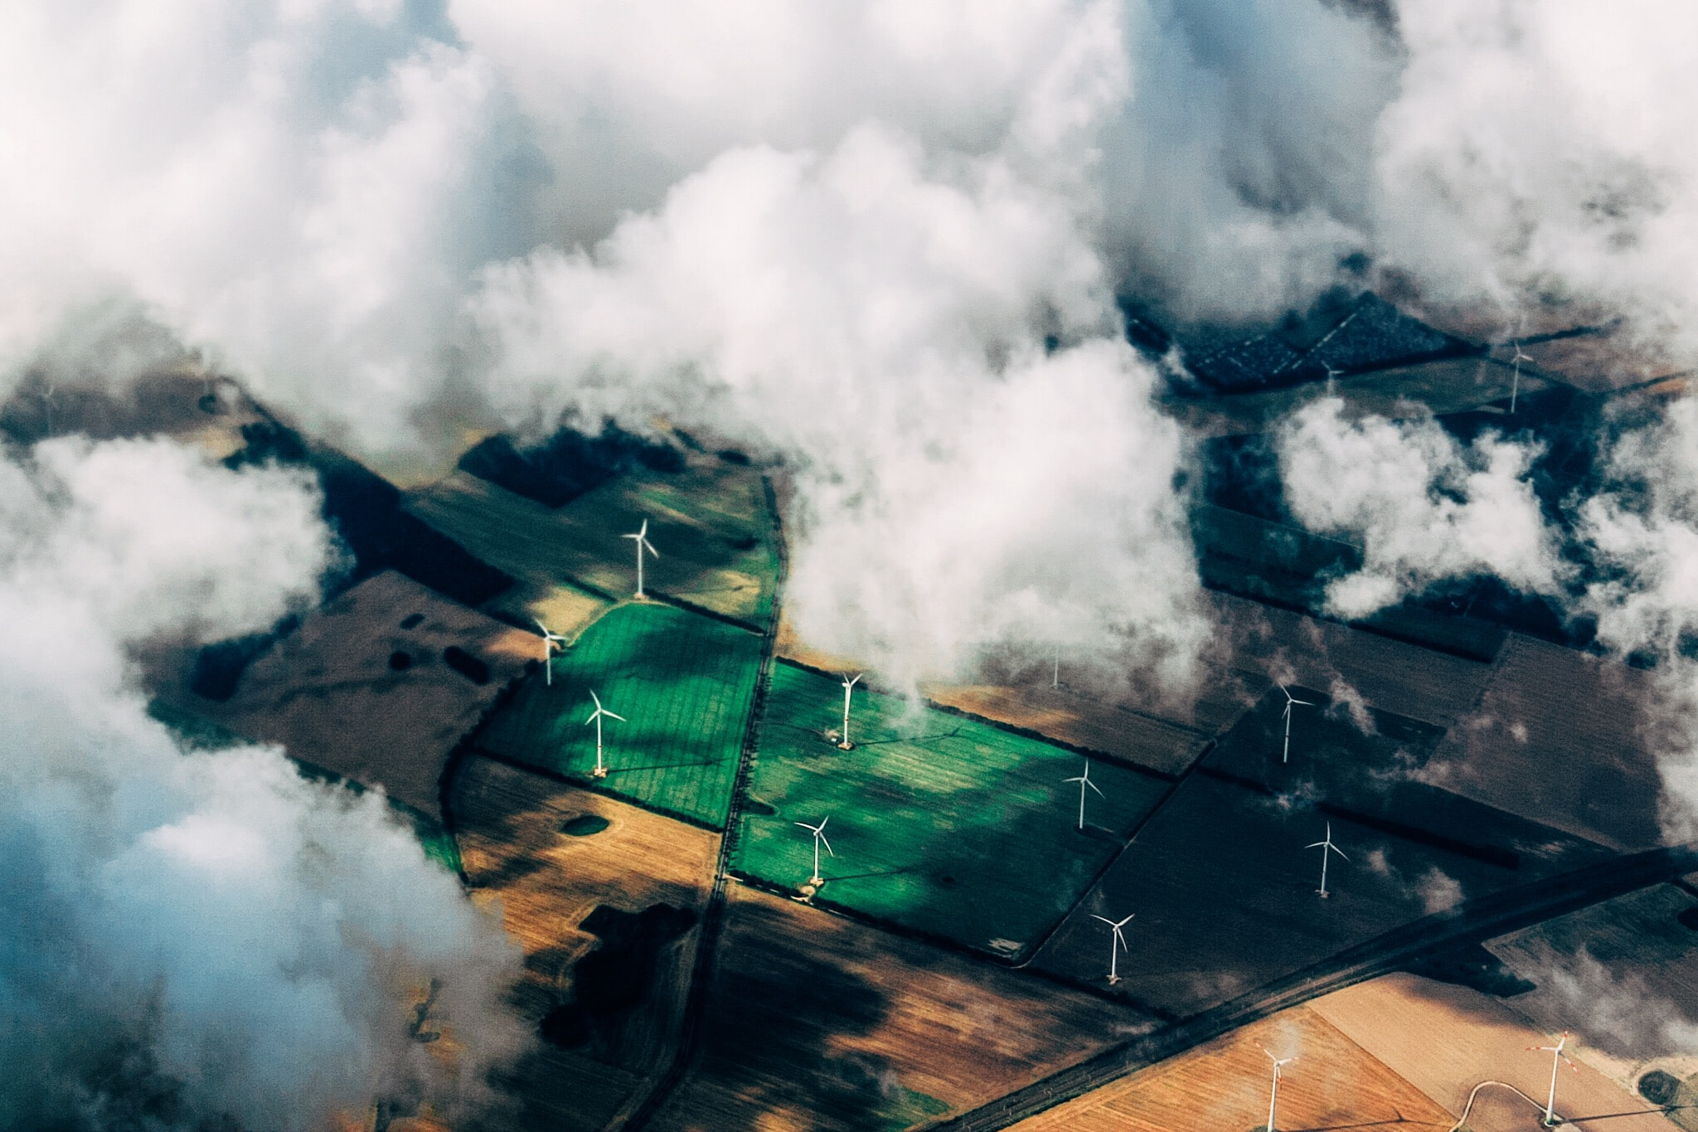

THANK YOU!
Source: unsplashcom

