Slide 1

Pacific NDC Dialogue:
Achieving NDC Targets in SIDS through Energy Sector Transformation

Slide 2
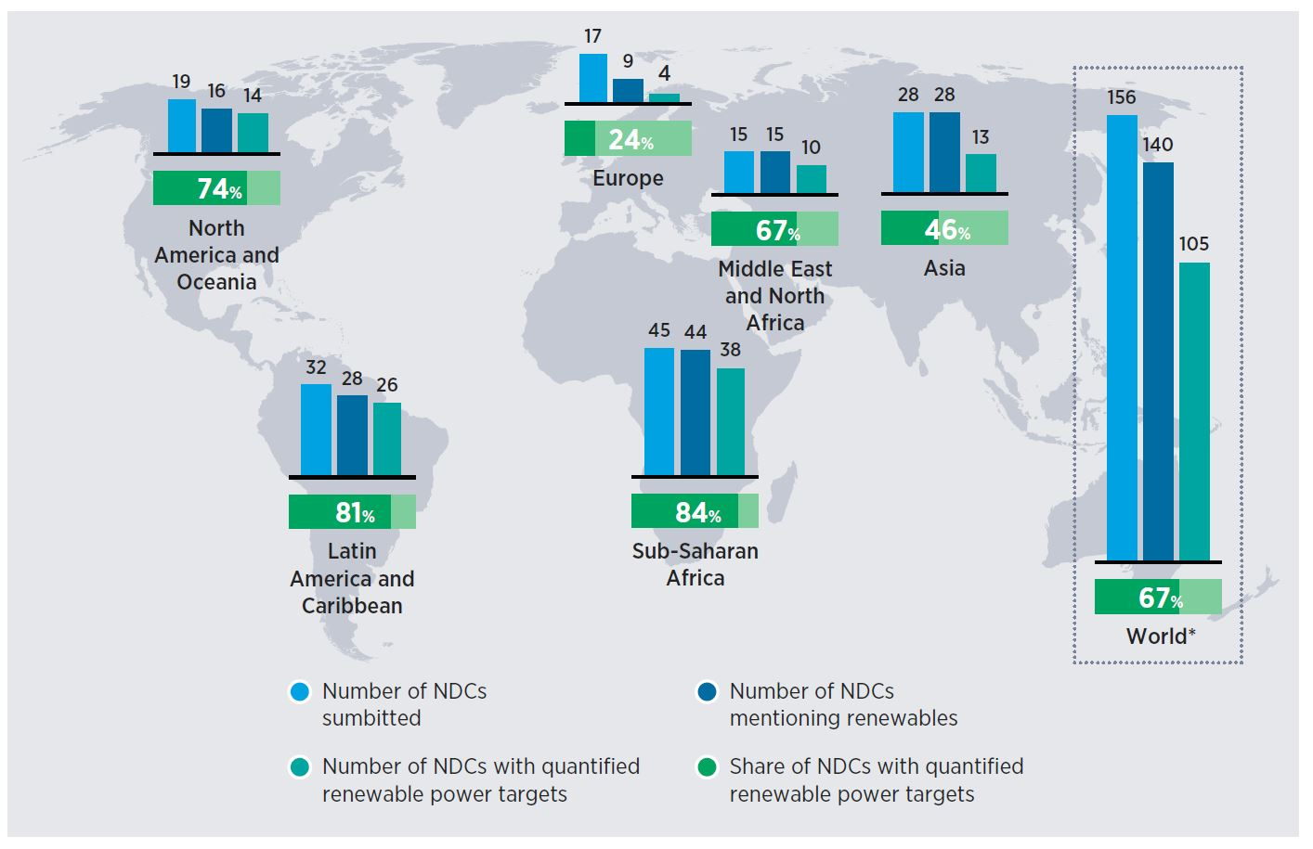
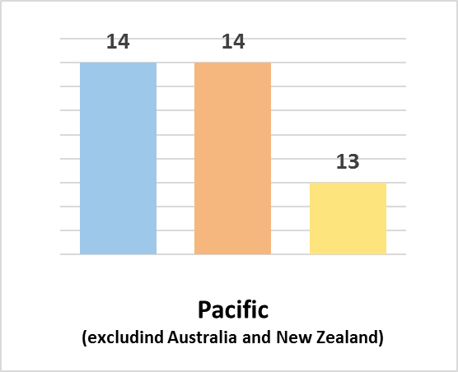
Renewable Energy in 1st NDCs
First NDC power targets overlook 59% of the
potential for renewable electricity deployment
in line with the Paris Agreement by 2030,
according to IRENA estimates
135 countries have renewable electricity targets in their national and sub-national energy plans
140 NDCs mention renewables in the power
sector, but only 105 NDCs of the 140 include
quantified targets for renewable electricity
To drive the changes needed for a climate-safe
future, NDCs must become more ambitious in
2020

Slide 3
NDC Enhancement Support
SOURCES OF REQUESTS
Data and Statistics
Resource Assessment
Long Term Energy Planning (LTEP)
Power System Flexibility (FlexTool)
Renewable Energy Roadmaps (REmap)
Renewable Readiness Assessment (RRA)
RE Policy – Capacity Building
RE Technology – Capacity Building
IRENA Receiving Direct Country Requests
IRENA Partnership with UNDP on Climate Promise
IRENA Partnership with NDC Partnership on Climate Action Enhancement Package (CAEP)

Slide 4
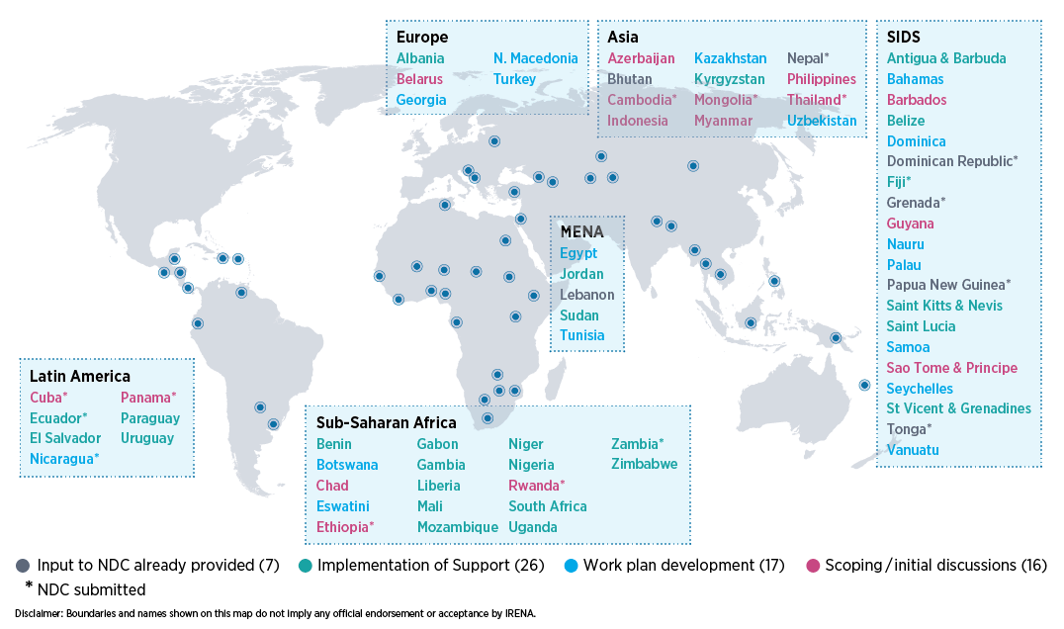
IRENA’s NDC-Energy Support
3 bn
tonnes
CO₂ – eq. annually
1.3 bn
people
21 SIDS
17 LDCs

Slide 5


IRENA NDC Implementation Support
Project Pipeline Development
Climate Investment Platform (CIP) and IRENA Project Facility 2.0
Investment Forums
Identification of a pipeline of public and private projects backed by governments
Project pre-screening
Regional interactive platforms in 14 regional clusters for matchmaking of investor-ready projects and enhanced government-investor dialogue
Technical Assistance for Stronger Enabling Frameworks
NDC implementation plans, investment frameworks, capacity building
Project preparation support for improved bankability
Facilitation of access to finance

Slide 6
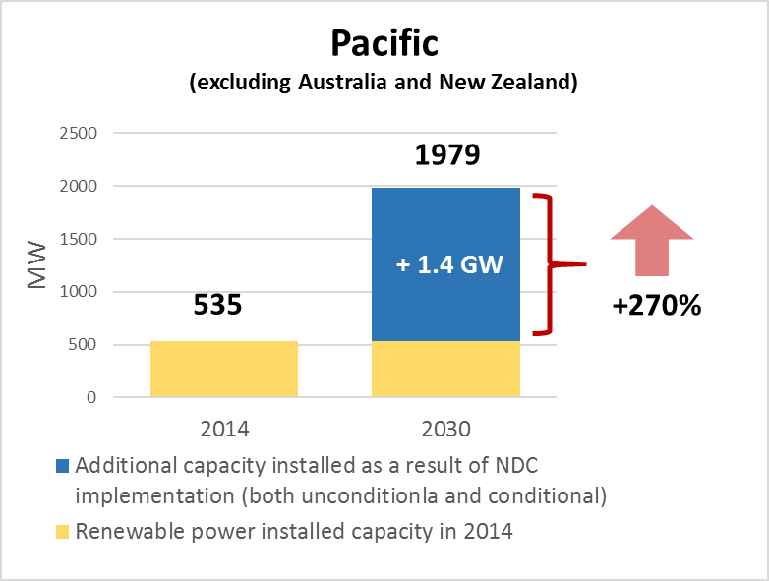
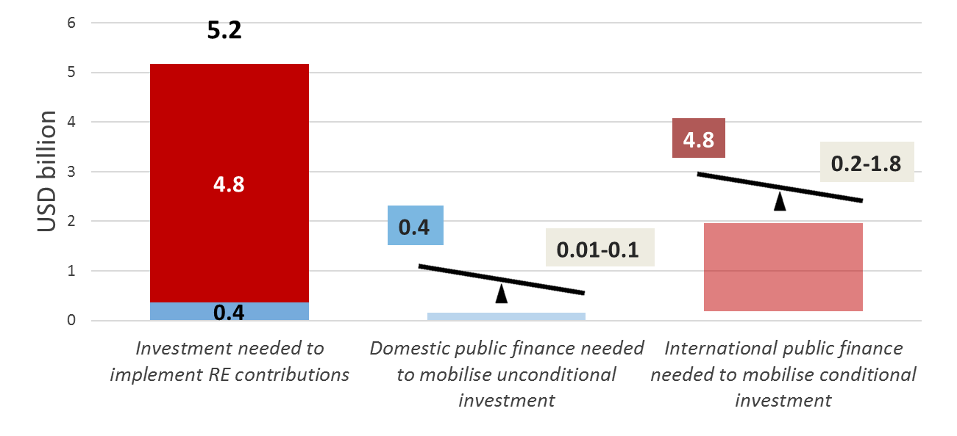
RE targets in Pacific NDCs
Additional RE capacity in Pacific NDCs
Additional investments needed by 2030

Slide 7

The SIDS Lighthouses Initiative
SIDS Lighthouses
Priority Areas
NDC enhancement and implementation support
Technical and regulatory advisory services
Promote all renewable sources, including geothermal and ocean energy
Foster access to finance and closer co-operation with the private sector
Strengthen institutional and human capacity development
Focus on transportation and end-use sectors
Energy efficiency
Renewable energy and other SDGs
Climate resilience and disaster recovery
Collection and dissemination of data and statistics
Foster partnerships and multilateral cooperation
Boost renewable power deployment (total target of 5 GW of installed capacity by 2023)
36 SIDS and 30 Partners
Framework to facilitate SIDS climate action through energy transformation
Addresses all elements of energy transition
Operationalises the Ambitious SIDS Climate Package and IRIE initiatives

Slide 8






IRENA’s Engagement on NDCs in the Pacific
Fiji: Review of energy data management methodology and of Climate Change Policy
Nauru: Support for project facilitation for climate proofing of health facilities across the island
Palau: Development of electricity roadmap to green hydrogen and ocean energy technologies
Tonga: Support on energy data management methodology, development and implementation of MRV system
Papua New Guinea: Energy data management for greenhouse gas emissions and NDC target tracking
Vanuatu: Development of a coconut biofuel strategy

Slide 9
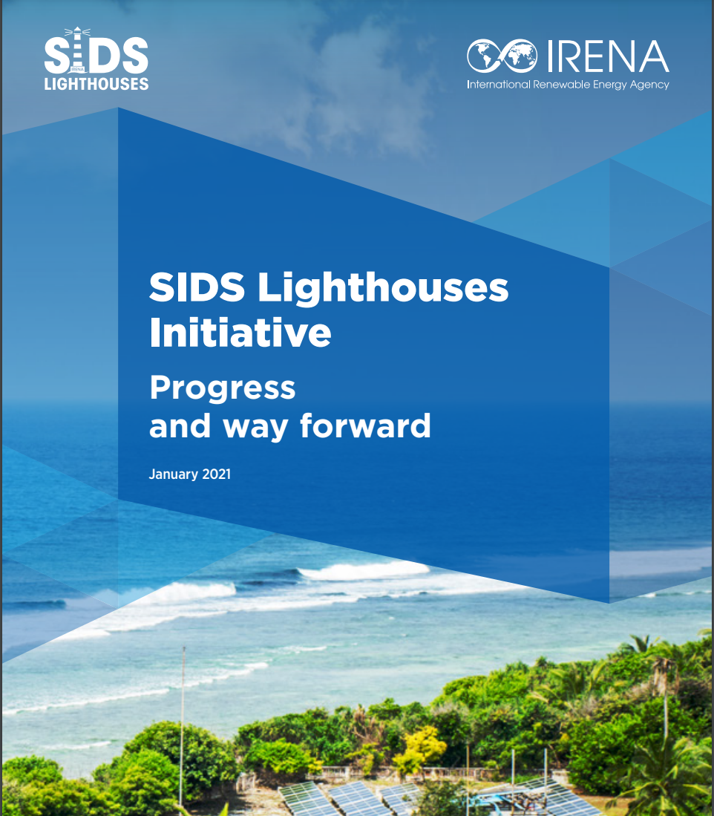
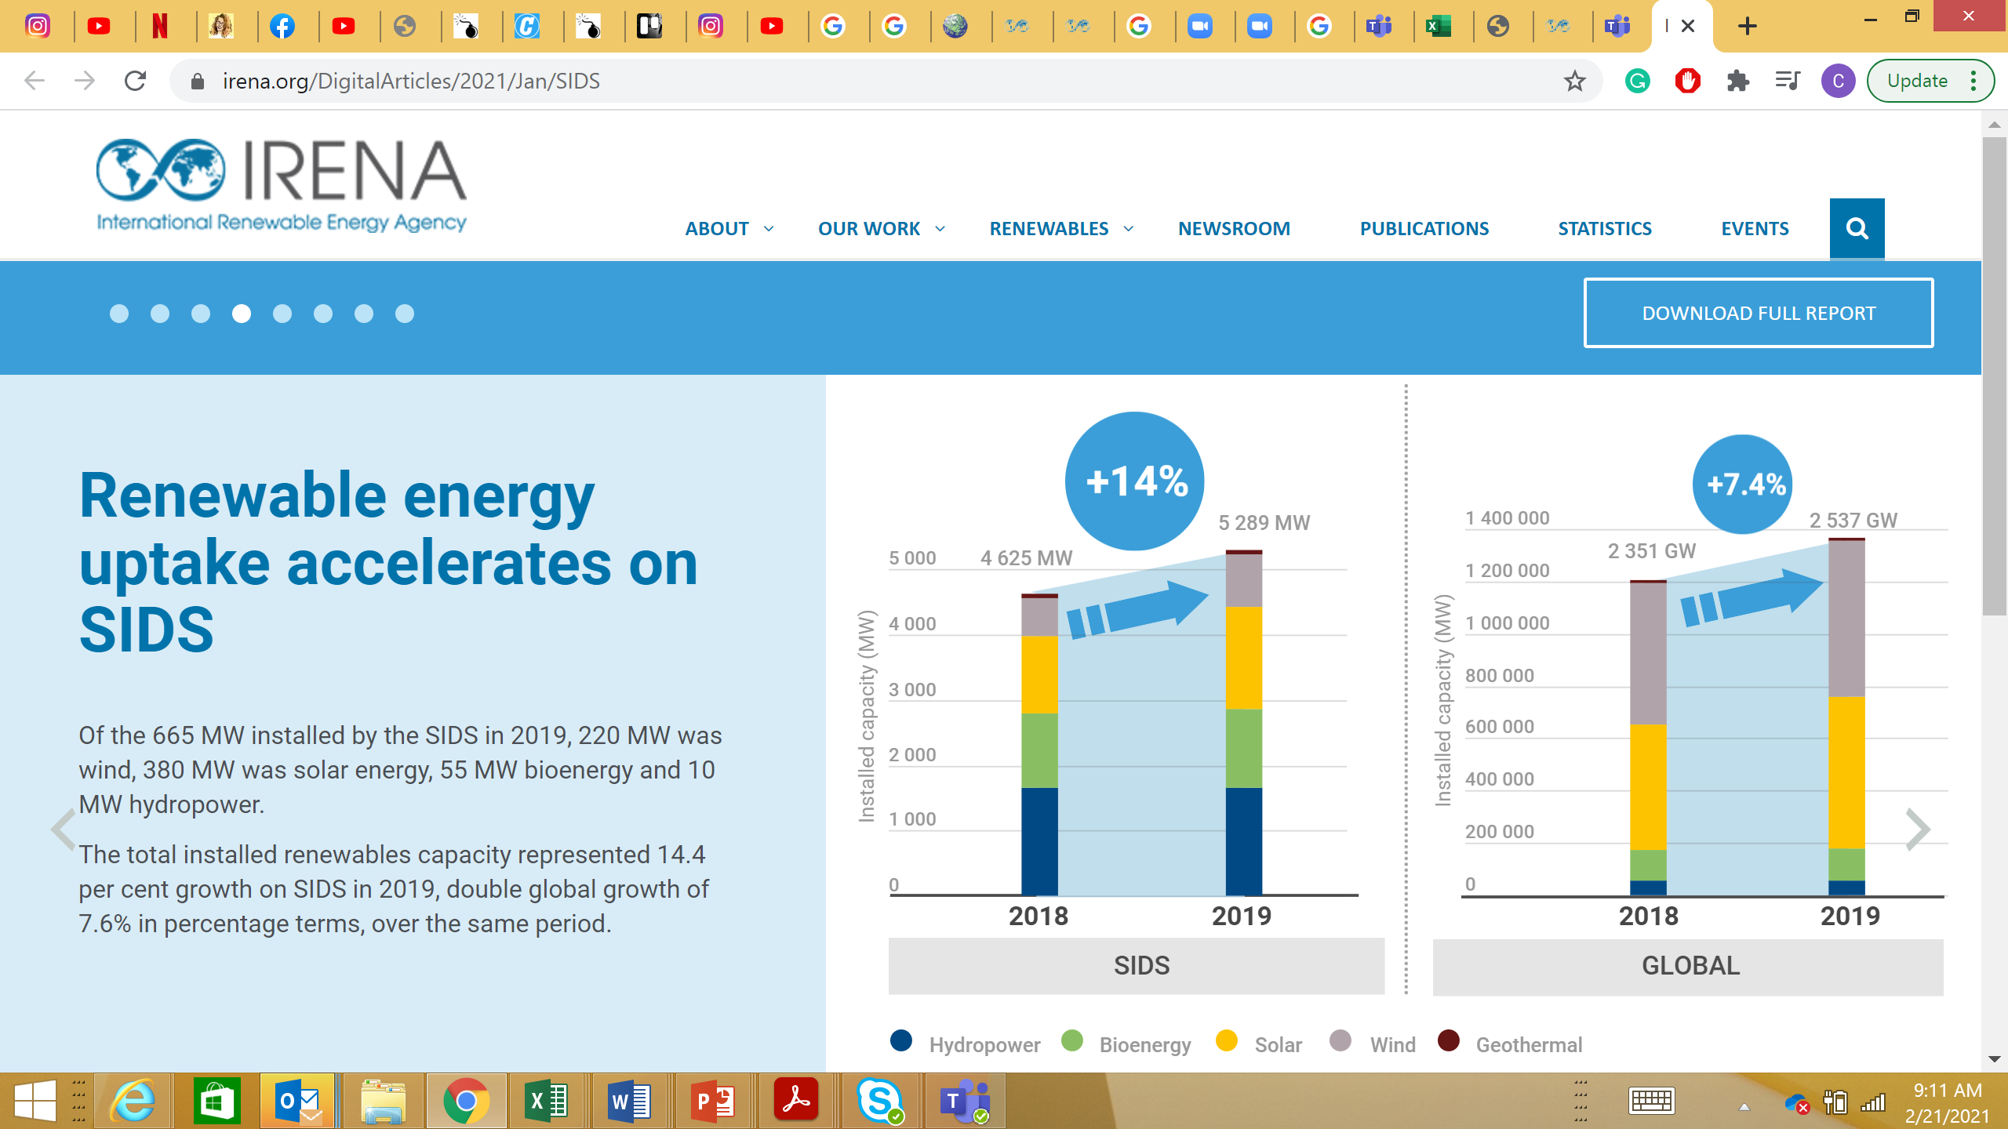
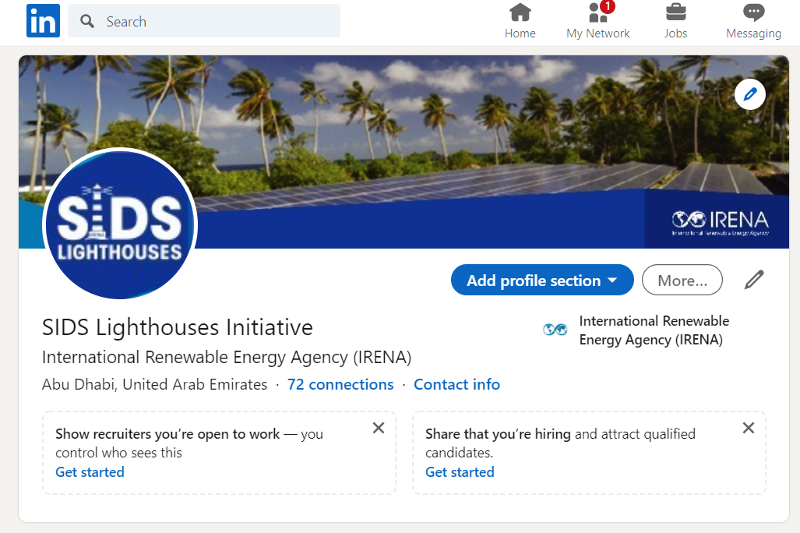
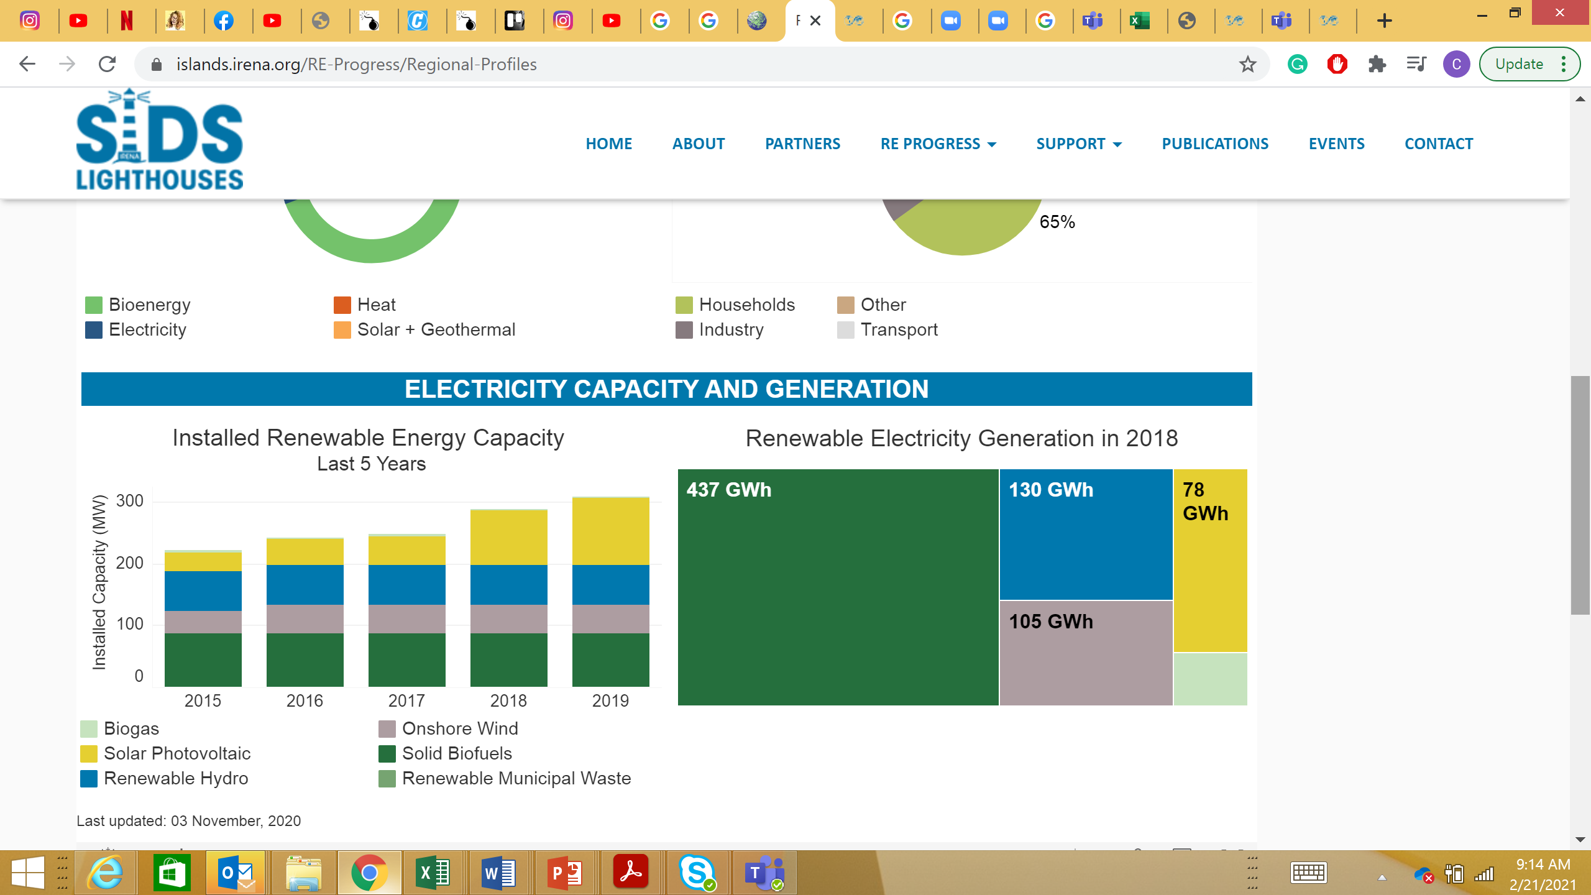
IRENA’s outreach for SIDS
Knowledge Sharing Platform
Website
LinkedIn
SIDS LHI Digital story
SIDS regional profiles

Slide 10
IRENA’s NDC and SIDS Lighthouses Contact Points
Mr. Gurbuz Gonul Director Country Engagement and Partnership (CEP) GGonul@irena.org, +97124179925 IRENA Headquarters, Masdar City P.O. Box 236, Abu Dhabi United Arab Emirates
SIDS LHI WEBSITE: https://islands.irena.org | SIDS LHI Email: Islands@irena.org

