Slide 1
Renewable Energy and Electricity interconnections
for a sustainable Northeast Asia
Hyun Ko
Programme Officer, Country Engagement and Partnerships

Slide 2
Joint Study on RE and Electricity Interconnection in Northeast Asia
  IRENA has conducted a joint study with KEEI for faster-pace developments of power grid interconnections and power trade in Northeast Asia region.
  By reviewing the outcomes of selected interconnection plans for integrating power systems in NEA, this report aims to provide stakeholders with an updated view of NEA interconnection.
  The report has also reviewed existing cases for cross-border interconnections and regional markets, particularly capturing the case in WAPP (shallow integration), SIEPAC and Nord Pool (deep) to draw success factors and implications for NEA region.
Available at www.irena.org/publications/

Slide 3
Current energy landscapes of Northeast Asia countries
Northeast Asia region has close trade relationship with each other, especially fossil fuels.
Energy co-operations in NEA are characterized by fossil-fuel oriented bilateral trades.
 |  | Mongolia | Russia
Importing countries | China | 2nd largest coal exporter | 2nd (Oil), 4th (Coal) largest exporter
 | Japan | - | 3rd (Coal), 5th (Oil and gas)
 | South Korea | - | 2nd (Coal), 4th (Oil), 7th (Gas)
* China began natural gas import from Russia via Power of Siberia pipeline (Dec. 2019)
Only a few small-size bilateral power interconnections have been realized (Mongolia-Russia, Mongolia-China, China-Russia)
The shift towards renewable energy production already started in NEA region.
Renewable energy power generation (2018): China (1st), Russia (7th), Japan (8th)
Recent developments point towards an increasing trend of energy connectivity in the region (China-South Korea power interconnection, etc.)

Slide 4
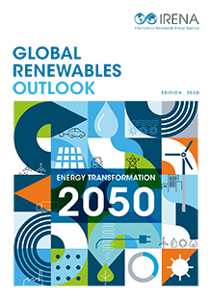
Transforming energy scenario for Northeast Asia
IRENA GRO (Global Renewables Outlook) analysis shows annual energy-related CO₂ emissions need to decline by 70% below today’s level by 2050
In the NEA region, energy-related CO₂ emissions can fall by more than 80% in the next 30 years
This will require increasing the share of renewable energy in total power generation from 23% to 90% by 2050
Renewable electricity generation capacity from 870 gigawatts (GW) today to 7 600 GW), of which three quarters will be solar and wind energy.

Slide 5
Review of selected studies on NEA regional electricity interconnection plans
To date, an extensive body of studies and plans on Northeast Asia interconnection propose a variety of possible grid formations and interconnection paths.

Slide 6
Review of selected interconnection studies/plans
Studies have identified that NEA regional interconnection is economically feasible and desirable from an environmental, social, and political perspective
Renewable electricity development is taking central stage at the NEA interconnectivity development studies.
The studies demonstrate that renewable resources would allow NEA interconnections to significantly lower regional carbon emissions
Future steps require an agreement on a unified view of the future grid configuration and should reflect the ongoing global energy transformation
Future studies must seek various non-technical and non-economic impediments
Diverse renewable energy generation options should be considered including wind and solar PV, , while reflecting declining cost of renewables as well as market developments in the region
Policy constraint both for coal and natural gas need to be incorporated in modelling
Further work needs to establish clear priority lists for transmission and generation projects

Slide 7
Case Study
Three cases were selected to provide insights and options for different stages of future development pathways in NEA region.
Each case study presents political/economic overview, infrastructure, institutions, and electricity market development in each region
While recognising significant differences to NEA region, these cases demonstrate many available options for establishing interconnectivity

Slide 8
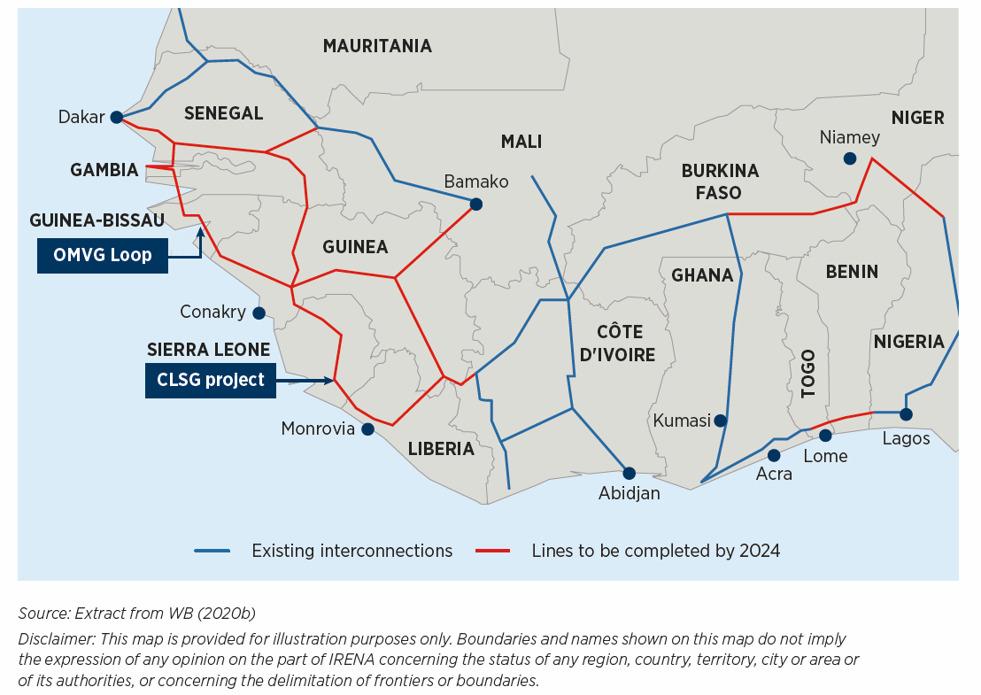
Case Study – West Africa (WAPP)
established in 1999
Electricity trade is largely on a bilateral basis with standardized templates and rules for PPAs and TSAs
Regional interconnections enable a list of hydro- power projects to access market and reap larger consumer benefits
ECOWAS masterplan aims 38% of total electricity production coming from renewables by late 2020s
WAPP prepare priority projects, demonstrate bankability, and mobilse finance
WAPP aims to create a day-ahead electricity market by the mid-2020’s in line with the completion of Interconnection infrastructure (i.e. CLSG, OMVG, ICC)
Interconnection infrastructure and generations has been built in scale (CLSG and OMVG projects) in last 10 yrs

Slide 9
Case Study – Central America (SIEPAC)
Established in 1996 under the framework treaty on the REM (Competition, Gradualism, Reciprocity)
Regional market operates as a secondary market (“6+1=1” model).
Full third party access, freedom to buy and sell are guaranteed. Transmission rights are auctioned.
RE generation represents 49% of the total regional portfolio, while hydro-power takes the highest share
VRE accounts for average 13% to a maximum 27% in the regional market.
Increasing share of VRE requires more robust measure to ensure system stability
Cross-border interconnections (1,790 km) and national grids need to be strengthened
The role of CDMER, EPR (SPC), MDBs were critical in region-specific investment projects

Slide 10
Case Study – Europe (Nord Pool)
Cross-border interconnections developed from the early 20th century
NORDEL (joint body of the Nordic TSOs) founded in 1963 and Nord pool was formed in 1996. Today, EU governs cross-border trade issues
Most electricity is traded through market, while direct sales and PPAs are possible
Nord pool demonstrates the appeal of competitive day-head market under deep integration model.
Competitive market leads to a more efficient utilisation of interconnection infrastructure and generation resources
Nordic countries pursue high share of RE in their energy mix (41.8% in 2009 to 53.5% in 2019)
The wide balancing area enable high shares of variable wind energy in the system.
Grid investment will see further increases due to increased integration of VRE

Slide 11



Lessons learned from West Africa, Central America and North Europe
Explicit political commitment
Free trade, economic co-operation and integration, political collaboration and partnership
Economic and financial benefits
Motives to trade based on cost differential between trading partners
Infrastructure and time needed for an interconnected system
Key infrastructure already in place to develop regional interconnectivity and market
Electricity markets
Regional market development interlinked with grid development
Separated national-regional markets vs. a single market
Institutions
Vital role of utilities in regional institutions
Regional structures having similar elements of national structures
West Africa Power Pool (WAPP)
Central American Integration System (SIEPEC)
Powr system interconnection is a comprehensive project creating regional interconnection infrastructure, institutions and electricity market through a series of coordinated action
Nordic Power Market

Slide 12
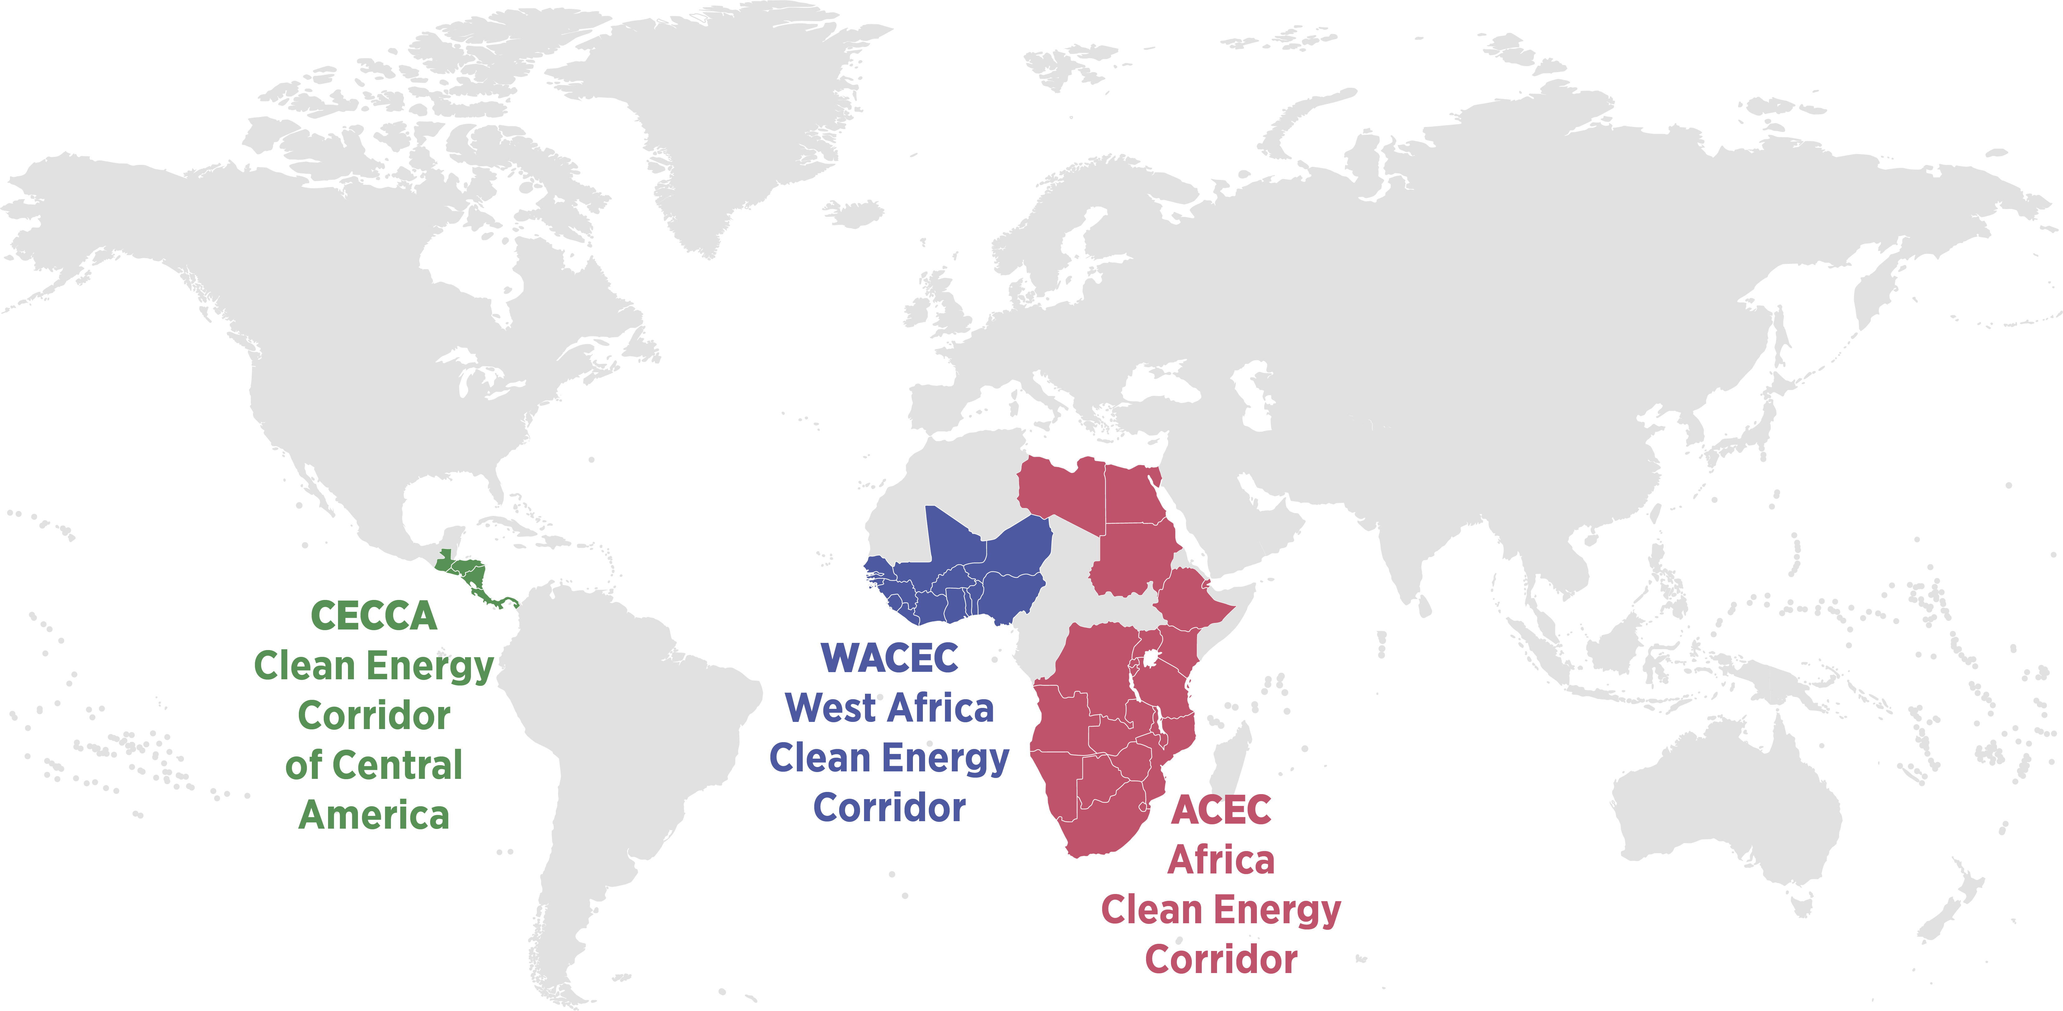
IRENA facilitates renewables-based cross-border interconnections
Africa
Programme for Infrastructure Development in Africa (PIDA) – Phase 2 (w/ AUC and partners)
Africa Continental Power Systems Masterplan (w/ AUDA-NEPAD, Power Pools, IAEA)
Northeast Asia
Regional electricity interconnection (w/ADB, ESCAP)
South America
Regional electricity integration of the South Cone countries (SIESUR) (w/ IDB, OLADE)
Clean Energy Corridors
Integration of cost-effective renewable energy options into power systems
Promotion of cross-border trade of renewable electricity

Slide 13
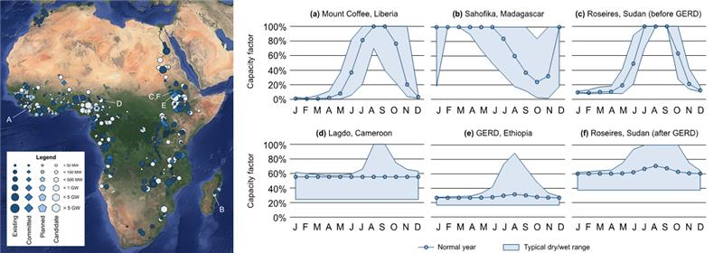
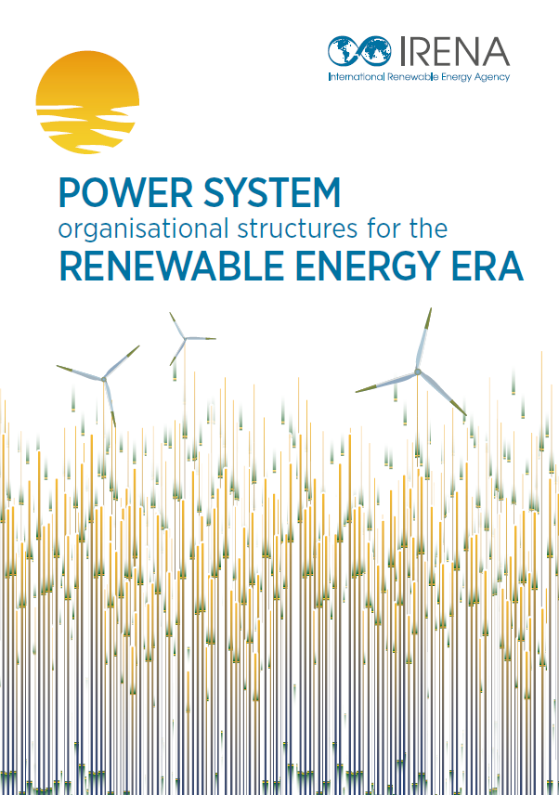
IRENA’s works on Clean Energy Corridor and power market design
Africa Clean Energy Corridor
The African Union (AUDA-NEPAD), five African power pools adopted MESSAGE/SPLAT model as official modelling tools for the Continental Power System masterplan
Africa Hydropower Database (resource assessment through the Global Atlas platform)
Capacity Building
Regulatory and technical framework
Collaborative Framework
platform to facilitate peer-to-peer collaboration and exchange of knowledge to overcome challenges faced by the countries with high shares of renewables in their energy system
Cross-Border Interconnections (May 2021), around 120 participants from 52 Members
2019
2020
2021
Forthcoming full report on
organizational structures

Slide 14
Thank you

