Slide 1
SCENARIOS
FOR THE ENERGY TRANSITION
Experiences and good practices in Latin America and
the Caribbean

Slide 2
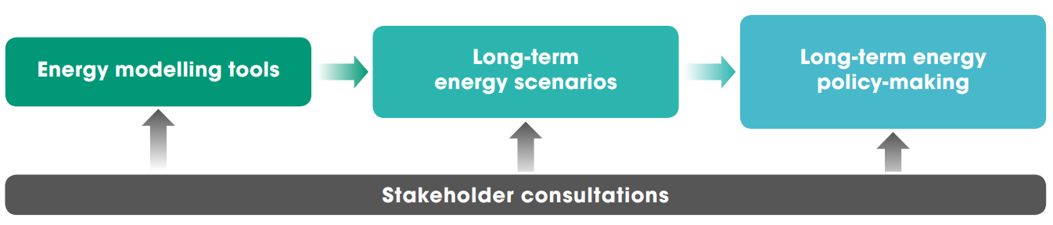
WHY LONG-TERM ENERGY SCENARIOS?
What is new?
Global decarbonization agreements. Massive technology innovation
Long-term visions for clean energy transition.
Avoiding risks. Represent transformative changes
Fundamental tool for policy making.
National policymaking. Public opinion
How are scenarios developed and used in the energy planning process?
Notes:
Could be divided into 2 slides

Slide 3

















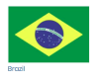





















LONG TERM ENERGY SCENARIOS INITIATIVE AND NETWORK
Promote the effective use and development of “long-term energy scenarios” (LTES) to guide national policymaking in pursuit of the clean energy transition
26 government planning institutions
11 technical institutions supporting government
Including 3 CEM member countries
7 Technical partners

Slide 4
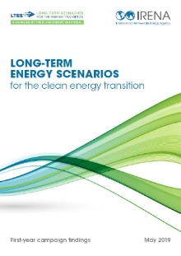
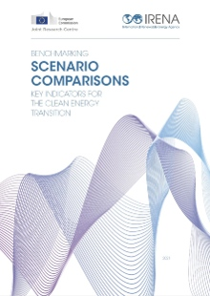
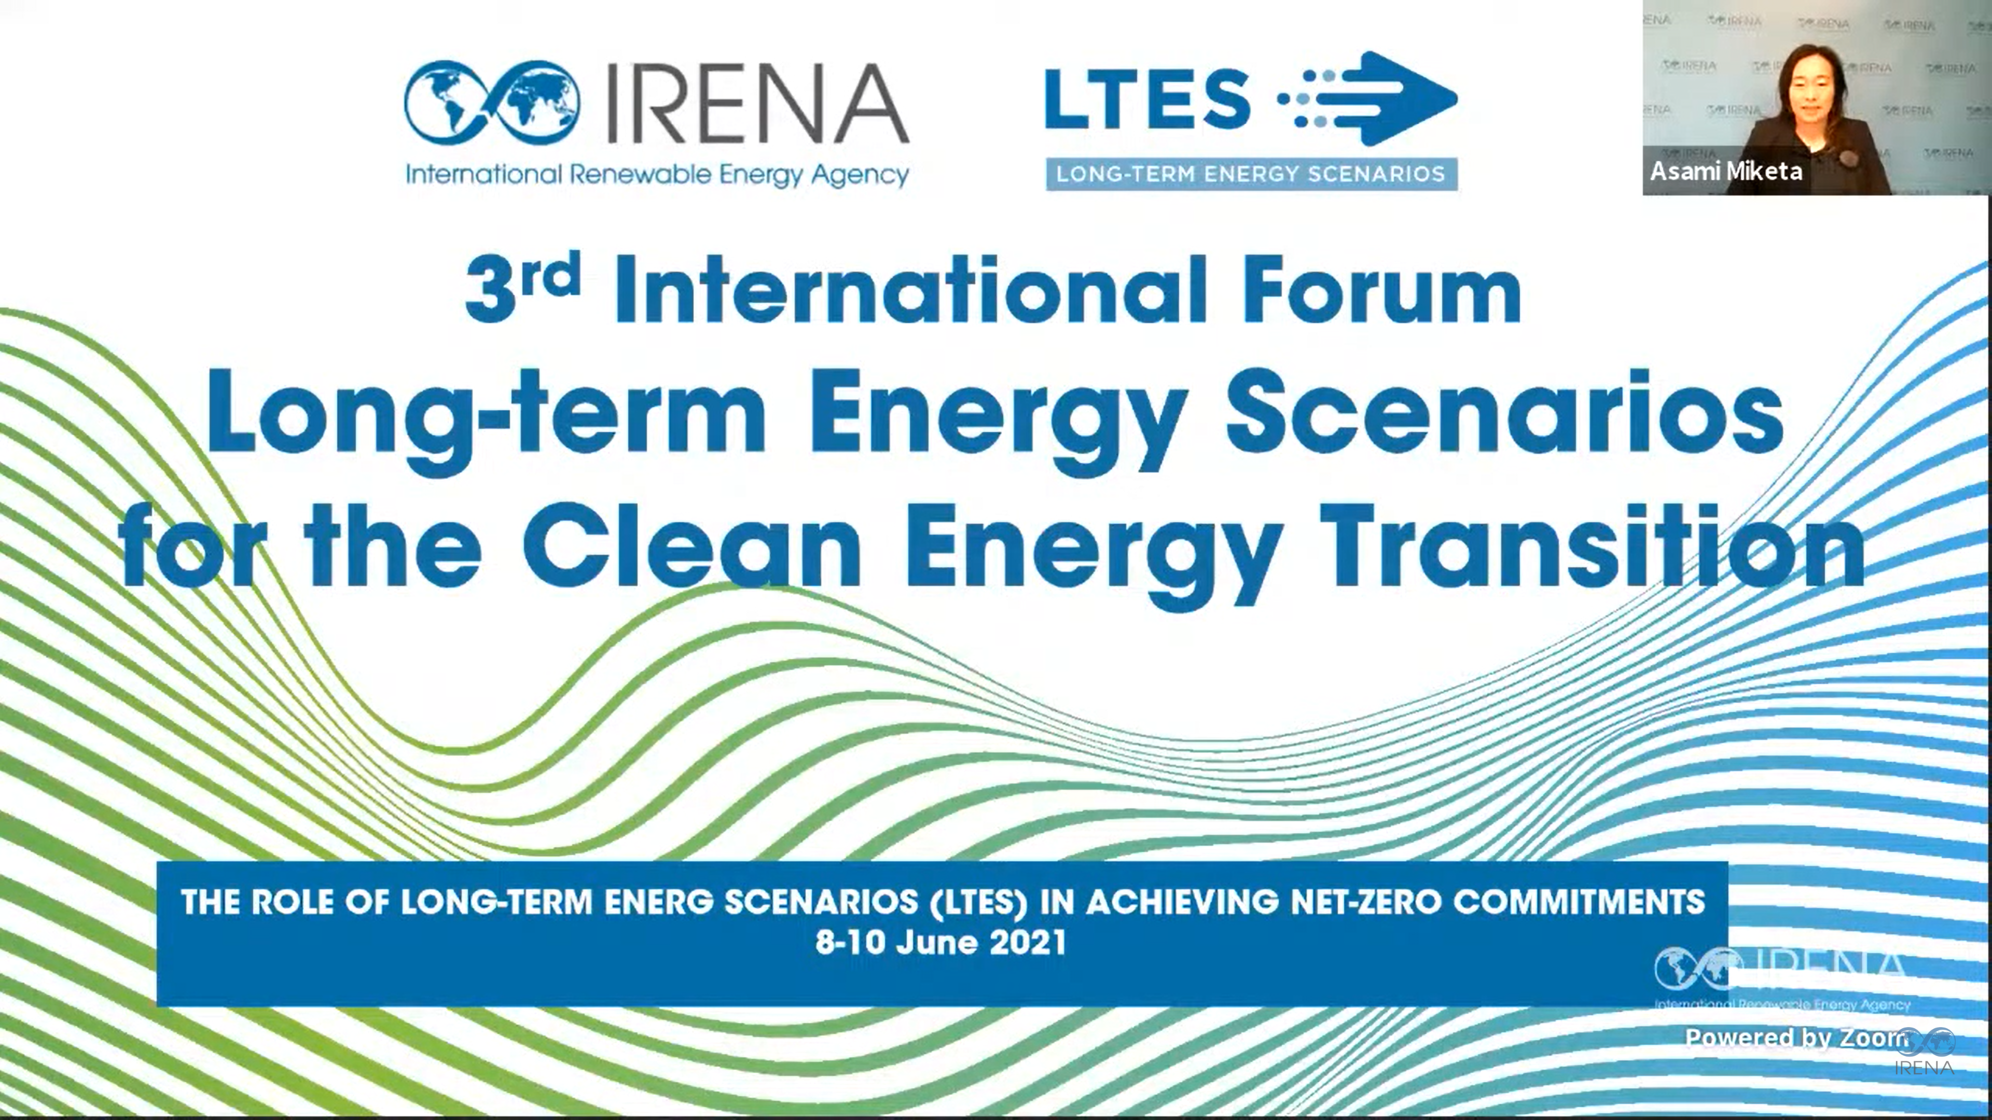
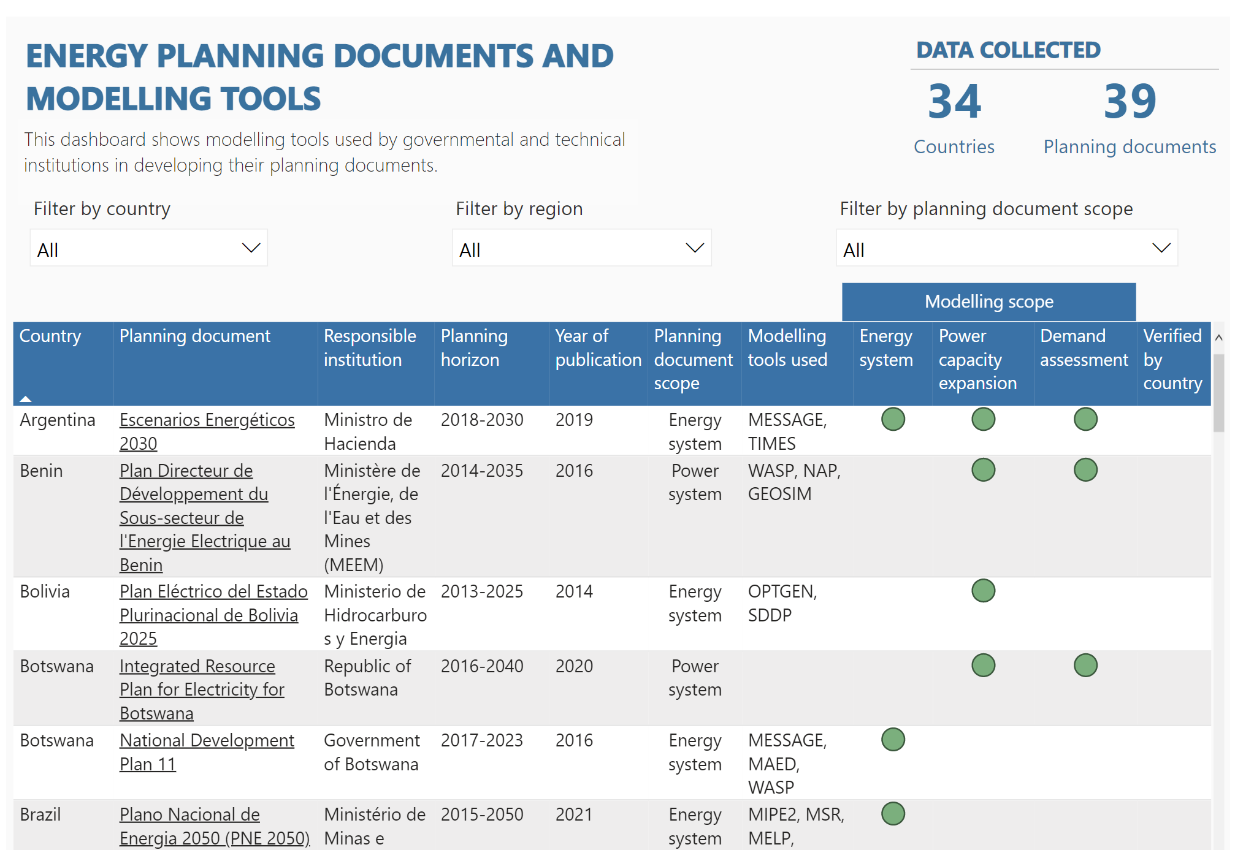

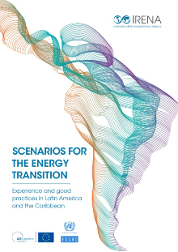
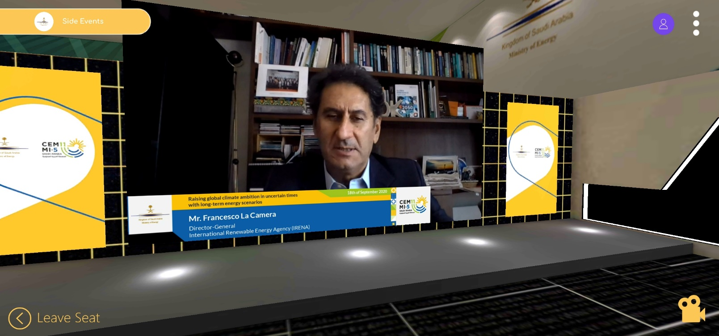
LONG-TERM ENERGY SCENARIO NETWORK
GLOBAL PLATFORM FOR KNOWLEDGE
Good practices and benchmark
Experts and high-level discussions
Convey knowledge to model scenarios
International Forum of LTES for the Clean Energy Transition, June 2021
11th Clean Energy Ministerial, September 2020

Slide 5
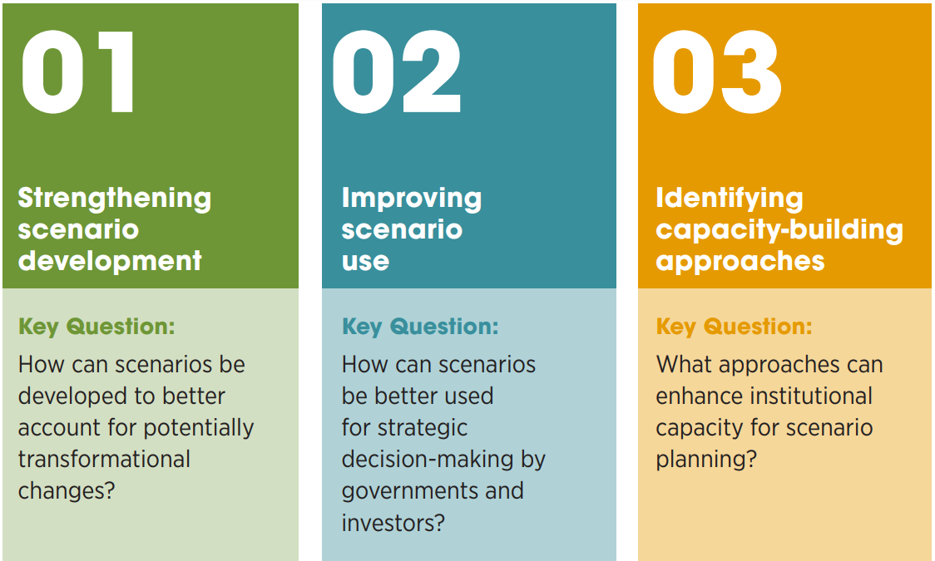
LONG-TERM ENERGY SCENARIO NETWORK
FOCUS

Slide 6














SCENARIOS FOR THE ENERGY TRANSITION
Experiences and good practices in LAC in the development and use of long-term energy scenario
https://www.irena.org/publications/2022/Jul/Scenarios-for-the-Energy-Transition-LAC

Slide 7
SCENARIOS FOR THE ENERGY TRANSITION
Key findings
The LAC region is developing energy scenarios with a broader scope that goes beyond technoeconomic criteria.
A number of LAC governments are developing increasingly integrated and long-term energy scenarios linked to their climate goals.
There is a growing emphasis on participatory scenario development as part of energy planning processes in the LAC region.
The long-term scenarios analysed by LAC countries are increasingly based on larger shares of renewables in their energy mix and on more efficient energy consumption.
Transparent energy data and statistics are crucial to the development of more reliable scenarios.
The support provided through international co-operation has been crucial in enabling many LAC countries to develop energy scenarios for medium- and long-term energy planning.

Slide 8
UPCOMING KEY ACTIVITIES
Africa report of webinar series “Long-Term Energy Scenarios (LTES) For Developing National Energy Transition Plans In Africa”.
Clean Energy Ministerial 13
Side Event on Transport
4th international forum on Long-Term Energy Scenarios.
Stocktaking report and presentation at COP27

Slide 9
THANK YOU!
9
Notes:
Could be divided into 2 slides

