Slide 1

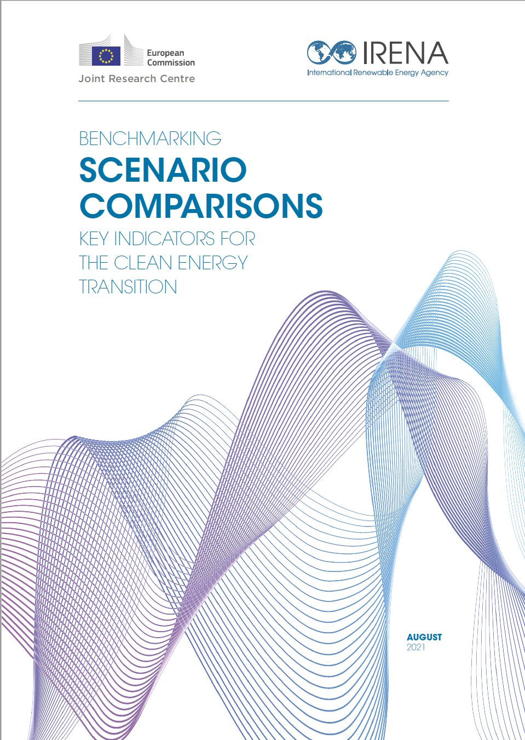
7th International Conference on Renewable Energy Sources and Energy Efficiency
“Effective stakeholder engagement for energy scenario communication”

Slide 2
Agenda
5 min. | Opening Remarks: Ministry of Energy Cyprus.
15 min. | Presentation: IRENA LTES Network
15 min. | Presentation: Climate Compatible Growth –CCG– D2D
15 min. | Presentation: International Calculator Programme
15 min. | Country case: Cyprus case on the use of participatory process
35 min. | Discussion and Q&A
5 Minutes | Closing

Slide 3
Opening Remarks:
Dr. Stella Hadjiyiannakou
Ministry of Energy Cyprus

Slide 4
Participatory Processes for Developing National Long-term Energy Scenarios
Introductory slides
Scene-setting
Juan Jose Garcia, Programme Officer, IRENA
12 October 2023

Slide 5
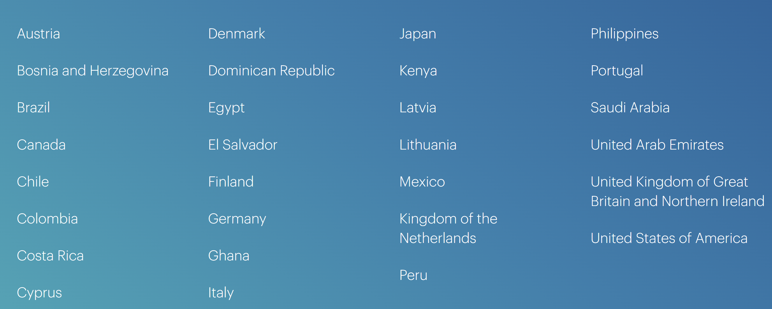
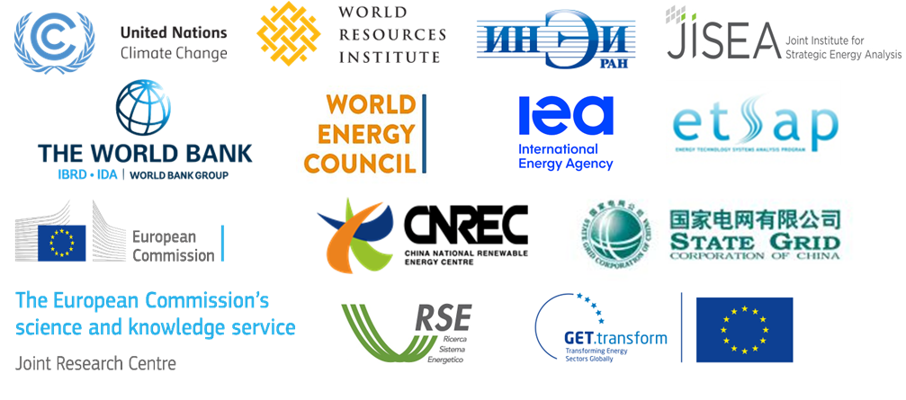
Long-term Energy Scenario (LTES) Network
LTES Network – Overview
Provides a global platform to exchange national LTES practices among scenario practitioners.
Promotes wider and more effective use of LTES for the clean energy transition in governments.
+60 countries examples synthetized in analytical reports.
Over 70 international and regional events and webinars organized.
      29 members
      12 technical partners institutions

Slide 6
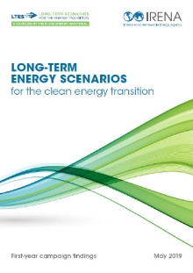


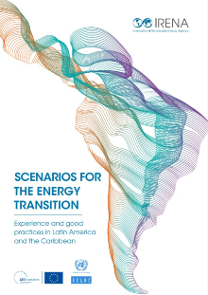

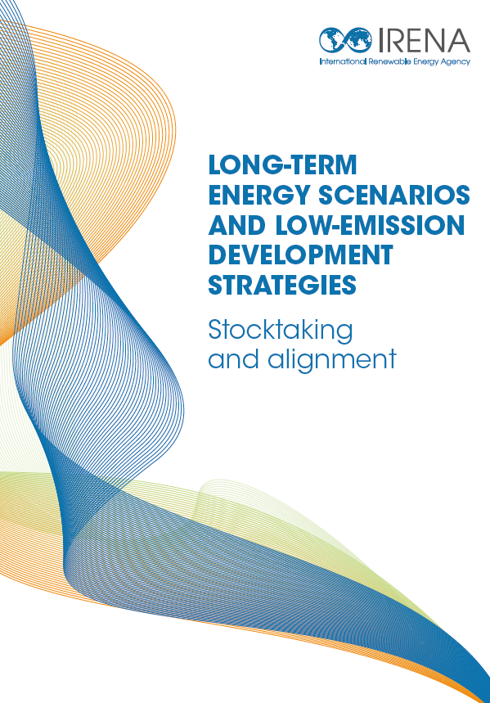
Long-term Energy Scenario (LTES) Network
Focus
Practices and experiences collected

Slide 7
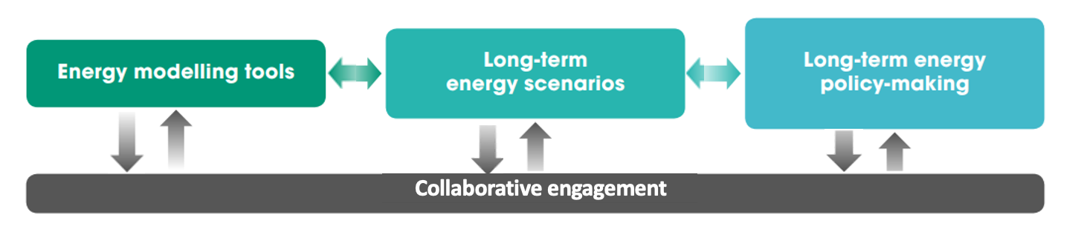
Long-term Energy Scenarios Initiative and Network
A transparent and open LTES development process is essential for the clean energy transition
Source: IRENA 2020, Scenarios for the Energy Transition (adapted)
Notes:
Usual explanation here, but to stress that while we used to consider things a one way communication to stakeholders, collaborative engagement is what is needed, which includes communication and the participation of various in the various stages of scenario development

Slide 8

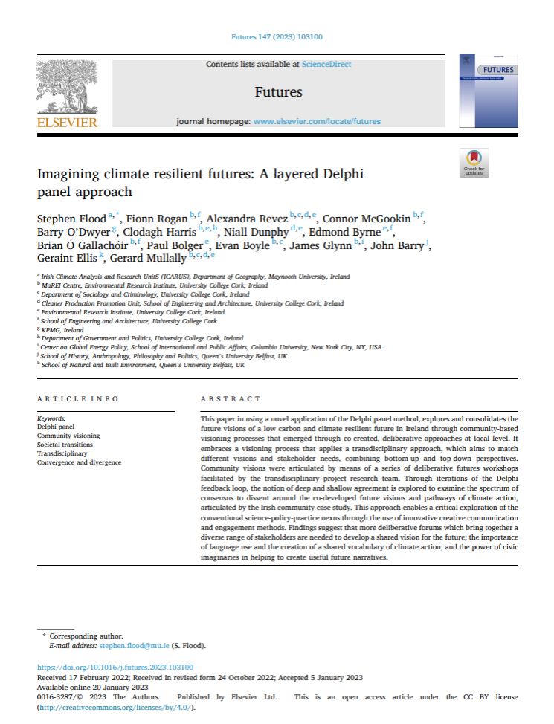
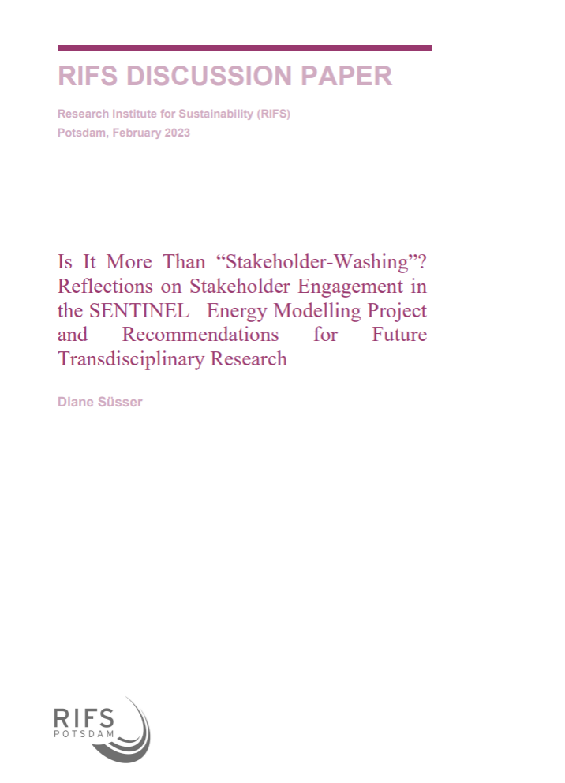
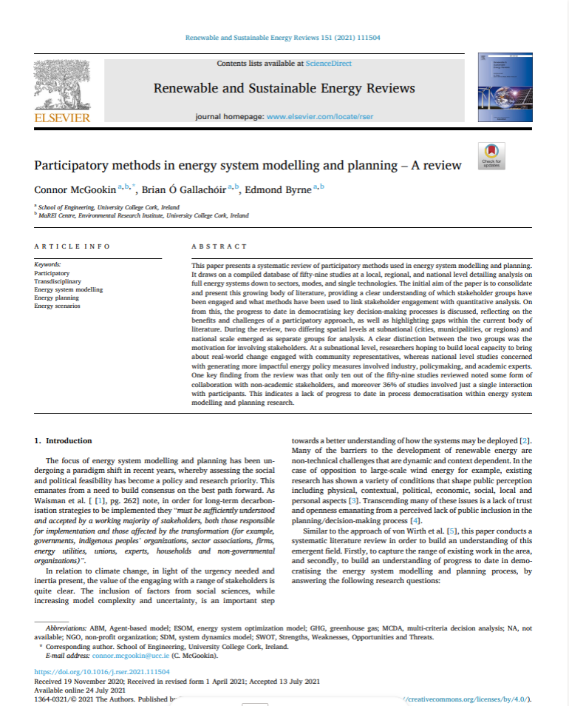
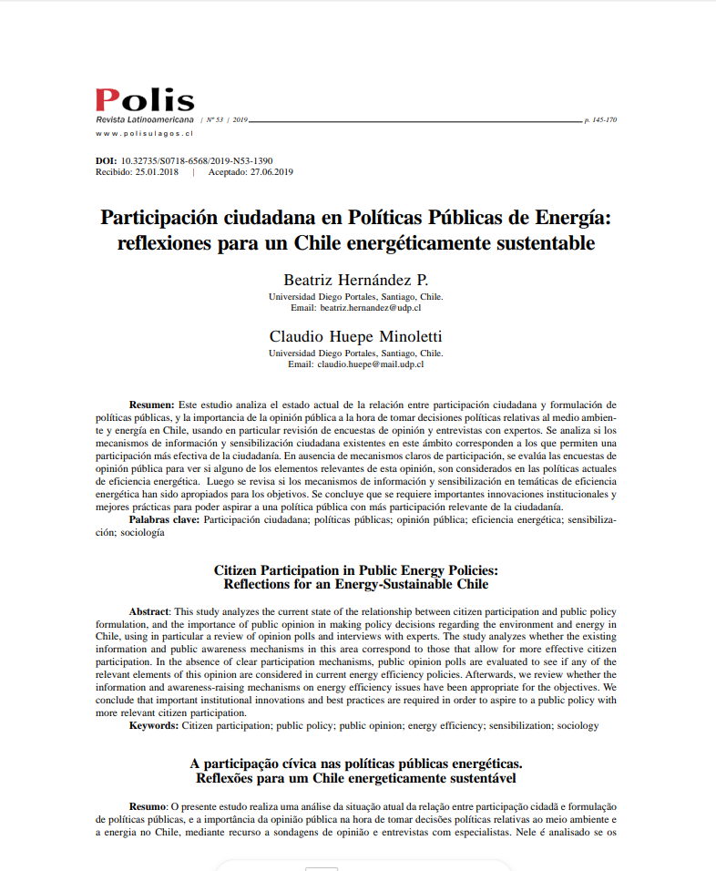
Participatory processes as a priority
LTES Network
Within the LTES Network, the topic of participatory processes and communication has been highlighted as a priority for the workplan almost yearly
Over two-thirds of member and partner focal points indicated interest in joining this workstream, highlighting the prioritization of this topic at the national level
Scientific community
and many more…
Notes:
First point is to stress that this is a priority for many countries and partners
Second point is to highlight that interest in how to ensure scenarios are useful, through communication and stakeholder engagement, are increasing in academia, and its not only about complex modelling results, and we are partnering with experts from the scientific community to explore it further

Slide 9
Many questions and gaps
How to achieve coordinated stakeholder involvement and buy-in?
How to keep stakeholders consistently engaged?
How to collect up-to-date, sector-specific data?
How to effectively communicate complex technical information?
How to incorporate qualitative analysis?
How to converge divergent stakeholder positions?
How to manage timely updates amidst volatile sector events?
How to overcome time constraints in scenario development?
What internal structures should be in place for effective development?
How to select stakeholders effectively?
How to address the 'Energy Trifecta' in the process?
How to shift the focus from short-term issues?
Notes:
The topic of participatory processes is broad, you can mention 3-4 questions from here
But what we want to focus on today is two of t hese bubbles mainly: how to communicate complex technical info to non experts, and especially in the context of communicating that to other implementing and financing ministries who can help mobilize investments and action to achieve the transition

Slide 10
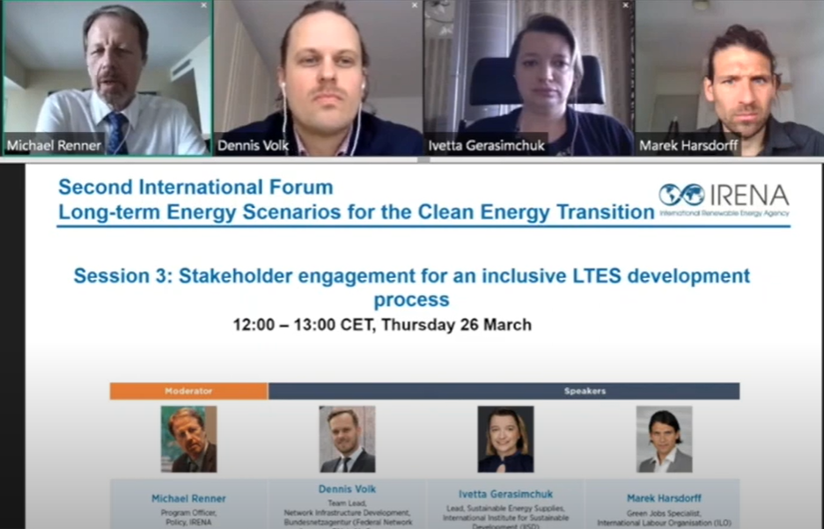
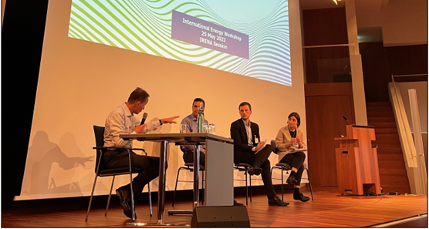
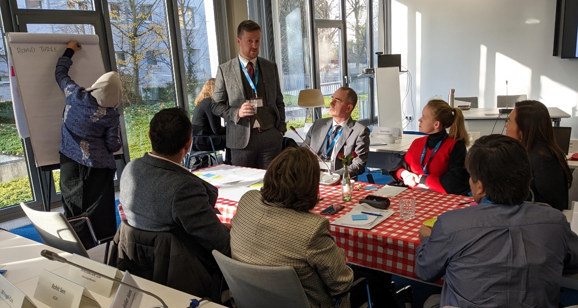
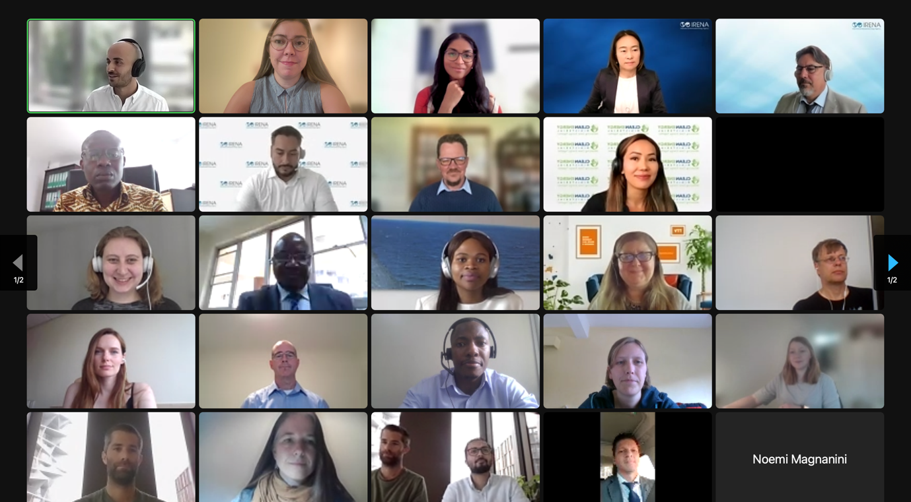
Findings from past activities
1. Prerequisites & Institutional Setup
Emphasizing Transparency in Energy Transition
Local Knowledge to Accelerate Regulation
Addressing Political Influence
Ensuring Institutional Support for Engagement
Coordination Among Ministries for Engagement
2. Data Collection & Model Building:
Addressing Energy Modeling & Non-expert Communication Gap
Enhancing Model Outputs with Stakeholder Input
Breaking Silos with Interdisciplinary Approach
Comparative Review for Model Robustness
3. Stakeholder Engagement & Communication:
Interactive Participation for Engagement
Building Trust for Model Acceptance
Stakeholder Capacity Building for Consultation
Genuine Impact & Monitoring for Engagement
4. Validation & Finalization:
Achieving Stakeholder Buy-in through Consensus
Evaluating Engagement with Internal Review
Prioritizing Citizen & Civil Society Voices
Navigate Power Dynamics & Consensus
Balancing Support from Public & Decision-Makers
Notes:
We’ve held several events so far exploring different sides of this topic, with our findings going across several aspects such as prerequisites and institutional set up for effective stakeholder engagement in scenarios, the phase for data collection and modelling, the process of stakeholder engagement itself (including the methodologies and stakeholder choice), and validating and finalizing the energy plans.
We highlight here some findings we found relevant for the questions in the previous slide. Mainly highlighting the important of solid coordination across ministries, addressing the comms gap, navigating consensus and power dynamics across stakeholders, monitoring the results of these engagement processes for impact, and balancing support from both policymakers and public.
We hope the presentations in this session and the panel discussion can give us further examples on HOW the above can be done, and how it was done through real life examples.

Slide 11
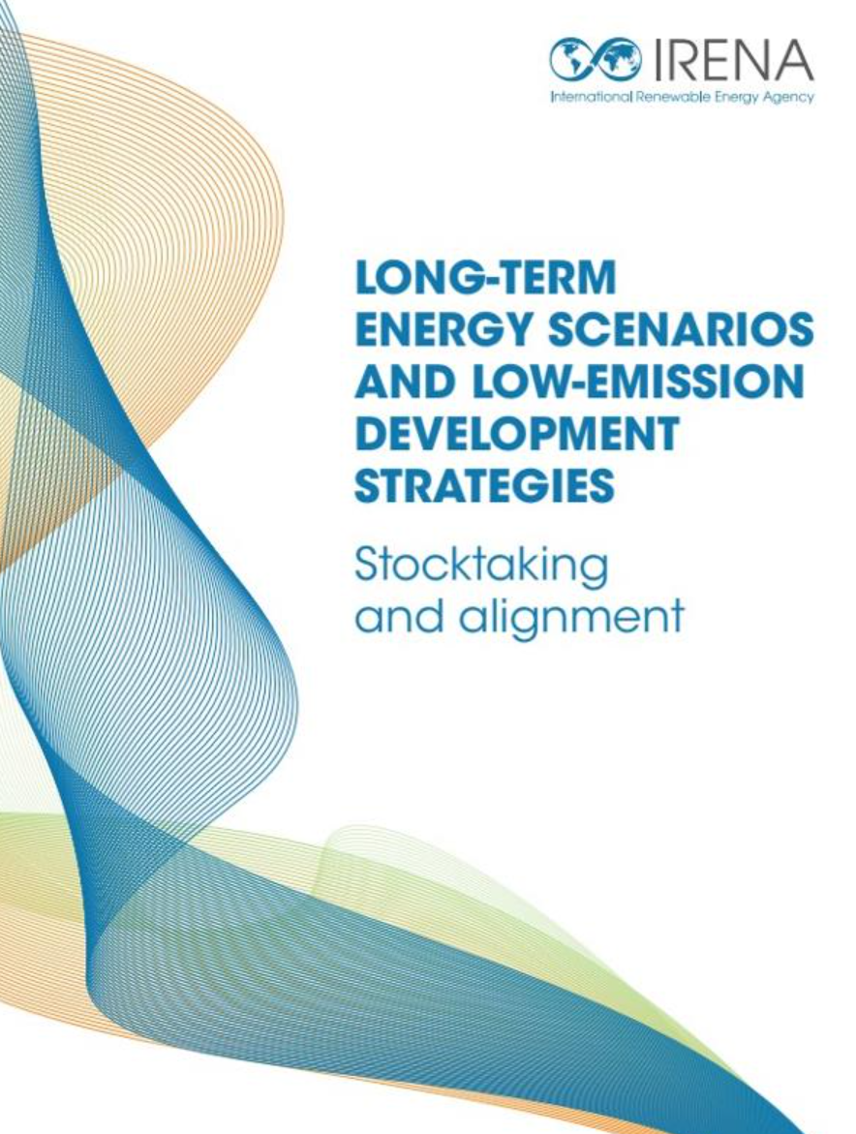
Toolbox on participatory processes
INTRODUCTION
PARTICIPATORY PROCESSES FOR SCENARIO DEVELOPMENT
TOOLBOX FOR GOVERNMENT PLANNERS
Toolbox for energy planners to use for developing participatory strategies for LTES development
To be developed collaboratively with countries and stakeholders
CASE STUDIES
TOOLS
STAKEHOLDERS
RESOURCES
Notes:
Findings will feed into a toolkit being prepared on this topic, which can help energy planners in developing participatory strategies when preparing long-term energy scenarios

Slide 12
Upcoming events
Joint online workshop on civil society engagement in energy planning
16 November 2023
Joint hybrid workshop on stakeholder-driven just energy transition scenarios
22 November 2023
Workshop on system operator engagement in national scenario development
Workshop on private sector engagement in national scenario development
In partnership with REN21, Renewable Grids Initiative and Green Grids Initiative (UK)
In partnership with the Institute for European Energy and Climate Policy (IEECP)
Date TBA
Date TBA
Notes:
Upcoming events on the topic

Slide 13
Thank you!
PLEASE Feel free to reach out to us at Ltes@irena.org
Notes:
4th LTES Forum- Importance of engaging different stakeholders and the general importance of proper stakeholder engagement in long term energy planning

Slide 14
Presentation:
Dr. Vivien Foster.
Climate Compatible Growth/Imperial College London

Slide 15
Presentation:
Dr. Onesmus Mwabonje.
Technical lead on 2050 International Calculator program.

Slide 16







Scenario visualization. Policy impacts from the 2050 Calculators
Long-Term Energy Scenarios (LTES) Network
7th International Conference on Renewable Energy Sources and Energy Efficiency
(RESEE2023)
12th October 2023
Hilton Hotel, Nicosia, Cyprus

Slide 17
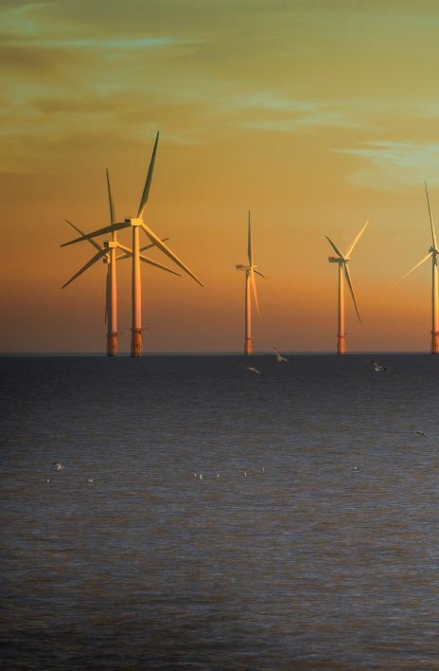
The 2050 Calculator programme
The 2050 Calculator was inspired by Sir David MacKay, Chief Scientific Advisor to the UK Government. He saw that the public debate about emissions and energy was woefully ill-informed and wanted people to have access to clear information. The tool makes it possible to see the relative impact of different policy options, and it makes this clear to everyone. It is accessible, open, and transparent.
An interactive energy model to help governments plan their low-carbon transition in an interactive, stakeholder-focused and evidence-based way.

Slide 18
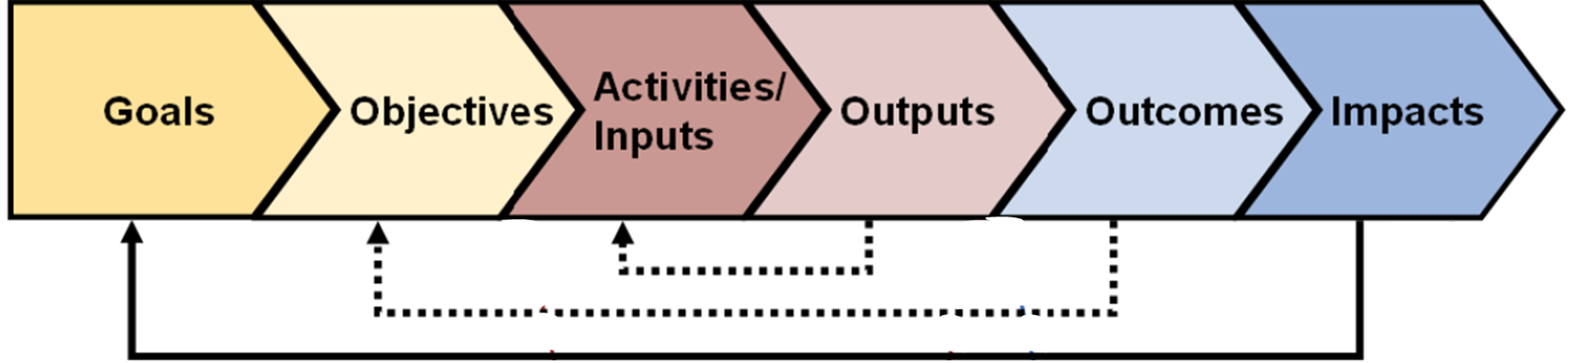
Four key principles behind the tool
Openness – a tool and its data which is fully published and available free online
Collaboration – built by an interdisciplinary team with input from sectoral experts, stakeholders and through public consultation
Simplicity – modelling as simply as possible, while still including all emissions and a full range of future scenarios
Transparency – using the principles of ‘co-design,’ co-development and public calls for evidence will ensure full engagement with all relevant sectors of society. All calculations and assumptions are available and clearly explained
Developed using the ‘Theory of change’: e.g. https://www.alnap.org/help-library/theory-of-change-basics-a-primer-on-theory-of-change
Notes:
To Michel

Slide 19
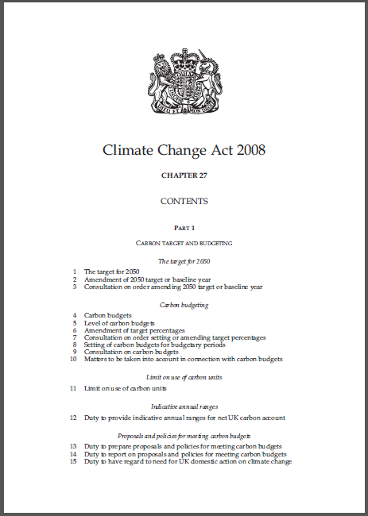
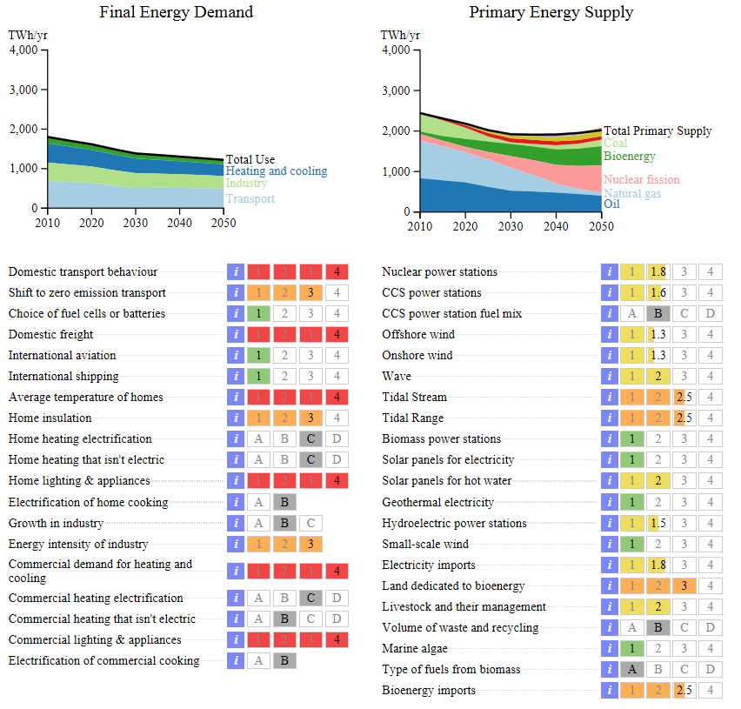

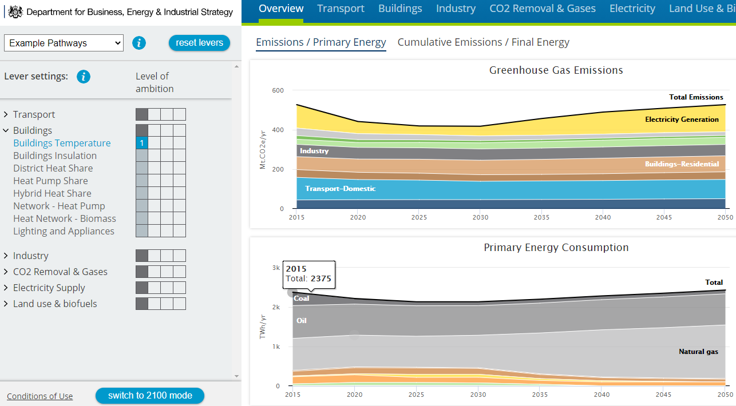
What did it do?
Informed the 2011 Carbon Plan, the UK’s strategy to reduce emissions.
Outlined four different scenarios for meeting an 80% emissions reduction target​ by 2050; agreed across relevant ministries.
Helped reduce the number of options, without locking us into one technology path.
What now?
The updated UK Mackay Carbon Calculator was launched in December 2020 alongside a “My2050” game.
Why?
The UK Government developed the 2050 Calculator to respond to the 2008 Climate Change Act which set ambitious, legally-binding targets, and 5-year carbon budgets.
The calculator has three different layers of complexity for different audiences:
Excel spreadsheet
Webtool
My2050

Slide 20
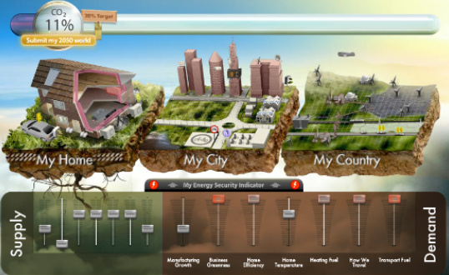
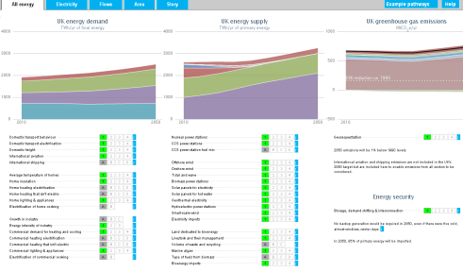
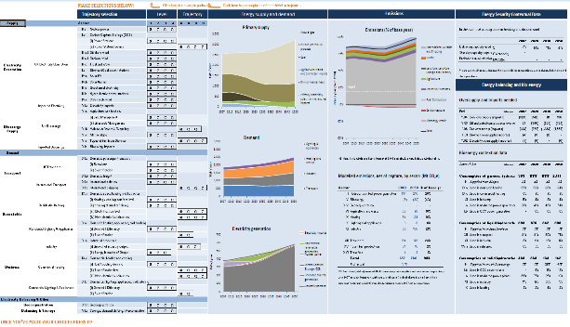
With three different layers of complexity for different audiences
2050 analysis
Product
My2050
Web tool
Excel spreadsheet
Audience
    General public
    School children
    Policy makers
    Stakeholders
    Well-informed public
    Government technical experts
    Stakeholder experts
Complexity

Slide 21
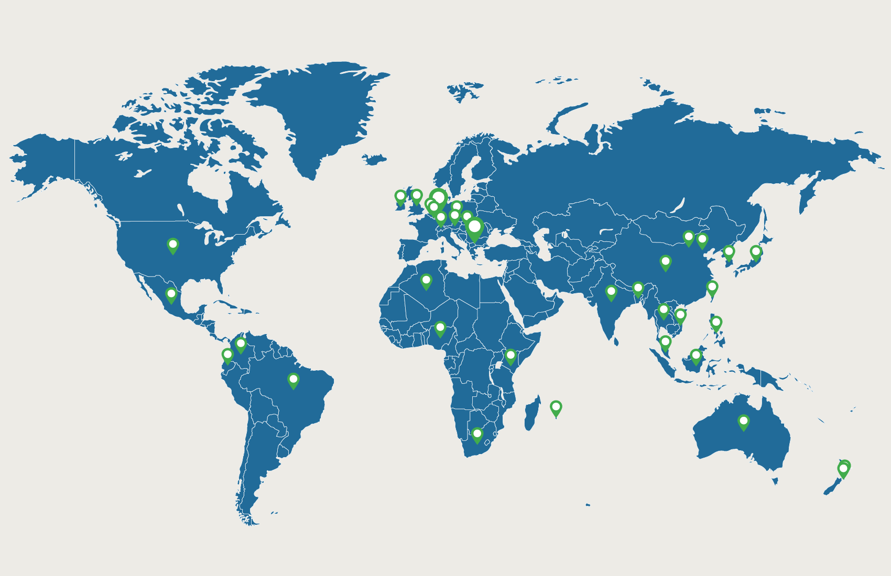
2050 Calculator Programme
Since 2010, over 60 countries now have their own customised Calculators, including Nigeria, South Africa, Kenya, India, Vietnam, the EU and China
Policymaking tools
Educational tools
Colombia, India, Nigeria, Vietnam used UK-funded Calculators to develop their NDCs
Belgium, Colombia, Mexico, South Africa, South Korea, Taiwan developed Educational My2050s

Slide 22

A brand new - Kenya 2050 Calculator
KCERT 2050 – Kenya Carbon Emissions Reduction Tool
200+
Stakeholders consulted
6
Sectors
2
Future technologies included (CCUS and hydrogen)
1st
In East Africa
Objective
Kenya made
KCERT 2050 explores evidence-based pathways to explore what’s possible for Kenya to achieve its climate ambitions, including contributing to the NDCs.
KCERT 2050 was designed in Kenya, by Kenyans, for Kenya.

Slide 23
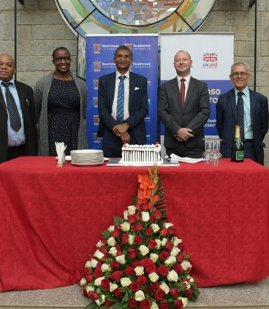
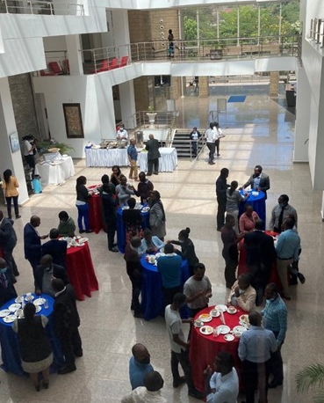
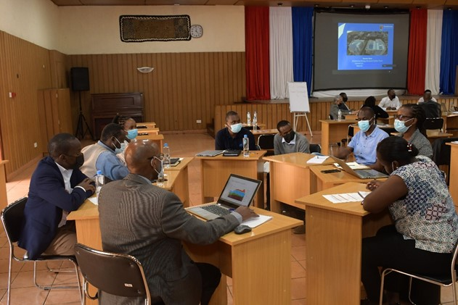
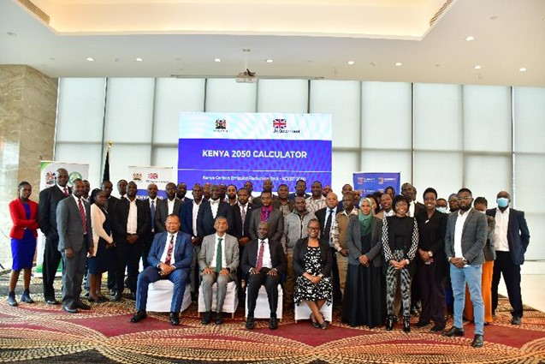
Co-design & expert workshop
For Kenyan sector experts to select the sectors and data most relevant to Kenya’s low carbon transition
Launch
July 2022, attended by a wide range of Government of Kenya officials who will play a key role embedding the Calculator into their decision making
Kick off
November 2021, attended by the Government of Kenya, UK Government, and Strathmore University
Three validation workshops
Including over 200 representatives from government, private sector, CSO and academia

Slide 24
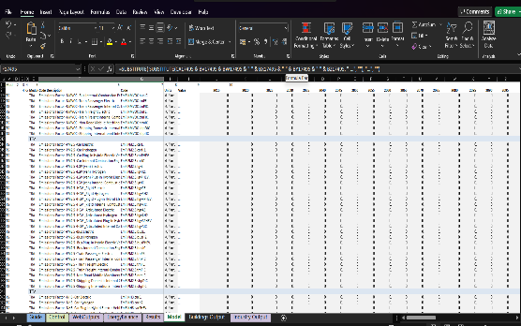
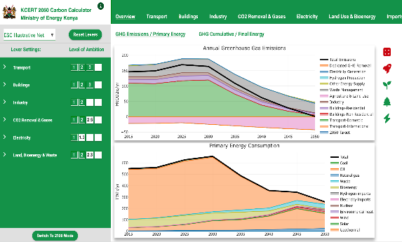
KCERT: Excel-based Model
The basis of the KCERT model is an Excel spreadsheet, which feeds the more user-friendly, web-based interface.
Excel Spreadsheet
Web Tool

Slide 25
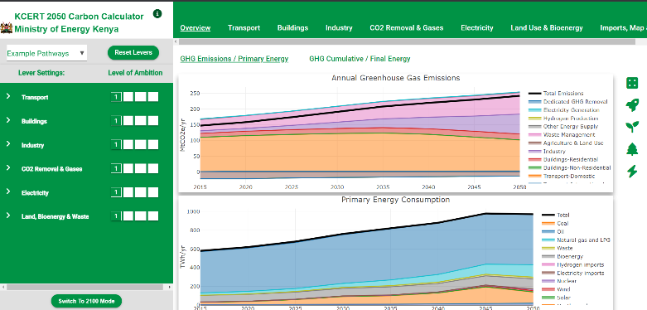
How does it work?
The Levers
Each lever relates to a type of action to reduce emissions, e.g., building nuclear power stations or using more public transport
Each lever has four options – levels 1 to level 4 (ambition levels) – which the user selects. This represents the full range of what is possible for this action up to 2050
39 levers to let users adjust lifestyle and sectoral decarbonisation strategies
Level 4
The upper limit of what is considered plausible
(GHG removal, green power generation)
Level 3
Very ambitious needing technical breakthroughs
(Increased or advanced technology or reduced unit energy service demand)
Level 2
Ambitious but reasonable effort
(change of behaviour, additional capacity for existing green technologies)
Level 1
No/Least Effort
(Existing capacity or same technology or no change in consumption)
Notes:
162 sub-levers under each lever to account for detail the action needed to achieve ambition levels

Slide 26
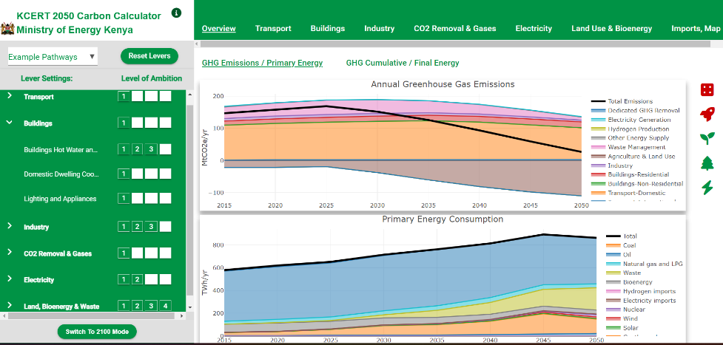
How does it work?
Graphs allow users to explore the impact of their choices on GHG emissions and energy consumption.
Users can toggle
between sectors to
view sector specific
impact on emissions, energy consumption

Slide 27
How does it work?
Alerts show when:
≥ 1 levers are at ambition level 4
Level ambition start date ≥ default start date
Biomass imports have exceeded maximum limit
insufficient land is available for forestry and bioenergy
Electricity supply does not meets peak demand
Graphs allow users to explore the impact of their choices on GHG emissions and energy consumption.

Slide 28
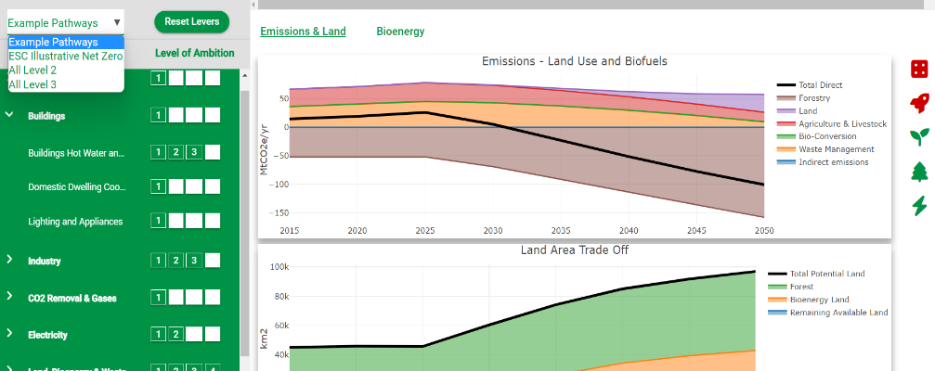
How does it work?
There are two options for building decarbonisation pathways:
(1)
Selecting
from a list of examples here
(2)
Build you own pathway using the levers by varying their levels of ambition

Slide 29
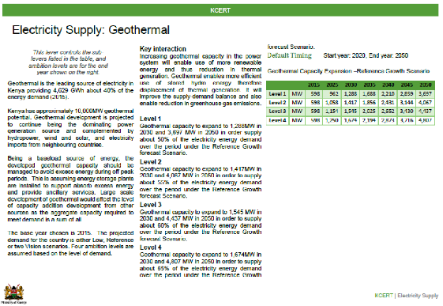
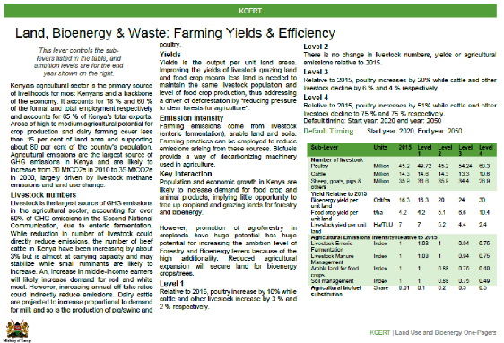
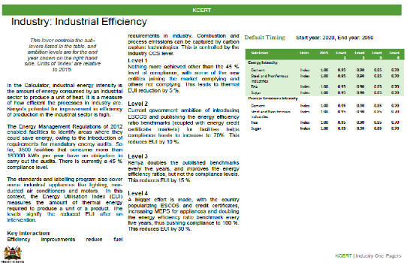
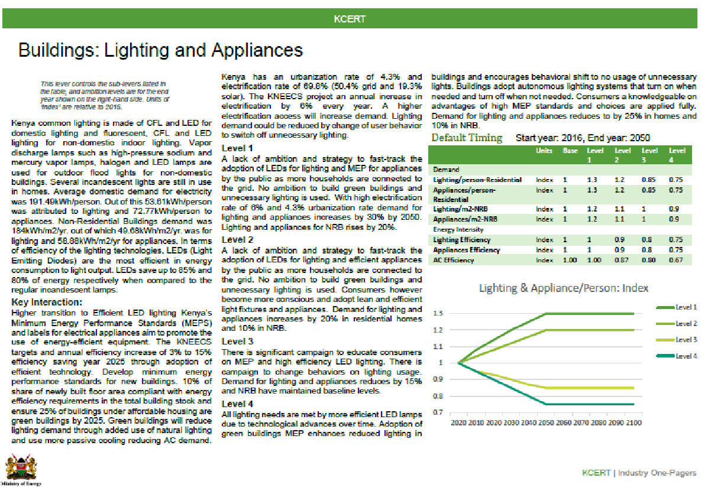
How does it work?
One-page descriptions of the sectors levers and ambition level choices

Slide 30
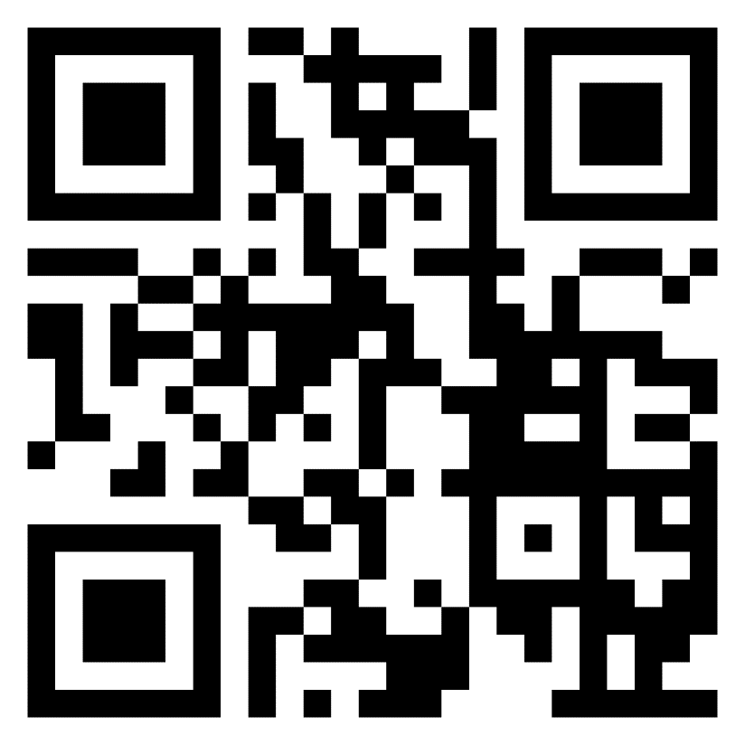
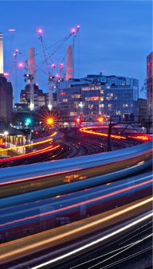

kcert.ilabafrica.ac.ke
KCERT 2050 works best on a laptop, or in landscape mode on your phone

Slide 31





Onesmus Mwabonje
E-mail: o.mwabonje@imperial.ac.uk
Tel: +44 (0)7884437045
https://www.imperial.ac.uk/life-cycle-network/

Slide 32
Cyprus case:
Dr. Constantinos Taliotis, The Cyprus Institute Energy, Environment and Water Research Centre

Slide 33


The participatory process for developing and using energy scenarios in Cyprus
Constantinos Taliotis
7th International Conference on Renewable Energy Sources and Energy Efficiency - Energy Security – IRENA LTES session
12/10/2023
www.cyi.ac.cy

Slide 34

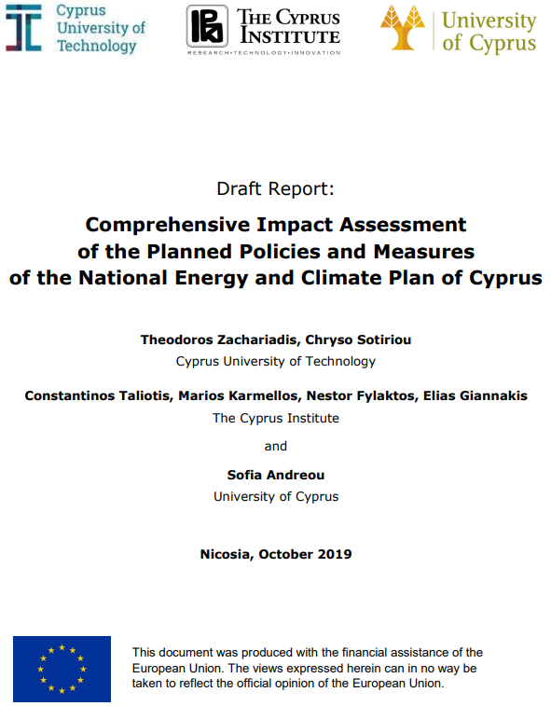
Use of our modelling framework in official analyses
CyI provides scientific support to governmental authorities for the energy, climate and transport aspects of the European Green Deal (Memorandum of Understanding with Finance Ministry – DG Growth)
Last year we supported the TSO for their ten-year electricity forecast
We are also providing support for the preparation of the revised National Energy and Climate Plan (NECP)
www.cyi.ac.cy

Slide 35
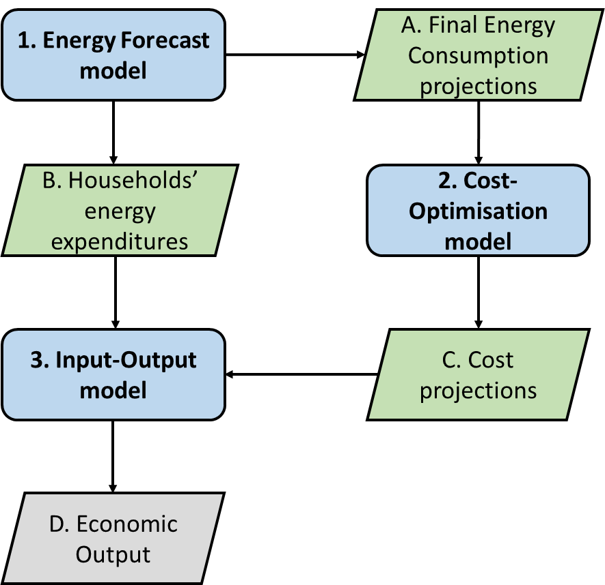
Supporting the formulation of the National Energy and Climate Plan
Three models are interlinked to provide projections regarding:
Primary energy supply and Final energy demand
Technology deployment and use
Greenhouse gas and air pollutant emissions
Investment requirements
Estimation of economy-wide impacts of energy policies and investments
www.cyi.ac.cy

Slide 36
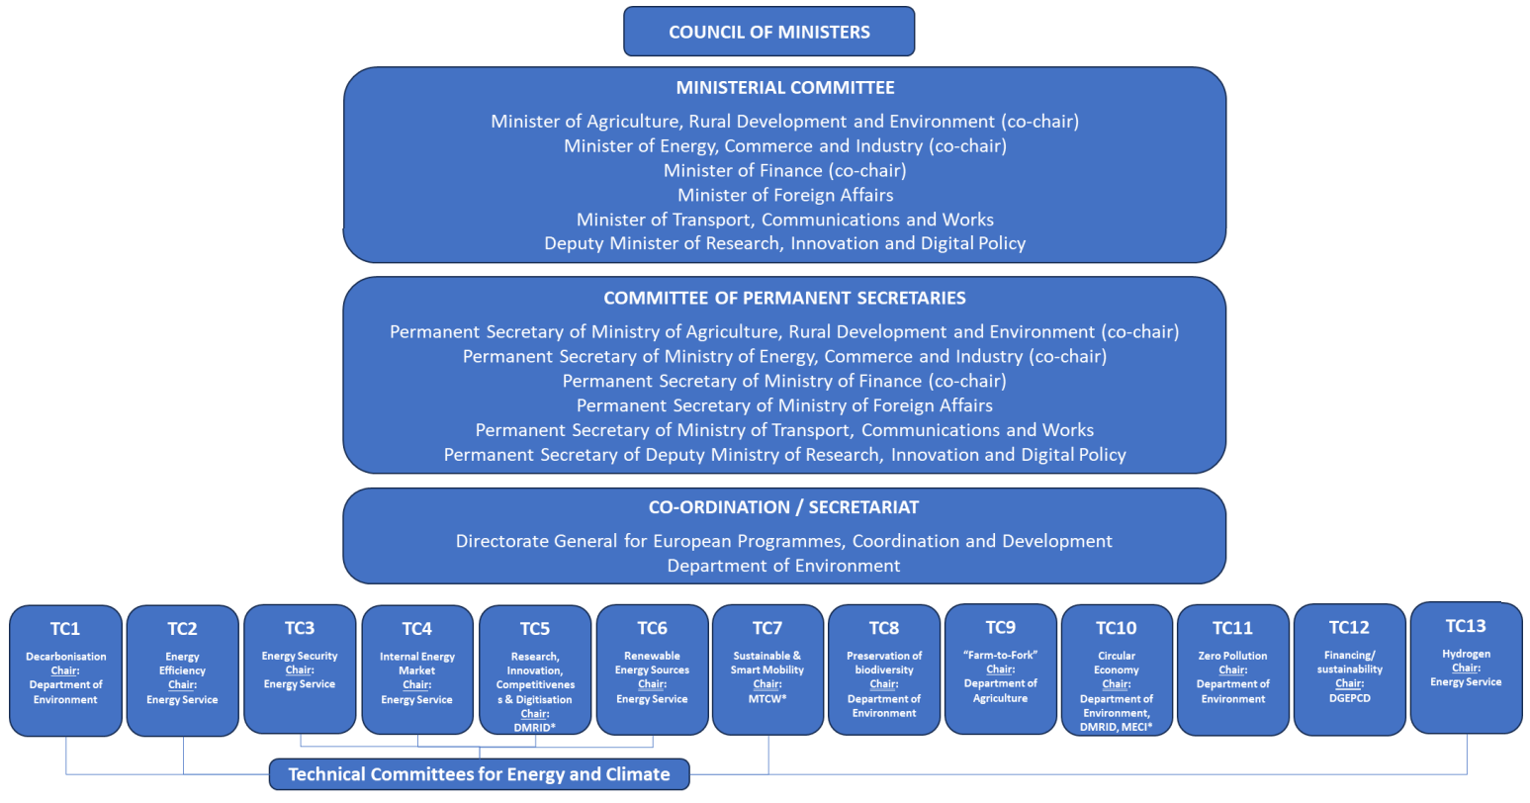
National Governance System for the Implementation of the Green Deal
Notes:
The core of the “National Governance System for the Implementation of the Green Deal” is a Ministerial Committee, co-chaired by the Minister of Finance and the Minister of Agriculture, Rural Development and Environment. The Committee shall be composed of the two co-chairmen and the Minister for Energy, Commerce and Industry, the Minister for Transport, Communications and Works, the Minister for Foreign Affairs and the Deputy Minister for Research, Innovation and Digitalisation. This Committee recommends to the Council of Ministers policies and measures related to the topics included under the Green Deal, including energy and climate policies and measures (e.g. National Energy and Climate Plan (NECP), Long Term Policy for Low Emission Growth). At the following level, the Committee of Directors General of the same Ministries is the intermediate step between the Ministerial Committee and the specialised Technical Committees.

Slide 37
Providing input to the National Energy and Climate Plan (NECP)
Is national information available?
Identification of required input
Contact focal point (e.g. Ministry of Energy)
Identify and contact relevant stakeholder
Provision of input from relevant stakeholder
Adoption in models and assessment process
Input data and assumptions transparency with all stakeholders
Yes
Retrieve relevant assumptions from bibliography
Validate assumptions with stakeholders
No
www.cyi.ac.cy

Slide 38
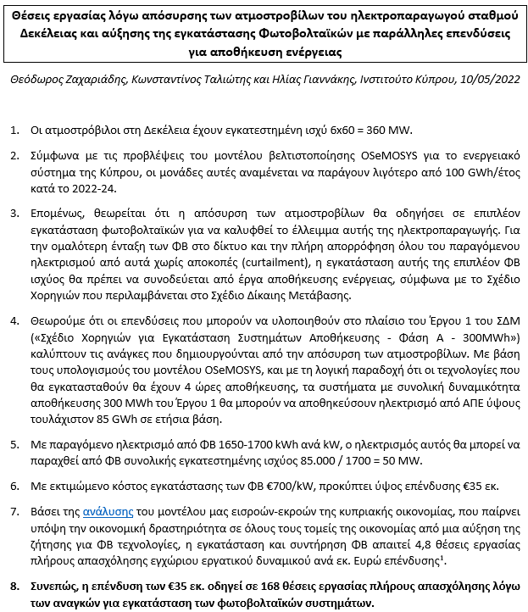
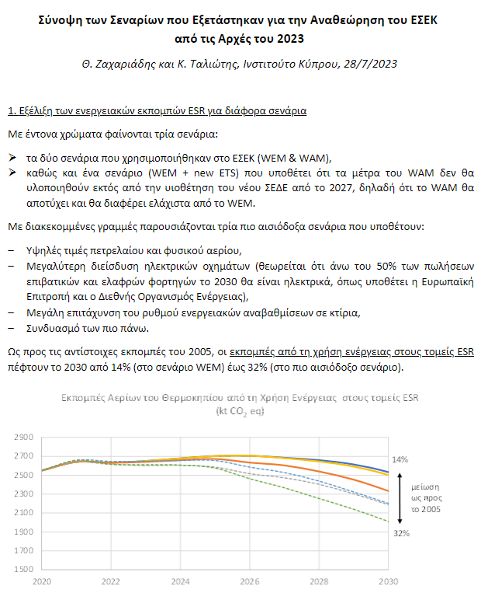
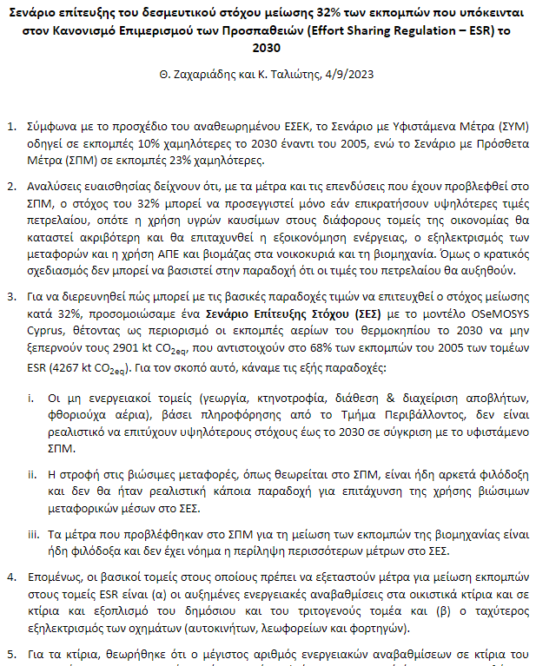
Short notes to communicate key impacts
Preparation of short briefs to provide overview of key impacts of policies and measures
concise, quantitative, non-technical, provision of indicators
Impact on job employment of replacing part of the thermal unit stock with PV & storage
Synopsis of assessed scenarios during the formulation of the draft revised NECP
Scenarios for the achievement of the emission reduction target in ESR sectors and their impact
www.cyi.ac.cy

Slide 39
Example - Summarised comparison of assessed scenarios
www.cyi.ac.cy

Slide 40
Investment needs in the National Energy and Climate Plan (NECP)
With Additional Measures
(additional funds)
With Existing Measures
Public budget – €2.2 Billion
Recovery and Resilience Plan – €350
European Structural and Investment Funds – €332 M
Just Transition Plan – €179 M
Connecting Europe Facility - €657 M
National Budget for Sustainable Mobility - €700 M
Public budget - €540 M
REPowerEU – €94 M
Just Transition Plan – €96 M
Social Climate Fund – €100 M
National Budget – €150 M
Unidentified funds (building renovations) – €100 M
Private investments – €15.4 Billion
Efficient/electric vehicles, sustainable fuels, renewable energy technologies, storage technologies, building renovations etc.
Private investments – €15 Billion
Efficient/electric vehicles, sustainable fuels, renewable energy technologies, storage technologies, building renovations etc.
www.cyi.ac.cy

Slide 41
Investment needs in the period 2023-2030
Million Euros’2022 | Public & Private Investments
Sector | With Existing Measures | With Additional Measures | Additional Investments (public + private) | % difference WAM-WEM
Power generation | 1,625 | 1,691 | 67 | 4%
Electricity storage technologies | 150 | 300 | 150 | 100%
Gas Infrastructure | 272 | 272 | 0 | 0%
Electricity Interconnector | 2,000 | 2,000 | 0 | 0%
Sustainable Mobility | 1,427 | 1,731 | 303 | 21%
Private transport | 11,546 | 10,572 | -974 | -8%
Residential & commercial buildings* | 477 | 897 | 420 | 88%
Industry** | 75 | 193 | 118 | 157%
Total Investments | 17,572 | 17,656 | 84 | 0.5%
* Includes public investments, public grants for private investments, and autonomous private investments in some energy-consuming equipment (e.g. heat pumps, solar water heaters). Other private investments without public support are not included.
** Includes investments in restoration of waste sites. Purely private investments are not included.
www.cyi.ac.cy

Slide 42
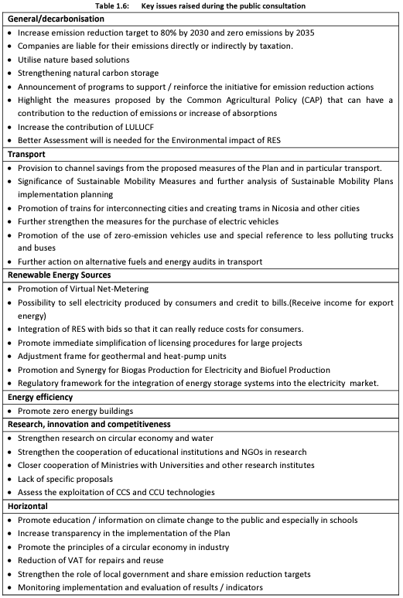
Public consultation and awareness
The NECP undergoes through a public consultation process. Draft legislation related to climate change, energy and environmental issues are open to public consultation before their adoption.
House of Parliament
Local and regional authorities
Industry and private sector
Trade Unions
Civil society organisations, energy companies, universities/research institutions, natural persons…
www.cyi.ac.cy
Notes:
The previous NECP was posted for consultation on the website of the Department of Environment for a period of 26 days, from 21 October 2019 to 15 November 2019. 108 comments were received.
The consultation process for updating the draft NECP started with the publication of an information document on 13/12/2022 in the notices on the website of the Department of Environment, giving the public the opportunity to comment on the new obligations and targets and taking into account the content of the NECP submitted in 2020.
Since the launch of the consultation, 46 contributions have been received from stakeholder associations, civil society organisations and businesses active in the energy sector.
The main issues raised during the public consultation are presented in the table below by sector. Following the assessment of the consultation comments, the draft update of the Plan was prepared.

Slide 43
The need for reconciliation across planning efforts
The NECP can be considered as a synthesis of sectoral analyses/planning efforts
There is a need to adopt the NECP as the primary planning document that will set the vision and provide guidance and direction to all relevant authorities
  For instance, it may not yet be fully aligned with specific national authorities’ efforts (e.g., Transmission and Distribution System Operators)
Enhance stakeholder participation for proactive planning – e.g. to reconcile green energy development with environmental concerns, to mainstream public investments with the energy transition goals, to plan for the construction of enabling infrastructure
www.cyi.ac.cy
Notes:
The big picture approach should also allow stakeholder participation for proactive planning - e.g. to reconcile green energy development with environmental concerns, to mainstream public investments with the energy transition goals, to plan for the construction of enabling infrastructure (grids, electric charging stations etc.) in advance of green energy expansion projects.

Slide 44
Thank you
Constantinos Taliotis
Associate Research Scientist
Energy, Environment and Water Research Centre (EEWRC)
The Cyprus Institute
t +357 22 397 524
e c.taliotis@cyi.ac.cy
w energy.cyi.ac.cy
44
www.cyi.ac.cy

Slide 45
Panel discussion

