Slide 1
Long-Term Energy Scenarios for the Energy Transition: Experience and Good Practices in Africa
Presenters:
Juan Jose Gracia, Angela Mutsotso | IRENA
MONDAY, 18 MARCH 2024 • 09:30 – 10:00 CET

Slide 2


SPEAKERS
Juan Jose Gracia
IRENA
Angela Mutsotso IRENA

Slide 3
Please make sure to mute yourself during the session to avoid background noise
If you have Questions to the speaker please use the Q&A
If you encounter any technical issues, please connect via phone or contact the Help Desk: 888.259.3826 or https://support.goto.com/webinar

Slide 4

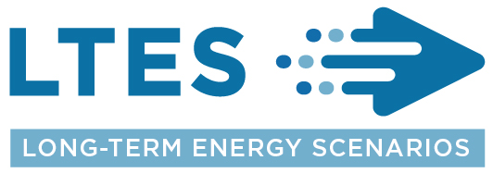
Long-Term Energy Scenarios for the Energy Transition: Experience and Good Practices in Africa
IRENA Insights webinar, 12 March 2024
Juan Jose Gracia & Angela Mutsotso
IRENA is grateful for the generous support of the Ministry of Foreign Affairs of Denmark in developing the Webinar Series and Report

Slide 5
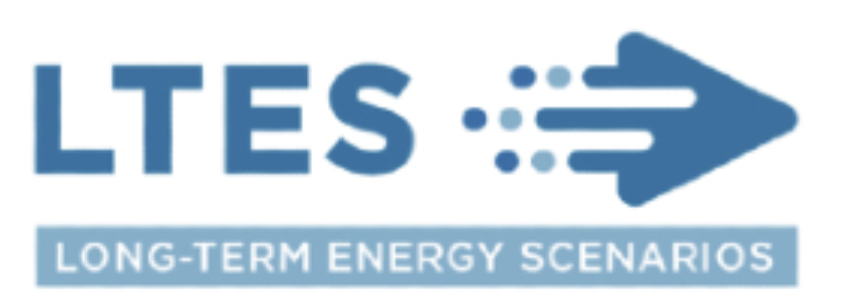
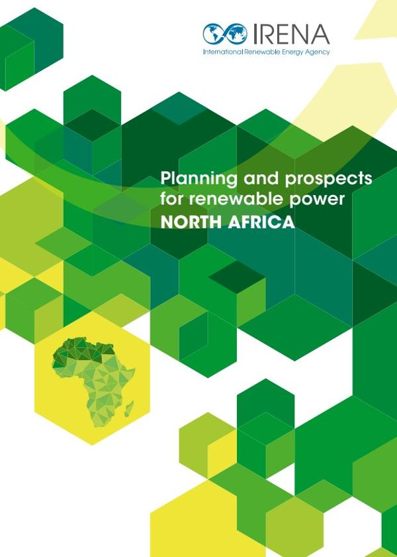
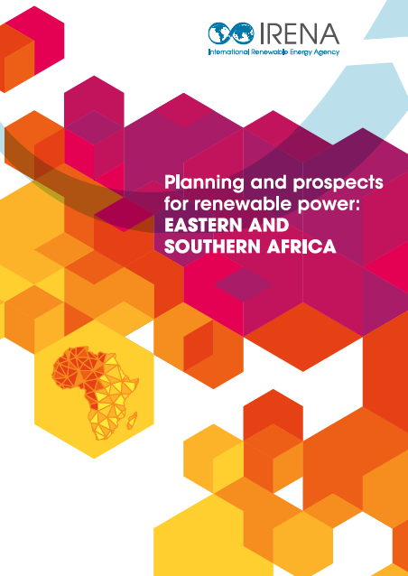
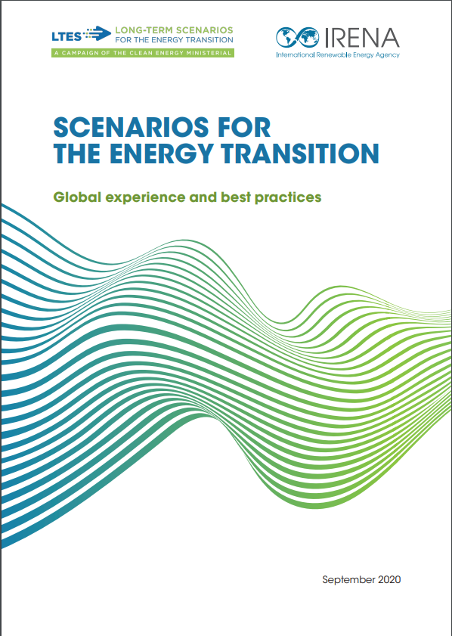
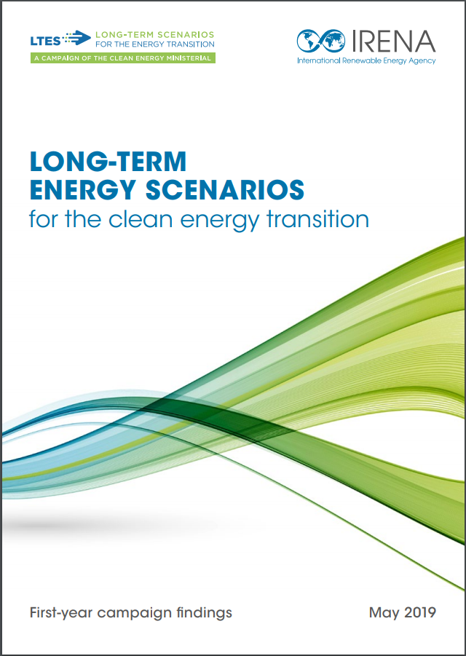
IRENA’s long term energy planning support portfolio
1. Institutional Capacity Building
2. Planning model development and applications
3. IRENA LTES Network
National masterplan development
Regional model analysis and planning
Energy planning for NDCs
Peer-to-peer learning
SPLAT Starter model kits
Renewable data for planning
https://www.irena.org/Energy-Transition/Planning/Long-term-energy-planning-support/Capacity-building-for-energy-planning-and-modelling
“Planning and prospects for renewable power in Africa series” since 2012
https://www.irena.org/energytransition/Energy-Transition-Scenarios-Network

Slide 6
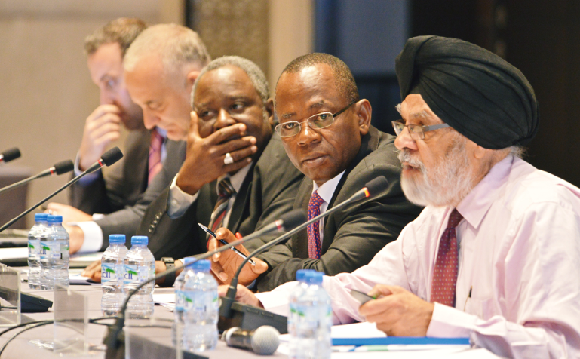
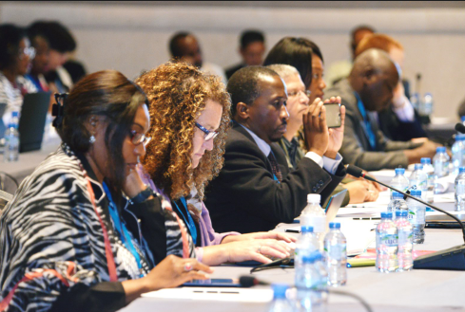
What is long-term energy planning? What are the benefits?
Long-term energy planning, if done properly:
Creates consensus among stakeholders
Can help to avoid costly stop-gap solutions or investment mistakes
Reduces uncertainties in policy direction and project selection
Accelerates investment and service delivery
Summary from “Planning renewable energy strategies: Africa power sector, achievements and way forward”, Abu Dhabi January 2015
Notes:
Ownership of the skills and processes
Transparent methodology
Robust data

Slide 7
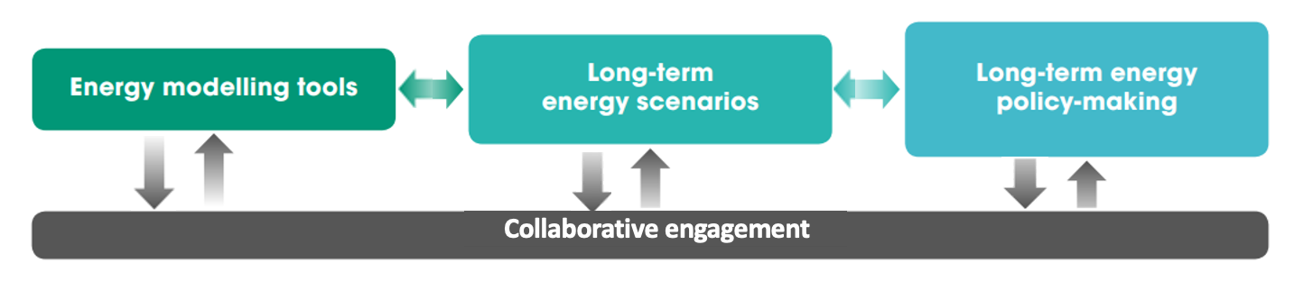
Long-Term Energy Scenarios Initiative and Network
A transparent and open LTES development process is essential for the clean energy transition
Source: IRENA 2020, Scenarios for the Energy Transition (adapted)
Notes:
Simplified mental model on how energy scenarios fit into overall energy planning concept. Scenarios are strategic tools to provide input into policy. We differentiate between energy scenarios and modelling tools- models provide the quantitive aspects and scenarios provide the qualitative we obtain qulaitiatve aspects from stakeholder consultations. This combination provide pathways to inform policies.

Slide 8








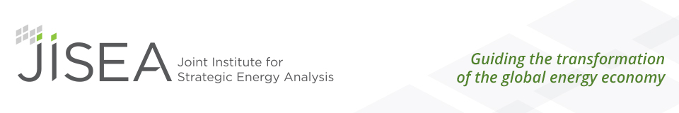

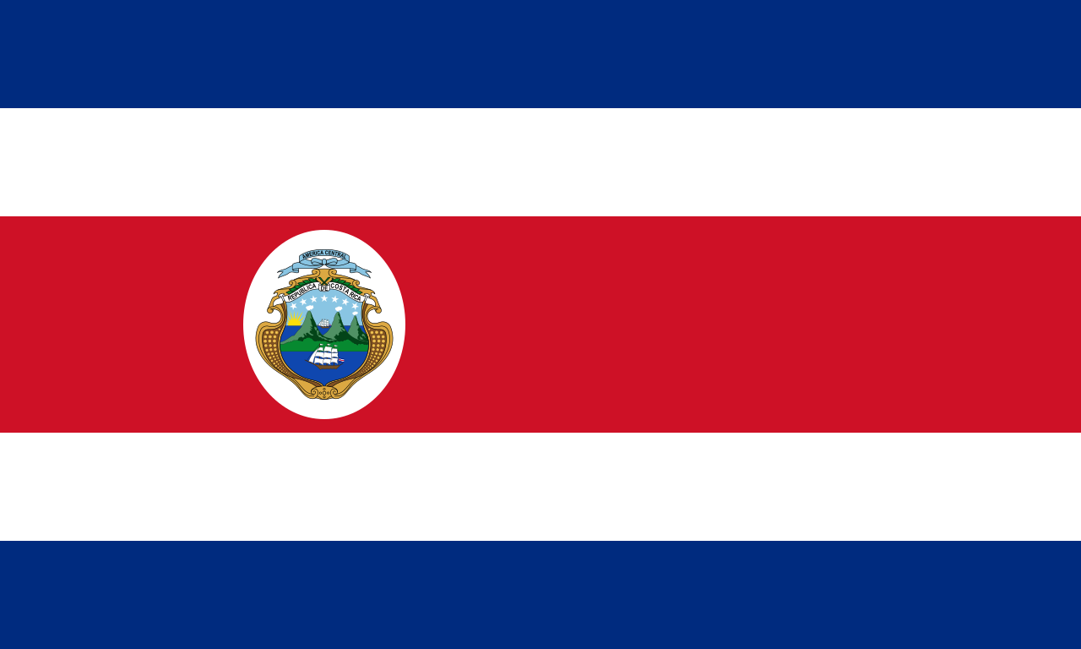



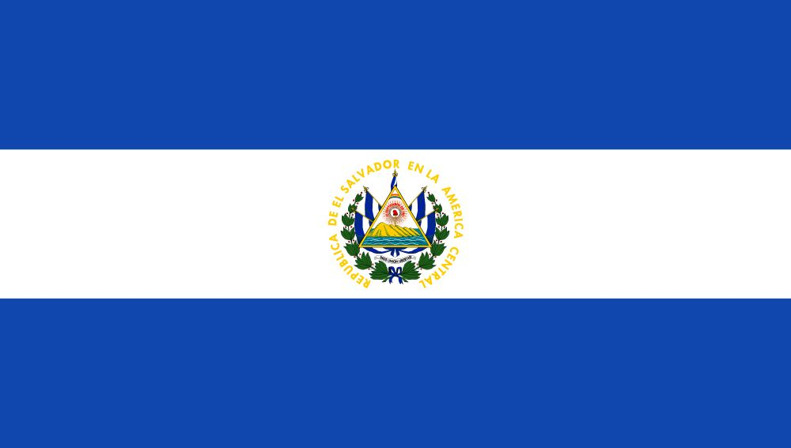




























Long-Term Energy Scenarios Network
Provides a global platform to exchange national long-term energy scenario (LTES) practices among scenario practitioners.
Promotes wider and more effective use of LTES for the clean energy transition in governments.
+60 country examples over 70 international and regional events and webinars organized.
29 Country Members
14 Technical Partners
8
Notes:
Intro of the Long-Term Energy Scenarios Network.
LTES Network provides a global platform for peer-to-peer exchange on long-term energy scenarios (LTES), aiming to promote wider and more effective use of LTES in governments
Initiated in 2018 as a Campaign and later Initiative of the Clean Energy Ministerial, now a Network of 27 government planning institutions and 13 technical partners
The Network gathers knowledge on energy planning practices around the world and disseminates good practices through regional webinars and reports
Also own analysis and research on relevant topics, more on later slides.
The Network brings together a wide variety of perspectives: next to government representatives, we have active exchanges with academia, private and financial institutions, the climate community, and other international organisations.
Therefore there is a clear potential to find synergies with a wide range of actors in the field of the clean energy transition.

Slide 9
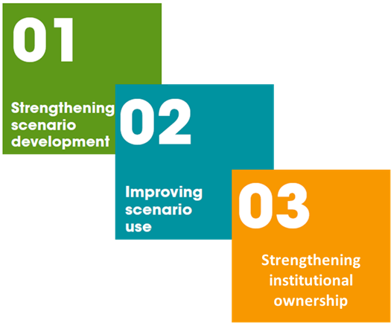
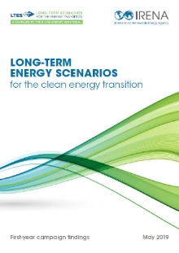
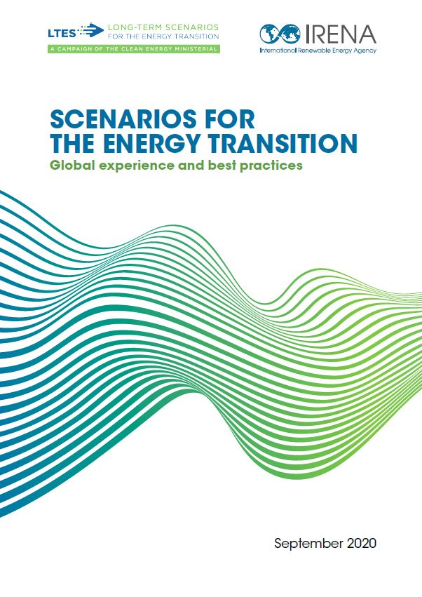
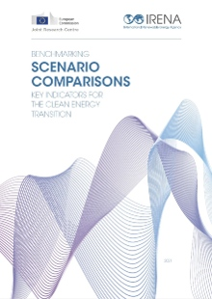
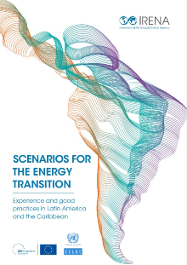
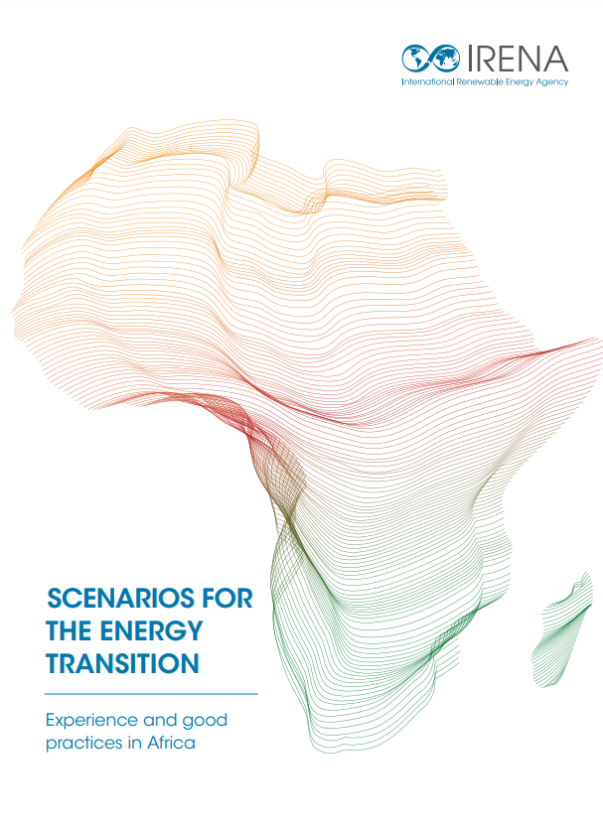
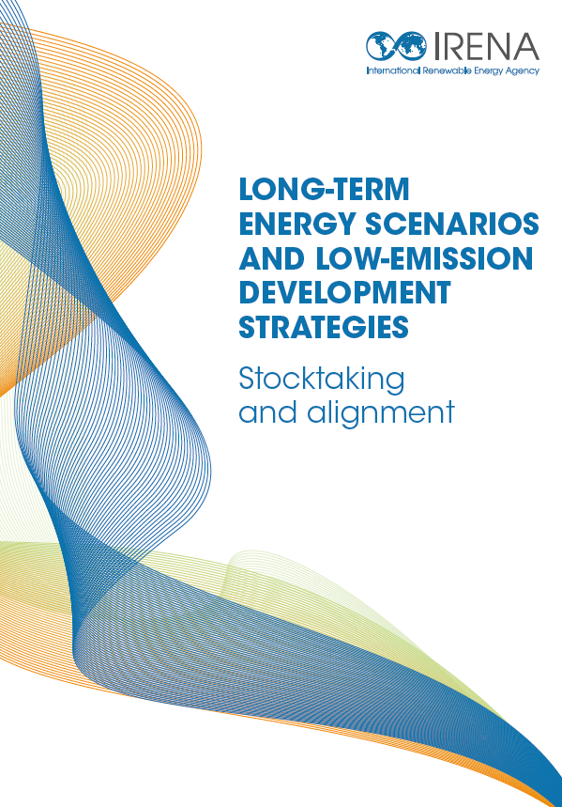
Long-Term Energy Scenario (LTES) Network
Focus
Practices and experiences collected

Slide 10







Report’s Framework
The Africa Webinar series
To facilitate the peer-to-peer exchange of practices and experiences on long-term energy scenarios (LTES) in the region to accelerate the clean energy transition.
Webinar series focuses on countries that have harnessed LTES to promote clean energy transitions.
Selected government energy scenario practitioners discussed current practices, experiences, challenges, and opportunities in developing and using LTES.
nepad.org
afdb.org
au.int/commission
get-transform.eu
energy.go.ke
irena.org
uneca.org
Notes:
Note on joint event and all partners and country and non-country institutions eg EAPP (work on this)
Mention DEA colleagues and give them special thanks- put on the cover page that the Danish Gvt supported this

Slide 11
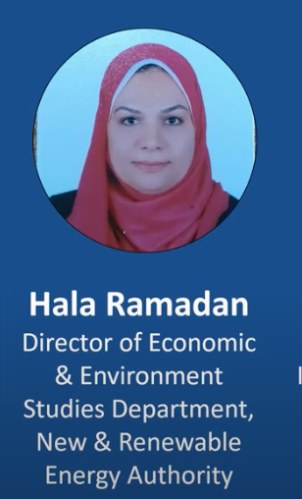
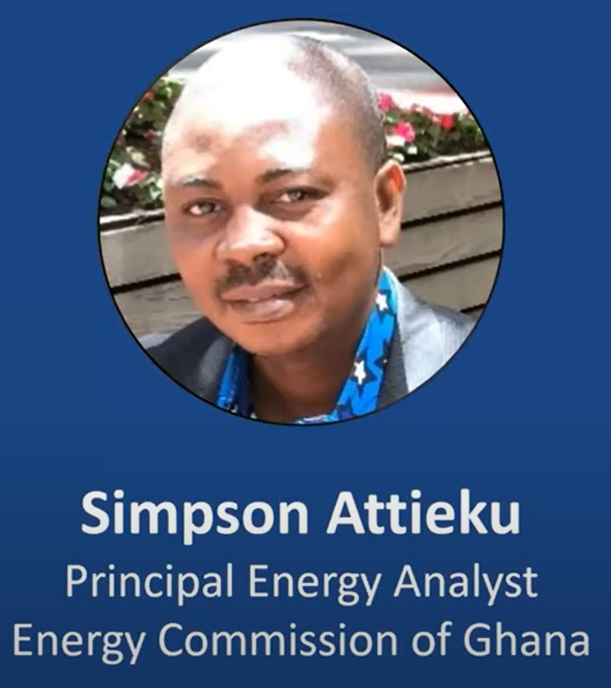
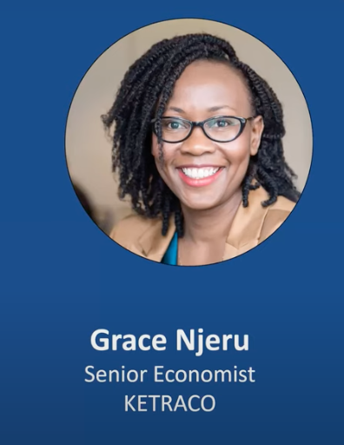
Speakers (LTES Members)
From top left to right: Egypt, Ghana and Kenya
Notes:
Selected countries with good planning practices according to our knowledge
Mention that speakers are nominated by their governments
Highlight countries that are members (first speakers from members and then non members)

Slide 12
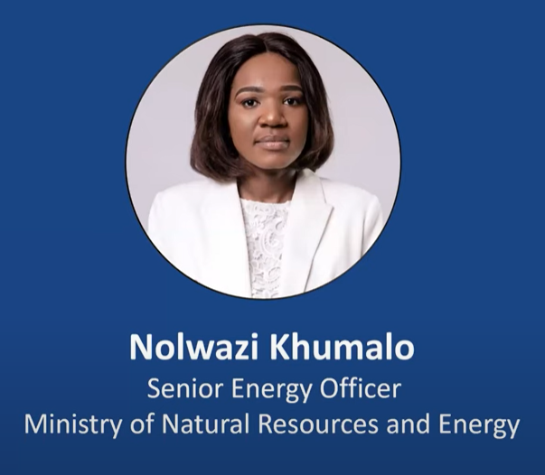
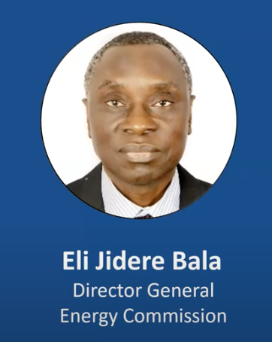
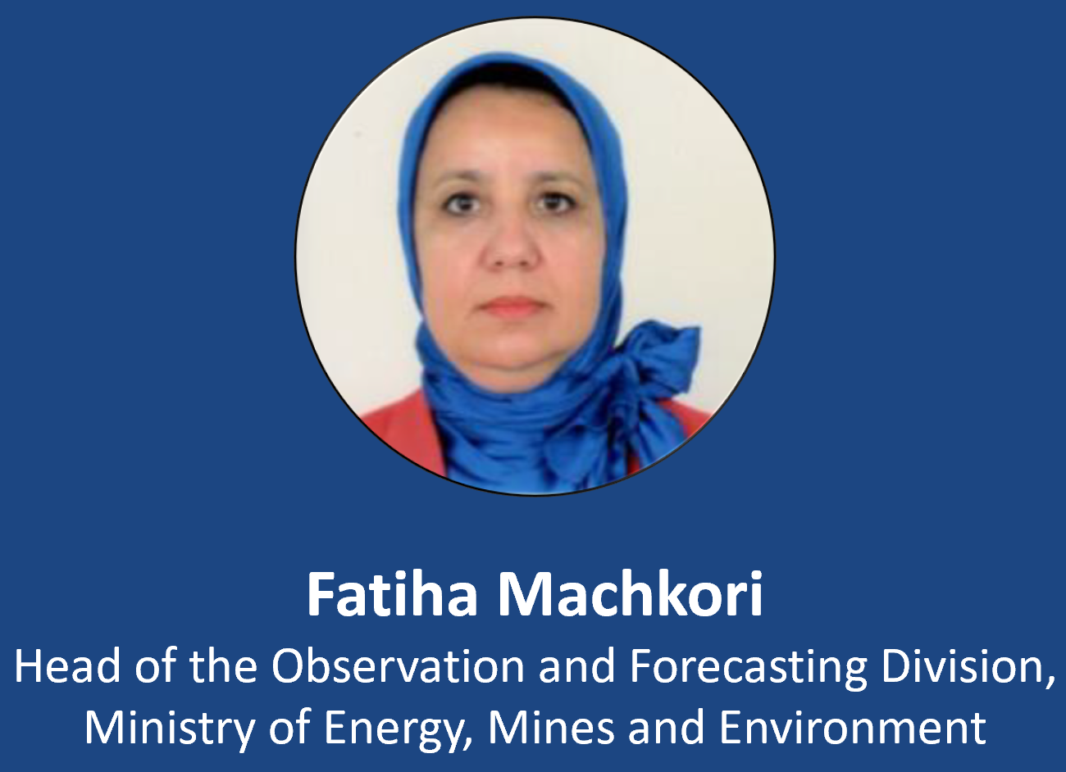
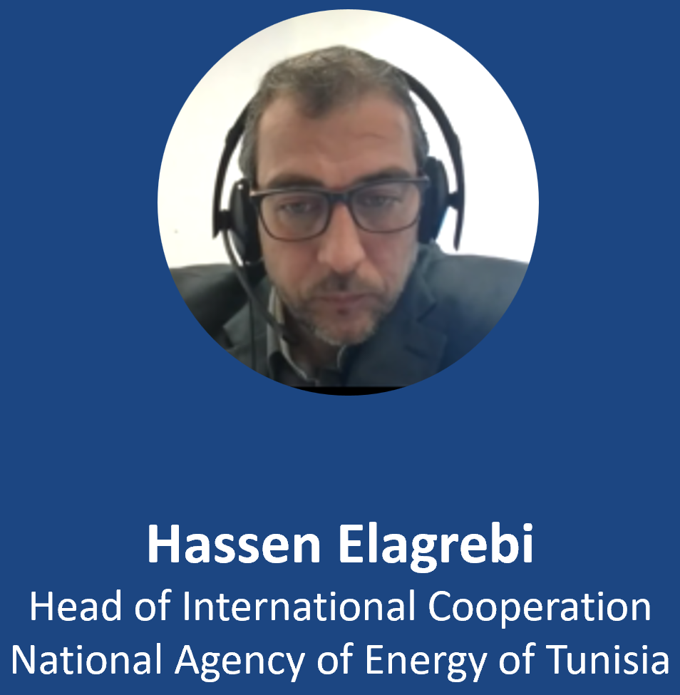
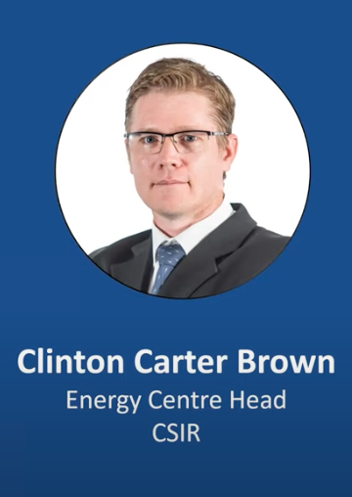
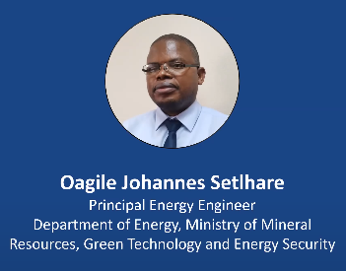
Speakers
From top left to right and to the bottom:
Eswatini, Nigeria, Morocco Tunisia, South Africa and Botswana

Slide 13
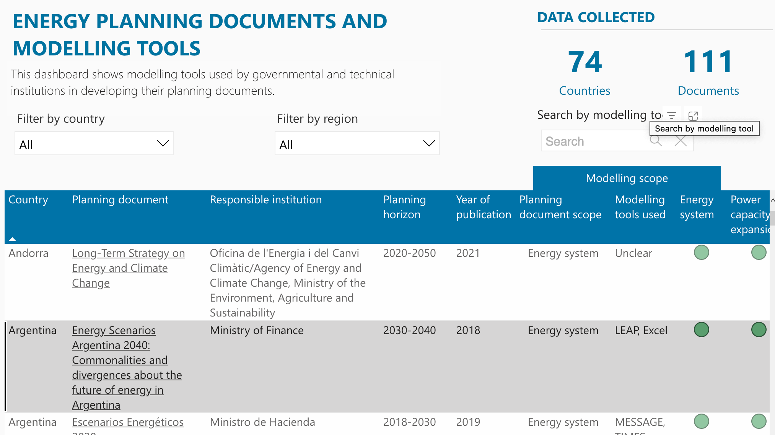
https://www.irena.org/Energy-Transition/Planning/Long-term-energy-planning-support/National-Energy-Transition-Planning-Dashboard
Notes:
2. Nigeria and South Africa are developing strategies for increasing the share of biogas, biofuels, concentrated solar power (CSP), and geothermal in their energy mix. In addition, Egypt, Eswatini, and Ghana have adopted energy efficiency programs such as electric mobility programs and the promotion of appliances powered by electricity generated by the local agriculture sector. So, these countries have more ambitious renewable energy targets for the expansion of generation, transmission, and distribution.
3. The countries that acknowledge the importance of transparency and effective communication with the public when using scenarios to inform investment and policy decisions are Botswana, Egypt, Ghana, Kenya, and Morocco. These countries have established various channels and mechanisms to communicate their long-term energy scenarios with stakeholders, hold workshops, and engage the public through diverse media. They recognize that publicizing scenario development and energy policy contributes to transparency and accountability by building trust around the energy planning process.
4. The countries that acknowledged the importance of building the right type of scenario capacity in government to strengthen capacity for mid-to long-term energy planning are Botswana, Morocco, Nigeria, South Africa, and Tunisia.

Slide 14
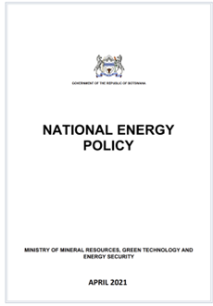
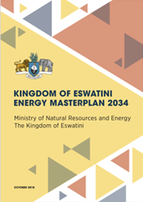
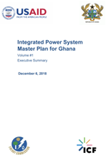
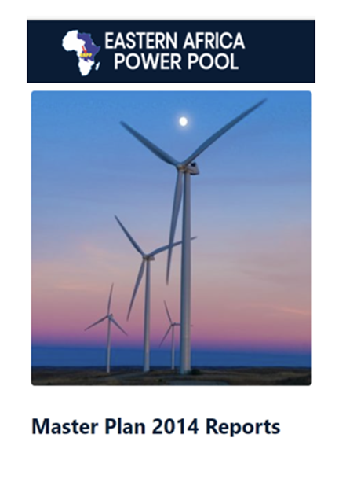
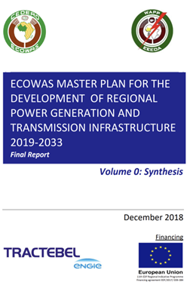
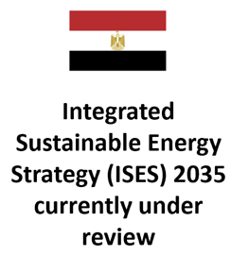
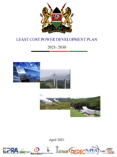
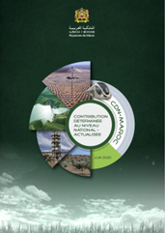
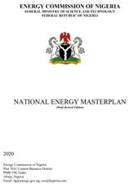
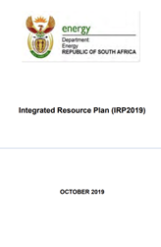
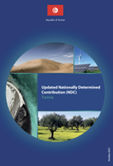
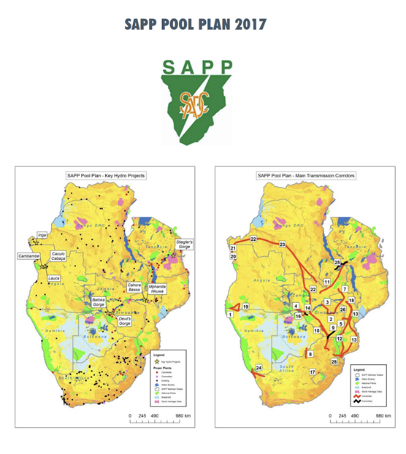
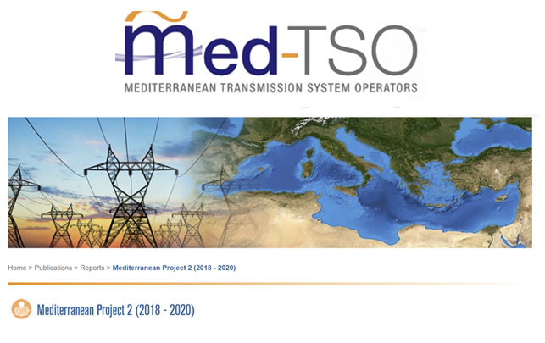
National Energy Planning Documents
Botswana
Egypt
Eswatini
Ghana
East African Power Pool
West African Power Pool
Kenya
Morocco
Nigeria
South Africa
Tunisia
Med- TSO
Southern Africa Power Pool
Notes:
Note to clarify the documents were the basis of national energy planning in the respective countries and were highlighted alongside the governance structure
The report summarizes the knowledge gathered in the webinar series on ‘Long term energy scenarios (LTES) for developing national energy transition plans in Africa’
The report highlights how African countries are governing the development and the use of LTES to plan the energy transition
Nine African countries participated in the webinar series: Botswana, Egypt, Eswatini, Ghana, Kenya, Morocco, Nigeria, South Africa and Tunisia.
To complement the national presentations, the regional organizations/power pools also contributed, exhibiting their experiences at regional level.

Slide 15
STRENGTHENING INSTITUTIONAL OWNERSHIP
Building the Right Type of Scenario Capacity in Government
Strengthening capacity for mid- to long-term energy planning
Countries have partnered with international organisations and the private sector to strengthen their capacity for energy planning
Countries secure financial resources and technical assistance through international partnerships
Kenya, EAPP, WAPP and Med-TSO work in close collaboration with consultants to ensure their skill sets are transferred to government institutions
 | In-source | Outsource | National partners | International partners
Botswana | X |  | X
Egypt | ⬅ |  |  | X
Eswatini | X |  |  | X
Ghana | X |  | X | X
Kenya | X |  | X
Morocco | ? |  |  | X
Nigeria | X |  |  | X
South Africa | X |  | X
Tunisia | X |  |  | X
Notes:
Egypt has worked with international partners to enhance their capacity and is moving towards in-sourcing their scenario development. Egypt is transitioning from outsourcing skills to building in-house capacity through the establishment of a local energy modelling unit
*Do not give a value judgement but mention that every country chooses what works best for them- this is in relation to developing quantitative scenarios
International partners include DEA, GET.Transform and governments such as the US through NREL

Slide 16
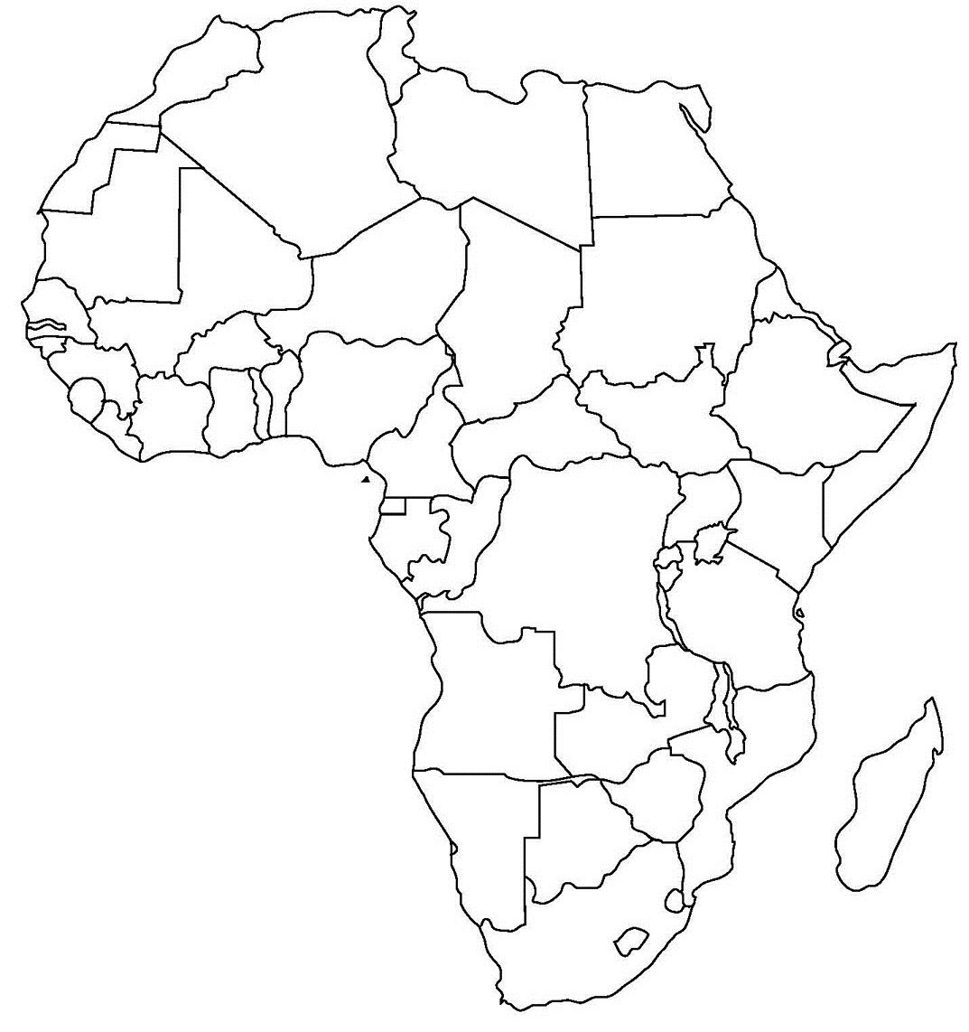
IMPROVING SCENARIO USE
Morocco
-LTES used to plan for deployment of renewables & assess climate mitigation actions
-LTES are communicated through targeted outreach
Egypt
- Communicate LTES through workshops and media
Kenya
- LTES Inform power sector optimization to minimise risk and deployment of renewables
- Targeted stakeholder outreach
Nigeria
-LTES used to plan for deployment of renewables & infrastructure development
-LTES inform decarbonisation plans
-LTES are validated by stakeholders
South Africa
-LTES used to assess deployment of renewables
-LTES used in policy formulation to achieve social & environmental outcomes
Notes:
This encompasses the purpose of scenario building and transparent and effective communication

Slide 17
STRENGTHENING SCENARIO DEVELOPMENT PROCESSES
Morocco
-LTES are formed as part of an NDC-driven process
-Extensive stakeholder consultation
- Account for all emitting sectors
Egypt
-Updated every 2 years as stated in legislation
- Multiple ministries and institutions participate in LTES development
Kenya
- Updated every 2 years
-Multiple ministries and institutions participate in LTES development
-Scenarios focus on the power sector
Nigeria
-Updated every 5 years as stated in legislation
- Multiple ministries and institutions participate in LTES development
National planning office conducts energy planning
LTES and LT-LEDS are aligned
South Africa
-Extensive stakeholder consultation is conducted
-Scenarios assess battery technologies to support VRE focusing on the power sector
Notes:
This encompasses governance structures and boundaries of planning

Slide 18
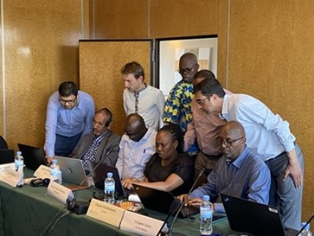
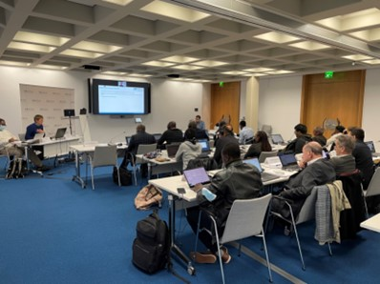
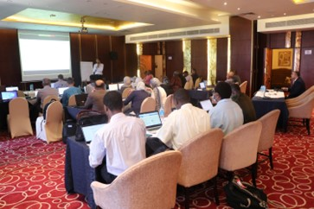
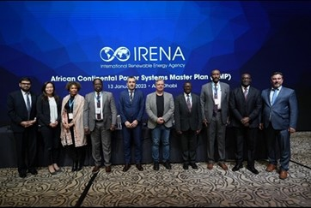
Support countries and regions to devise their own strategies: Continental level
African Continental Power Systems Masterplan:
A continent-wide collaborative process of African power pools and AUDA-NEPAD to plan the electricity generation and transmission and promote capacity building in energy planning
In 37th AU assembly on 17-18 Feb, the African heads of States officially endorsed the first CMP plan entailing African energy transition scenarios up to 2040, as AU’s flagship project under Agenda 2063
IRENA is supporting the CMP initiative as official partner:
  Organized a 3 year long training programme on generation modelling & contributed to over 30 stakeholder meetings
  Next in plan are the joint capacity building programme for East African Power Pool and outreach efforts on mobilizing finance for CMP
Notes:
IRENA supports building institutional capacity for long-term planning, for countries to devise their own strategies
2 key modality of support – tailor made programmes developed together with the partners on the ground (e.g, West Africa – ECREEE, Central Africa – CAPP, Eswatini – the government of Eswatini)
Other shorter term trainings are provided in cooperation with partner organizations throughout Africa

Slide 19
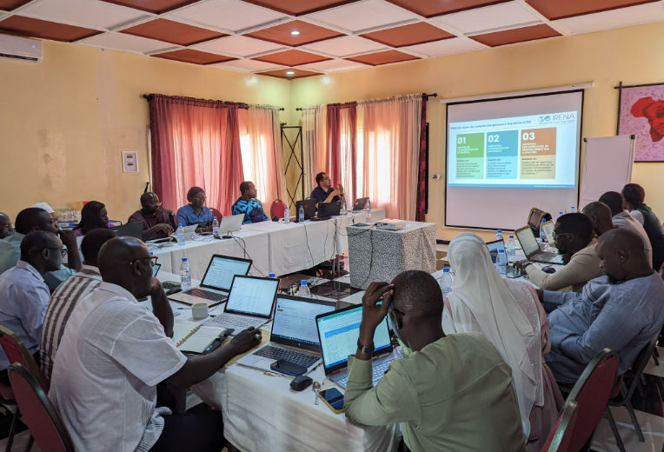
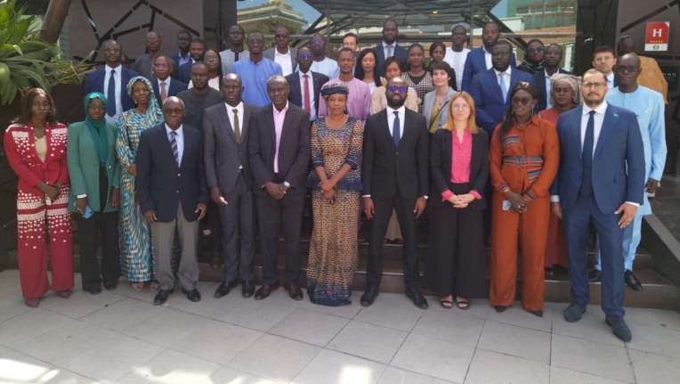
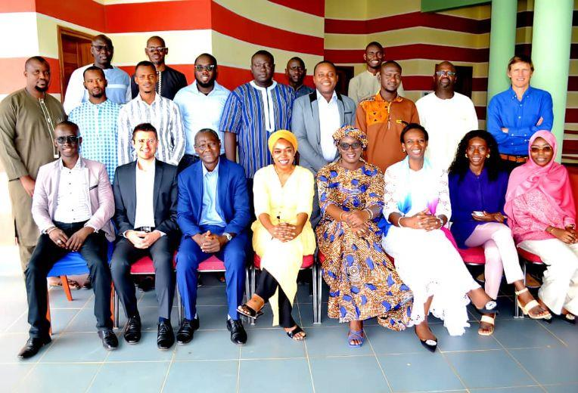
Example: Senegal Masterplan Development Support Programme
Outcomes:
IRENA and GIZ supporting the Ministry of Petroleum and Energy in Power System Planning with 1+ year programme
Building capacity: National team trained on use of IRENA SPLAT-MESSAGE model for their own power system planning
Establishing governance: Cross-divisional national team from every official planning institution
1st Training 19-23 June 2023 Dakar, Senegal
2nd Training 28 Aug-1 Sept 2023 Dakar, Senegal
Kick off Meeting 20-21 March 2023 Dakar, Senegal
Notes:
Emphasize that our programme is to (1) to equip the team with the good planning methods (2) help build institutioal planning capcity (3) structured programs embedded in thier own institutional structure and only as a resullts of 1-3, (4) masster plan document is drafted by the national members.
It is important to recognize that our working modality is quite differnt from other organizations. In many other cases, (1) development partners develop the plans, and share the results - and they call it capacity building (2) one or two adhock training is given rather than structured programme (3) focus on human capacity development rather than institutional capacity development.
To build institutional capacity on energy sector scenario development among public institutions in Senegal’s energy sector and support them with development of a Power Sector Masterplan that supports Senegal’s energy transition planning, building on IRENA’s SPLAT-Africa model for power system capacity expansion planning for all African countries

Slide 20




Example: Cameroon national programme
Outcomes:
New inter-agency planning structures formed in the government
Ca. 300 hours of training for 20+ staff over 1.5 years
Six key scenarios developed using SPLAT-MESSAGE to explore official policy goals
Already being used as internal benchmark to screen project investments

Slide 21
Thank you!

Slide 22
Q & A
10 min

Slide 23
THANK YOU FOR JOINING US!
SEE YOU IN OUR NEXT WEBINARS
www.irena.org/events/2020/Jun/IRENA-Insights

