Slide 1
The age of renewables Presentation at COP 23 renewable energy day
Kingsmill Bond
November 2017

Slide 2
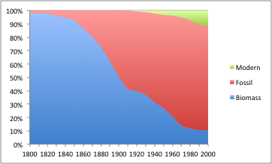
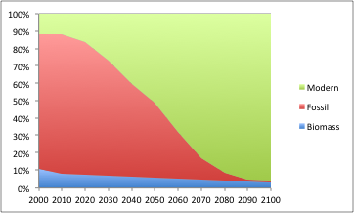
An energy transition is taking place
Global energy share 1800-2000
Global energy share 2000-2100
Source: Smil, BP
Source: BP, TSRP estimates
The world is switching from fossil fuels to renewables.
This is a structural shift not a cyclical one.
The last time the world saw a change of such significance was the switch from biomass to fossil fuels after 1800.
Energy is a foundation technology. So everything else changes too.

Slide 3
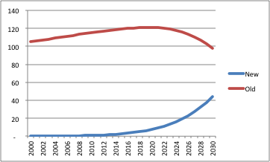
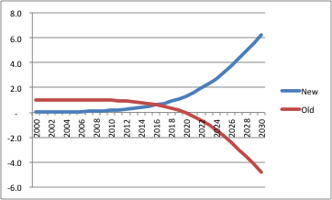
Markets are driven by incremental change
Demand units
Incremental demand units
Source: TSRP
Source: TSRP
Financial markets seek to discount the future. They are thus moved by incremental change, not by total market size.
Markets look at questions like: when does growth stop; who gets the new growth.
When demand stops growing you typically get stranded assets, bankruptcies and radical sector restructuring. Losers become apparent much faster than winners.

Slide 4
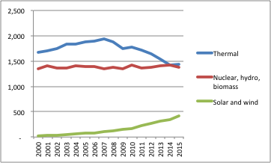
Incremental change is quick and early
Electricity supply in Europe TWh
UK energy demand shifts in the early C20
Source: BP
Source: Fouquet
Incremental change is especially powerful at times of structural (rather than cyclical) shifts.
By definition it strikes when the old industry is at its peak. And when the challenging technology is small and widely dismissed.
Demand for fossil fuels to generate electricity in Europe started to fall in 2008 when renewables were just 3% of total supply.
In the UK’s transitions from coal and gas to oil and electricity, demand for the old technology peaked when the new technologies were 2-3% of the total.

Slide 5
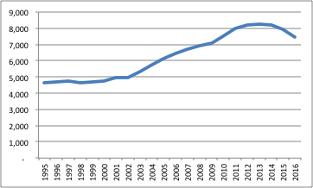
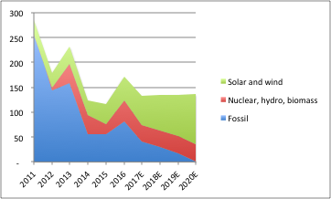
We are surrounded by tipping points
Global coal demand mtoe
Incremental global energy demand mtoe
Source: BP
Source: BP, TSRP estimates
US oil demand peaked in 2005, and OECD energy demand peaked in 2007.
Global coal demand and global per capita fossil fuel demand both peaked in 2013.
At current growth rates, global demand for thermal energy to produce electricity will peak in 2018, global demand for fossil fuels will peak in 2020, and global conventional car demand will peak in 2021.
2020 will thus mark the beginning of the end of the age of fossil fuels and the start of the age of renewables. At this point, fossils will be 83% of global energy supply; solar and wind will make up only 4% of the total.

Slide 6
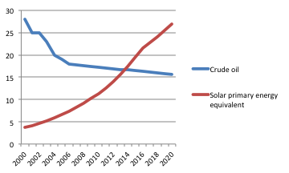
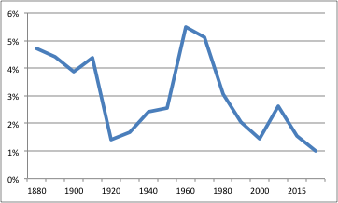
Change is relentless
EROI of solar and oil
Annualised energy demand growth
Source: Gagnon, TSRP estimates
Source: BP, IEA
This energy revolution is far more powerful than that after 1800.
Global. Renewables are global. Technology is global.
Costs of solar, wind and batteries are driven by technology experience curves.
Regulation is driven by pollution, energy security, and carbon concerns.
The emerging market energy leapfrog means all standard models are wrong.
Efficiency. The hurdle rate required to reach a tipping point is much lower as energy demand growth is one third of the levels it was in the last century.

Slide 7
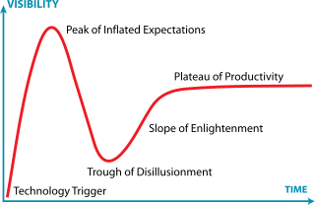
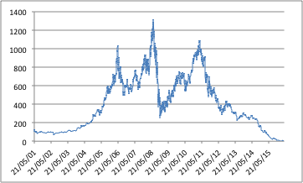
Financial markets will speed up the revolution
The Gartner hype cycle
Peabody share price
Source: Gartner
Source: Bloomberg
Capital will increasingly flee areas of decline.
Financial resources will flood into the areas of growth.
This will drive a powerful self-reinforcing dynamic to speed up the transition.
The US will eventually have a Sputnik moment to avoid redundancy.
Not to say it will be easy. Embedded capital losses are huge and vested interests are powerful.

Slide 8
TSRP Disclosure Statement
The analysis and information presented in this report (Report) by Trusted Sources UK Limited (TS) may include summary profiles of key companies in the relevant sector and the information is offered for subscriber interest only. This Report is not to be used or considered as a recommendation to buy, hold or sell any securities or other financial instruments and does not constitute an investment recommendation or investment advice.
The information contained in this Report has been compiled by TS from various public and industry sources that we believe to be reliable; no representation or warranty, expressed or implied is made by TS, its affiliates or any other person as to the accuracy or completeness of the information. TS is not responsible for any errors in or omissions to such information, or for any consequences that may result from the use of such information. Such information is provided with the expectation that it will be read as part of a wider investment analysis and this Report should not be relied upon on a stand-alone basis. Past performance should not be taken as an indication or guarantee of future performance; we make no representation or warranty regarding future performance. The opinions expressed in this Report reflect the judgment of TS as of the date hereof and are subject to change without notice.
This Report is not an offer to sell or a solicitation of an offer to buy any securities. The offer and sale of securities are regulated generally in various jurisdictions, particularly the manner in which securities may be offered and sold to residents of a particular country or jurisdiction. Securities referenced in this Report may not be eligible for sale in some jurisdictions. To the fullest extent provided by law, neither TS nor any of its affiliates, nor any other person accepts any liability whatsoever for any direct or consequential loss, including without limitation, lost profits arising from any use of this Report or the information contained herein.
No director, officer or employee of TS is on the board of directors of any company referenced herein and no one at any such referenced company is on the board of directors of TS. TS does not invest in any securities although it is possible that one or more of TS's directors, officers, employees or consultants may at times be invested in the securities of a referenced company.
TS is not authorised or regulated in the United Kingdom by the Financial Services Authority or by any other regulator in any jurisdiction for the provision of investment advice. Specific professional financial and investment advice should be sought from your stockbroker, bank manager, solicitor, accountant or other independent professional adviser authorised pursuant to the Financial Services and Markets Act 2000 if you are resident in the United Kingdom or, if not, another appropriately qualified independent financial adviser who specialises in advising on the acquisition of shares and other securities before any investment is
undertaken.
This Report, including the text and graphics, is subject to copyright protection under English law and, through international treaties, other countries. No part of the contents or materials available in this Report may be reproduced, licensed, sold, hired, published, transmitted, modified, adapted, publicly displayed, broadcast or otherwise made available in any way without TS's prior written permission. All rights reserved.

Slide 9
London
T +44 (0) 207 246 7800
sales@tslombard.com
Hong Kong
T +852 2521 0746
sales@tslombard.com
New York
T +1 212 367 7644
sales@tslombard.com

