Slide 1

Renewable Energy Policies for the Energy Transition: Focus on Heating and Cooling
Diala Hawila,
Emanuele Bianco,
Jinlei Feng
Knowledge, Policy and Finance Centre, IRENA
27 April 2021

Slide 2
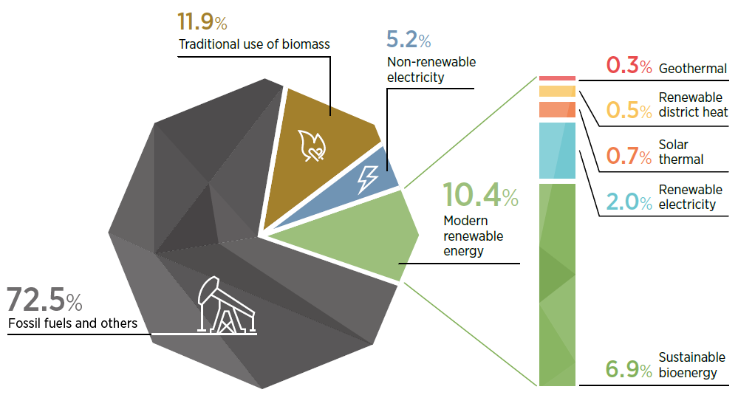
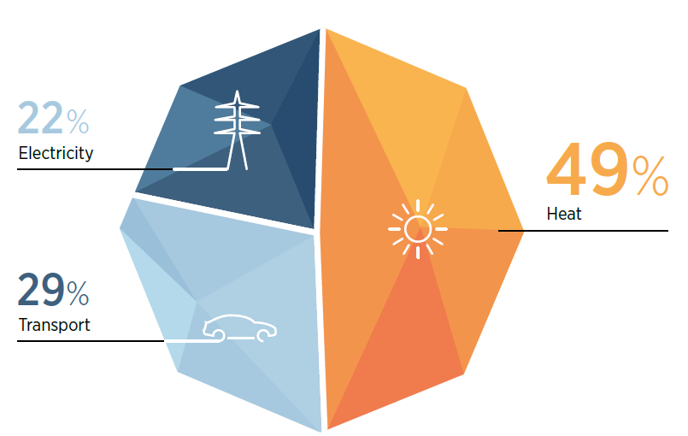
The energy for heating and cooling is largely sourced from fossil fuels
Total final energy consumption,
by final energy use, 2018
Share of energy sources in total final energy consumption of
heating and cooling, 2019

Slide 3
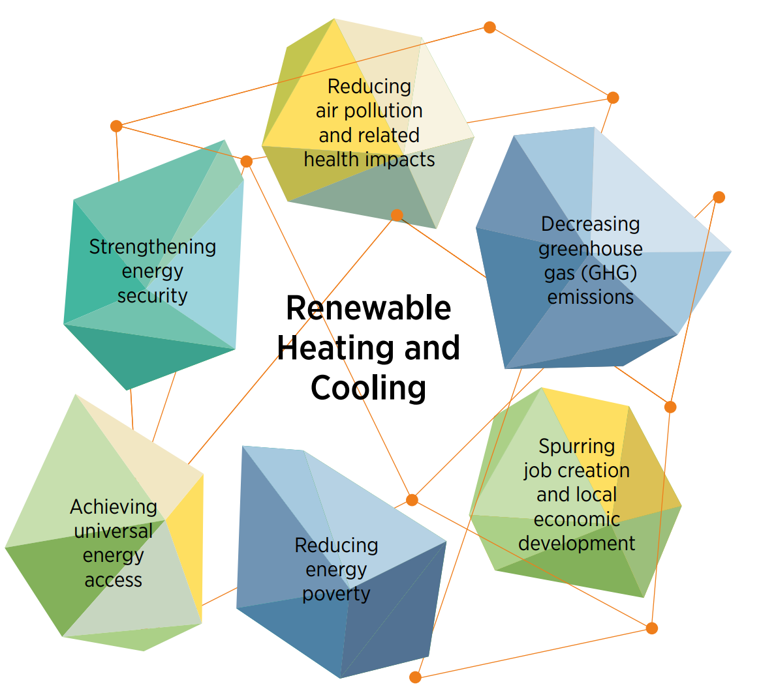


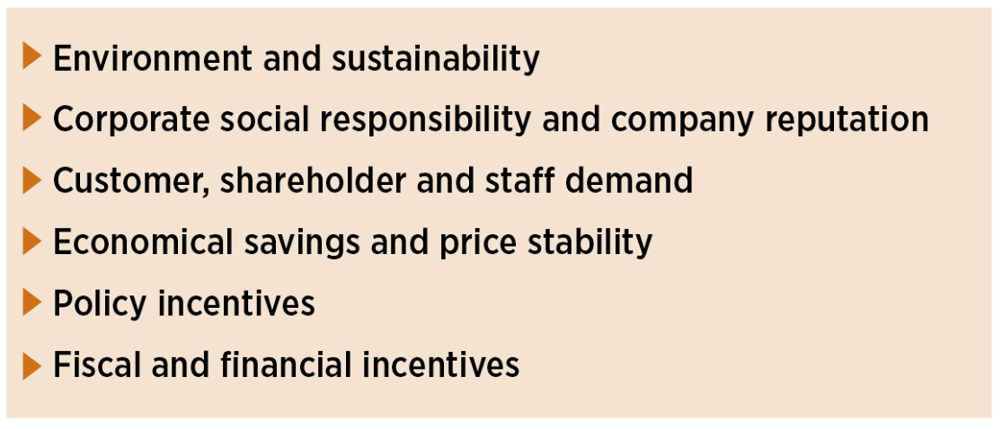
The benefits of the energy transition in heating and cooling are clear
Corporate drivers and barriers for renewable heating and cooling
https://coalition.irena.org/
Notes:
In addition to target-setting, the Coalition’s report identifies six main drivers that play a key role in increasing the share of renewables in companies’ in general, but particularly for heating and cooling operations. These key drivers include environment and sustainability; corporate social responsibility and company reputation; customer, shareholder and staff demand; economical savings and price stability; policy incentives; and fiscal and financial incentives.
While companies are increasingly eager to set and achieve ambitious renewable energy targets, barriers or disincentives continue to exist. Key barriers include fossil fuel lock-in; cost competitiveness of conventional energy solutions; lack of access to finance; competing internal priorities; lack of available technologies; new investments in cost-intensive advanced technologies; sparse information and data; regulatory/policy uncertainty; lack of government support; structural/behavioural barriers.

Slide 4
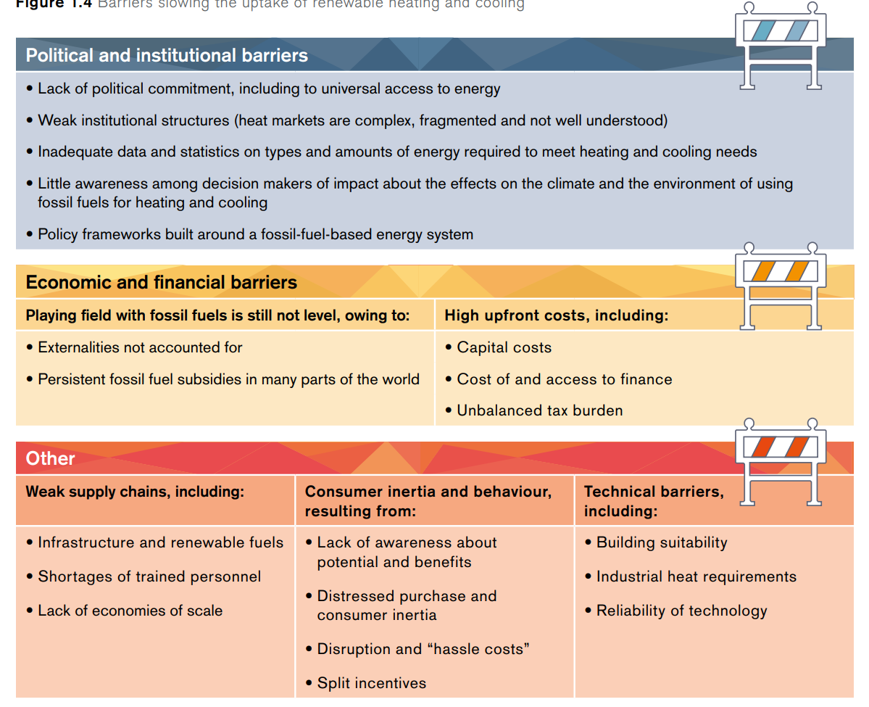
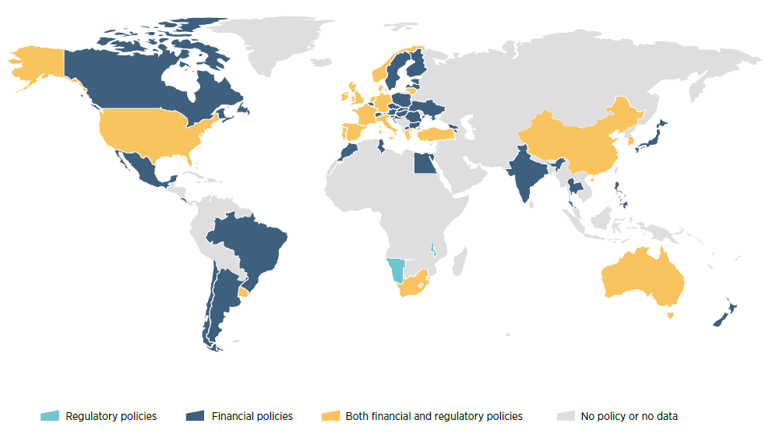
But barriers still exist on many fronts
Countries with policies for renewable heating and cooling, 2009-19
Notes:
Numerous barriers slow down the transition to renewable heating and cooling.
They range from the highest levels of policy making – where long-term decisions are made – to the lowest levels where homeowners are making individual purchasing decisions.
Chief among the common barriers are high upfront costs, regulatory and institutional frameworks based on fossil fuels, consumer inertia, and technical hurdles.
These barriers are common among many of the pathways discussed and widely shared around the world.
Despite their prevalence, these barriers can be overcome with policies addressing all end-use sectors and that support all available options.

Slide 5
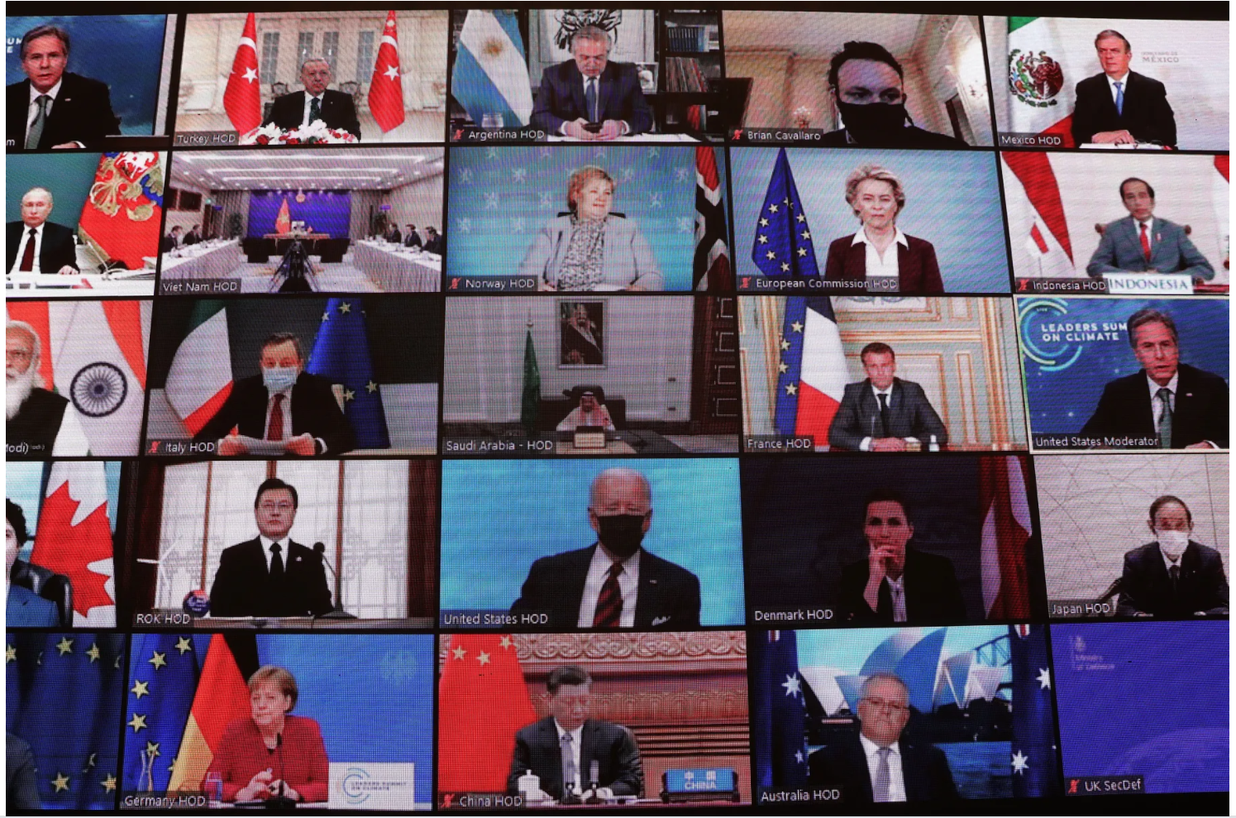
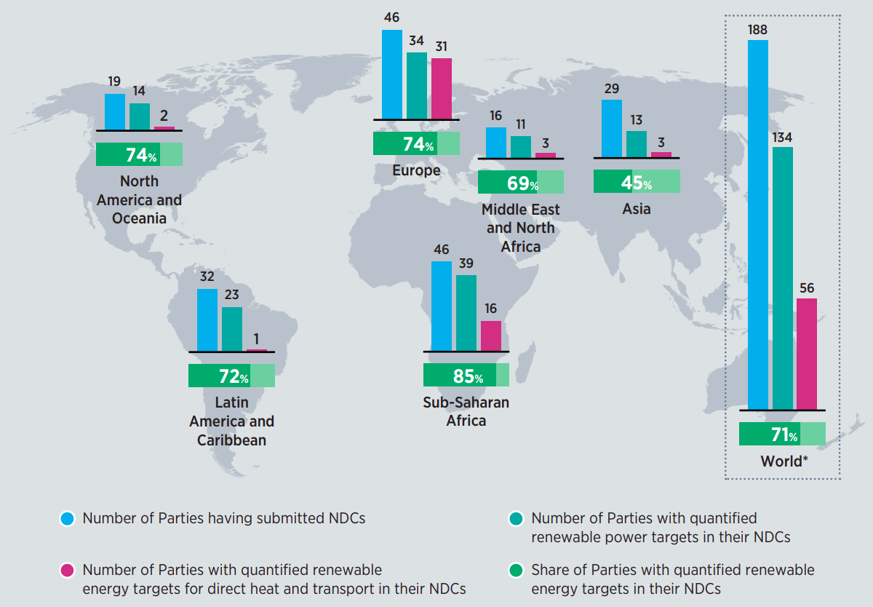
To attract investments in the sector, there is a need for raising ambition
Renewable energy components in current NDCs
Notes:
While the majority of NDCs include renewable energy targets only for electricity generation, significant CO₂ emission reductions will be needed by 2050 in end-use sectors

Slide 6


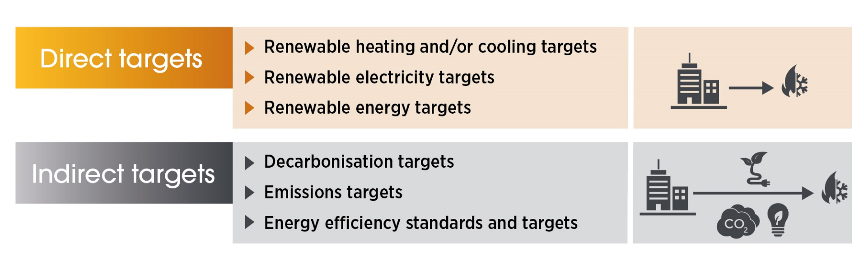

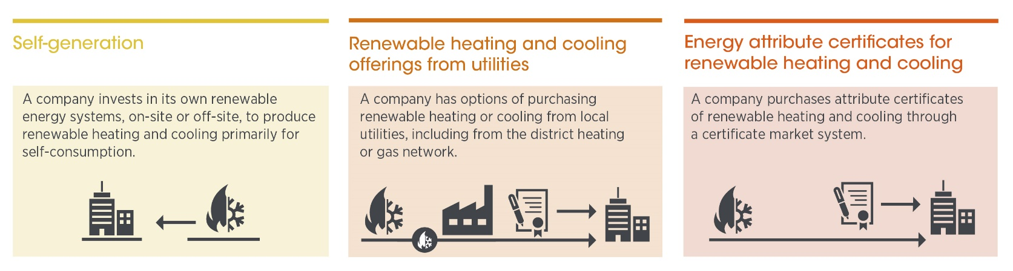
Specific targets for renewables in heating and cooling are needed to guide investments
49 countries with national targets for renewable H&C
Companies wanting to decarbonise heating and cooling are more likely to set indirect targets with broader climate and sustainability objectives
166 countries with targets for renewables in the power sector
Existing and potential corporate sourcing models for renewable heating and cooling
Source: IRENA (2021)
Accelerating corporate sourcing models for renewable heating and cooling is crucial to decarbonise industry
Source: IRENA (2021)
Source: IRENA (2021)
Notes:
The IRENA Coalition for Action’s latest report Companies in transition towards 100% renewable energy: Focus on heating and cooling examines the technical, economic and policy opportunities available to, as well as challenges faced by companies in the industrial sector trying to integrate high shares of renewables in their heating and cooling operations.
While companies are increasingly sourcing renewable electricity, the sourcing of renewable heating and cooling is still in its infancy and highly dependent on the available infrastructure and renewable resources on-site or in close proximity, as well as the existence of enabling frameworks.
New sourcing mechanisms that facilitate easy access to renewable heating and cooling will be critical to scale up corporate sourcing of renewables and accelerate the rapid decarbonisation of industry. These include self-generation, renewable heating and cooling offerings from utilities and energy attribute certificates for renewable heating and cooling.
Findings of the Coalition’s report indicate that companies wanting to decarbonise heating and cooling are more likely to set indirect targets with broader climate and sustainability objectives – such as emissions reduction targets, energy efficiency targets or standards, or decarbonisation targets – as opposed to direct renewable heating and cooling targets. This is in stark contrast to companies increasingly setting direct renewable electricity targets.

Slide 7
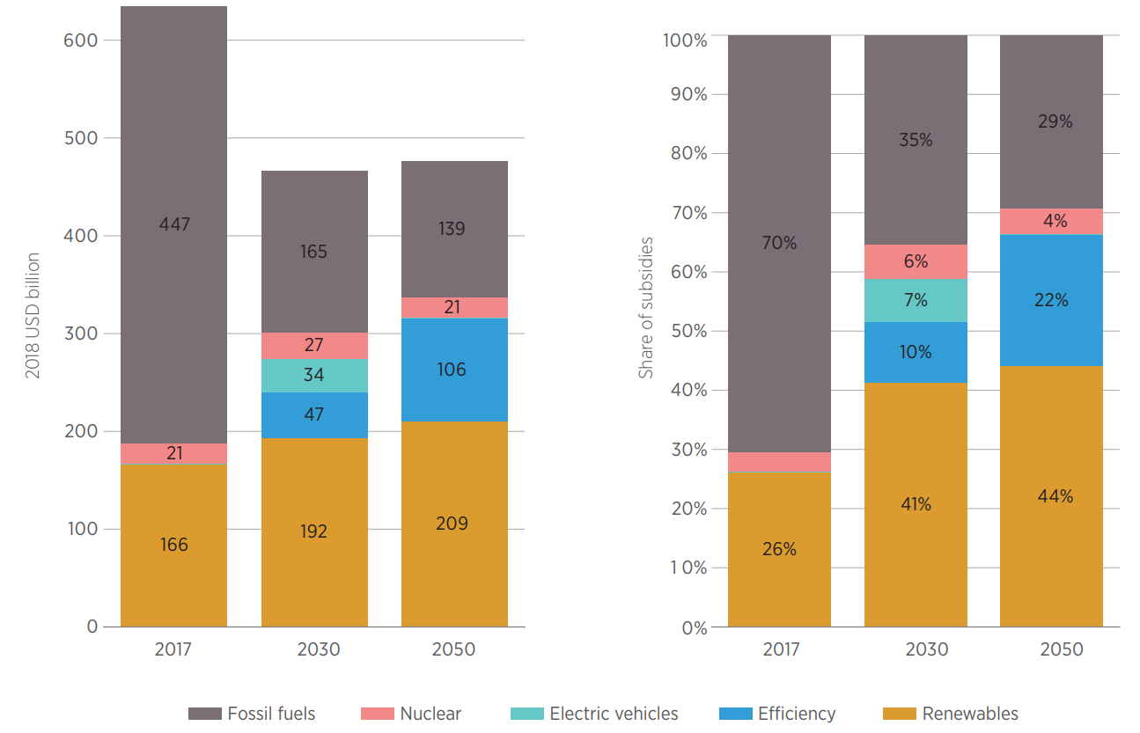
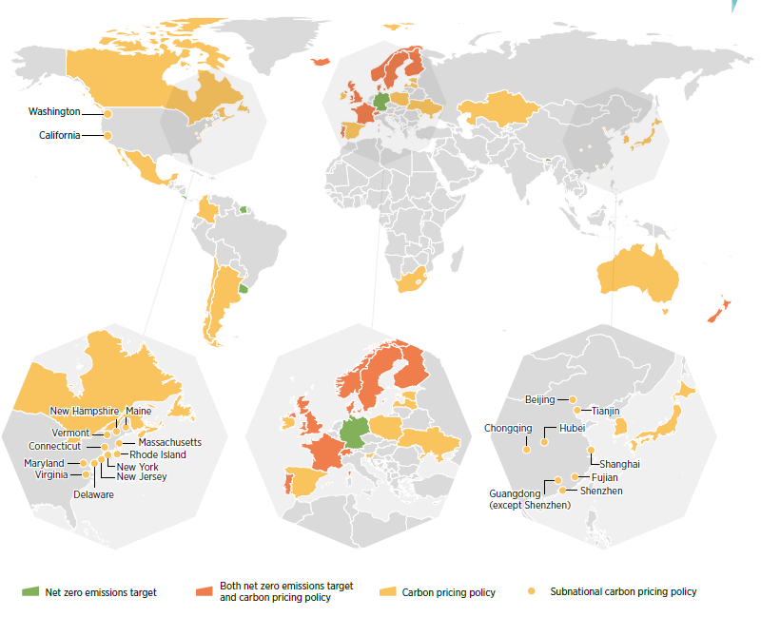
And a need for public intervention to level the playing field
Energy sector subsidies by source excluding climate and health costs, 2017
Jurisdictions with selected climate change policies, early 2020

Slide 8
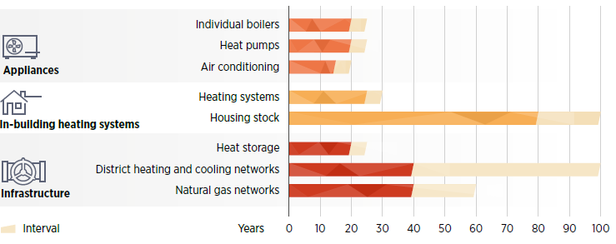
The transition requires robust institutional coordination and a long- term integrated plan
Intersectoral coordination
Operating lifetime of heating and cooling infrastructure, systems and appliances
Energy
Transport
Agriculture/
Forestry

Slide 9






The five pathways and key infrastructure
Renewables-based electrification
Renewable gases
Sustainable biomass
Solar thermal heat
Geothermal heat
District heating and cooling

Slide 10
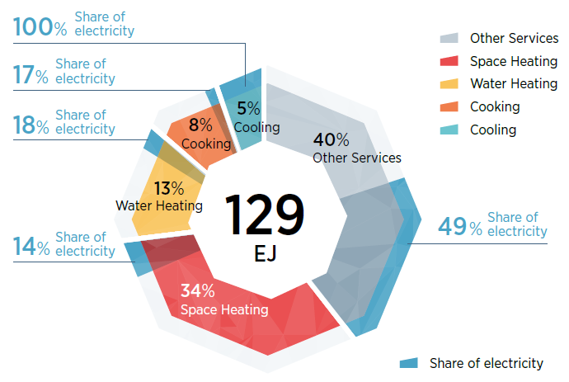
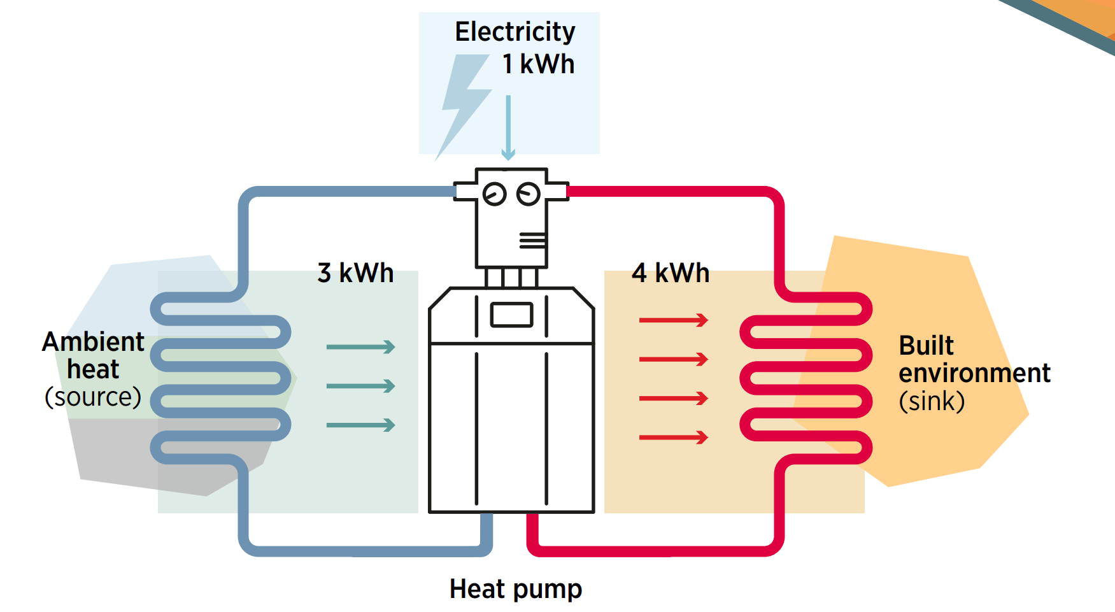
Renewables-based electrification
Global share of electricity in the buildings sector by service, 2019
Heat pumps

Slide 11
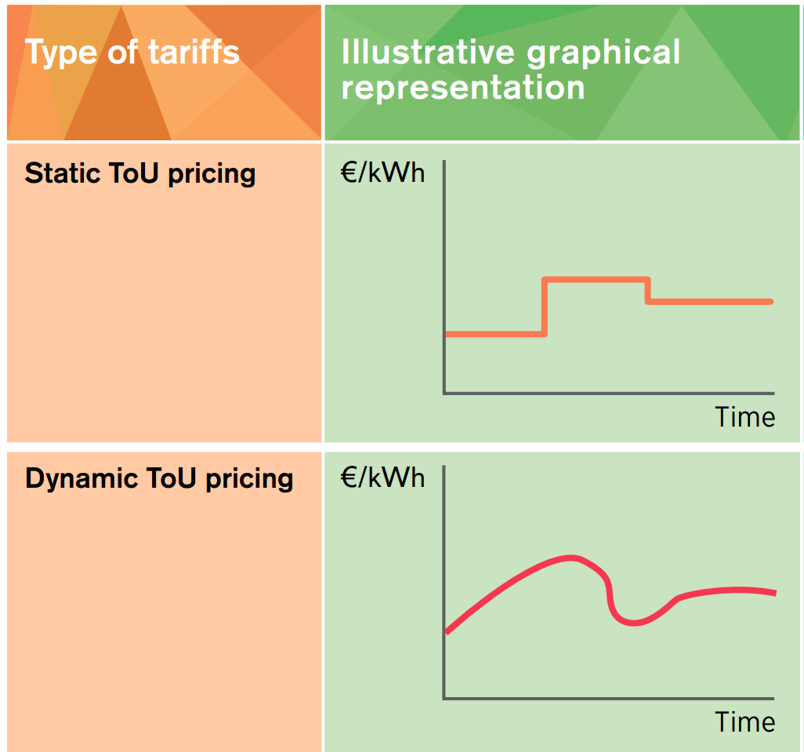
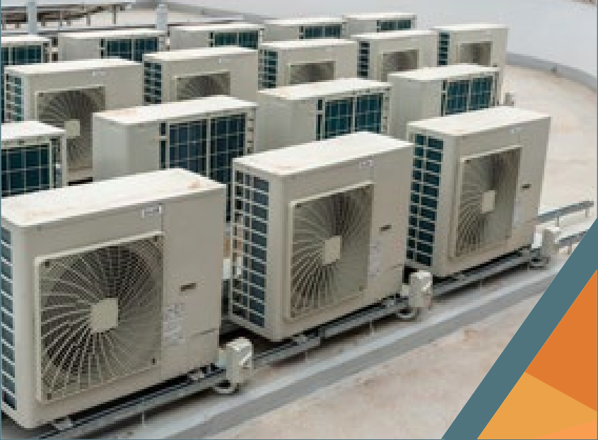

Flexibility from heating and cooling
More and more wind and solar power in the power system call for increased system flexibility
Heating and cooling electric appliances are excellent resources of flexibility
Harvesting flexibility:
  Active sector coupling
  Passive demand-side response

Slide 12
Renewables-based electrification policies
Overcoming high upfront cost of appliances (HP)
Capital grants, subsidies, loans, rebates
Addressing high operational costs
Electric heating tariffs, energy efficiency in building codes
Addressing network constraints
Tariffication schemes (ToU tariffs), digital monitoring & control for DR, conducive market design
Increasing consumer confidence
Quality standards, labels, MEPS
Examples:
China’s Clean Winter Heating in Northern Regions pilot program
The United Kingdom’s Renewable Heat Incentive

Slide 13
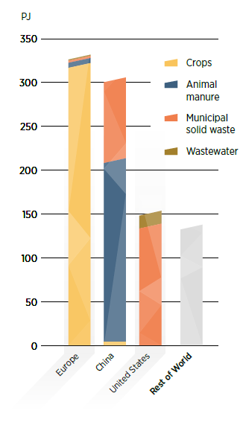
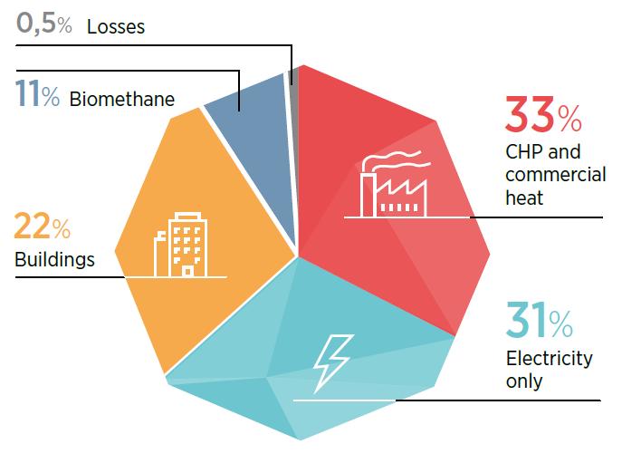
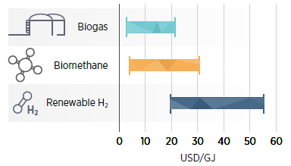
Renewable gases
Biogas production by region and by feedstock and end use, 2017
Renewable gas production cost range, 2018

Slide 14
Policies for renewable gases
Closing the gap with fossil fuels
Recognition of avoided CH₄ emissions from biogas/ biomethane
Stimulating investment by lowering the risk
RE gas injection subsidies
Clear long-term framework for the gas industry
Targets
Capital grants, loan guarantees, soft loans
Harnessing the potential of existing gas infra-structure
“Guarantee of origin” registries
Blending demonstration projects
Deploying renewable gases in industry
Industrial clusters for hydrogen projects
Examples:
Denmark’s target : 100% of gas injected into its grid renewable by 2035; France’s target : 10% of renewable gas consumption by 2030
California’s low carbon fuel standard
SDE++ auction system for green hydrogen in the Netherlands

Slide 15
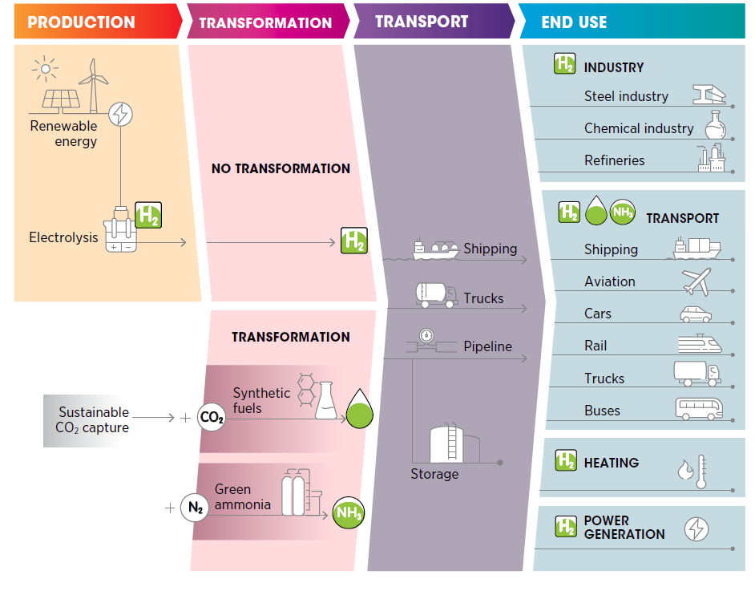


Green hydrogen: The new wave of interest
Green hydrogen can be utilised in a wide range of end-uses
Identify the applications that provide the highest value and prioritise action towards them
Maintain the principle of additionality

Slide 16
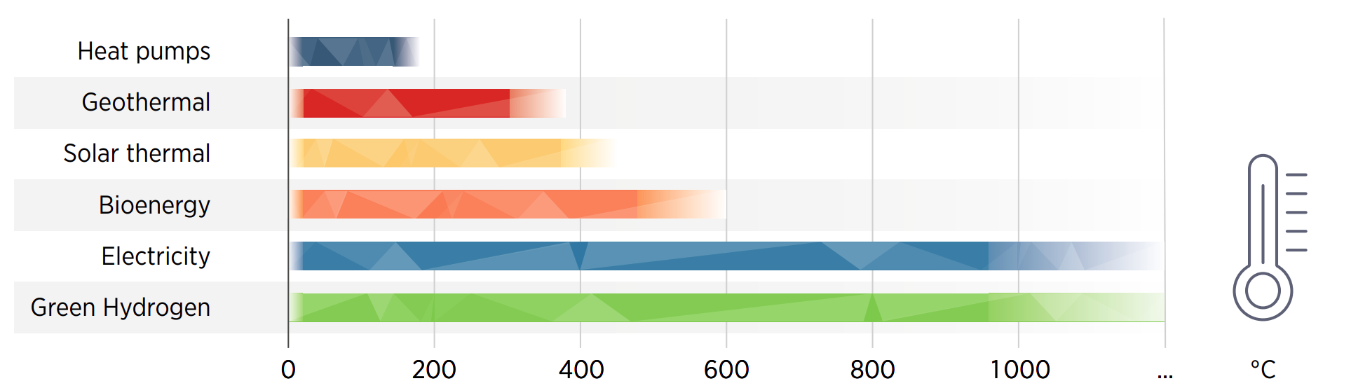
Green hydrogen for heating
Working temperatures for various renewable heat technologies

Slide 17
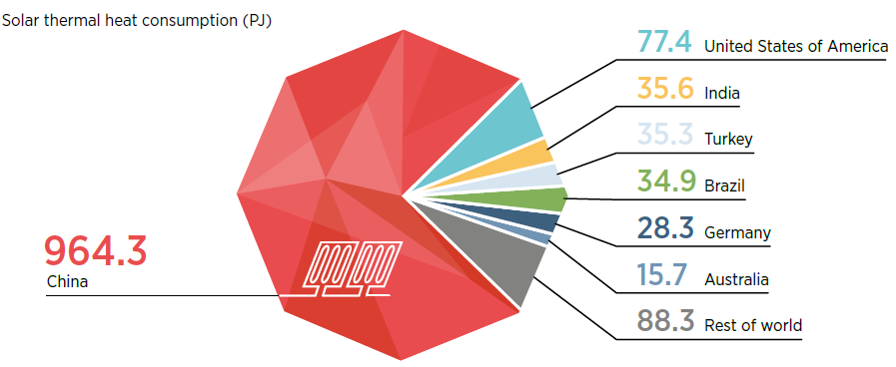

Direct use of solar thermal heat
Solar thermal heat use by country, 2017 (PJ)
Global solar thermal capacity in operation, 2009-19 (GWth)

Slide 18
Policies for the direct use of solar thermal heat
Overcoming upfront costs
Technology-specific targets
Improving the range of possible applications
RD&D
Rising consumers awareness and confidence
Public campaigns, information-sharing
Certification schemes
Loans, grants, subsidies, tax incentives
Improving investors confidence
Examples:
China’s SWH deployment was supported by a mix of targets, subsidies and mandates
Combinaison of grants, tax exemptions and preferential loans in Tunisia (PROSOL), Rwanda (SolaRwanda) & Lebanon
Solar thermal District Heating in Denmark developed thanks to high fossil fuel taxes

Slide 19

Direct use of geothermal heat
Geothermal heat use by sector and by country, 2017
Geothermal heating by use in Turkey, 2018

Slide 20
Policies for the direct use of geothermal heat
De-risking geothermal exploration
Road maps and action plans
Data collection and sharing on geothermal resources
Dedicated loan guarantees and grants
Risk insurance funds
Improving investors confidence
Overcoming high upfront costs
Tax incentives, loans
Example of the Netherlands:
Geothermal Action Plan (2011) & Acceleration Plan for Geothermal Energy in Horticulture (2014)
SDE++ feed-in-premium for renewable heat
Public geological database
Post-damage guarantee scheme
Collaborative venture programme between government and industry for information sharing

Slide 21
District heating and cooling as key enabling infrastructure
District heating and cooling (DHC) networks can be viewed as an enabler of greater renewable uptake
According to IRENA’s 1.5C Scenario, the share renewables in district energy needs to rise from 9% (2018) to 90% (2050)
DHC is best suited for dense urban areas, which provide the anchor load needed to ensure large and steady heat demand

Slide 22
Policies for the deployment of district heating and cooling networks
Addressing financial barriers
Strengthening consumer awareness
Demonstration projects
City targets
Ensuring stable demand
Heat mapping
Addressing regulatory barriers
Subsidies, grants, tax credits
Direct investment
Land value capture strategies
Energy efficiency policies
Mandating zones
Allowing third party access
Examples:
Targets on renewable-based district heating and cooling in Helsinborg (Sweden)
Connection mandate in Amsterdam (the Netherlands)
United Kingdom’s guideline for heat mapping

Slide 23
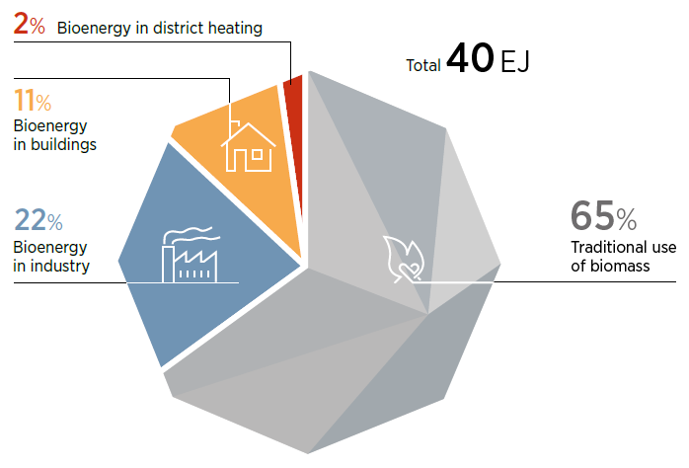
Sustainable use of biomass
Bioenergy used for heating, 2018
Benefits of sustainable biomass include:
Direct and indirect GHG reductions
Environmental benefits such as clean air
Socio-economic improvements such as job creation, improved health, and gender equity
Sustainable biomass should take into consideration environmental, social and economic aspects, and impacts on land-use changes, biodiversity and others.

Slide 24
Policies for the sustainable use of biomass
Addressing cost and market barriers
Ensuring sustainability of biomass supply
Clear sustainability guidelines & biomass certification schemes
Strict standards, certification of systems & installers
Ensuring quality of installations and fuels
Grants, tax incentives, loans, FiT
Developing reliable supply chains
Consistent & long-term policy, clear planning & regulatory framework
Examples:
Italy’s «Conto termico» (grants) & France’s «Fonds Chaleur» (subsidies)
Loan support for biomass CHP from Brazil’s development bank
India’s grant scheme for industrial-scale biomass co-generation
Sustainability criteria in the EU RED II Directive

Slide 25

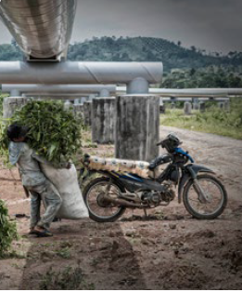
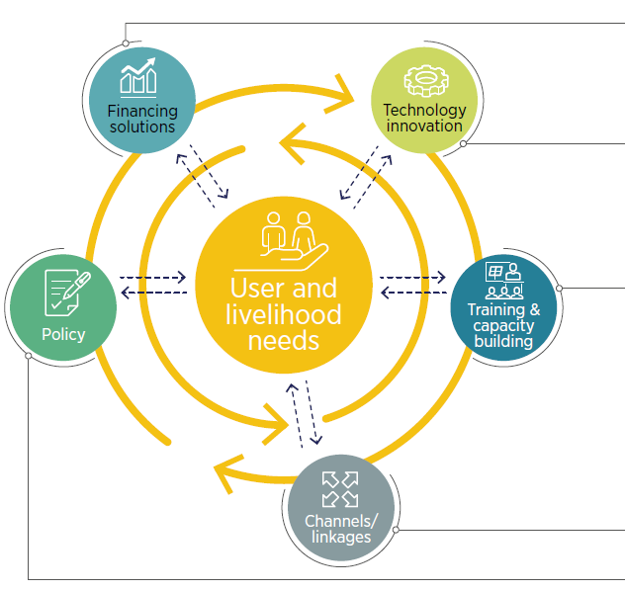
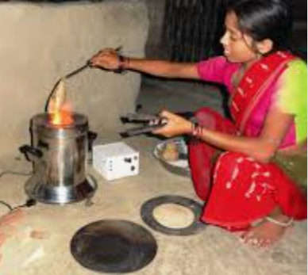
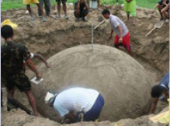
Provide universal access to clean, affordable and reliable heating energy
Ecosystem needs for supporting livelihoods
Access to finance
Cost of capital
Ownership models
Efficient technology
Caters to specific needs
Last mile supply chain
Awareness of solutions
Training
Knowledge transfer
Stable input sources
Access to new or existing markets to sell products
Cross-cutting plans
Awareness in financial inst
Derisking tools
Source: SELCO Foundation, 2018

Slide 26
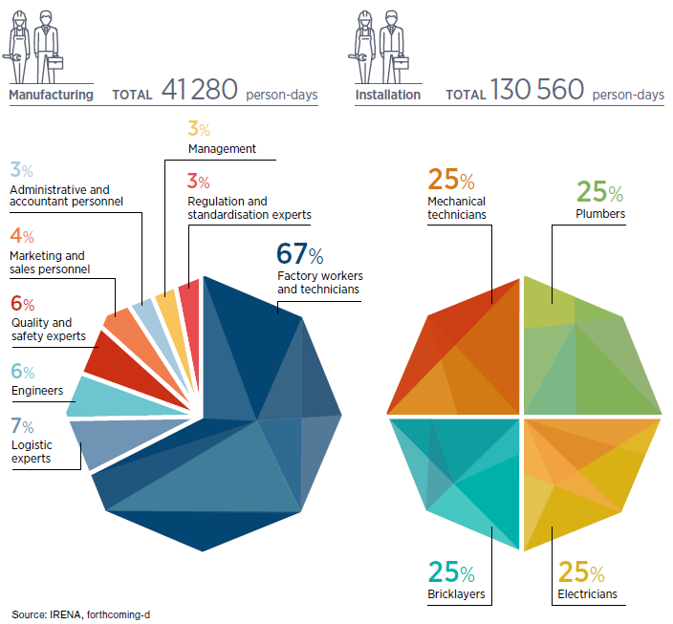
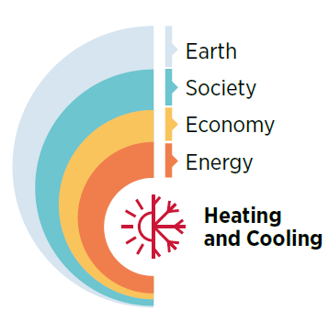
Ensure a just and inclusive transition
Human resources required for the manufacturing and installation of SWHs for 10 000 single-family households, by occupation
The broad dimension of renewable energy
policy making

Slide 27







^{www.irena.org}
^{www.instagram.com/irenaimages}
^{www.twitter.com/irena}
www.flickr.com/photos/irenaimages
^{www.facebook.com/irena.org}
^{www.youtube.com/user/irenaorg}

