Slide 1
Green recovery policies:
Examples of transformative change in renewable energy
Michael Renner
Celia García-Baños
Knowledge Policy and Finance Centre

Slide 2
Overview of presentation
Factors influencing employment
Renewable energy jobs today
Post COVID recovery and energy transition
Challenges & opportunities
Leveraging local capacities
Gender dimension
Short- & long-term scenarios
Comprehensive policy framework

Slide 3
Factors influencing RE employment creation
Technical advances and falling costs
◆ Rising competitiveness
◆ Lower costs allow
more deployment per $ spent
Deployment: New and cumulative capacity
◆ Jobs in project development; manufacturing; sales; construction & installation
◆ Jobs in O&M
COVID-19 impacts & recovery
◆ Impacts along supply chain, and by end-use
◆ Stimulus and job retention
◆ Remote work arrangements
Changes in labour intensities
◆ Automation; use of AI
◆ Economies of scale
◆ Learning effects
RE policy ambition
◆ Deployment & integrating policies
◆ Industrial policies; trade policies; skill-training; labour market; gender policies
Supply chain structures
◆ Commodity, technology dependencies
◆ Trade patterns and geographic footprints
◆ Localisation efforts

Slide 4
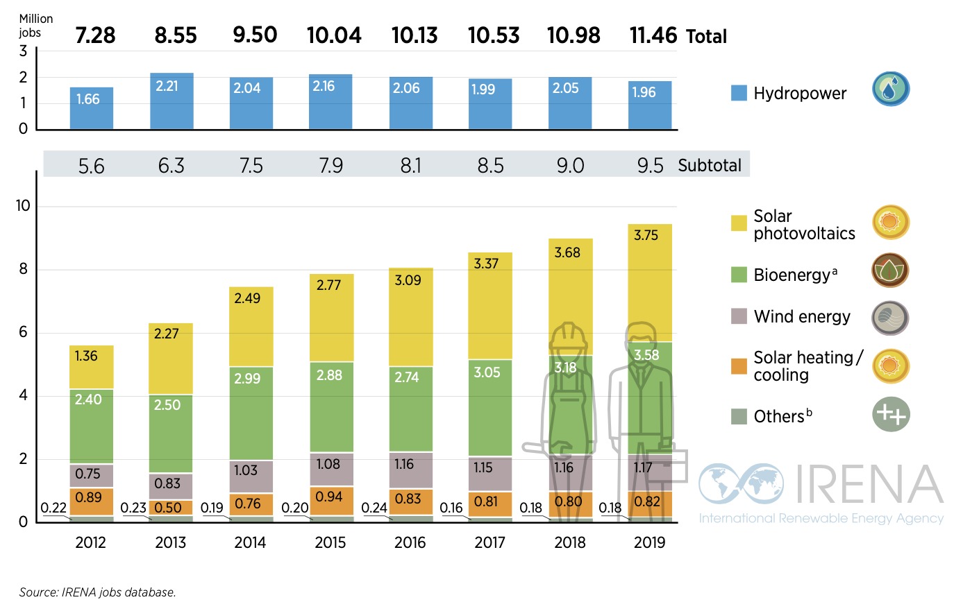
Growth of renewable energy jobs, 2012-19
(direct jobs only)

Slide 5
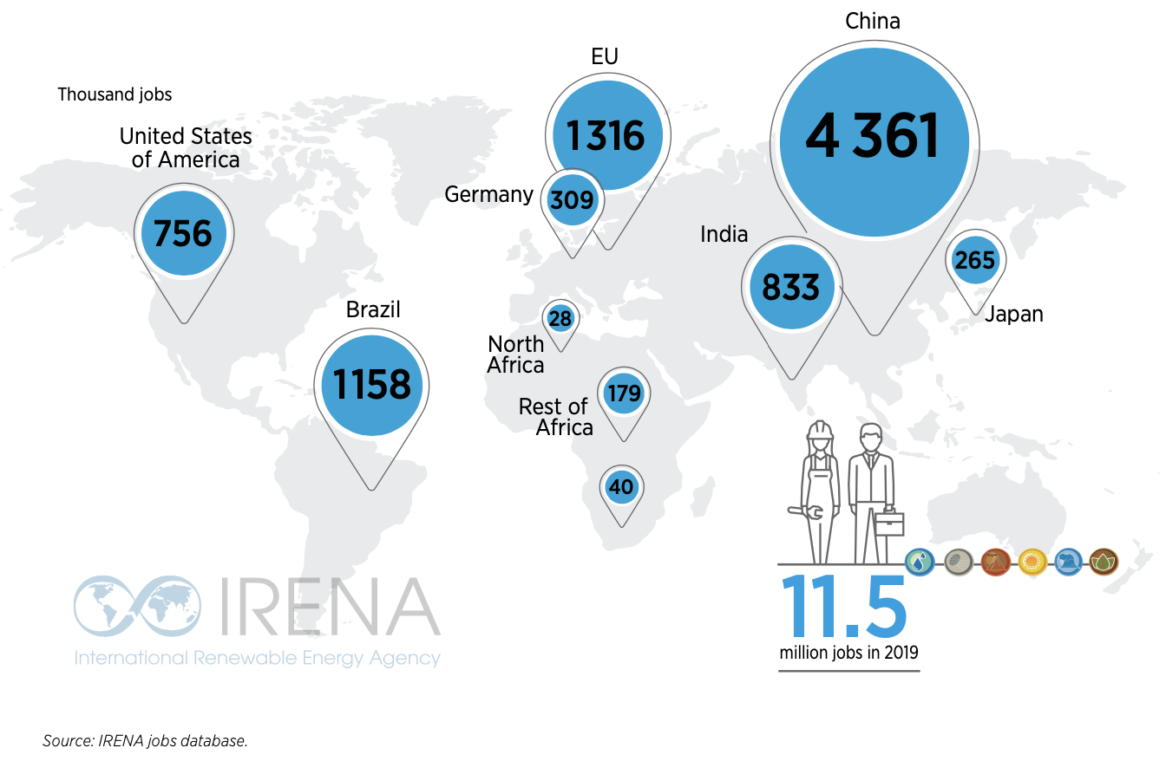
Jobs in renewable energy: Leading countries

Slide 6
Renewable Energy Value Chain Illustration
Project planning
Procurement
of inputs
Manufacture of components
Transport of equipment
Project installation
Grid connection (where applicable)
Operations & maintenance
Decommission
Legal services (contracting, permitting)
Administration & Sales
Education, Skills-training
Surveying, environmental studies, etc.
Policy making
Financing
Research and development
Support services and enabling functions

Slide 7
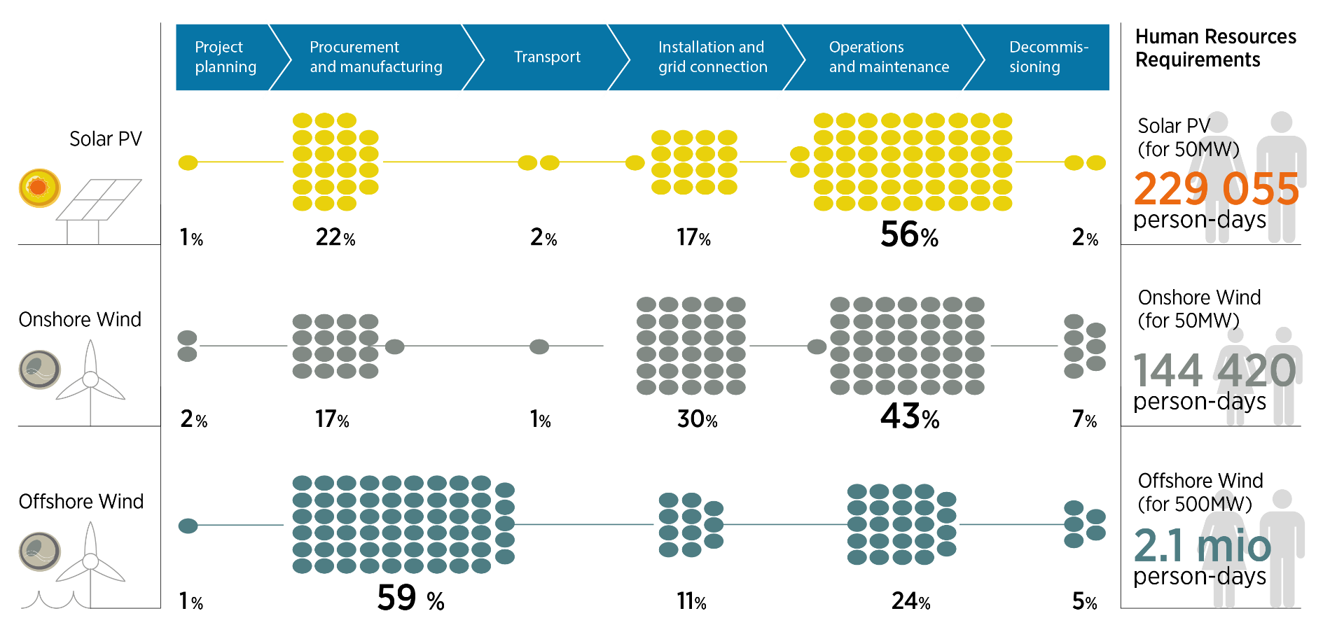
Labour requirements along wind and solar energy value chains

Slide 8
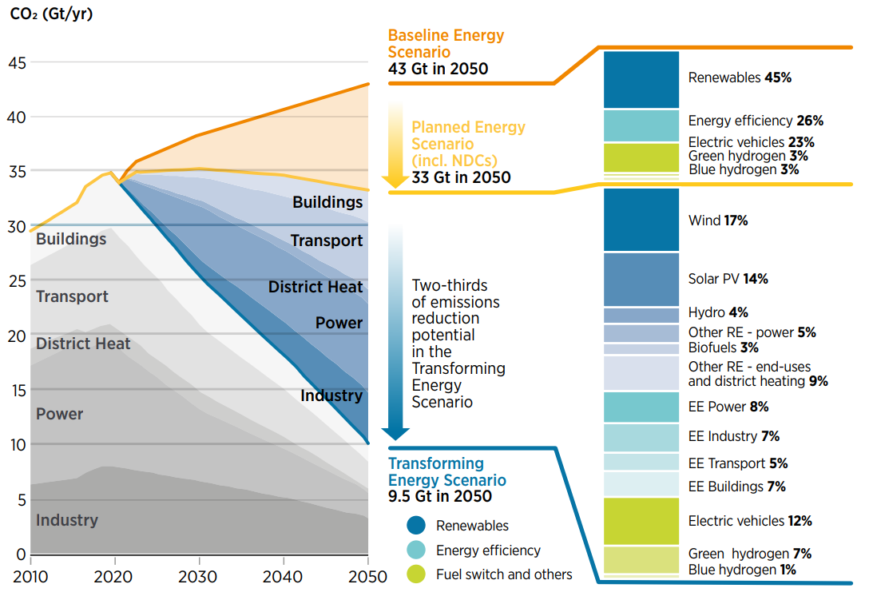
A sustainable climate and energy pathway to 2050
Transforming Energy Scenario:
Annual energy-related CO₂ emissions would decline by 70% in 2050.
Share of RE would increase from 14% of total primary energy supply in 2017 to 28% in 2030, and 65% in 2050.

Slide 9
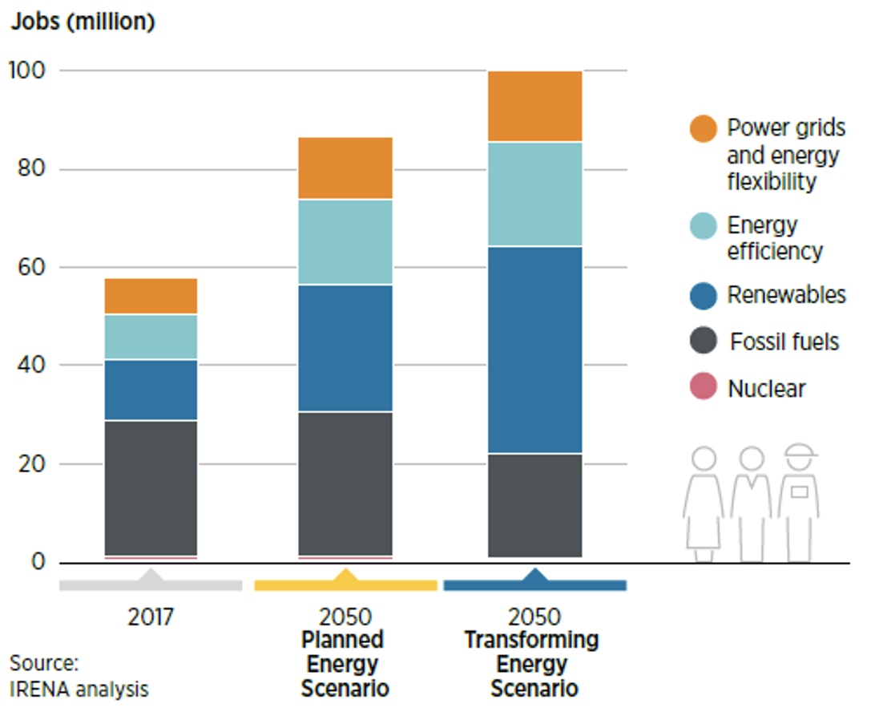
Energy sector jobs: Renewables gain, fossil fuels shrink
TES 2050
compared with today:
+30.4 million renewables jobs
-6.4 million fossil fuel jobs

Slide 10
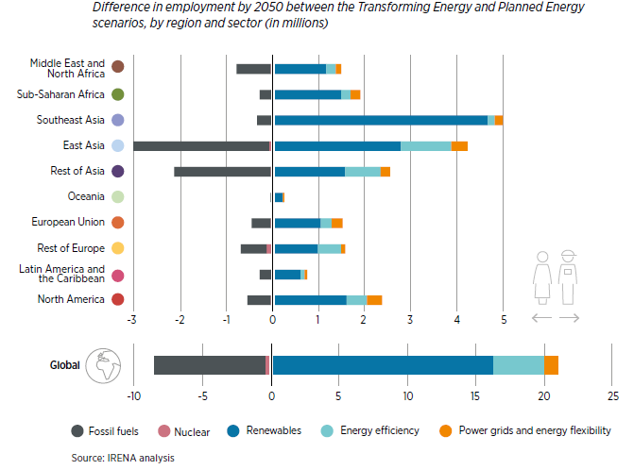
All regions see gains in energy sector jobs by 2050

Slide 11
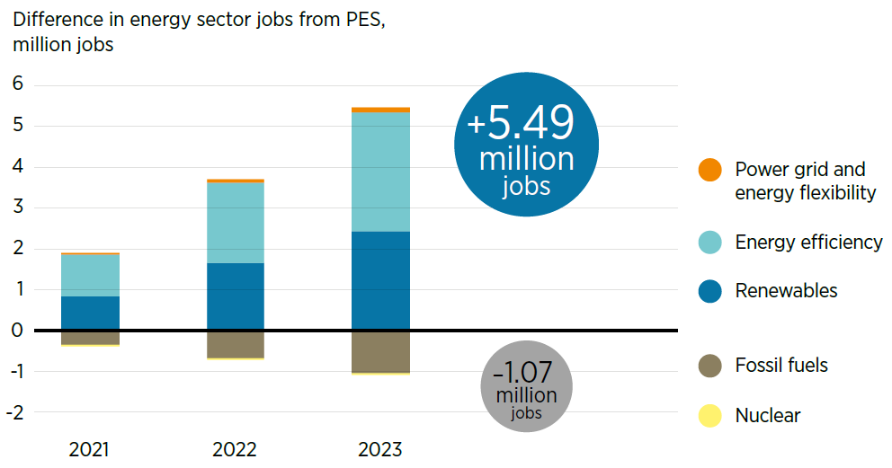
Post-COVID strategy: Employment and growth benefits
Changes in energy sector jobs resulting from transition-related investment (Transforming Energy Scenario compared to Planned Energy Scenario, 2021-2023)
+ 1.0% GDP per year, 2020 – 2023 compared to PES

Slide 12
Outlook for sustainable energy jobs: 2030 and 2050
IRENA’s Transforming Energy Scenario:
2050: 42 million RE jobs
Plus:
Energy Efficiency: 21.3 million
Energy flexibility: 14.5 million
2030: 29.5 million RE jobs
Plus:
Energy Efficiency: 29.2 million
Energy flexibility: 12.1 million
Now: 11.5 million RE jobs
Plus:
Energy Efficiency: 9.5 million
Energy flexibility: 7.4 million

Slide 13
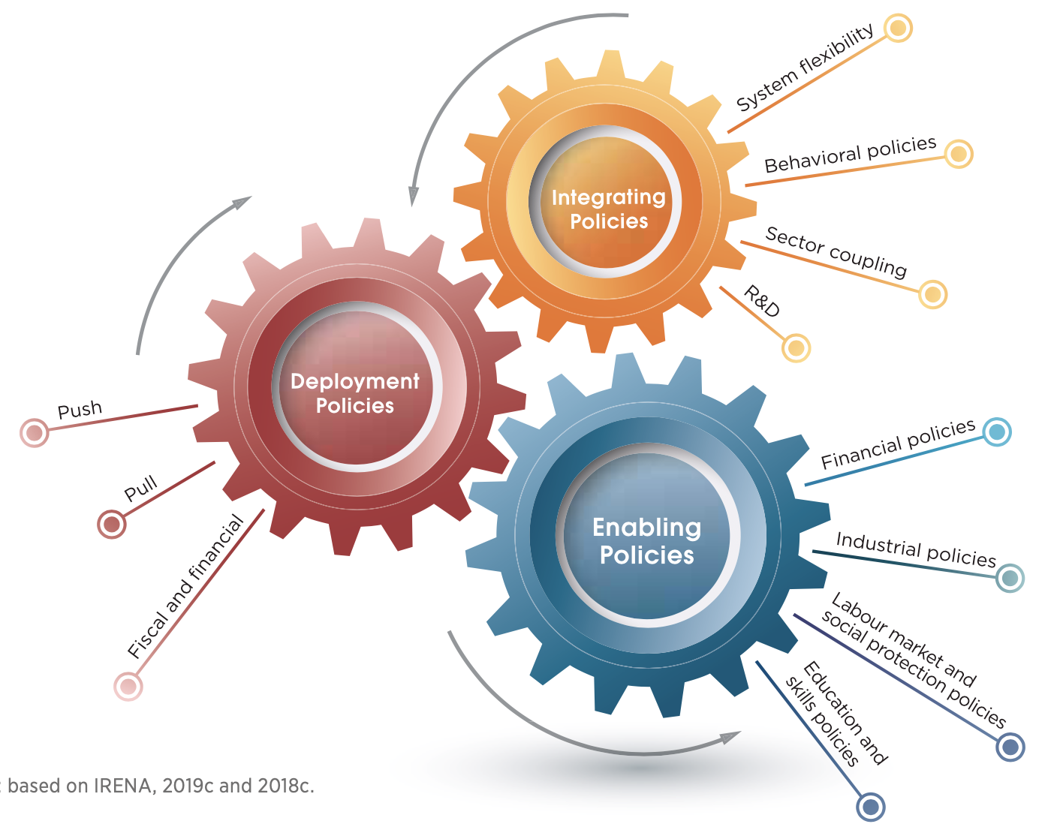
Energy transition: Challenges and policy framework
CHALLENGES
POLICIES
Structural realities
Decent jobs agenda
Fossil fuel dependence
Job creation
Social protection
Supply chain limits
Rights at work
Commodity dependence
Social dialogue
Technology dependence
Diversity needs
Just Transition Policies
Job mis-alignments
Gender
Spatial
Minorities
Temporal
Marginalised groups
Occupational
Sectoral
Youth

Slide 14
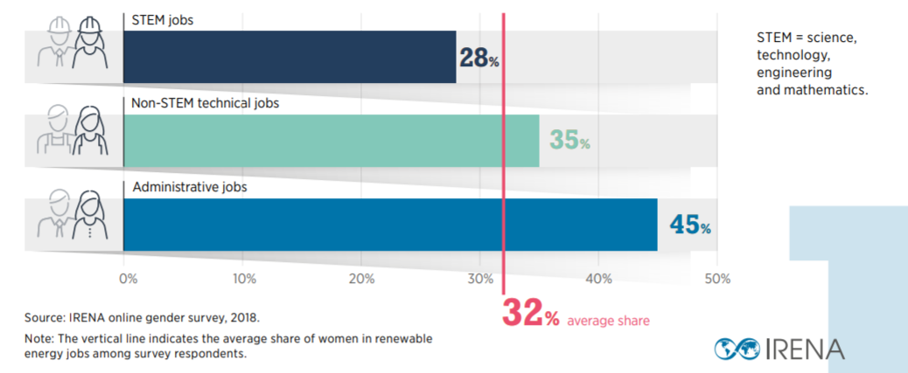
Renewable energy jobs: A gender perspective
11.5 million
jobs in 2019
32% in RE
21% in wind

Slide 15
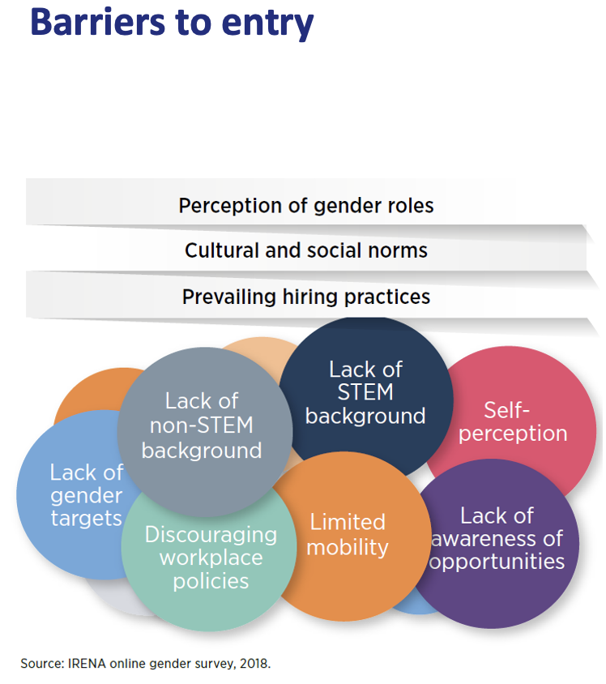
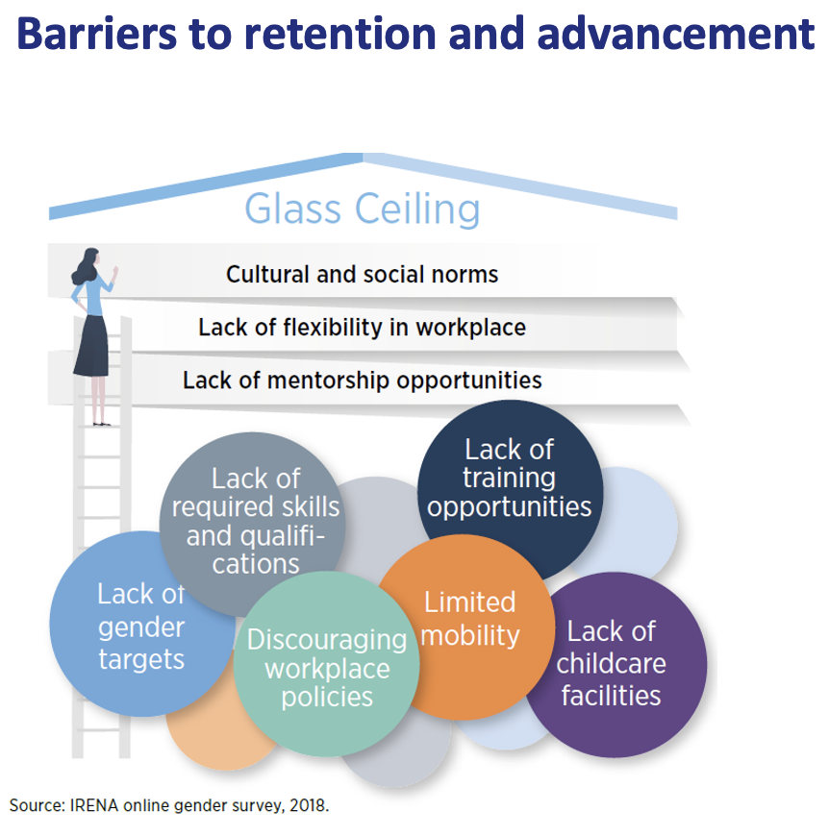
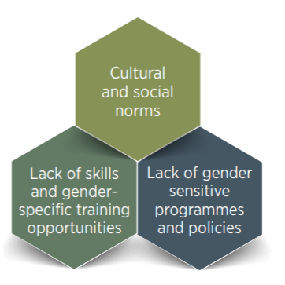
Gender dimension in renewables: Barriers faced by women
Barriers to entry
Barriers to retention & advancement
Barriers in the access context

Slide 16
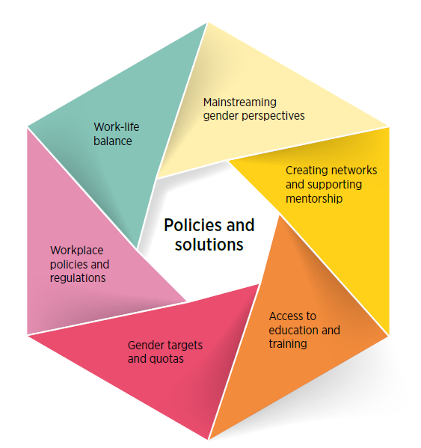
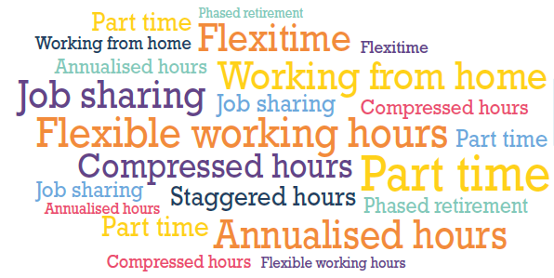
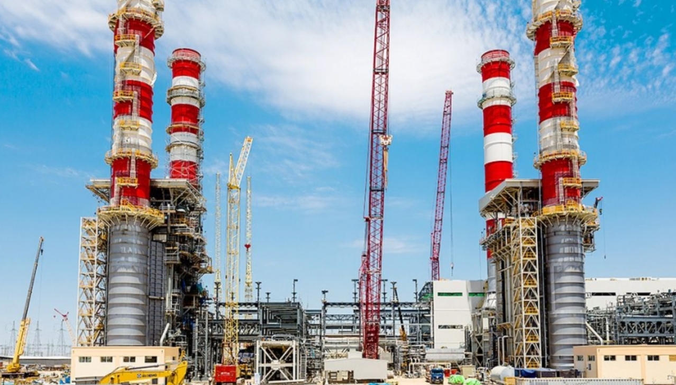
Policies and solutions to increase women’s participation
Part-time employment, flexi-time and job-sharing
Paid parental leave
Gender audit
Training in gender awareness
Fair and transparent internal processes (appraisal and promotion)
Mentorship programmes
Understand and addressing wage gaps
Remove restricting laws
Awareness of opportunities
Mentorship programmes
Publishing training opportunities
Apprenticeships
Access to finance
“30-by-30” programme Engineers Canada
Goals for gender diversity and equity
Encourage gender through deployment policies (e.g. auctions)
University curricula
Scholarships, internships and enrolment targets
Vocational training

Slide 17
Thank you!

