Slide 1

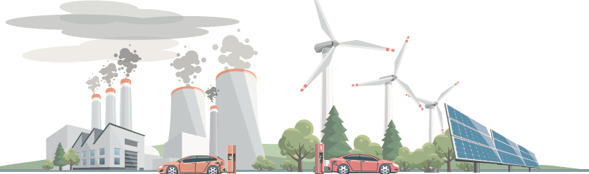
Reaching Zero with Renewables
Green commodities in the industry sector
Dolf Gielen
Director Innovation and Technology
EU-GCC Clean Energy Technology Network webinar - Integration of Renewable Energies in the Industry Sector
3 March 2021

Slide 2
Key insights
The energy transition is ongoing
Some sectors are not yet receiving the attention they require – notably industry
Role of RE options is much larger than estimated previously – significant scale-up potential
Massive electrification with RE power and green hydrogen supply structure is critical
“Smart” electrification and production of clean energy vectors is key for successful sector coupling
Consider moving energy-intensive industry production steps closer to low-cost RE sources
Growing potential for green commodity trade e.g. DRI, ammonia, methanol etc
  Export opportunities for MENA region
A significant scale-up of action on multiple fronts needs to begin now
Need to establish standards & certification system for green commodities
2

Slide 3
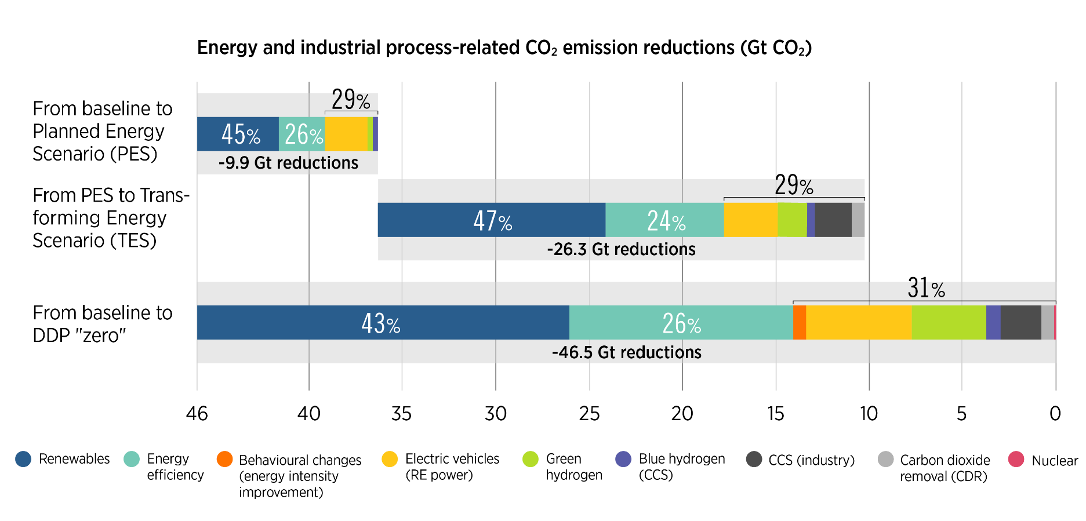
Global Renewables Outlook outlines options to cut energy-related CO₂ emissions to 2050
2 degrees
1.5 degrees
H₂
Source: IRENA
Energy efficiency, renewables, end-use electrification, green hydrogen and synthetic fuels will play a crucial role in global decarbonisation.
3

Slide 4
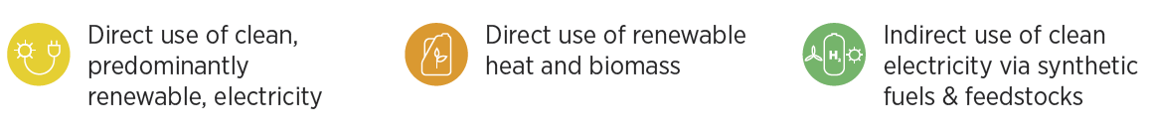
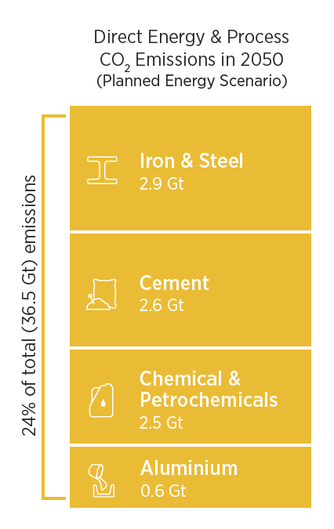
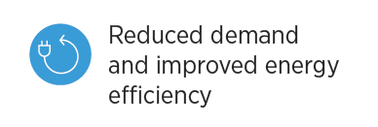
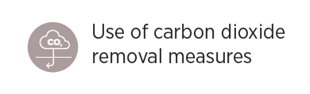
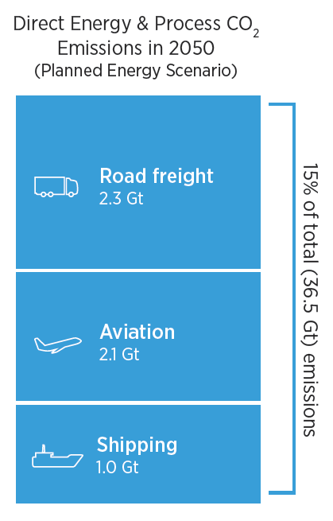
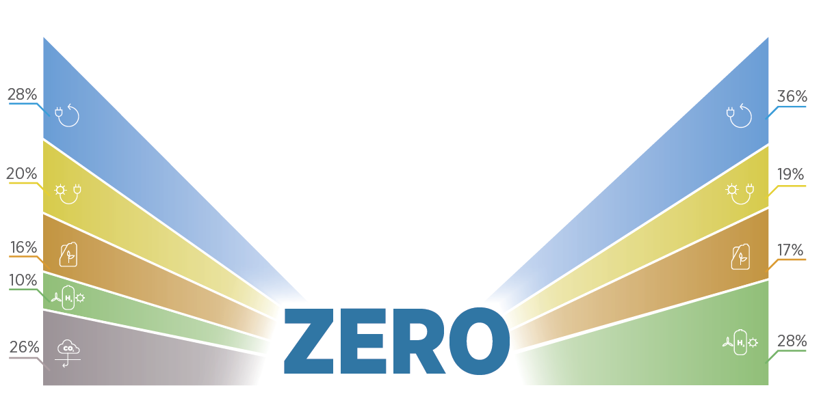
5 Measures for Reaching Zero – key role for renewables
4

Slide 5
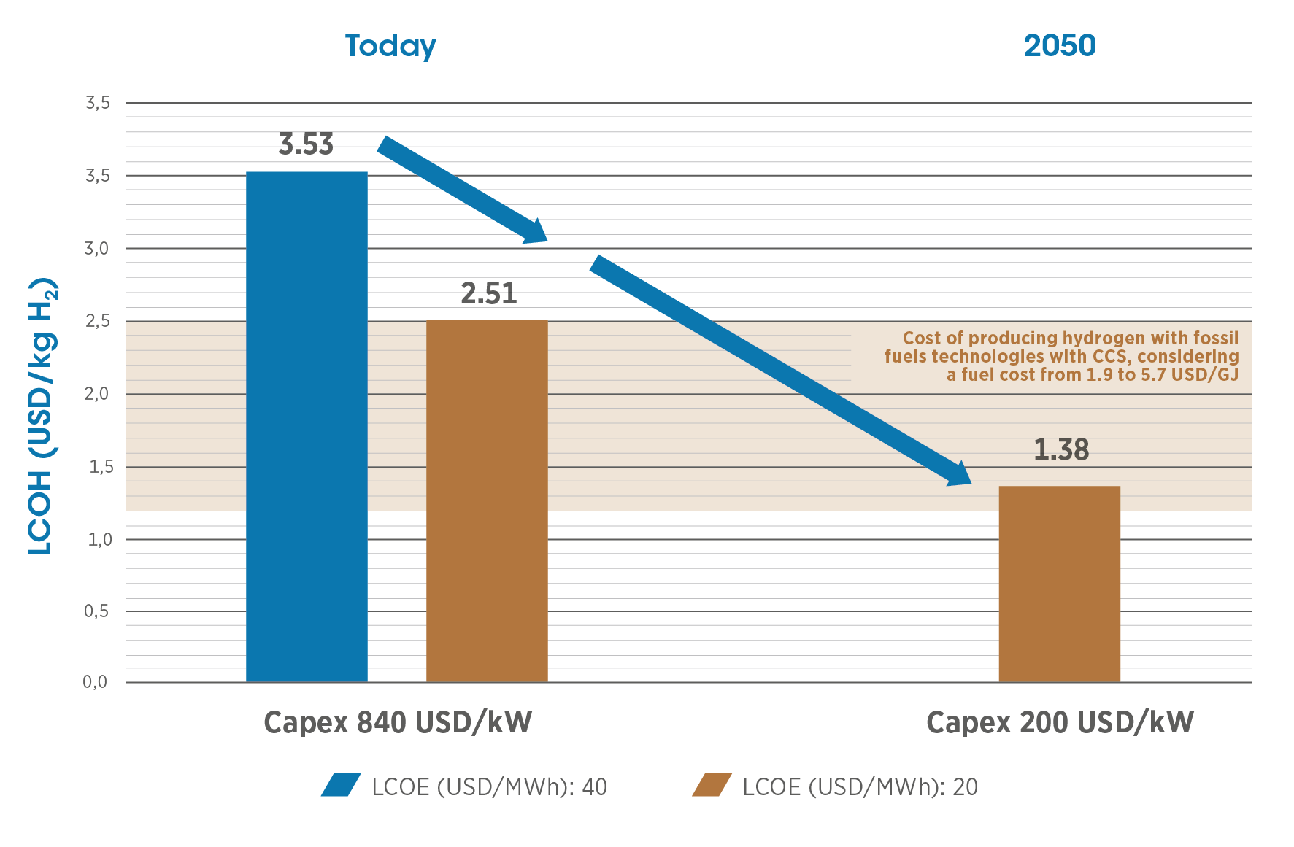
E-fuels based on green hydrogen
Today:
98% grey hydrogen supply
1% of all hydrogen supply is green and 1% is blue
0.3 GW electrolysers
60 -80 GW pipeline of electrolysers
Green hydrogen will be cheaper than blue hydrogen
2020-2030
2040-2050
December 2020
2050:
2/3 of supply is green and 1/3 is blue – 2 - 4x today’s hydrogen demand
Electrolyser system cost may drop to 200 USD/kW in 2050
Electrolyser efficiency may improve to 45 kWh/kg
Hydrogen production can increase RE power demand significantly and provide additional flexibility
Source: IRENA (2019)
Key assumptions electrolyser: Load factor: 4200 hours (48%), conversion efficiency 65% (today), 75% (2050)
5

Slide 6
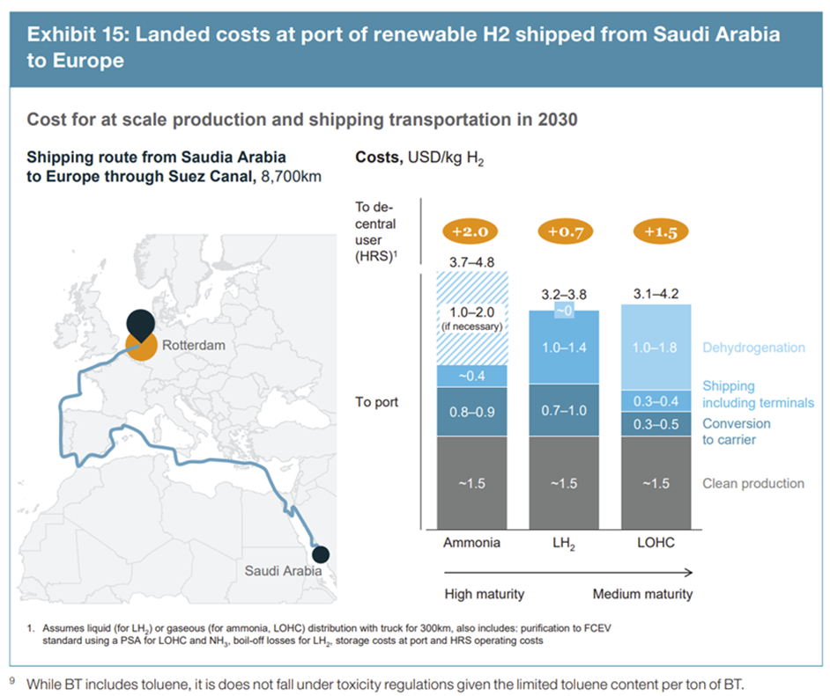
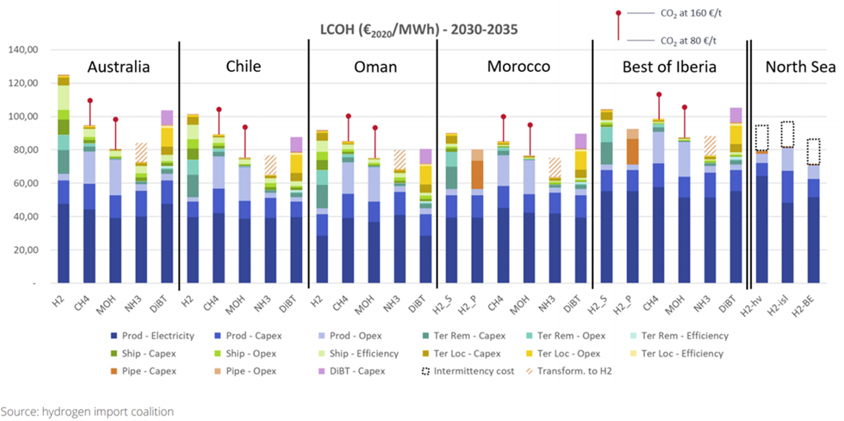
Shipping hydrogen or shipping commodities?
The energy transition is ongoing, its likely that trade will be needed
Shipping hydrogen can more than double the supply cost – a costly form of energy
Shipping green commodities avoids reconversion cost and efficiency losses
Source: Hydrogen Council
6

Slide 7
Green hydrogen
A key part of future Energy Systems
Hydrogen’s role
  Increase the flexibility of power systems at all timescales
  Ammonia as a commodity (N-fertiliser) and as a fuel (shipping) – market potential 300 Mt NH3 – 75 Mt H2
  Hydrogen for aviation synfuel, synthetic diesel and naphtha – 110 Mt H2
  Products and global market potentials 2050: up to 375 Mt for existing and new markets from 120 Mt/yr today
  Road transportation fuel (freight+passenger cars) could increase this total by 50%
Key Points in 2050
  Hydrogen production costs: 0.9-2.0 USD/kg H2
  Electrolyser capacity: 1700 GW (TES)
  Electricity to produce green hydrogen: 7.5 PWh (TES)
  Solar and Wind capacity: at least 4 TW (TES)
  Hydrogen demand doubles from TES to DDP
  Up to a quarter of all electricity for green hydrogen production by 2050
7

Slide 8
Example: Ammonia
Global production 200 Mt/yr
Ammonia is mainly produced from natural gas approx. 1.5 t CO₂/t ammonia
Its production can be combined with low cost CO₂ capture
Use of fossil CO₂ for short life ureas fertilised production should be avoided
Ammonia can also be produced from green hydrogen
A Mt-scale plant for export is under development in Saudi Arabia (NEOM)
Availability of low-cost green hydrogen and low-cost renewable electricity is a precondition
Current LCOA green ammonia USD 475/t, by 2030 USD 350/t (current ammonia price USD 200-300/t)
Consider relocating this industry and import green ammonia
Need for green sourcing standards and certification (Guarantees of Origin – what about trade outside EU)
8

Slide 9
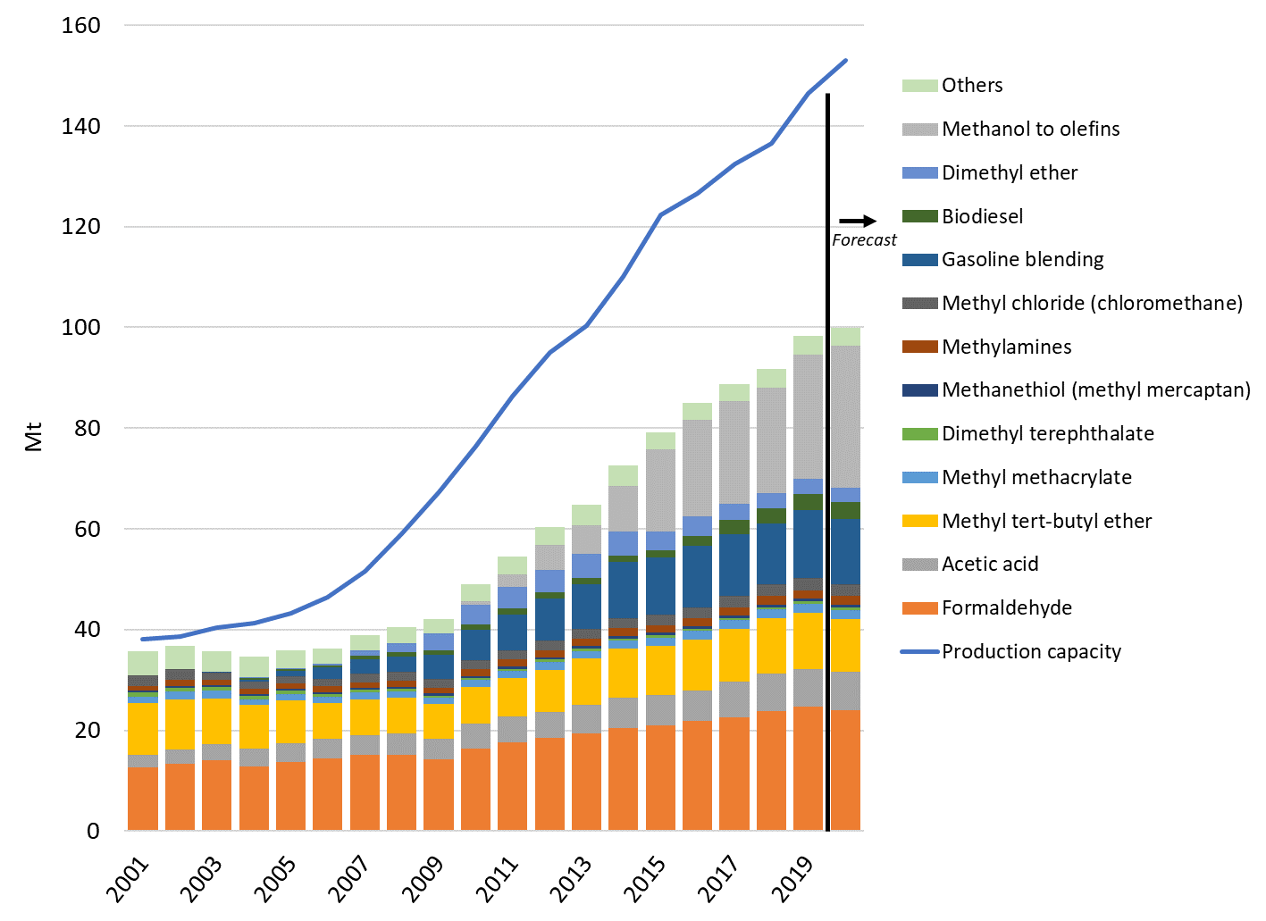
Example: Methanol
In the last 10 years methanol production capacity and use has more than doubled, from 40Mt in 2009 to 100Mt in 2019
Around 2/3 is used in the production of chemical products and 1/3 in the production of fuels
Recent applications, such as Methanol-to-Olefins (MtO) for plastic products are growing even faster (China)
Based on data from MMSA (2020)
Source: IRENA and MI (2021) Innovation Outlook: Renewable Methanol
9

Slide 10
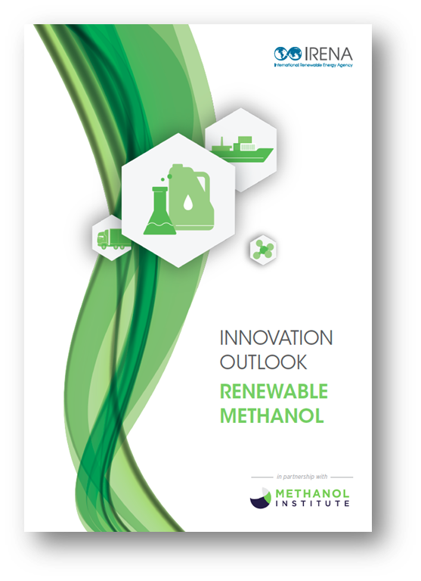
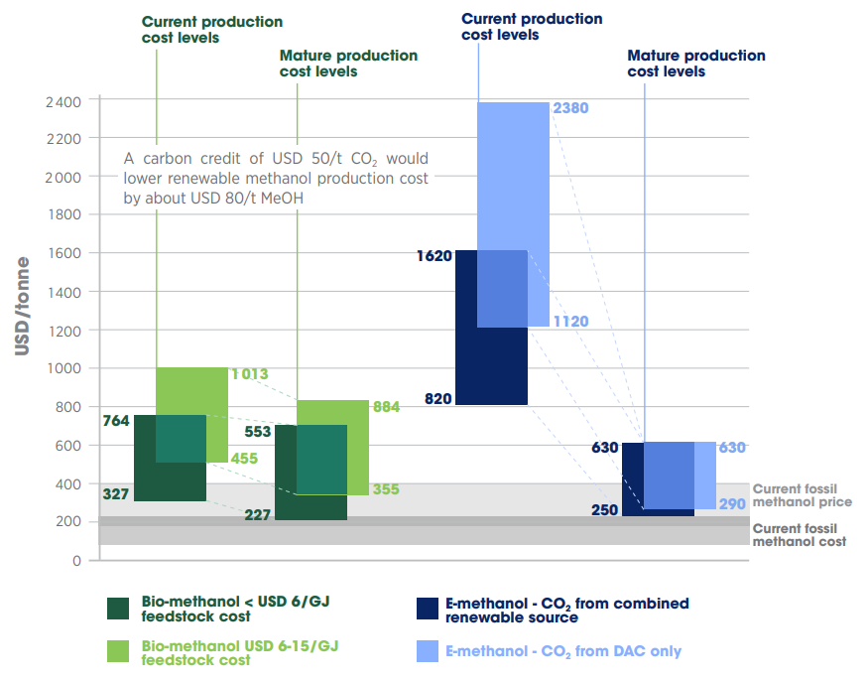
Report launched 27 January
Example: Methanol
Biomethanol exists today and more in the pipeline
  Biomethanol from gasification
    MSW gasification in Edmonton and in Rotterdam (Enerkem)
  Biomethanol from the pulping cycle
    Mönsterås, Sweden (Sodra)
  Biomethanol from biomethane
    Texas, Netherlands (BioMCN)
  Synthesised from green (renewable-based) hydrogen and CO₂
The shift to such types could expand methanol's use as a chemical feedstock and help to make industry and transport fuels carbon neutral
Today 2x as expensive, future cost commensurate with todays fossil generation cost
10
Source: https://irena.org/publications/2021/Jan/Innovation-Outlook-Renewable-Methanol

Slide 11
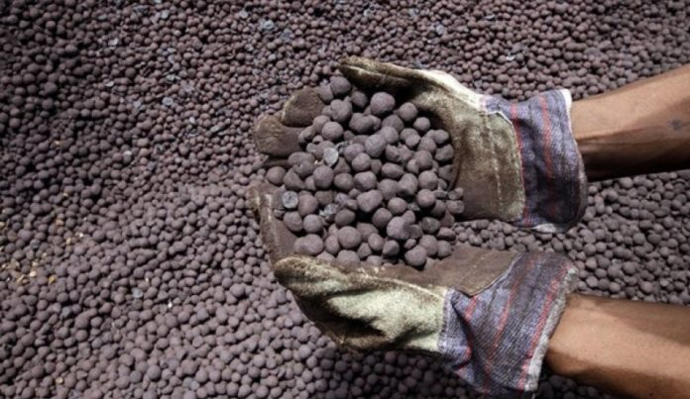
Example Direct reduction of iron ore with hydrogen
The bulk of direct CO₂ emissions is related to iron making process
Today iron making is coke and coal based
Interesting opportunities to use green hydrogen
Hydrogen-based Direct Reduced Iron (DRI) production is technically feasible
Also natural gas based DRI production with CO2 capture and storage is feasible
  Emirates steel project UAE (CO2-EOR project)
DRI is a bulk commodity than can be shipped
Photo copyright: Steel-360

Slide 12
Green hydrogen and green commodity standards & certification
Support market creation
  There is no current large-scale market trading green hydrogen. Lower GHG emissions from green hydrogen need to be quantified and tracked to be valued.
Enable global trade
  Once hydrogen and green commodities are traded across borders, the GHG emissions associated with its production, transport and conversion processes need to be tracked. Need for the same standards in exporting and importing country.
Promote efficient use of renewable electricity
  Achieved by a hydrogen and green commodity certification system that keeps consistency with certification of other commodities (electricity/gas) coupled with additionality.
Fundamental component of supporting policy
  Policy instruments like contracts for difference, grants, blending mandates and quotas need to track the green hydrogen to check progress and compliance.
Part of the activities of IRENA Collaborative Framework on Green Hydrogen
12

Slide 13



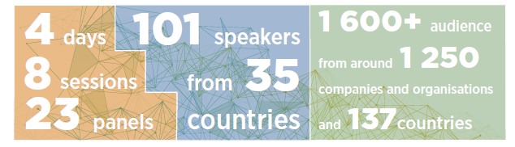

Recent work on end-use sectors
  GRO 2020 edition outlines the investments and technologies needed to decarbonise the entire energy system in line with the Paris Agreement.
Collaborative Framework on Green Hydrogen
The umbrella for IRENA hydrogen engagement
  IRENA has established a Collaborative Framework on Green Hydrogen in June 2020, to foster dialogue between governments and private sector
  65 countries, Hydrogen Council and IPHE participation. Co-facilitated by EC and Morocco.
  Ongoing work on standardization and Guarantees of Origin
  Reaching Zero with Renewables focuses on how industry and transport could achieve zero emissions by 2060 and assesses the use of renewables and related technologies.
Focus: Innovative solutions for the energy-end-use sectors of transport & industry. Showcased emerging renewables based solutions from around the world
Collaborating with private sector, associations and other partners
Summaries and recordings at http://innovationweek.irena.org
13

Slide 14






Thanks for your attention!
^{www.irena.org}
^{www.instagram.com/irenaimages}
^{www.twitter.com/irena}
www.flickr.com/photos/irenaimages
^{www.facebook.com/irena.org}
^{www.youtube.com/user/irenaorg}
Notes:
I

